Slide 1

11 setState
Peter H. Chen

Slide 2
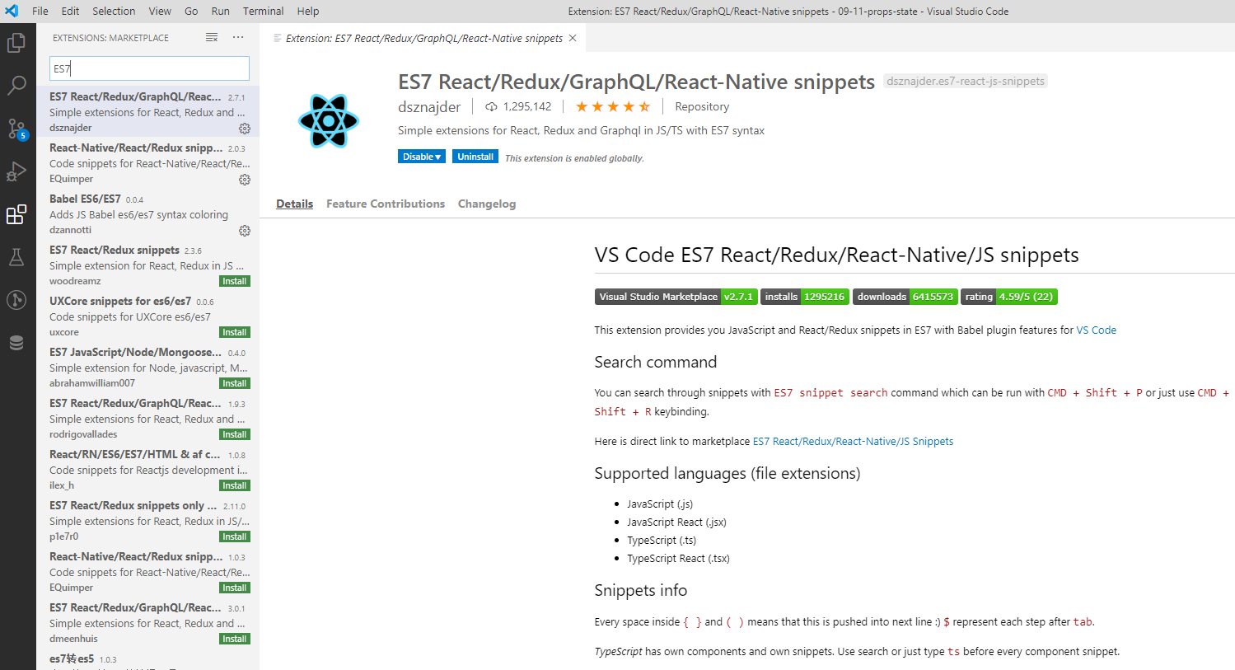
11 setState
https://www.youtube.com/watch?v=uirRaVjRsf4&list=PLC3y8-rFHvwgg3vaYJgHGnModB54rxOk3&index=11
Set state in React:
Use ES7 for VS Code IDE.

Slide 3
11 setState
https://www.youtube.com/watch?v=uirRaVjRsf4&list=PLC3y8-rFHvwgg3vaYJgHGnModB54rxOk3&index=11
Set state in React:
We create a counter component in this discussion:
We have counter value and Create a button to increment the counter value.
Create Counter.js.
We are learning the state in class components. This is going to be a class component as well.

Slide 4
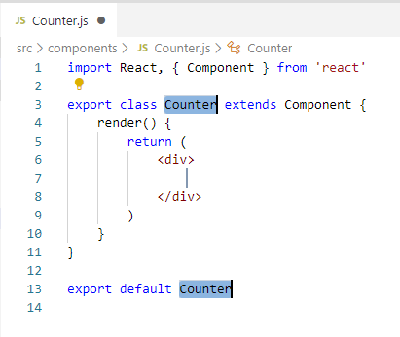
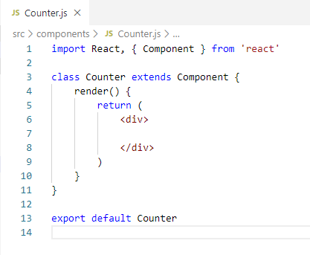
11 setState
https://www.youtube.com/watch?v=uirRaVjRsf4&list=PLC3y8-rFHvwgg3vaYJgHGnModB54rxOk3&index=11
Set state in React:
Type “rce” come out of a “React Class Component with EC7”.
We use “export default Counter” and remove “export” on “class Counter extends Component”.

Slide 5
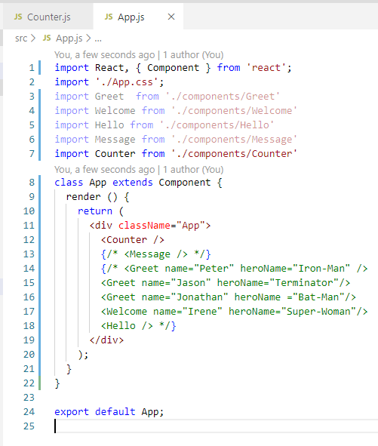
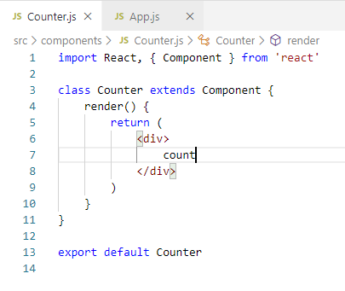
11 setState
https://www.youtube.com/watch?v=uirRaVjRsf4&list=PLC3y8-rFHvwgg3vaYJgHGnModB54rxOk3&index=11
Set state in React:
Add <Counter /> to App.js

Slide 6
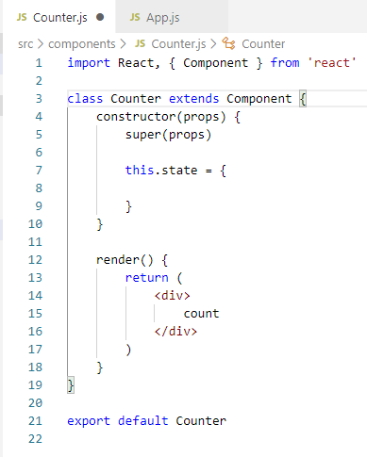
11 setState
https://www.youtube.com/watch?v=uirRaVjRsf4&list=PLC3y8-rFHvwgg3vaYJgHGnModB54rxOk3&index=11
Set state in React:
Type ‘rconst’ for “react constructor”

Slide 7
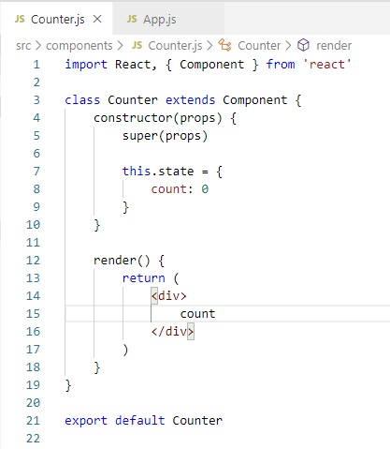
11 setState
https://www.youtube.com/watch?v=uirRaVjRsf4&list=PLC3y8-rFHvwgg3vaYJgHGnModB54rxOk3&index=11
Set state in React:
The super (porps) call based Component inheritance.
Set the count initial value to 0.

Slide 8
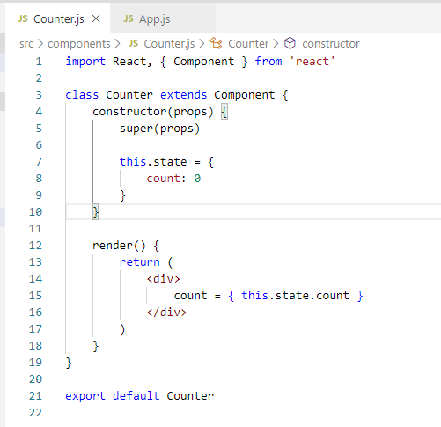
11 setState
https://www.youtube.com/watch?v=uirRaVjRsf4&list=PLC3y8-rFHvwgg3vaYJgHGnModB54rxOk3&index=11
Set state in React:
Display the count by render () { return <div> { this.state.count } </div> }

Slide 9
11.1 onClick

Slide 10
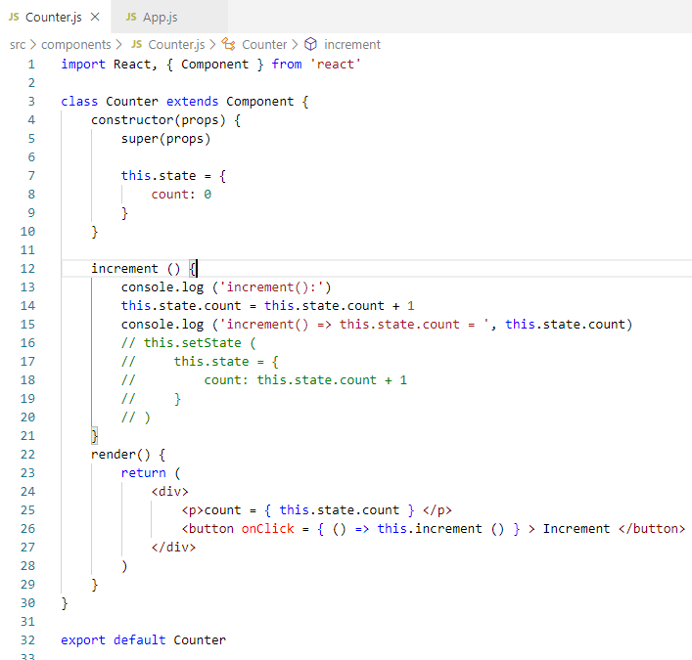
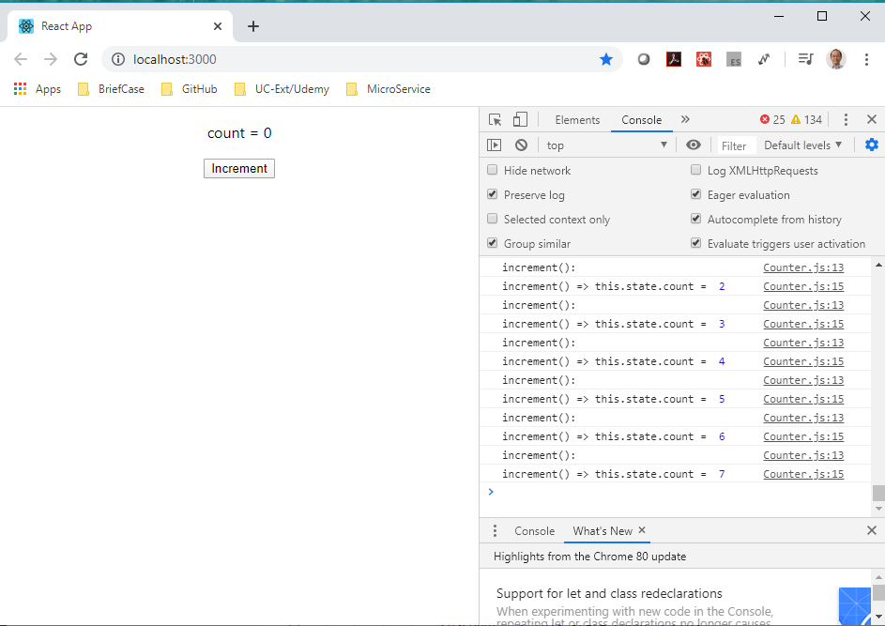
11.1 onClick
https://www.youtube.com/watch?v=uirRaVjRsf4&list=PLC3y8-rFHvwgg3vaYJgHGnModB54rxOk3&index=11
Set state in React:
Add the “this.state.count = this.state.count + 1”.
The console increase but GUI does not change.

Slide 11
11.2 Update by setState

Slide 12
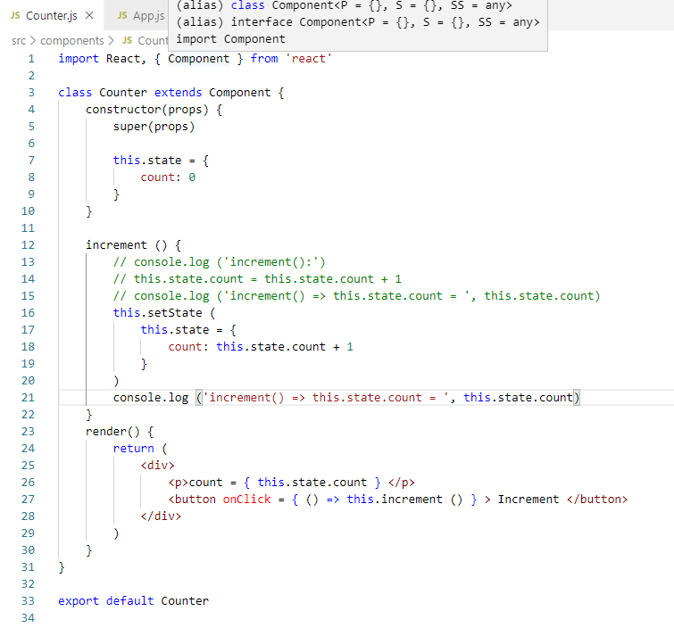
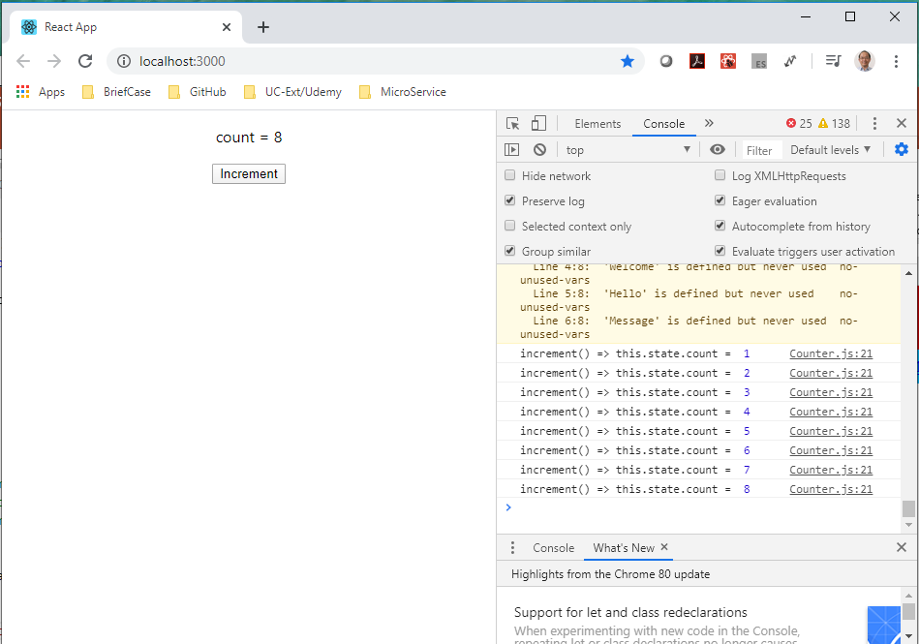
11.2 Update by setState
https://www.youtube.com/watch?v=uirRaVjRsf4&list=PLC3y8-rFHvwgg3vaYJgHGnModB54rxOk3&index=11
Set state in React:
The React only take this.setState ( this.state = { count: this.state.count + 1 } )
This update values for both GUI and console.

Slide 13
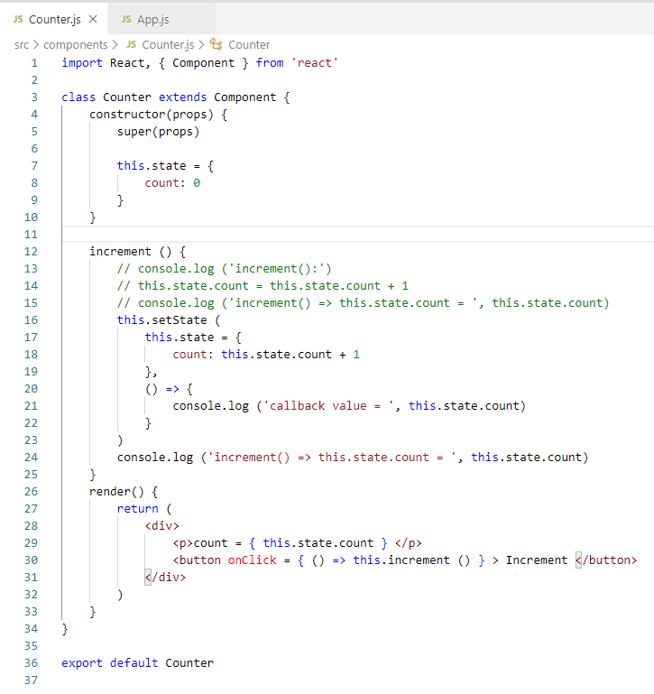
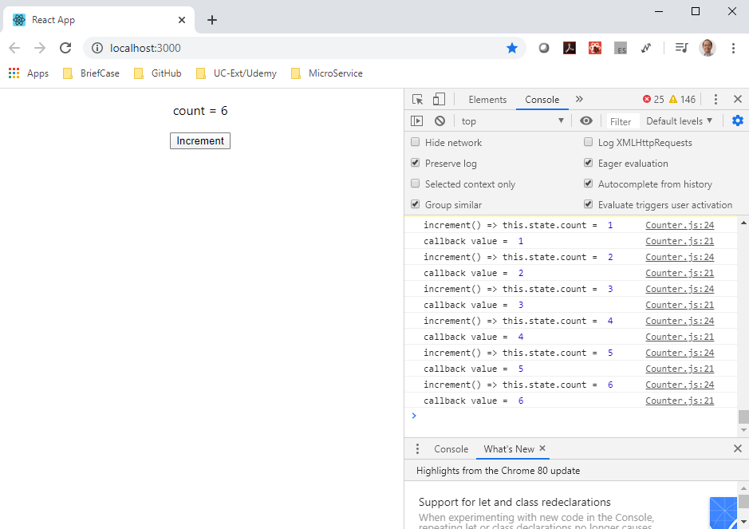
11.2 Update by setState
https://www.youtube.com/watch?v=uirRaVjRsf4&list=PLC3y8-rFHvwgg3vaYJgHGnModB54rxOk3&index=11
Set state in React:
If you have console update problem, we can add callback function.
Put the callback function in the second parameter in the same block of setState () to guarantee the same value.
Callback Console
Console log

Slide 14
11.3 Update by setState Five Times

Slide 15
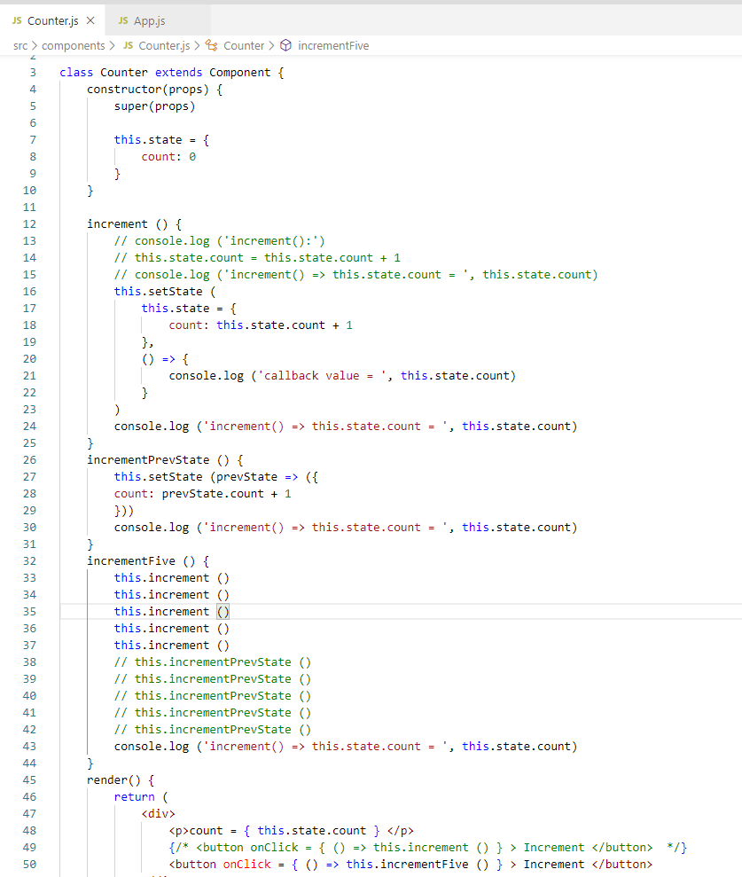
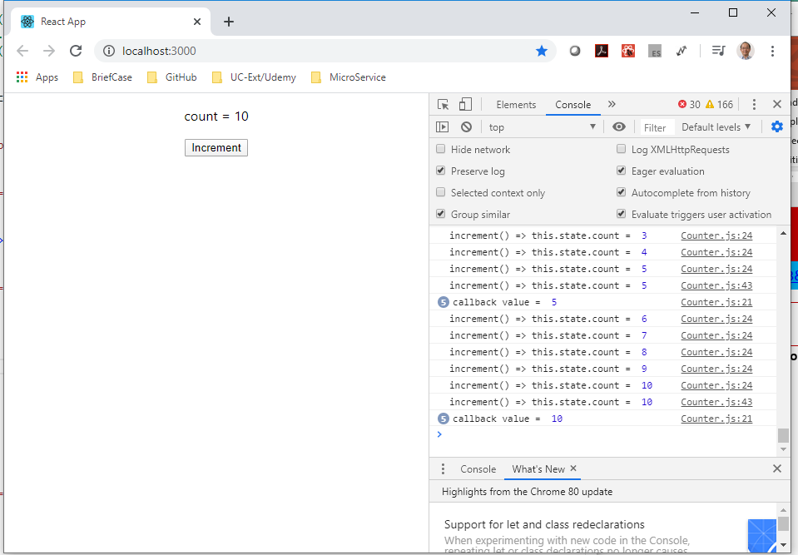
11.3 Update by setState Five Times
https://www.youtube.com/watch?v=uirRaVjRsf4&list=PLC3y8-rFHvwgg3vaYJgHGnModB54rxOk3&index=11
Increment by 5:
Since React update in one batch, we need to increase by prevState to prevent error.

Slide 16
11.4 Update by prevState

Slide 17
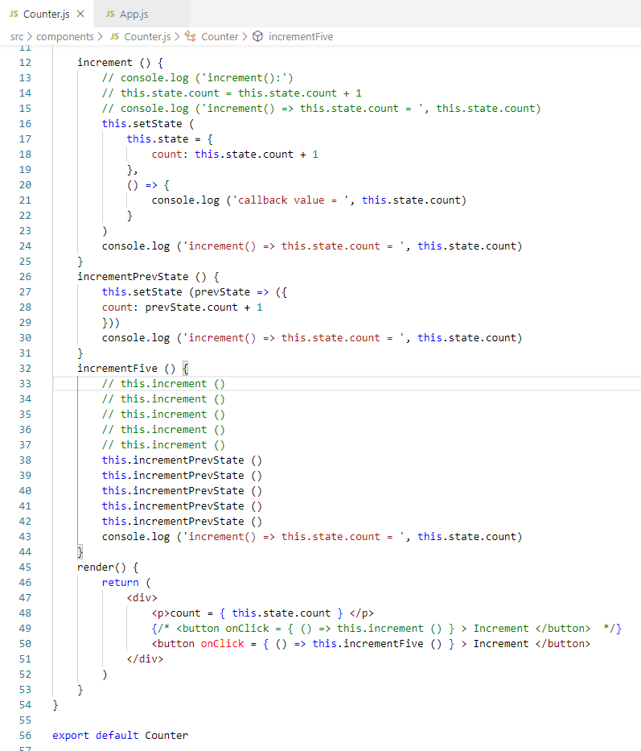
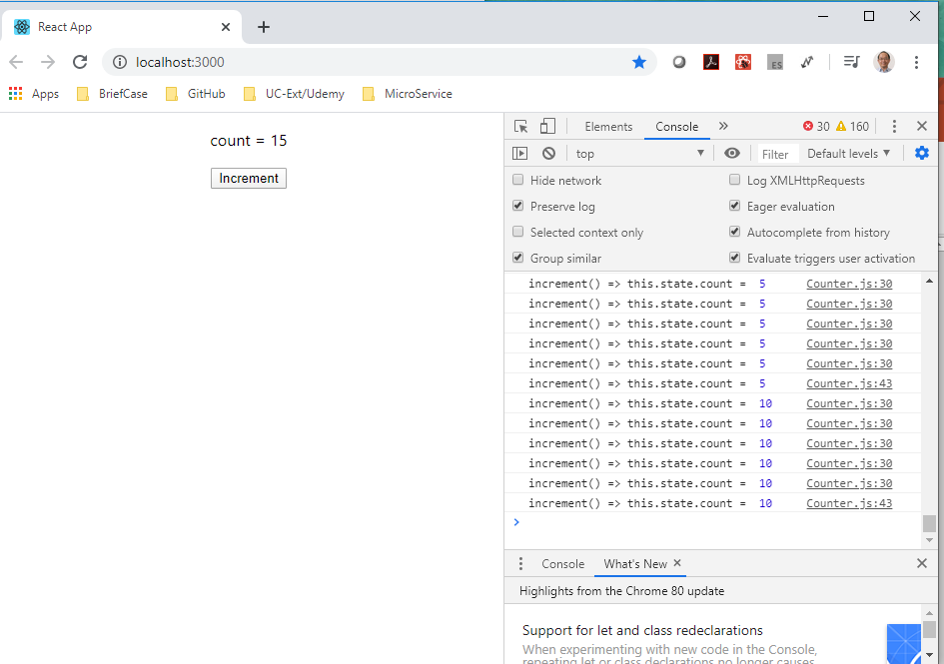
11.4 Update by prevState
https://www.youtube.com/watch?v=uirRaVjRsf4&list=PLC3y8-rFHvwgg3vaYJgHGnModB54rxOk3&index=11
Increment by 5:
Since React update in one batch, we need to increase by prevState to prevent error.
I do not have problem in current state and prevState. New React may fix the state problem.

Slide 18
11.5 Summary of setState

Slide 19
11.5 Summary of setState
https://www.youtube.com/watch?v=uirRaVjRsf4&list=PLC3y8-rFHvwgg3vaYJgHGnModB54rxOk3&index=11
Summary of setState:
Always make use of setState and never modify the state directly.
Code has to be executed after the state has been updated. Place the code in the callback function which is the second argument to the setState method.
When you have to update state based on the previous state value, pass in a function as an argument instead of the regular object.

Slide 20
11.6 Quiz

Slide 21
11.6 Quiz
https://www.youtube.com/watch?v=uirRaVjRsf4&list=PLC3y8-rFHvwgg3vaYJgHGnModB54rxOk3&index=11
Quiz:
1. In VS Code, what is framework we need for React?
Ans: Install “ES7 React/Redux/GraphQL/React-Native snippets”

Slide 22
11.6 Quiz
https://www.youtube.com/watch?v=uirRaVjRsf4&list=PLC3y8-rFHvwgg3vaYJgHGnModB54rxOk3&index=11
Quiz:
2. In VS Code, what is command to create a React Class?
Ans: Type ‘rce’ to create a React Class. ‘rce’ stands for ‘React Class Component with EC7’.
3. Give a file name Counter.js, what is ‘rce’ code generated for you?
Ans:
> import React, { Component } from ‘react’
> export class Counter extends Component {
> render {
> return (
> <div>
>
> </div>
> )
> }
> }
> export default Counter
Cross out ‘export’ in front of class Counter.

Slide 23
11.6 Quiz
https://www.youtube.com/watch?v=uirRaVjRsf4&list=PLC3y8-rFHvwgg3vaYJgHGnModB54rxOk3&index=11
Quiz:
4. In VS Code, what is command to create a React Class?
Ans: Type ‘rconst’ to create a React Class. ‘rconst’ stands for ‘React constructor’.
5. What is ‘rconst’ code generated?
Ans:
In class
> constructor (props) {
> super (props)
> this.state = {
>
> }
>}

Slide 24
11.6 Quiz
https://www.youtube.com/watch?v=uirRaVjRsf4&list=PLC3y8-rFHvwgg3vaYJgHGnModB54rxOk3&index=11
Quiz:
6. How to initialize 0 to the count in this.state?
Ans:
> constructor (props) {
> super (props)
> this.state = {
> count: 0
> }
>}

Slide 25
11.6 Quiz
https://www.youtube.com/watch?v=uirRaVjRsf4&list=PLC3y8-rFHvwgg3vaYJgHGnModB54rxOk3&index=11
Quiz:
7. How to display the count of this.state?
Ans:
> class … {
> render () {
> return (<div> { this.state.count } </div>)
> }
>}

Slide 26
11.6 Quiz
https://www.youtube.com/watch?v=uirRaVjRsf4&list=PLC3y8-rFHvwgg3vaYJgHGnModB54rxOk3&index=11
Quiz:
8. React does not update by this.state.count = this.state.count + 1, we have to use setState(). What is setState() code looks like?
Ans:
> class … {
> increment () {
> //this.state.count = this.state.count + 1
> this.setState (
> this.state {
> count: this.state.count + 1
> }
> }
> }
>}

Slide 27
11.6 Quiz
https://www.youtube.com/watch?v=uirRaVjRsf4&list=PLC3y8-rFHvwgg3vaYJgHGnModB54rxOk3&index=11
Quiz:
9. How to add a on click button and call a function increment() to increment the counter display?
Ans:
> class … {
> increment () {
> //this.state.count = this.state.count + 1
> this.setState (
> this.state {
> count: this.state.count + 1
> }
> }
> }
> render () {
> return (
> <div>
> <p>{ this.state.count } </p>
> <button onClick = { () => this.increment() } > Increment </button>
> </div>
> )
> }
>}

Slide 28
End of Chapter

