Slide 1

14 Bind Event Handler
Peter H. Chen

Slide 2
14 Bind Event Handler
https://www.youtube.com/watch?v=kVWpBtRjkCk&list=PLC3y8-rFHvwgg3vaYJgHGnModB54rxOk3&index=14
Bind Event Handler:
We discuss how to bind event handler in React Component.
What is the reason to bind event handler?
Because the ‘this’ keyword works for JavaScript, ‘this’ keyword is not for React.
We will see why event handling is required for React.
We will understand how ‘this’ keyword works in JavaScript.
First, we create components/EventBind.js.
In the EventBind.js, tytpe ‘rce’ for React Class Component with ES7e.
Remove the name ‘export’ in front of ‘export class EventBind extends Component’

Slide 3
14 Bind Event Handler
https://www.youtube.com/watch?v=kVWpBtRjkCk&list=PLC3y8-rFHvwgg3vaYJgHGnModB54rxOk3&index=14
Bind Event Handler:
We discuss how to bind event handler in React Component.
What is the reason to bind event handler?
Because the ‘this’ keyword works for JavaScript, ‘this’ keyword is not for React.
We will see why event handling is required for React.
We will understand how ‘this’ keyword works in JavaScript.

Slide 4
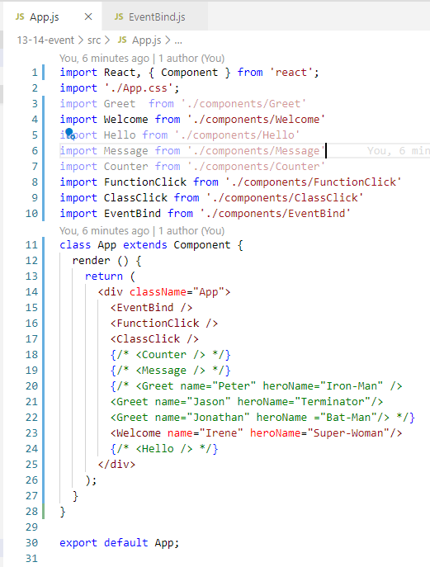
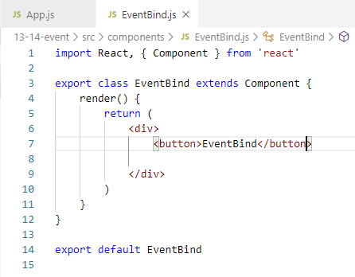
14 Bind Event Handler
https://www.youtube.com/watch?v=kVWpBtRjkCk&list=PLC3y8-rFHvwgg3vaYJgHGnModB54rxOk3&index=14
Bind Event Handler:
First, we create components/EventBind.js.
In the EventBind.js, tytpe ‘rce’ for React Class Component with ES7.
Add <button>EventBind</button>
Remove the name ‘export’ in front of ‘export class EventBind extends Component’
In the App.js, import “EventBind.js” and add component <EventBind />

Slide 5
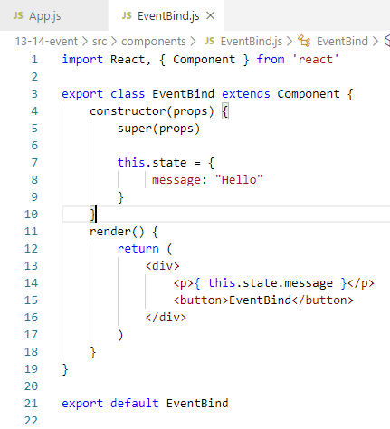
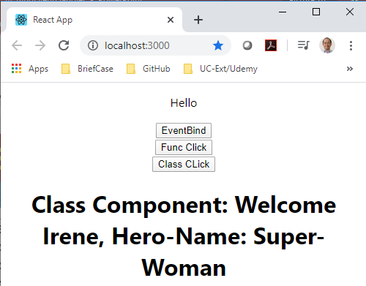
14 Bind Event Handler
https://www.youtube.com/watch?v=kVWpBtRjkCk&list=PLC3y8-rFHvwgg3vaYJgHGnModB54rxOk3&index=14
Bind Event Handler:
Add the constructor ‘rconst’
Add ‘this.state = { message: ‘Hello’ }
Add <p> { this.state.message } </p>

Slide 6
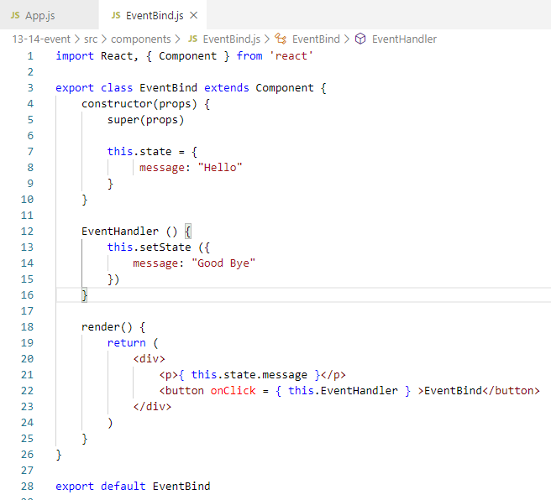
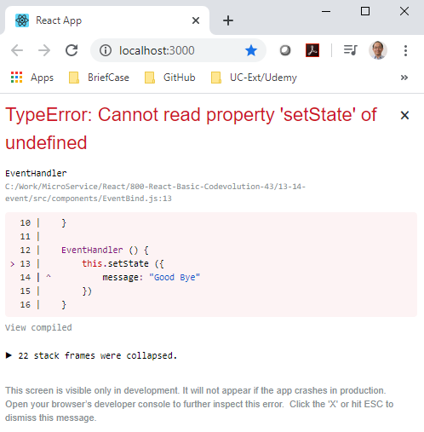
14 Bind Event Handler
https://www.youtube.com/watch?v=kVWpBtRjkCk&list=PLC3y8-rFHvwgg3vaYJgHGnModB54rxOk3&index=14
Bind Event Handler:
Let change the message to ‘Good Bye’ when user click the ‘EventBind’ button.
Add ‘onClick’ attribute, then we pass { Event Handler }.
Use ‘setState’ to change the state message. We got ‘setState’ undefined error.

Slide 7
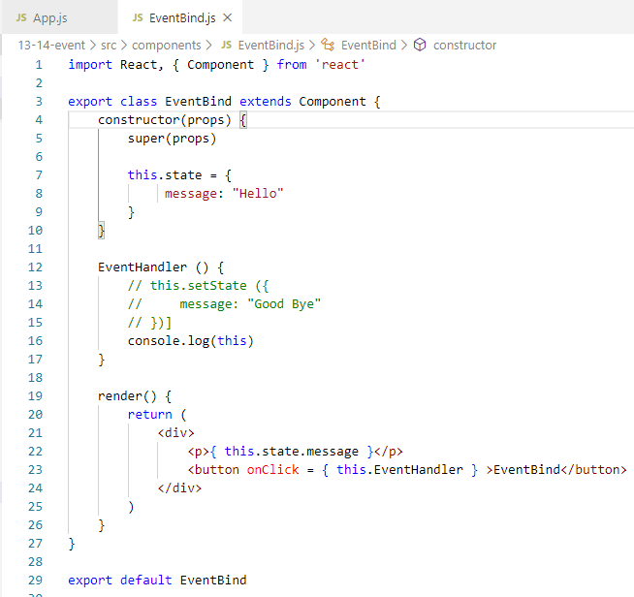
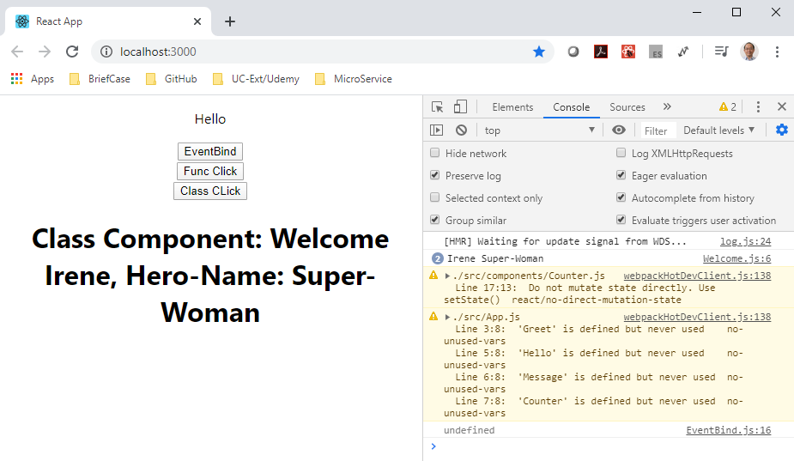
14 Bind Event Handler
https://www.youtube.com/watch?v=kVWpBtRjkCk&list=PLC3y8-rFHvwgg3vaYJgHGnModB54rxOk3&index=14
Bind Event Handler:
Comment ‘this.setState ()’ and add ‘console.log(this)’.
We can see ‘this’ is undefined. The JavaScript cannot see ‘this’ keyword.

Slide 8
14.1 Bind ‘this’ Keyword

Slide 9
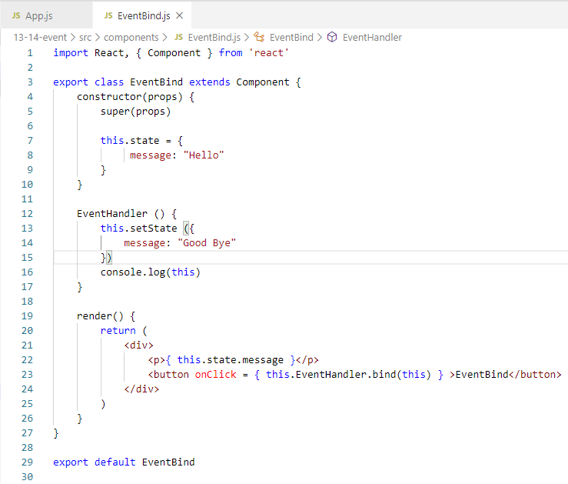
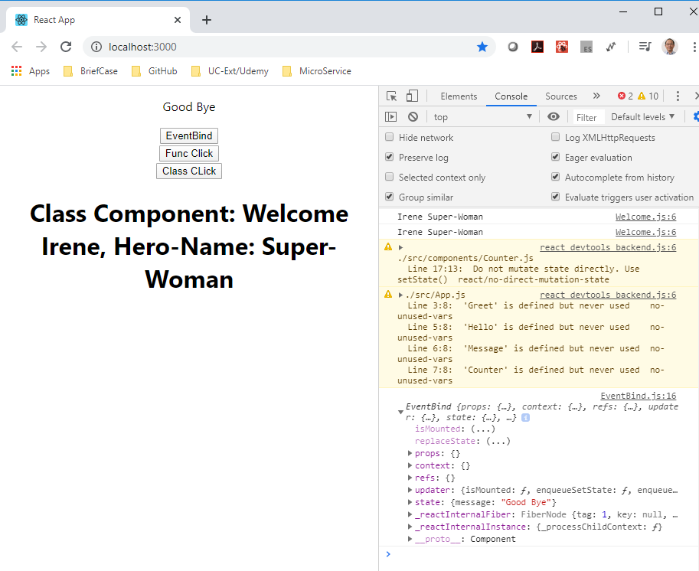
14.1 Bind ‘this’ Keyword
https://www.youtube.com/watch?v=kVWpBtRjkCk&list=PLC3y8-rFHvwgg3vaYJgHGnModB54rxOk3&index=14
Bind Event Handler:
There are a number of ways to bind the event handler. We will go over all of them.
The first way is to use keyword ‘bind’ to bind the event handler.
In the <button onClick = { this.EventHandler.bind(this) > BindClick</button>
You can the ‘this’ object is print in the console.

Slide 10
14.1 Bind ‘this’ Keyword
https://www.youtube.com/watch?v=kVWpBtRjkCk&list=PLC3y8-rFHvwgg3vaYJgHGnModB54rxOk3&index=14
Bind Event Handler:
In the console, as you can see ‘this’ keyword is no longer undefined anymore.
The EventHandler and setState will update the message and call render() display the element.
This method works for small application, for large application, the component contain nested children, this binding approach can cause application troublesome.

Slide 11
14.2 Bind by Arrow Function

Slide 12
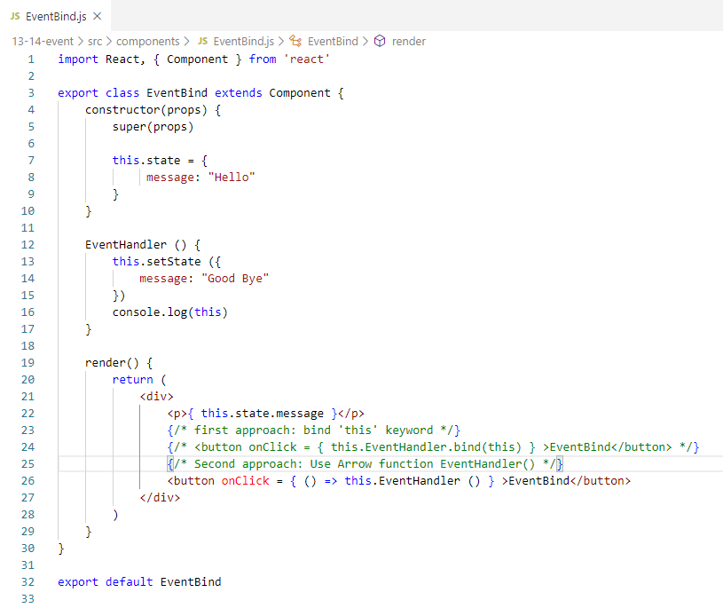
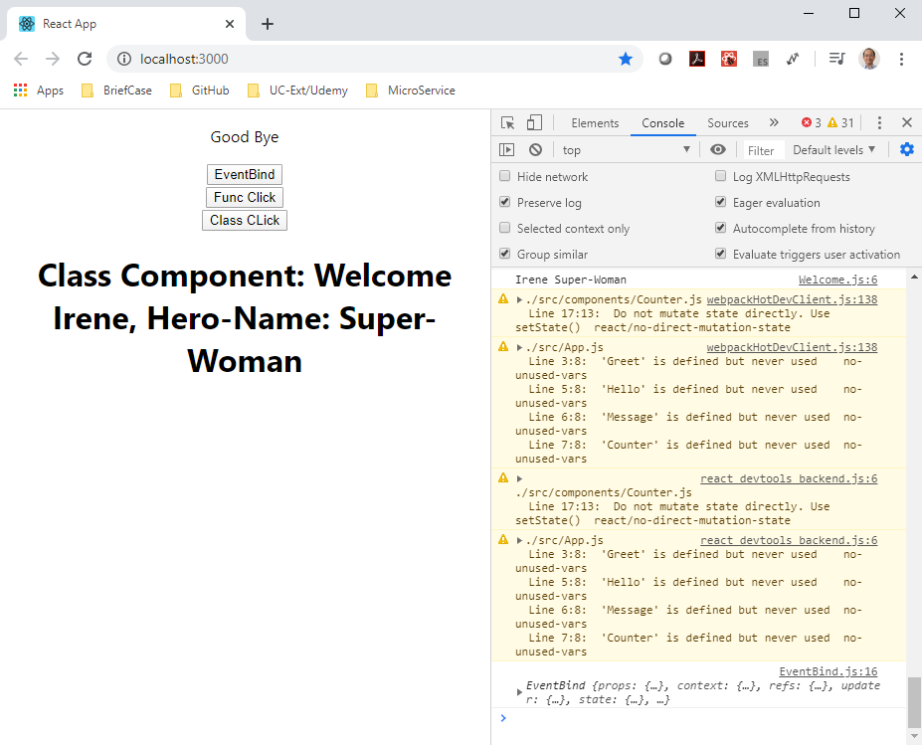
14.2 Bind by Arrow Function
https://www.youtube.com/watch?v=kVWpBtRjkCk&list=PLC3y8-rFHvwgg3vaYJgHGnModB54rxOk3&index=14
Bind Event Handler:
The second approach is to arrow function in the render method instead of Event Handler.

Slide 13
14.2 Bind by Arrow Function
https://www.youtube.com/watch?v=kVWpBtRjkCk&list=PLC3y8-rFHvwgg3vaYJgHGnModB54rxOk3&index=14
Bind Event Handler:
The arrow function approach also have the performance issue.

Slide 14
14.3 Bind ‘this’ in Constructor

Slide 15
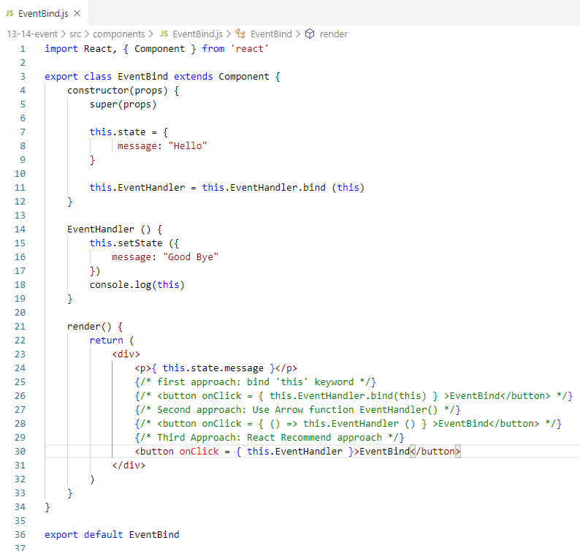
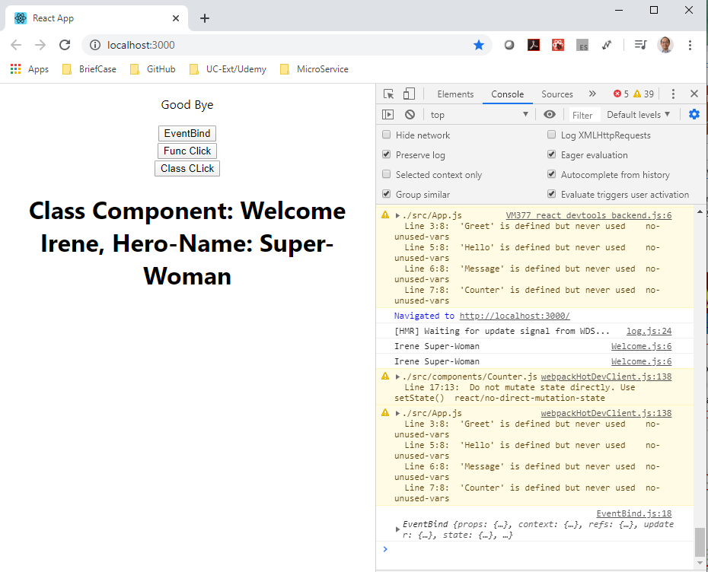
14.3 Bind ‘this’ in Constructor
https://www.youtube.com/watch?v=kVWpBtRjkCk&list=PLC3y8-rFHvwgg3vaYJgHGnModB54rxOk3&index=14
Bind Event Handler:
The third approach is official approach from React.
We bind the event handler in the constructor instead of binding in the render method.
In the constructor, we add “this.EventHandler = this.EventHandler.bind (this)”

Slide 16
14.3 Bind ‘this’ in Constructor
https://www.youtube.com/watch?v=kVWpBtRjkCk&list=PLC3y8-rFHvwgg3vaYJgHGnModB54rxOk3&index=14
Bind Event Handler:
Because the constructor just called once, bind ‘this’ in the constructor is the best approach for ‘this’ event binding.

Slide 17
14.4 Use Arrow Function in Class

Slide 18
14.4 Use Arrow Function in Class
https://www.youtube.com/watch?v=kVWpBtRjkCk&list=PLC3y8-rFHvwgg3vaYJgHGnModB54rxOk3&index=14
Bind Event Handler:
The fourth way is to bind the ‘this’ by the arrow function in the class property.
You change the way in the method of class into the class property.
We comment out the binding in the constructor.
Add the Arrow instead of traditional function.

Slide 19
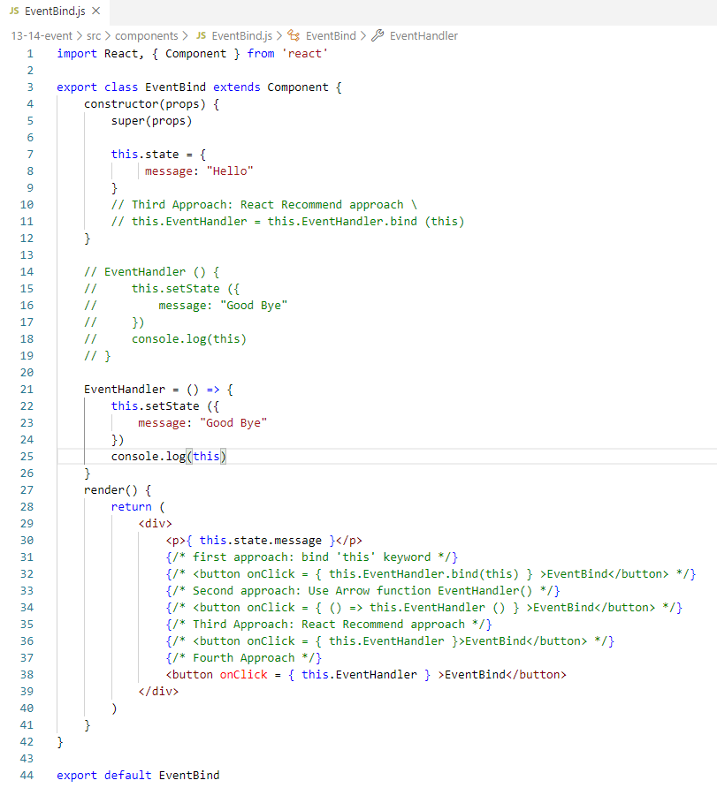
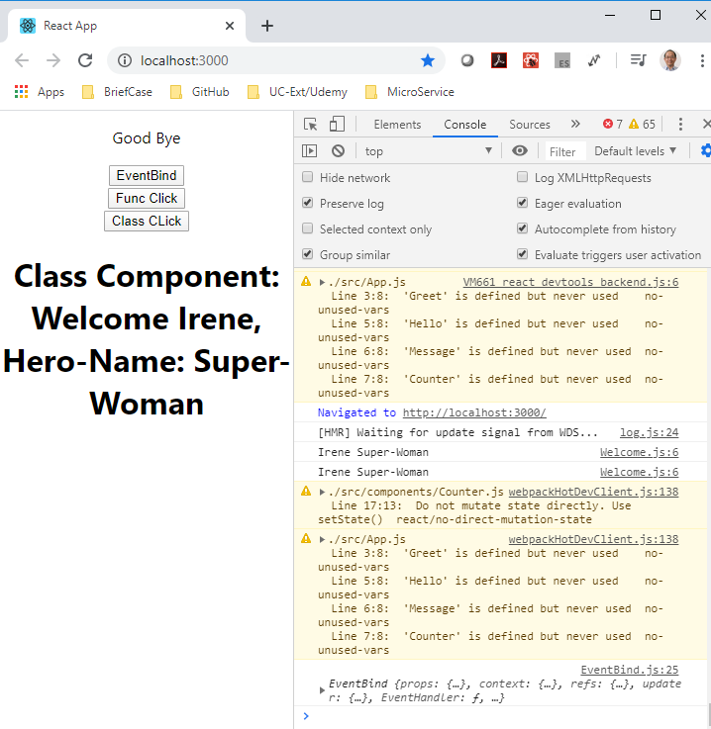
14.4 Use Arrow Function in Class
https://www.youtube.com/watch?v=kVWpBtRjkCk&list=PLC3y8-rFHvwgg3vaYJgHGnModB54rxOk3&index=14
Bind Event Handler:

Slide 20
14.5 Summary of Event Handler

Slide 21
14.5 Summary of Event Handler
https://www.youtube.com/watch?v=kVWpBtRjkCk&list=PLC3y8-rFHvwgg3vaYJgHGnModB54rxOk3&index=14
Summary of Event Handler:
Approach 1: D not use for performance reason.
1) Use Regular Event Handler Function and
2) bind ‘this’ and Regular Event Handler Function in onClick.
Approach 2: Easiest way but same as the first approach do not use for performance reason.
1) Use Regular Event Handler Function and
2) Arrow Function to bind Regular Event Handler Function.
Approach 3: Recommend by React Documentation for large application. This is the best option
1) Use Regular Event Handler Function and
2) Bind ‘this’ in constructor once.
Approach 4: Recommend by React Documentation but still in experiment for performance.
1) Use Arrow Event Handler Function event handler in class and
2) onClick with Arrow Event Handler Function

Slide 22
14.6 Quiz

Slide 23
14.6 Quiz
https://www.youtube.com/watch?v=kVWpBtRjkCk&list=PLC3y8-rFHvwgg3vaYJgHGnModB54rxOk3&index=14
1. What is the reason to bind event handler?
Ans:
Because the ‘this’ keyword works for JavaScript, ‘this’ keyword is not for React.
We need to bind the event for React.

Slide 24
14.6 Quiz
https://www.youtube.com/watch?v=kVWpBtRjkCk&list=PLC3y8-rFHvwgg3vaYJgHGnModB54rxOk3&index=14
2. Give the example to bind the event handler.
> constructor (props) {
> super (props)
> this.state = { message: “ abc” }
> }
> EventHandler () {
> this.setState ( { message: “cde”} )
> }
> render () {
> return (
> <div>
> <button onClick = { this.EventHandler.bind(this) } > EventBind</button>
> </div>)
> }

Slide 25
14.6 Quiz
https://www.youtube.com/watch?v=kVWpBtRjkCk&list=PLC3y8-rFHvwgg3vaYJgHGnModB54rxOk3&index=14
3. Give example of arrow function for event handler.
> constructor (props) {
> super (props)
> this.state = { message: “ abc” }
> }
> EventHandler = () => {
> this.setState ( { message: “cde”} )
> }
> render () {
> return (
> <div>
> <button onClick = { this.EventHandler } > EventBind</button>
> </div>)
> }

Slide 26
End of Chapter

