Slide 1

6 Class Component
Peter H. Chen

Slide 2
6 Class Component
https://www.youtube.com/watch?v=lnV34uLEzis&list=PLC3y8-rFHvwgg3vaYJgHGnModB54rxOk3&index=6
Class Component:
React Class Components are basically ES6 classes.
Similar to functional components, a class component also can optionally receive props as input and return HTML.
Apart from the props, a class component can also maintain a private internal state.
In simpler words, it can maintain some information which is private to that component and use that information to describe the user interface.
Properties
(props)
ES6 Class
HTML (JSX)
State

Slide 3
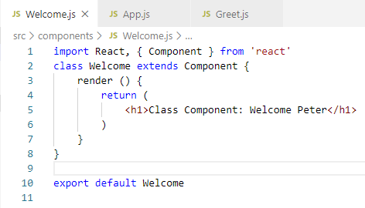
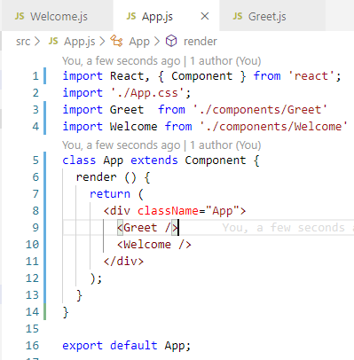
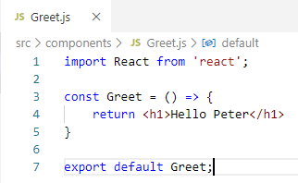
6 Class Component
https://www.youtube.com/watch?v=lnV34uLEzis&list=PLC3y8-rFHvwgg3vaYJgHGnModB54rxOk3&index=6
Class Component:
To get the comparison, let’s create the exact same degree of component.
This time, we create the class component.
Let’s create a file called Welcome.js

Slide 4
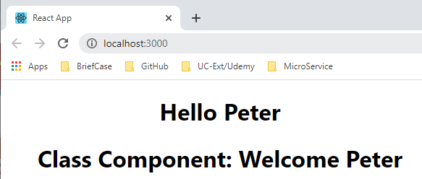
6 Class Component
https://www.youtube.com/watch?v=lnV34uLEzis&list=PLC3y8-rFHvwgg3vaYJgHGnModB54rxOk3&index=6
Class Component:
> npm start

Slide 5
6 Class Component
https://www.youtube.com/watch?v=lnV34uLEzis&list=PLC3y8-rFHvwgg3vaYJgHGnModB54rxOk3&index=6
Now, we have function component and class component.
You may be wonder what is the advantage of using one over the other and what exactly should be use a particular component type?
Now, we briefly discuss the basic idea of function and class component.

Slide 6
6 Class Component
https://www.youtube.com/watch?v=lnV34uLEzis&list=PLC3y8-rFHvwgg3vaYJgHGnModB54rxOk3&index=6
Functional vs Class Components
Functional Components are simple functions receiving props and returning a declaration.
You should use functional components are much as possible.
If we can create a component with both approaches, always use the functional components.
The first advantage of using a functional component over a class component is the absence of ‘this’ keyword which you will encounter in a class-based component. ‘this’ keyword can be quite tricky and functional component will help you in that aspect.
The second advantage is forced to think of a solution without using state. If you have a number of components each with their own private state. The maintenance and debugging your application are difficult. Functional components tend to be without any complicated logic and mainly responsible for user interface.
Functional Component
This is why functional components are also called stateless components, dump components, or presentational component
Simple Functions
Use functional Component as much as possible
Absence of ‘this’ keyword
Solution without using state
Mainly responsible for user interface
Stateless/Dump/Presentational

Slide 7
6 Class Component
https://www.youtube.com/watch?v=lnV34uLEzis&list=PLC3y8-rFHvwgg3vaYJgHGnModB54rxOk3&index=6
Functional vs Class Components
Class Component, on the other hand, are a bit more feature-rich.
They can maintain their own private data called as state.
They can contain complicated UI logic and most importantly.
They provide lifecycle hooks. We will discuss more on lifecycle hooks later on. At this moment, we just need to know they are very useful and because they are capable of and how they are used, class components are also called stateful components, smart components, or container components.
Class Component
More feature rich
Maintain their own private data – state
Complex UI logic
Provide lifecycle hooks
Stateful/Smart/Container

Slide 8
6 Class Component
https://www.youtube.com/watch?v=lnV34uLEzis&list=PLC3y8-rFHvwgg3vaYJgHGnModB54rxOk3&index=6
Functional vs Class Components
Functional Component
Class Component
Simple Functions
Use functional Component as much as possible
Absence of ‘this’ keyword
Solution without using state
Mainly responsible for user interface
Stateless/Dump/Presentational
More feature rich
Maintain their own private data – state
Complex UI logic
Provide lifecycle hooks
Stateful/Smart/Container

Slide 9
6 Class Component
https://www.youtube.com/watch?v=lnV34uLEzis&list=PLC3y8-rFHvwgg3vaYJgHGnModB54rxOk3&index=6
Functional vs Class Components
So far, we have seen three components: App.js, Greet.js, and Welcome.js.
All the three components, we simply return some HTML.
In reality, these are not regular HTML. They are something known as JSX.
What exactly is JSX? We will discuss next.

Slide 10
End of Chapter

