Slide 1

8 JSX
Peter H. Chen

Slide 2
8 JSX
https://www.youtube.com/watch?v=7fPXI_MnBOY&list=PLC3y8-rFHvwgg3vaYJgHGnModB54rxOk3&index=8
JSX:
React uses a lot of JSX. It is really import what JSX.
JavaScript XML (JSX): Extension to the JavaScript language syntax.
JSX let you write XML-like code for elements and components.
Just like HTML, JSX tags have a tag name, attributes, and children.
Why do we need JSX?
JSX is not a necessity to write React applications. You can definitely use React without JSX.
JSX makes your React code simpler and elegant. As you already seen, it provides a syntax which is familiar to many developers.
JSX ultimately transpiles to pure JavaScript which is understood by the browsers. We discuss what is JXS and why do we use it. How it works behind the scenes.
What is the code looks like without the JSX and with JSX? That way, you not only understand how JXS translates to regular JavaScript but also appreciate how JSX bring out simplicity in your code.

Slide 3
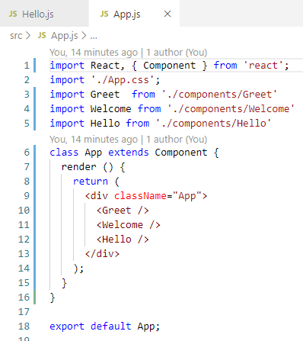
8 JSX
https://www.youtube.com/watch?v=7fPXI_MnBOY&list=PLC3y8-rFHvwgg3vaYJgHGnModB54rxOk3&index=8
JSX:
We will create another file component/Hello.js.
Hello.js is a simple functional component that render “Hello Peter” in the browser.

Slide 4
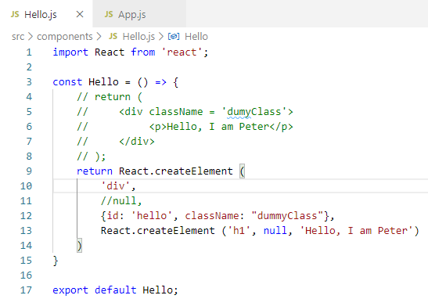
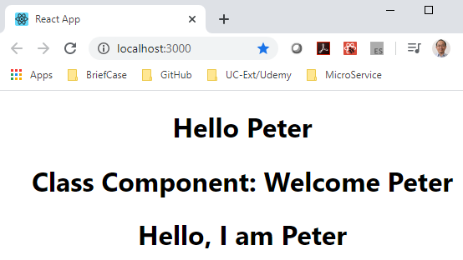
8 JSX
https://www.youtube.com/watch?v=7fPXI_MnBOY&list=PLC3y8-rFHvwgg3vaYJgHGnModB54rxOk3&index=8
JSX:
React Library can create element React.createElement (HTML element, optional property, children of HTML element)
> return React.createElement (‘div’, null, ‘Hello Peter’);
The third argument have to use createElement() to create element with ‘h1’ and text. 4
The second argument can be used for ID assignment and className assignment.

Slide 5
8 JSX
https://www.youtube.com/watch?v=7fPXI_MnBOY&list=PLC3y8-rFHvwgg3vaYJgHGnModB54rxOk3&index=8
JSX:
The React Library include the translation of JSX into JavaScript code.
If we have hundreds of elements, the JavaScript code to create element will become very clumsy.
JSX, on the other hand, will keep the code elegant, simple, and readable.

Slide 6
8 JSX
https://www.youtube.com/watch?v=7fPXI_MnBOY&list=PLC3y8-rFHvwgg3vaYJgHGnModB54rxOk3&index=8
HTML vs JSX:
We compare the difference of HTML and JSX.
HTML
JSX
Class
for
camelCase property naming convention
Onclick
tabindex
className
htmlFor
camelCase property naming convention
onClick
tabIndex

Slide 7
8 JSX
https://www.youtube.com/watch?v=7fPXI_MnBOY&list=PLC3y8-rFHvwgg3vaYJgHGnModB54rxOk3&index=8
React Fire: Modernizing React DOM
https://github.com/facebook/react/issues/13525
React changing code discussion panel.
Change the className into Class and etc.
This link will help you to stay update with the changes.

Slide 8
End of Chapter

