Slide 1

9 Props
Peter H. Chen

Slide 2
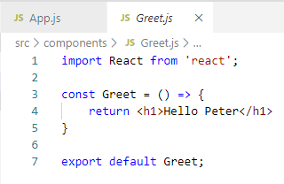
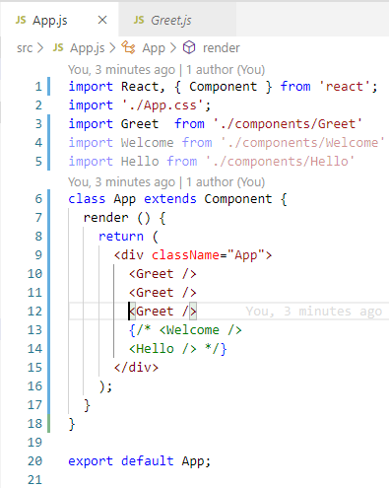
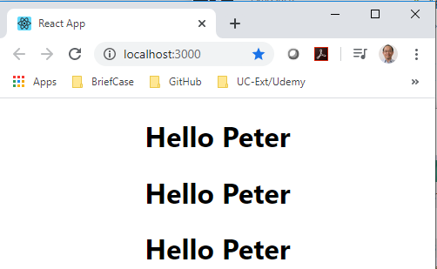
9 Props
https://www.youtube.com/watch?v=m7OWXtbiXX8&list=PLC3y8-rFHvwgg3vaYJgHGnModB54rxOk3&index=9
Props:
The component Greet can be re-used as many times as you want, for example, you can call Greet three times.

Slide 3
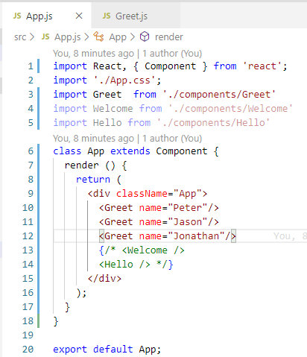
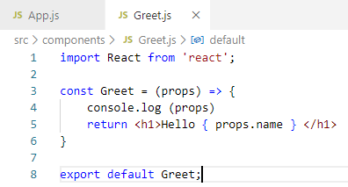
9 Props
https://www.youtube.com/watch?v=m7OWXtbiXX8&list=PLC3y8-rFHvwgg3vaYJgHGnModB54rxOk3&index=9
Props:
In Greet.js, we can have passing parameter ‘props’ as a convention, you can use other name but props is a convention for passing parameter.

Slide 4
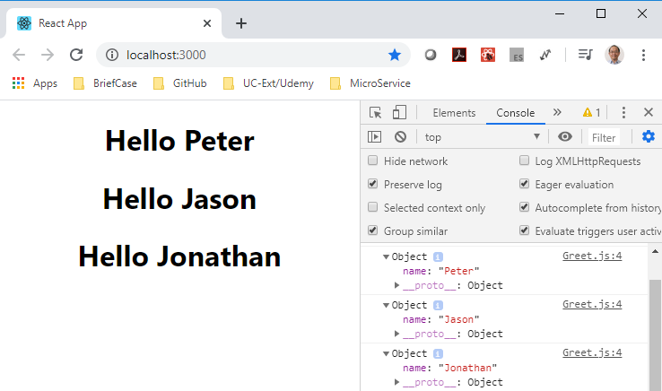
9 Props
https://www.youtube.com/watch?v=m7OWXtbiXX8&list=PLC3y8-rFHvwgg3vaYJgHGnModB54rxOk3&index=9
Props:
> npm start
> FN + F-12 to see console output

Slide 5
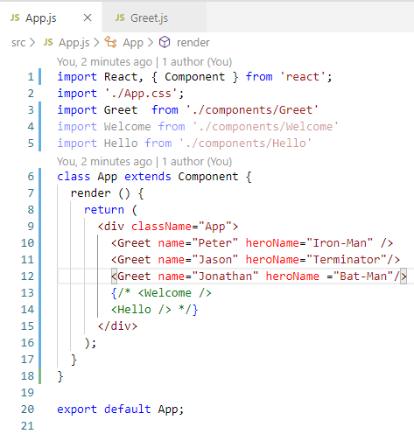
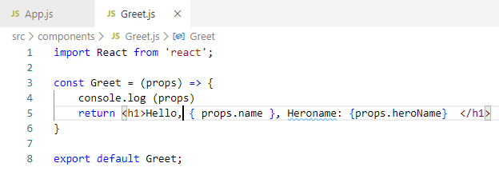
9 Props
https://www.youtube.com/watch?v=m7OWXtbiXX8&list=PLC3y8-rFHvwgg3vaYJgHGnModB54rxOk3&index=9
Props:
Let’s pass in the second argument.

Slide 6
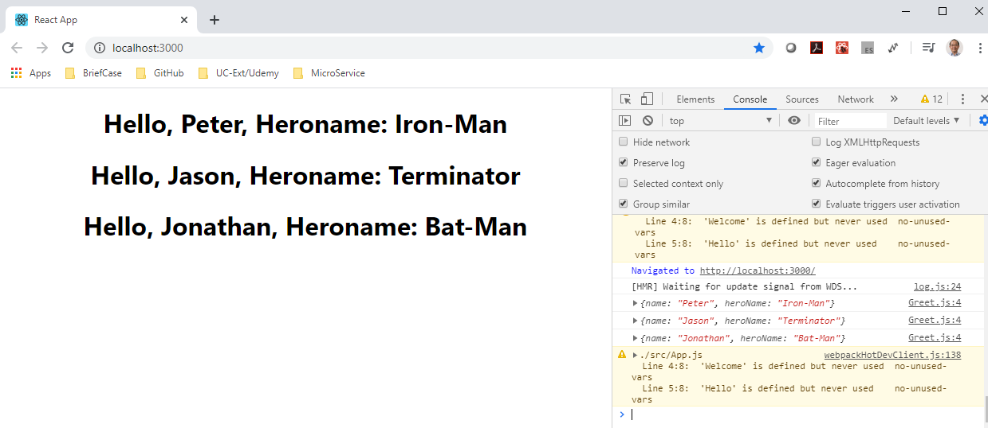
9 Props
https://www.youtube.com/watch?v=m7OWXtbiXX8&list=PLC3y8-rFHvwgg3vaYJgHGnModB54rxOk3&index=9
Props:
> npm start
> FN + F-12 to see console output

Slide 7
9.1 Props for Class Component

Slide 8
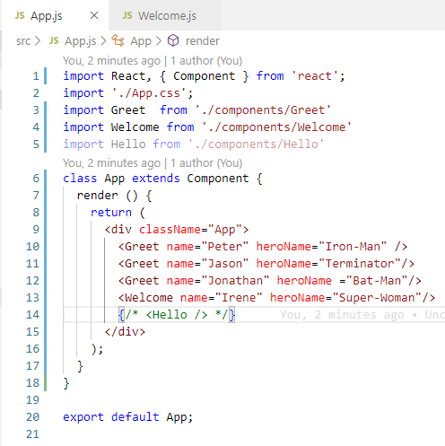
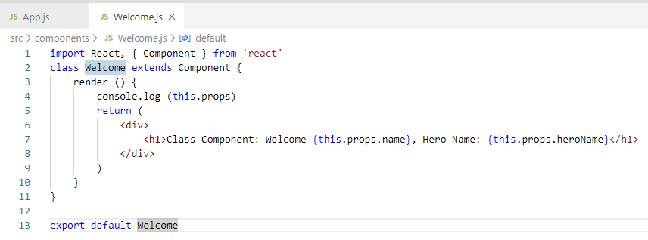
9.1 Props for Class Component
https://www.youtube.com/watch?v=m7OWXtbiXX8&list=PLC3y8-rFHvwgg3vaYJgHGnModB54rxOk3&index=9
Props:
Class component does not have passing props like function.
Just accessed by ‘this’ keyword. Use Console.log () inside the render() but outside the return (<element>)

Slide 9
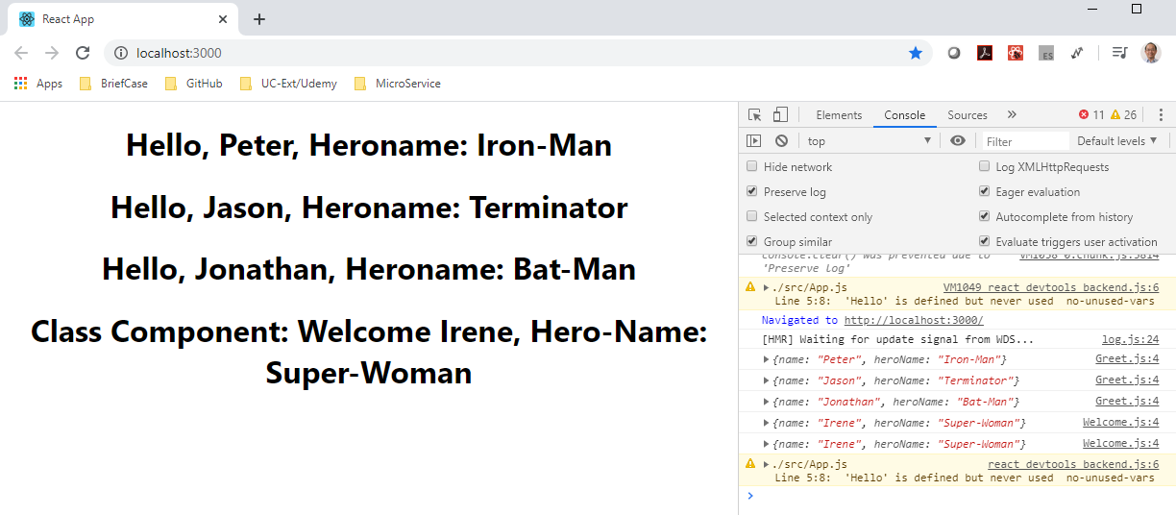
9.1 Props for Class Component
https://www.youtube.com/watch?v=m7OWXtbiXX8&list=PLC3y8-rFHvwgg3vaYJgHGnModB54rxOk3&index=9
Props:
> npm start
> FN + F-12 to see console output

Slide 10
9.1 Props for Class Component
https://www.youtube.com/watch?v=m7OWXtbiXX8&list=PLC3y8-rFHvwgg3vaYJgHGnModB54rxOk3&index=9
Summary:
Functional component: Use props as the passing parameter
Class Component: Use this.props to access the passing parameter.
Console.log output should be used outside the element.

Slide 11
End of Chapter

