Slide 1

17 List Rendering
Peter H. Chen

Slide 2
17 List Rendering
https://www.youtube.com/watch?v=5s8Ol9uw-yM&list=PLC3y8-rFHvwgg3vaYJgHGnModB54rxOk3&index=17s
List Rendering:
When you build web application, display a list of items is a common example. For example, a list of name, a list of products, a list of courses, and so on.
What we want is to repeat some HTML for each item in the list.
We will discuss how to do that in React.
One of the best thing in React is that React is heavily reply on JavaScript and not introduce new methods to manipulate and render data.
If you are familiar with JavaScript, you can iterate the array by map method and return new array with the desired changed.

Slide 3
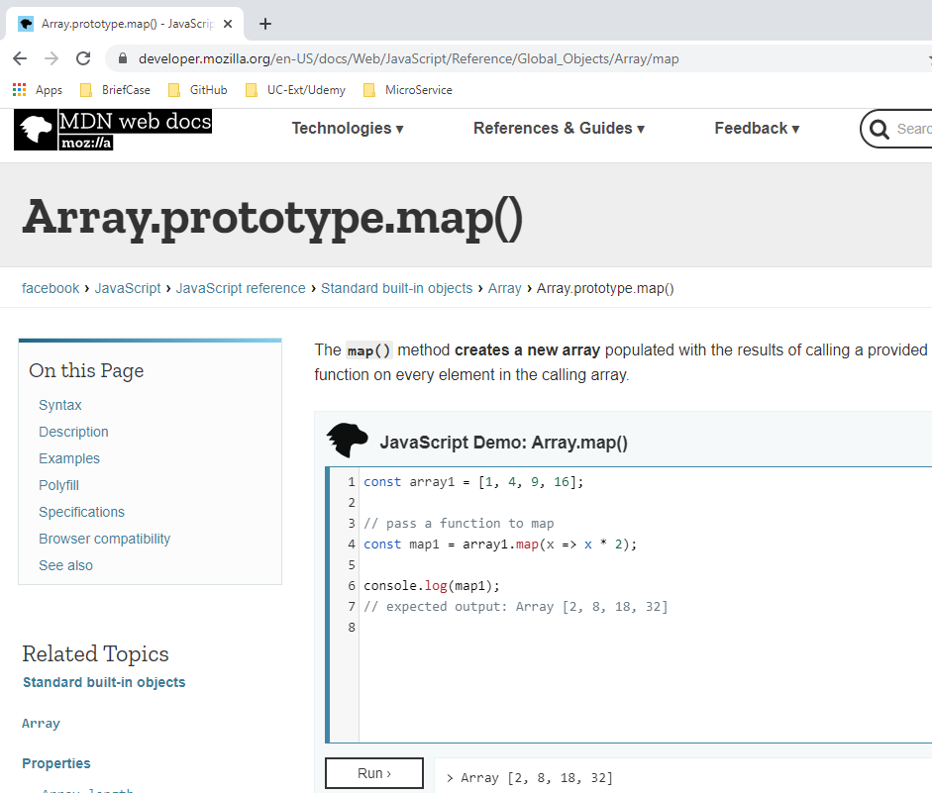
17 List Rendering
https://www.youtube.com/watch?v=5s8Ol9uw-yM&list=PLC3y8-rFHvwgg3vaYJgHGnModB54rxOk3&index=17s
List Rendering:
https://developer.mozilla.org/en-US/docs/Web/JavaScript/Reference/Global_Objects/Array/map
The MDN Web Docs has Arrary prototype map method.

Slide 4
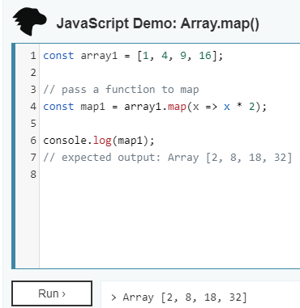
17 List Rendering
https://www.youtube.com/watch?v=5s8Ol9uw-yM&list=PLC3y8-rFHvwgg3vaYJgHGnModB54rxOk3&index=17s
List Rendering:
You can see the map method creates a new array with the results of calling a provided function on every element in the calling array.
In line 1 of the example, we have an array of numbers.
In line 4, we call the map method with function “x => x * 2” as an argument.
The function “x => x * 2” is an arrow function. The passing parameter is x and return function body is x * 2.
The entire operation is assigned to a variable call map1.
Line 6 display by console.log (map1).
What map method does is go over each element in the array and apply a transformation specified in the function body.
1 => 1 * 2, 4 => 4 * 2, 9 => 9 *2, and etc.

Slide 5
17.1 Name List

Slide 6
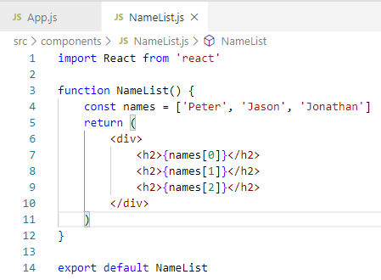
17.1 Name List
https://www.youtube.com/watch?v=5s8Ol9uw-yM&list=PLC3y8-rFHvwgg3vaYJgHGnModB54rxOk3&index=17
List Rendering:
Create NameList.js
Type ‘rfce’ (React Functional Component with ES7)

Slide 7
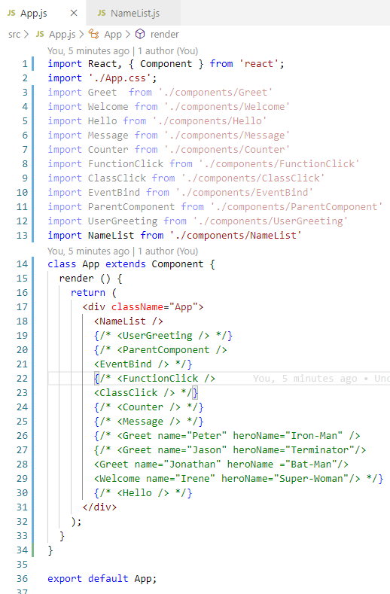
17.1 Name List
https://www.youtube.com/watch?v=5s8Ol9uw-yM&list=PLC3y8-rFHvwgg3vaYJgHGnModB54rxOk3&index=17
List Rendering:
App.js
<NameList />

Slide 8
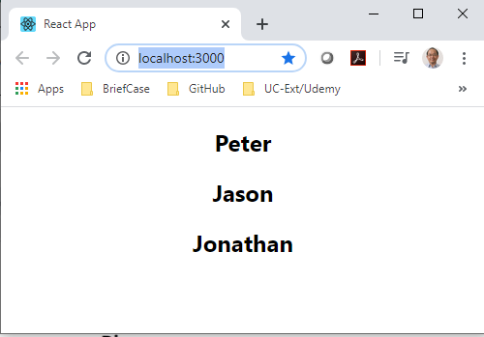
17.1 Name List
https://www.youtube.com/watch?v=5s8Ol9uw-yM&list=PLC3y8-rFHvwgg3vaYJgHGnModB54rxOk3&index=17
List Rendering:
> npm start

Slide 9
17.2 map in render

Slide 10
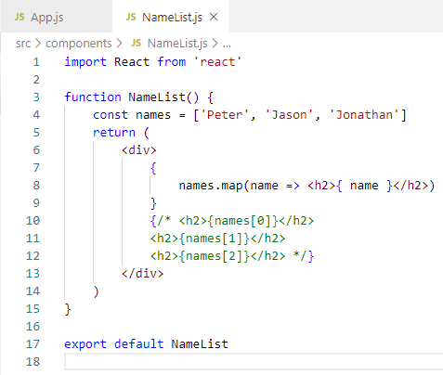
17.2 map in render
https://www.youtube.com/watch?v=5s8Ol9uw-yM&list=PLC3y8-rFHvwgg3vaYJgHGnModB54rxOk3&index=17
List Rendering:
The above is not a solution.
How to use map to display the array?
<div>
{
names.map (
name => <h2>{name}</h2>
)
}
</div>

Slide 11
17.3 nameList in render

Slide 12
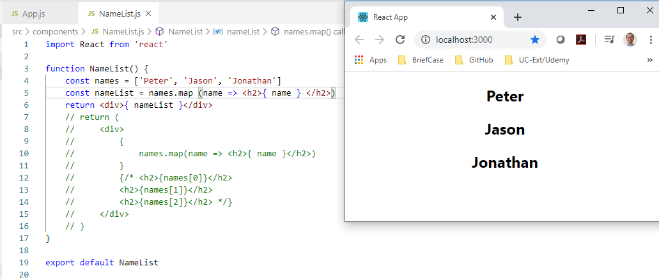
17.3 nameList in render
https://www.youtube.com/watch?v=5s8Ol9uw-yM&list=PLC3y8-rFHvwgg3vaYJgHGnModB54rxOk3&index=17
List Rendering:
Create a const nameList and render the NameList.
const names = [‘Peter’, ‘Jason’, ‘Jonathan’]
const nameList = names.map (name => <h2> { name } </h2>)
return <div> { nameList } </div>

Slide 13
17.4 Array of Persons

Slide 14
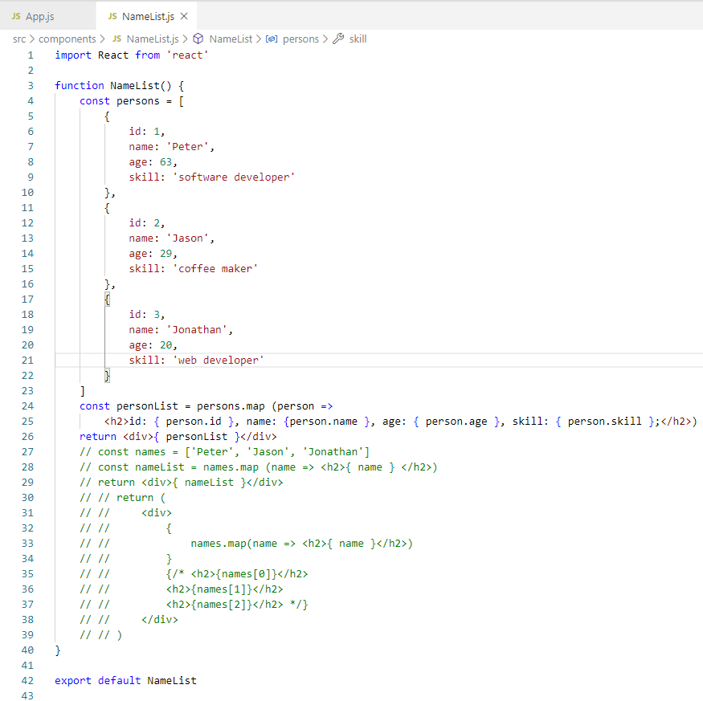
17.4 Array of Persons
https://www.youtube.com/watch?v=5s8Ol9uw-yM&list=PLC3y8-rFHvwgg3vaYJgHGnModB54rxOk3&index=17
List Rendering:
Array of dictionary of Persons

Slide 15
17.5 NameList and Person Component

Slide 16
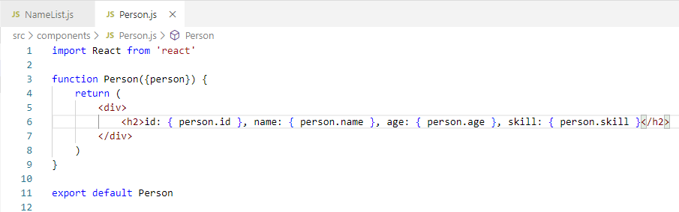
17.5 NameList and Person Component
https://www.youtube.com/watch?v=5s8Ol9uw-yM&list=PLC3y8-rFHvwgg3vaYJgHGnModB54rxOk3&index=17
List Rendering:
Create ./components/Person.js:
Person function is responsible for HTML.
Display all the dictionary data as the props {person} in the Name List array.
The passing props have to be JavaScript in {}.
Props in JavaScript

Slide 17
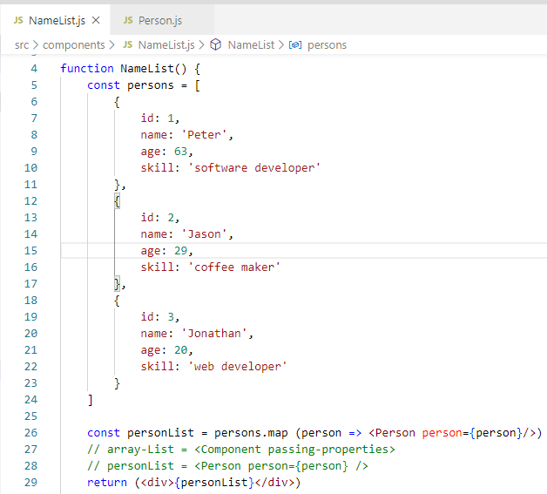
17.5 NameList and Person Component
https://www.youtube.com/watch?v=5s8Ol9uw-yM&list=PLC3y8-rFHvwgg3vaYJgHGnModB54rxOk3&index=17
List Rendering:
NameList only responsible for personList.
Pass NameList in JavaScript {}:
<Component-name properties />

Slide 18
17.6 Console Error Message

Slide 19
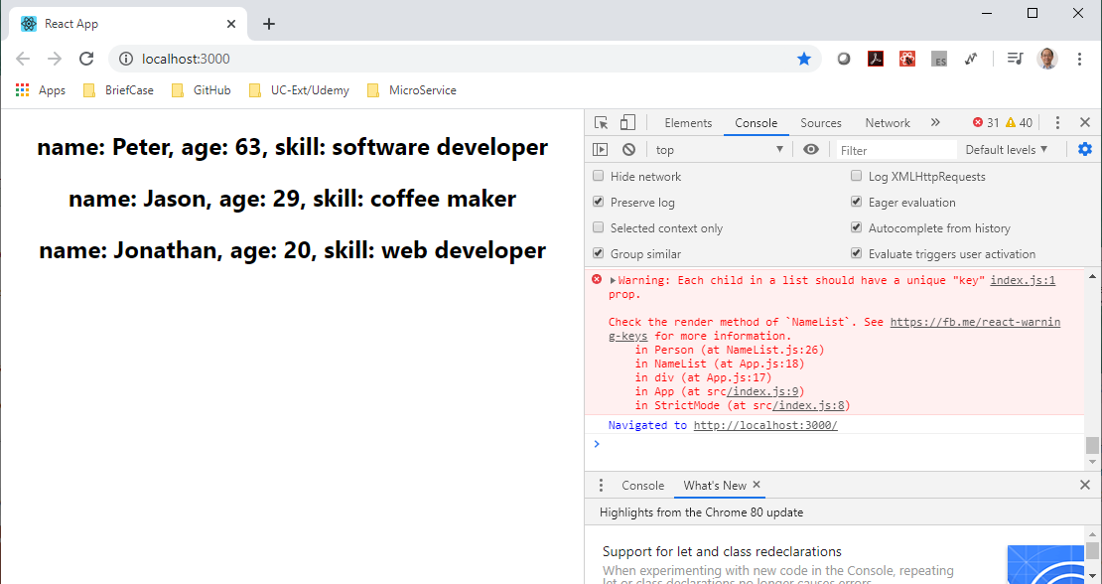
17.6 Console Error Message
https://www.youtube.com/watch?v=5s8Ol9uw-yM&list=PLC3y8-rFHvwgg3vaYJgHGnModB54rxOk3&index=17
If we open the console, we can see error message “Each child in a list should have a unique “key” prop.
What is unique “key” prop? We will discuss next.

Slide 20
End of Chapter

