Slide 1

18 List and Key
Peter H. Chen

Slide 2
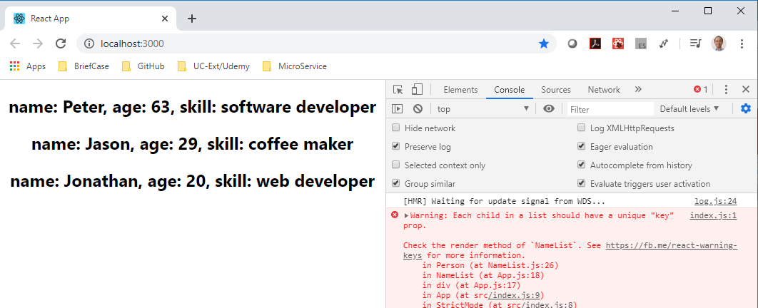
18 List and Key
https://www.youtube.com/watch?v=0sasRxl35_8&list=PLC3y8-rFHvwgg3vaYJgHGnModB54rxOk3&index=18
List and Key:
Each Child in a list should have a unique “key” prop.

Slide 3
18 List and Key
https://www.youtube.com/watch?v=0sasRxl35_8&list=PLC3y8-rFHvwgg3vaYJgHGnModB54rxOk3&index=18
List and Key:
Each Child in a list should have a unique “key” prop.
This message tell us: Each item in the list we render using the map operator should have a prop called key and the value to the key prop should be unique within the list.
We need to add the unique key prop to each item in our list.

Slide 4
18 List and Key
https://www.youtube.com/watch?v=0sasRxl35_8&list=PLC3y8-rFHvwgg3vaYJgHGnModB54rxOk3&index=18
List and Key:
In the NameList.js, we need to add the key prop for map function.
const personList = persons.map (person => <Person key=“unique” person={person} />
Typically, ID is unique. We can assign the id to the key.
const personList = persons.map (person => <Person key={person.id} person={person} />

Slide 5
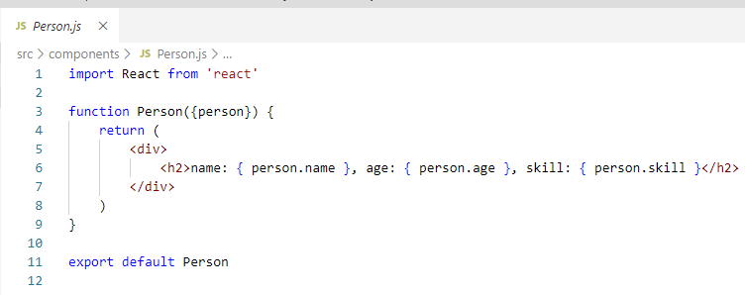
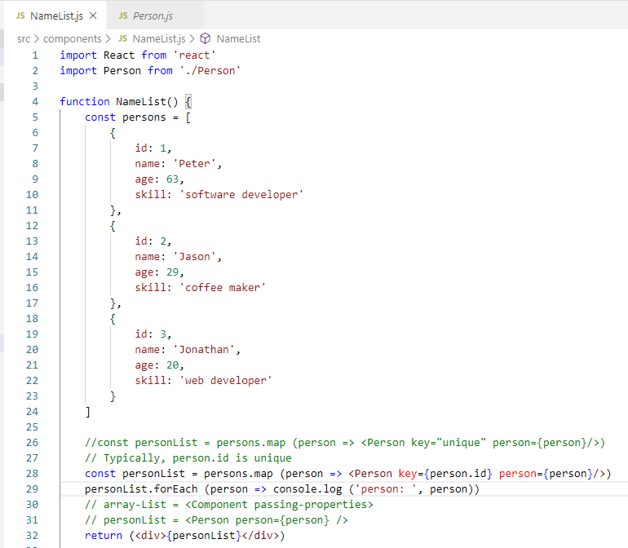
18 List and Key
https://www.youtube.com/watch?v=0sasRxl35_8&list=PLC3y8-rFHvwgg3vaYJgHGnModB54rxOk3&index=18
List and Key:
const personList = persons.map (person => <Person key={person.id} person={person} />

Slide 6
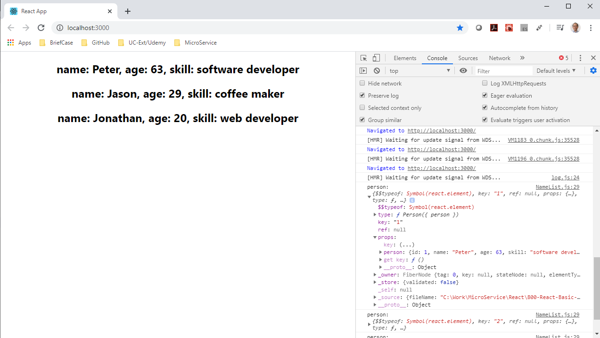
18 List and Key
https://www.youtube.com/watch?v=0sasRxl35_8&list=PLC3y8-rFHvwgg3vaYJgHGnModB54rxOk3&index=18
List and Key:
Remove the error message and check the dumped item object information.

Slide 7
18 List and Key
https://www.youtube.com/watch?v=0sasRxl35_8&list=PLC3y8-rFHvwgg3vaYJgHGnModB54rxOk3&index=18
List and Key:
The Key can be name or anything which is unique.
For example, if you fore sure the name is unique, then key = {person.name} is also valid.
In the personList, the first argument is component, the second argument is key.
Arrary.map (=> <Person key= …>
Another import point is “key” is not accessible in the child component.

Slide 8
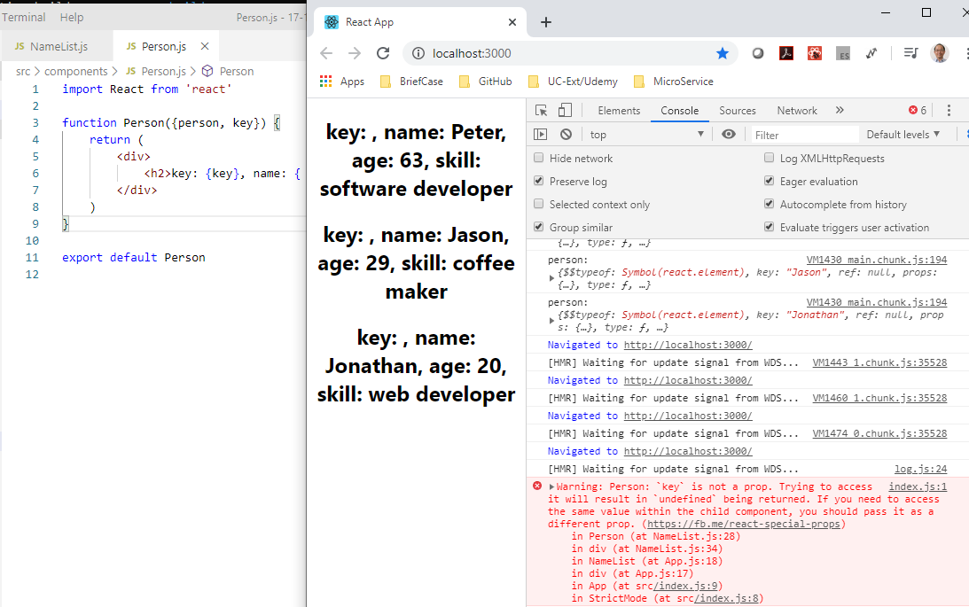
18 List and Key
https://www.youtube.com/watch?v=0sasRxl35_8&list=PLC3y8-rFHvwgg3vaYJgHGnModB54rxOk3&index=18
List and Key:
For example, we go to Person.js,
function Person ({person, key}) {
}

Slide 9
18 List and Key
https://www.youtube.com/watch?v=0sasRxl35_8&list=PLC3y8-rFHvwgg3vaYJgHGnModB54rxOk3&index=18
List and Key:
The “key” props is something I need to render there UI.
The key props is reserved only for React internal use.
If you try to pass key value to child component, pass it in different prop. The key prop is reserved. In your component, you should never use key prop to render your data.
The key prop is used by the React to identify which list has changed, added, or removed.
The key props is a crucial role for UI updated efficiently.

Slide 10
18.1 Lists and Keys

Slide 11
18.1 List and Key
https://www.youtube.com/watch?v=0sasRxl35_8&list=PLC3y8-rFHvwgg3vaYJgHGnModB54rxOk3&index=18
List with key Attribute:
We have a List without Key attribute: Bruce and Clark
We need to add another item “Diana” at the end of the list.
<ul>
<li>Bruce</li>
<li>Clark</li>
</ul>
<ul>
<li>Bruce</li>
<li>Clark</li>
<li>Diana<li>
</ul>
How React handle the update?
React just iterate both the lists at the same time and generates a mutation whenever there is a difference.
React:
iterate item 1 and no difference
iterate item 2 and no difference
There is a difference in third item and insert the third item into the DOM tree.

Slide 12
18.1 List and Key
https://www.youtube.com/watch?v=0sasRxl35_8&list=PLC3y8-rFHvwgg3vaYJgHGnModB54rxOk3&index=18
List with key Attribute:
This way, instead of tear down the old tree and building a new tree from scratch, React simply update the tree by inserting the item at the end of the list.

Slide 13
18.1 List and Key
https://www.youtube.com/watch?v=0sasRxl35_8&list=PLC3y8-rFHvwgg3vaYJgHGnModB54rxOk3&index=18
List with key Attribute:
If we want to insert the “Diana” at the top.
In this example, React find out every item is different.
React will end up nutating every child instead of realizing it can keep the Bruce and Clark sub-trees intact.
This inefficiency can be a problem.
<ul>
<li>Bruce</li>
<li>Clark</li>
</ul>
<ul>
<li>Diana<li>
<li>Bruce</li>
<li>Clark</li>
</ul>

Slide 14
18.1 List and Key
https://www.youtube.com/watch?v=0sasRxl35_8&list=PLC3y8-rFHvwgg3vaYJgHGnModB54rxOk3&index=18
List with key Attribute:
In order to solve this problem, React support the key attribute.
When children have keys, react use the key to match the children in the original tree with the children in the subsequent tree.
Now, react knows that the element with key 3 is the new one and the element with keys 1 and 2 have just moved.
So, React will preserve the sub-tree and simply insert the new item at the top of the list.
This turn out is much more efficient.
<ul>
<li key = “1”>Bruce</li>
<li key = “2”>Clark</li>
</ul>
<ul>
<li key =“3”>Diana<li>
<li key =“1”>Bruce</li>
<li key = “2”>Clark</li>
</ul>

Slide 15
18.2 Summary of Lists and Keys

Slide 16
18.2 Summary of Lists and Keys
https://www.youtube.com/watch?v=0sasRxl35_8&list=PLC3y8-rFHvwgg3vaYJgHGnModB54rxOk3&index=18
Lists and Keys:
A “key” is a special string attribute you need to include when creating lists of elements.
Keys give the elements a stable identity.
Keys help React identify which items have changed, added, or removed.
The keys help much more efficient update of the user interface.
Question:
In many cases, we only have the simple array which does not have an ID property that uniquely identifies the item.
What do we do in such a situation, we discuss this situation next.

Slide 17
End of Chapter

