Slide 1

19 Index and Key
Peter H. Chen

Slide 2
19 Index and Key
https://www.youtube.com/watch?v=xlPxnc5uUPQ&list=PLC3y8-rFHvwgg3vaYJgHGnModB54rxOk3&index=19
Index and Key:
A lot of developers index of an element as the key for list rendering.
Index key the code simple and elegant and get rid of the warning in the console.
In this discuss, we use index as the key when rendering the list.

Slide 3
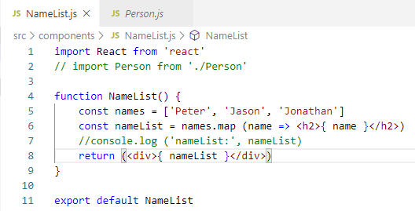
19 Index and Key
https://www.youtube.com/watch?v=xlPxnc5uUPQ&list=PLC3y8-rFHvwgg3vaYJgHGnModB54rxOk3&index=19
Index and Key:
In the NameList, we use list of names instead of persons array.
const names = [‘Peter’, ‘Jason’, ‘Jonamthan’]
const nameList = names.map (name => <h2>{name}</h2>)

Slide 4
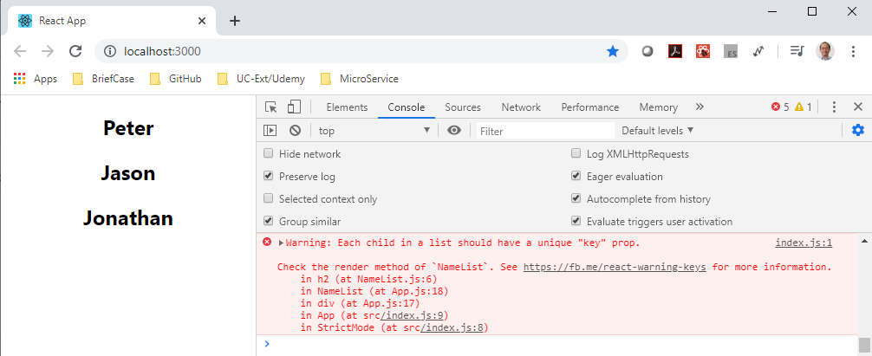
19 Index and Key
https://www.youtube.com/watch?v=xlPxnc5uUPQ&list=PLC3y8-rFHvwgg3vaYJgHGnModB54rxOk3&index=19
Index and Key:
If open the console, you see the error message “Each child is a list should have a unique “key” prop.

Slide 5
19.1 Key Props

Slide 6
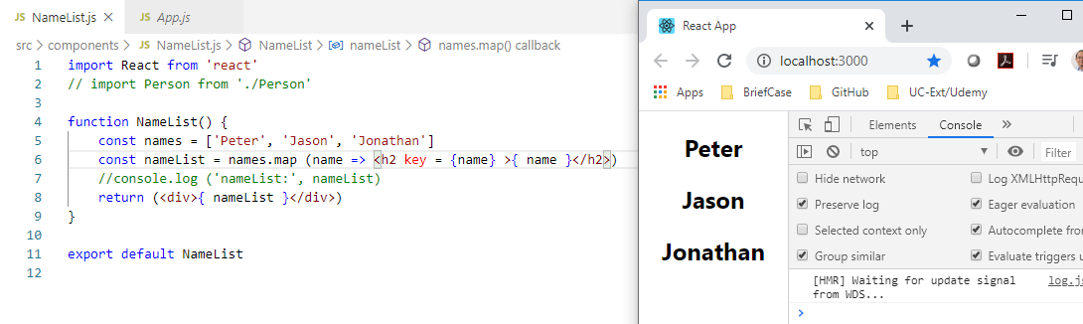
19.1 Key Props
https://www.youtube.com/watch?v=xlPxnc5uUPQ&list=PLC3y8-rFHvwgg3vaYJgHGnModB54rxOk3&index=19
Index Key
In order to fix the error for unique key, we need to add the key props.
There is a problem. We do not have ID that uniquely identify each item in the array.
We could use the name itself as the key.
In the map method, we add the <h2 key = { name } > { name } </h2>.

Slide 7
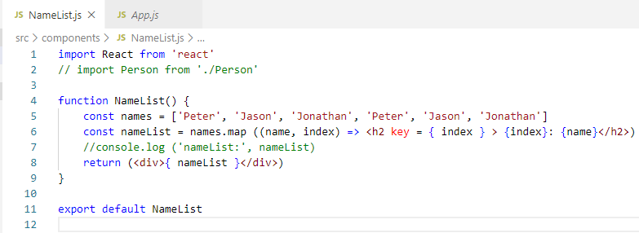
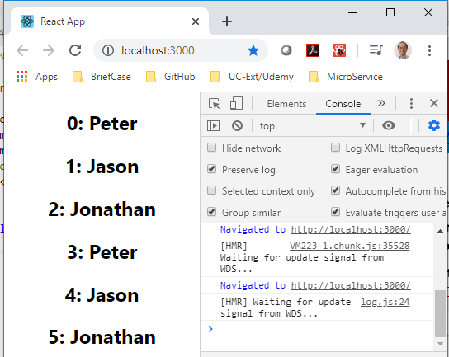
19.1 Key Props
https://www.youtube.com/watch?v=xlPxnc5uUPQ&list=PLC3y8-rFHvwgg3vaYJgHGnModB54rxOk3&index=19
Index Key
You can see the error is gone, but what if the name is duplicated?
If we add ‘Peter’ twice in the list, we will see the error in the console.
How to fix this?
In, the map method, we add map ((name, index) => <h2 key = { index } > … </h2>

Slide 8
19.2 Index as Anti-Pattern

Slide 9
19.2 Index as Key Anti-Pattern
https://www.youtube.com/watch?v=xlPxnc5uUPQ&list=PLC3y8-rFHvwgg3vaYJgHGnModB54rxOk3&index=19
Index as Key Anti-Pattern:
When you insert an item at the very beginning, the new item get the index of 0 which effectively creates key with a value of 0 and that pushes the key value by 1 for the remaining elements.
When update to the UI, React thinks that I already have the three elements with key equal to 0, 1, 2. Let me re-use them and then insert that new item with key value of 4.
It turns out that first three items have some values and let me put them back.
This is how even though we inserted a new item at the top. It appears as though it was inserted at the bottom and the values are all messed up.
It is the problem when try to sort the list.
<ul>
<li key = “0”><li>
<li key = “1”><li>
<li key = “2”><li>
<li key = “3”><li>
</ul>
<ul>
<li key = “0”> 1<li>
<li key = “1”> 2<li>
<li key = “2”> 3<li>
<li key = “3”> <li>
</ul>
<ul>
<li key = “0”> 1<li>
<li key = “1”> 2<li>
<li key = “2”> 3<li>
</ul>

Slide 10
19.3 Summary of Index as Key

Slide 11
19.3 Summary of Index as Key
https://www.youtube.com/watch?v=xlPxnc5uUPQ&list=PLC3y8-rFHvwgg3vaYJgHGnModB54rxOk3&index=19
Index as Key:
We need index as key in certain condition only.
When do we use index as a key?
The items in your list do not have a unique ID. If items have unique ID, always go with that.
The list is a static list and will not change. For example, you will never adding items to the list or removing items from the list.
The list will never be reordered or filtered, for example, sorting based on a column value or filtering based on user inputs.
When your list satisfied three conditions, you can safely use the index as the key.
You can generate the values by hashing for unique ID for your array.
Try not to use index as a key to prevent the diasater.

Slide 12
End of Chapter

