Slide 1

20 Styling CSS Component
Peter H. Chen

Slide 2
20 Styling CSS Component
https://www.youtube.com/watch?v=j5P9FHiBVNo&list=PLC3y8-rFHvwgg3vaYJgHGnModB54rxOk3&index=20
Styling CSS Component
We discuss the basic styling and CSS of React.
There are several options to style React components.
The first one is regular CSS stylesheets.
The second one is inline styling
Third, we have CSS Modules
Fourth, we can use CSS in JS Libraries which works really well with React.
We discuss first three approaches of CSS.
Styling React Components
CSS Stylesheets
Inline Styling
CSS Modules
CSS in JS Libraries (Styled Components)

Slide 3
20 Styling CSS Component
https://www.youtube.com/watch?v=j5P9FHiBVNo&list=PLC3y8-rFHvwgg3vaYJgHGnModB54rxOk3&index=20
Styling CSS Component
We discuss the basic styling and CSS of React.
There are several options to style React components.
The first one is regular CSS stylesheets.
The second one is inline styling
Third, we have CSS Modules
Fourth, we can use CSS in JS Libraries which works really well with React.
We discuss first three approaches of CSS.

Slide 4
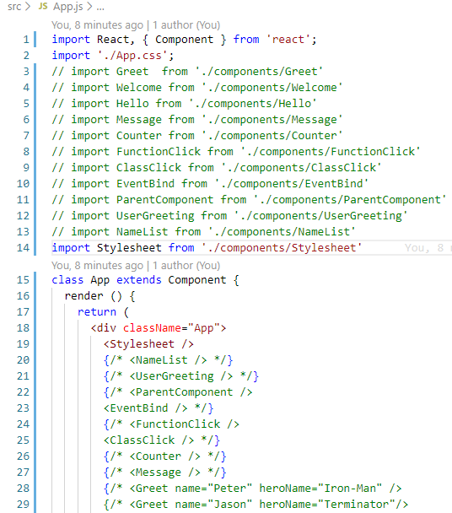
20 Styling CSS Component
https://www.youtube.com/watch?v=j5P9FHiBVNo&list=PLC3y8-rFHvwgg3vaYJgHGnModB54rxOk3&index=20
Styling CSS Component
App.js:
Import Stylesheet from “./component/Stylesheet’
Add component: <Stylesheet />

Slide 5
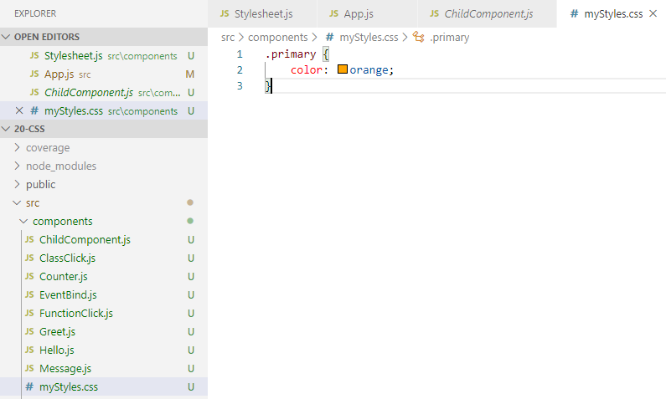
20 Styling CSS Component
https://www.youtube.com/watch?v=j5P9FHiBVNo&list=PLC3y8-rFHvwgg3vaYJgHGnModB54rxOk3&index=20
Styling CSS Component
CSS class: .primary { }

Slide 6
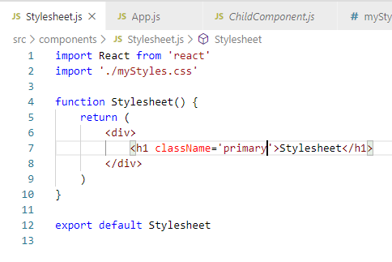
20 Styling CSS Component
https://www.youtube.com/watch?v=j5P9FHiBVNo&list=PLC3y8-rFHvwgg3vaYJgHGnModB54rxOk3&index=20
Styling CSS Component
Create rfce (React Functional Component with ES7)

Slide 7
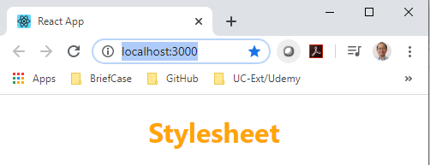
20 Styling CSS Component
https://www.youtube.com/watch?v=j5P9FHiBVNo&list=PLC3y8-rFHvwgg3vaYJgHGnModB54rxOk3&index=20
Styling CSS Component
> npm start

Slide 8
20.1 Control CSS Component

Slide 9
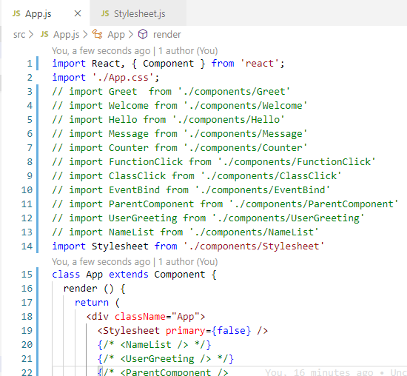
20.1 Control CSS Component
https://www.youtube.com/watch?v=j5P9FHiBVNo&list=PLC3y8-rFHvwgg3vaYJgHGnModB54rxOk3&index=20
Styling CSS Component
Pass props primary={false}

Slide 10
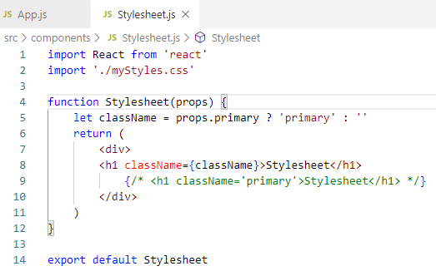
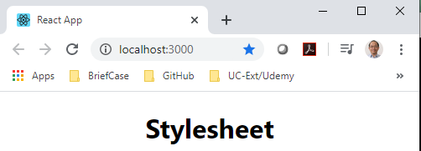
20.1 Control CSS Component
https://www.youtube.com/watch?v=j5P9FHiBVNo&list=PLC3y8-rFHvwgg3vaYJgHGnModB54rxOk3&index=20
Styling CSS Component
Let className = props.primary ? ‘primary’ : ‘’
props.primary = { true }
props.primary = { false }

Slide 11
20.2 Literal Template

Slide 12
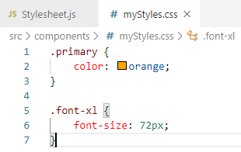
20.2 Literal Template
https://www.youtube.com/watch?v=j5P9FHiBVNo&list=PLC3y8-rFHvwgg3vaYJgHGnModB54rxOk3&index=20
Styling CSS Component
Create another class .font-xl { font-size: 72px; }

Slide 13
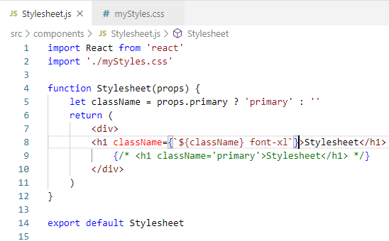
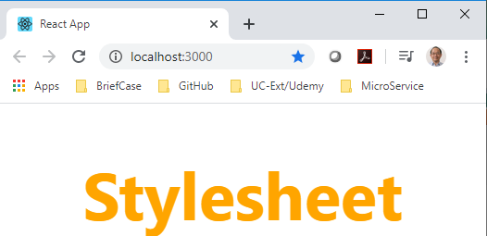
20.2 Literal Template
https://www.youtube.com/watch?v=j5P9FHiBVNo&list=PLC3y8-rFHvwgg3vaYJgHGnModB54rxOk3&index=20
Styling CSS Component
Use literal template (`${className} font-xl`} to control color and font size.

Slide 14
20.3 Inline Style

Slide 15
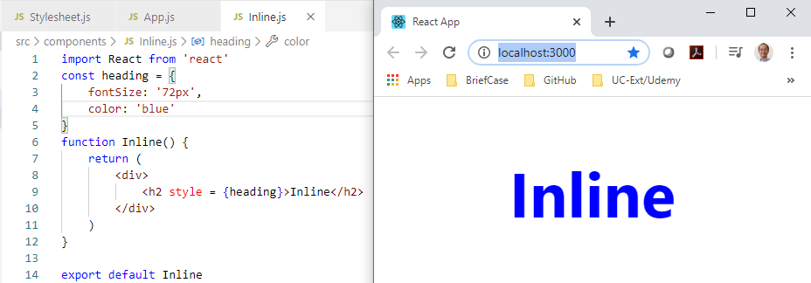
20.3 Inline Style
https://www.youtube.com/watch?v=j5P9FHiBVNo&list=PLC3y8-rFHvwgg3vaYJgHGnModB54rxOk3&index=20
Inline Style
Type ‘rfce’ (React Functional Component with ES7)

Slide 16
20.4 CSS Modules

Slide 17
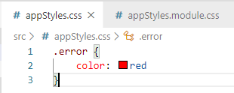
20.4 CSS Modules
https://www.youtube.com/watch?v=j5P9FHiBVNo&list=PLC3y8-rFHvwgg3vaYJgHGnModB54rxOk3&index=20
CSS Modules
Check package.json: “react-scripts”: “2.0.5” must greater than 2.
File name for CSS must be suffixed with “*Styles.css” and “*.module.css”.
For example, under the src folder, two style sheet in the source folder.
Create “appStyles.css” is the regular stylesheet and “appStyles.module.css” is a CSS module stylesheet.
In the regular stylesheet that is appStyles.css, we add the class “.error { color: red }”.
In the module stylesheet, we add the class “.success { color: green }”.

Slide 18
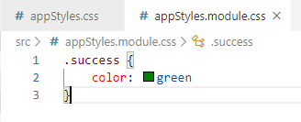
20.4 CSS Modules
https://www.youtube.com/watch?v=j5P9FHiBVNo&list=PLC3y8-rFHvwgg3vaYJgHGnModB54rxOk3&index=20
CSS Modules
In the regular stylesheet that is appStyles.css, we add the class “.error { color: red }”.
In the module stylesheet, we add the class “.success { color: green }”.

Slide 19
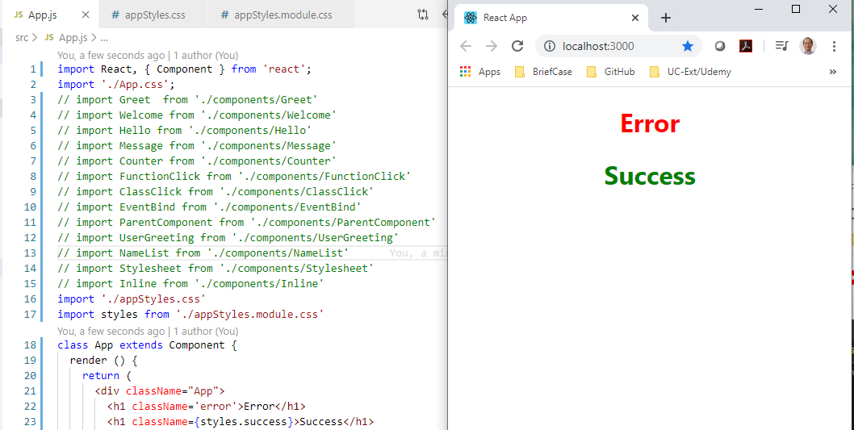
20.4 CSS Modules
https://www.youtube.com/watch?v=j5P9FHiBVNo&list=PLC3y8-rFHvwgg3vaYJgHGnModB54rxOk3&index=20
CSS Modules
In the App.js, we import both two files.
For regular stylesheet, we <import ‘./stylesheet’>.
For module stylesheet, we <import styles from ‘./appStyles.module.css’>

Slide 20
End of Chapter

