Slide 1

21 Form
Peter H. Chen

Slide 2
21 Form
https://www.youtube.com/watch?v=7Vo_VCcWupQ&list=PLC3y8-rFHvwgg3vaYJgHGnModB54rxOk3&index=21
Form:
We discuss the form in React.
We capture the input from the Form element like the input tag (text area tag) and also a select tag and have the data available for Form submission.
In regular HTML, Form elements, like input text area and so on, are responsible to handle the user input and update the respective values.

Slide 3
21 Form
https://www.youtube.com/watch?v=7Vo_VCcWupQ&list=PLC3y8-rFHvwgg3vaYJgHGnModB54rxOk3&index=21
Form:
What we want for react is to control the Form element, the Form element, whose value is controlled by React is called a Controlled Components.
The Controlled Components seem harder than HTML.
Let’s break down the Control Element and examine the code.
Consider the input element. The input element can have a value, the input element value can also change based on user interaction.
For example, a user typing in their email address. How do we deal with the changing values?
Controlled Element
<input type=‘text’ value= … onChange=…

Slide 4
21 Form
https://www.youtube.com/watch?v=7Vo_VCcWupQ&list=PLC3y8-rFHvwgg3vaYJgHGnModB54rxOk3&index=21
Form:
Within the components, this.state and setState.
In the Controlled Components, the value of the input field is set to the state property.
Next, we have an changed event fired whenever there is a change in the input field value.
In the changed handler, we use the setState () method to update the state.
When the state get updated, the render method is called and the new state is assigned as a value to the input element.
Controlled Element
this.state = {
email: ‘’
}
this.changeEmailHandler = (event) => {
this.setState ({email:event.target.value})
}
<input type=‘text’ value={this.state.email} onChange={this.changeEmailHandler) />

Slide 5
21 Form
https://www.youtube.com/watch?v=7Vo_VCcWupQ&list=PLC3y8-rFHvwgg3vaYJgHGnModB54rxOk3&index=21
Form:
There is a cycle of setting the initial value from ‘this.state’ propagating the changed value to the state.
Then back to the input field.
React will always have access to the component state which reflects the updated values of the Form element. That state object can be used to submit the Form data when needed.
Controlled Element
this.state = {
email: ‘’
}
this.changeEmailHandler = (event) => {
this.setState ({email:event.target.value})
}
<input type=‘text’ value={this.state.email} onChange={this.changeEmailHandler) />

Slide 6
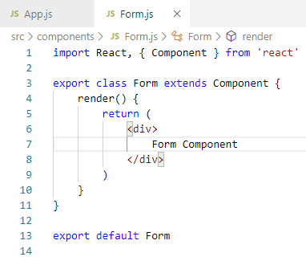
21 Form
https://www.youtube.com/watch?v=7Vo_VCcWupQ&list=PLC3y8-rFHvwgg3vaYJgHGnModB54rxOk3&index=21
Form:
Translate the above concept into the code.
Create a new file called components/Form.js.
Type ‘rce’ (React Class Component with ES7)

Slide 7
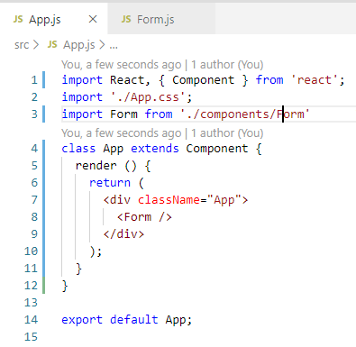
21 Form
https://www.youtube.com/watch?v=7Vo_VCcWupQ&list=PLC3y8-rFHvwgg3vaYJgHGnModB54rxOk3&index=21
Form:
In App.js, import Form from ‘./components/Form’ and add <Form />

Slide 8
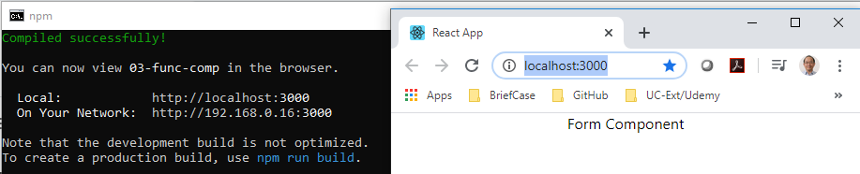
21 Form
https://www.youtube.com/watch?v=7Vo_VCcWupQ&list=PLC3y8-rFHvwgg3vaYJgHGnModB54rxOk3&index=21
Form:
> npm start

Slide 9
21.1 Form Control

Slide 10
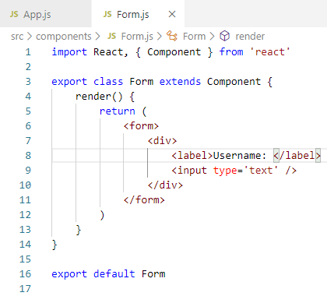
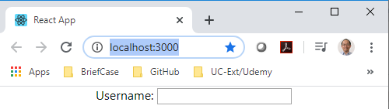
21.1 Form Control
https://www.youtube.com/watch?v=7Vo_VCcWupQ&list=PLC3y8-rFHvwgg3vaYJgHGnModB54rxOk3&index=21
Form:
Add Form Control in the Form Component.
Replace the <div> … </div> with
<form>
<div> … </div>
</form>

Slide 11
21.1 Form Control
https://www.youtube.com/watch?v=7Vo_VCcWupQ&list=PLC3y8-rFHvwgg3vaYJgHGnModB54rxOk3&index=21
Form:
Right now, the Form is regular HTML.
It is not a Controlled React Component.
To convert this into a Controlled Component, we need to follow two steps:

Slide 12
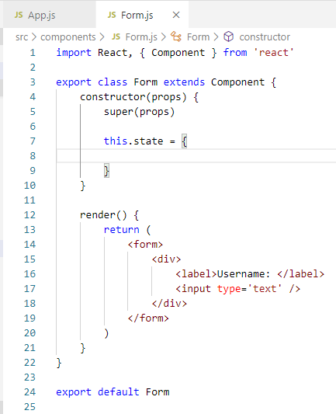
21.1 Form Control
https://www.youtube.com/watch?v=7Vo_VCcWupQ&list=PLC3y8-rFHvwgg3vaYJgHGnModB54rxOk3&index=21
Form:
The first step is to create a Component State that we control the input value of the input element.
Use ‘rconst’ to create React const.

Slide 13
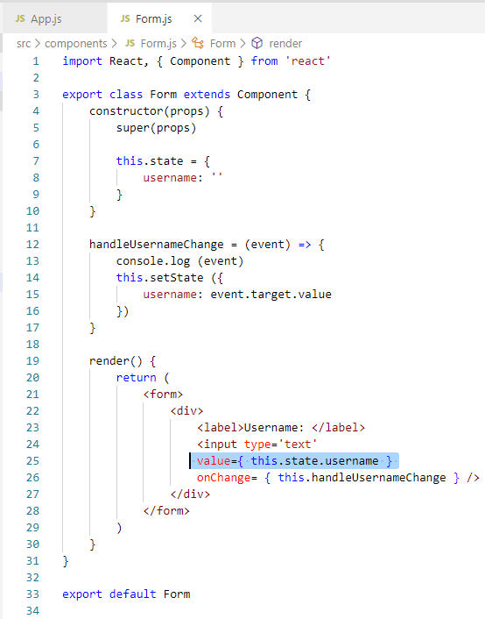
21.1 Form Control
https://www.youtube.com/watch?v=7Vo_VCcWupQ&list=PLC3y8-rFHvwgg3vaYJgHGnModB54rxOk3&index=21
Form:
Add username: ‘’
Add value=this.state.username

Slide 14
21.1 Form Control
https://www.youtube.com/watch?v=7Vo_VCcWupQ&list=PLC3y8-rFHvwgg3vaYJgHGnModB54rxOk3&index=21
Form:
In the second step, we add the event handler.
Add onChange event and assign a handler called handleUsernameChange onChange={ this.handleUsernameChnage }
Add handleUsernameChange with property arrow function () =>, the event itself is passed into arrow function as the parameter.

Slide 15
21.1 Form Control
https://www.youtube.com/watch?v=7Vo_VCcWupQ&list=PLC3y8-rFHvwgg3vaYJgHGnModB54rxOk3&index=21
Form:
We have one parameter called event. From this event, we can extract the value of the input element using event.target.value.
Any time you change the input value, the value is captured using event.target.value, all we have to do is to assign this captured value back to the state property and to update the state.
The state we will be using the setState () method, within the function body, this.setState ({ username: event.target.value })

Slide 16
21.1 Form Control
https://www.youtube.com/watch?v=7Vo_VCcWupQ&list=PLC3y8-rFHvwgg3vaYJgHGnModB54rxOk3&index=21
Form:
We have one parameter called event. From this event, we can extract the value of the input element using event.target.value.
Any time you change the input value, the value is captured using event.target.value, all we have to do is to assign this captured value back to the state property and to update the state.
The state we will be using the setState () method, within the function body, this.setState ({ username: event.target.value })

Slide 17
21.2 Text Area Control

Slide 18
21.2 Text Area Control
https://www.youtube.com/watch?v=7Vo_VCcWupQ&list=PLC3y8-rFHvwgg3vaYJgHGnModB54rxOk3&index=21
Text Area Control:
Create control components for a text area as well as a select tag.
This also help you to get used to the controlled component way of working with Form element.
There are three simple steps:
First, add the element HTML
Second, assign the component state to the element value, and
Third, assign an changed handler that update the state.

Slide 19
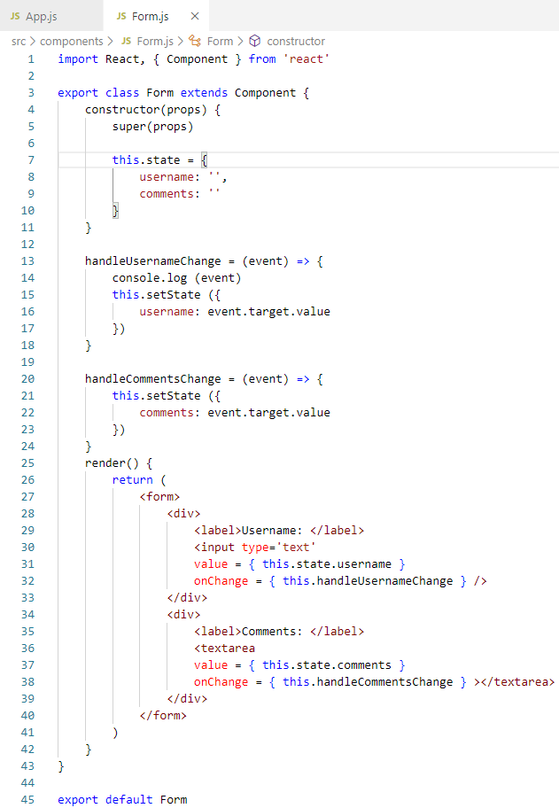
21.2 Text Area Control
https://www.youtube.com/watch?v=7Vo_VCcWupQ&list=PLC3y8-rFHvwgg3vaYJgHGnModB54rxOk3&index=21
Text Area Control:
We start with Step 1:
In the form, add
<div>
<label>Comments </label>
<textarea value= … onChange = … > </textarea>
</div>

Slide 20
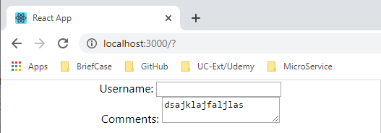
21.2 Text Area Control
https://www.youtube.com/watch?v=7Vo_VCcWupQ&list=PLC3y8-rFHvwgg3vaYJgHGnModB54rxOk3&index=21
Text Area Control:
> npm start

Slide 21
21.3 Select Tag

Slide 22
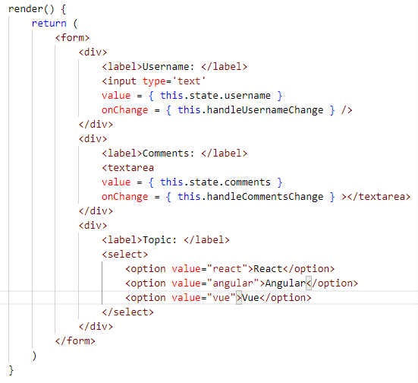
21.3 Select Tag
https://www.youtube.com/watch?v=7Vo_VCcWupQ&list=PLC3y8-rFHvwgg3vaYJgHGnModB54rxOk3&index=21
Select Tag:
We have three simple steps for Select Tag.
Step 1: Add HTML element, select options are: React, Angular, and Vue.

Slide 23
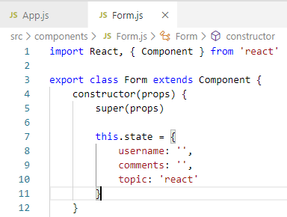
21.3 Select Tag
https://www.youtube.com/watch?v=7Vo_VCcWupQ&list=PLC3y8-rFHvwgg3vaYJgHGnModB54rxOk3&index=21
Select Tag:
Step 2: Assign initial state, initially, we assign the topic to ‘react’.

Slide 24
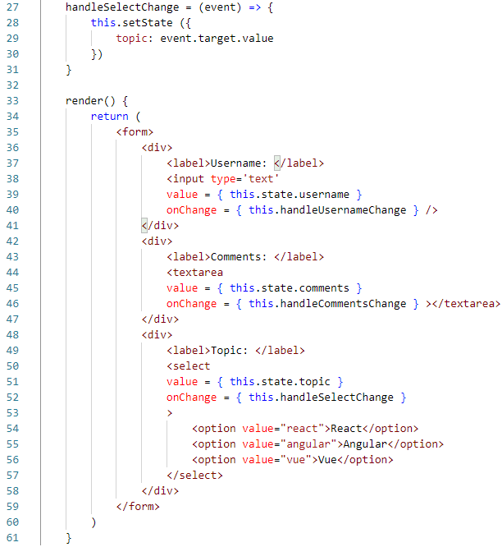
21.3 Select Tag
https://www.youtube.com/watch?v=7Vo_VCcWupQ&list=PLC3y8-rFHvwgg3vaYJgHGnModB54rxOk3&index=21
Select Tag:
Step 3: On the select side, we add the
value = { this.state.topic } and
onChange = { handleSelectChange }
handleSelectChange = (event) => {
setState ({
topic: event.target.value
})
}

Slide 25
21.4 Submit Form Data

Slide 26
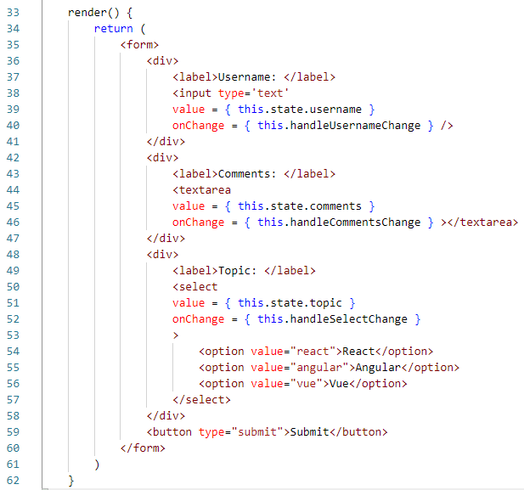
21.4 Submit Form Data
https://www.youtube.com/watch?v=7Vo_VCcWupQ&list=PLC3y8-rFHvwgg3vaYJgHGnModB54rxOk3&index=21
Submit Form Data:
In the Form.js, add the <button type=“submit”>Submit</button>

Slide 27
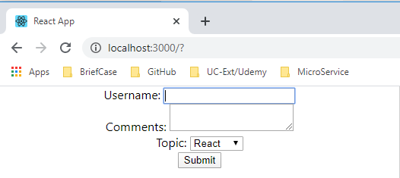
21.4 Submit Form Data
https://www.youtube.com/watch?v=7Vo_VCcWupQ&list=PLC3y8-rFHvwgg3vaYJgHGnModB54rxOk3&index=21
Submit Form Data:
> npm start
When you click the “Submit” button, you can see the page is refreshed.
Right now, the HTML have the default setting.
When you click the submit button, the page refresh to the default new page.
We need the JavaScript function to handle the submission form. That JavaScript function will also have access to the data that user entered into the form.

Slide 28
21.5 JavaScript Function

Slide 29
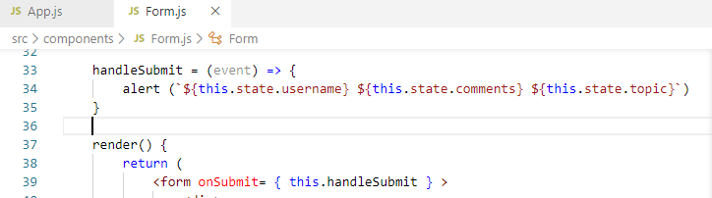
21.5 JavaScript Function
https://www.youtube.com/watch?v=7Vo_VCcWupQ&list=PLC3y8-rFHvwgg3vaYJgHGnModB54rxOk3&index=21
JavaScript Function:
On the <form> tag, we need to add onSubmit = { this.handleSubmit }
Add arrow function to handle the submit button.
handleSubmit = (event) => {
alert (`${this.state.username} ${this.state.comments} ${this.state.topic}`)
}

Slide 30
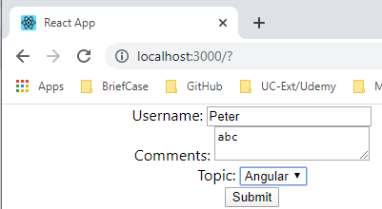
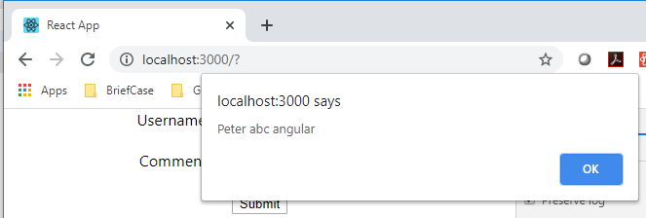
21.5 JavaScript Function
https://www.youtube.com/watch?v=7Vo_VCcWupQ&list=PLC3y8-rFHvwgg3vaYJgHGnModB54rxOk3&index=21
JavaScript Function:
> npm start
The data is refresh and lost.

Slide 31
21.6 Keep Submit Data

Slide 32
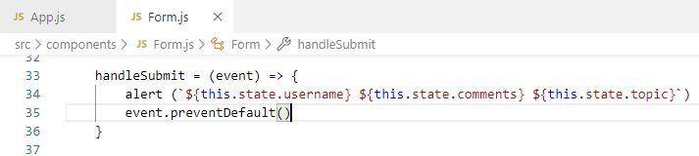
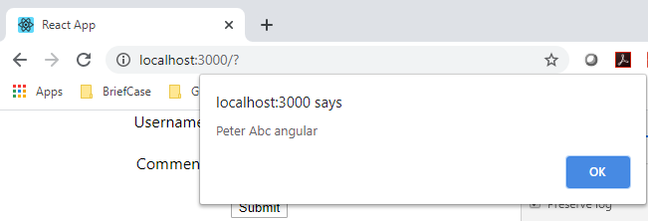
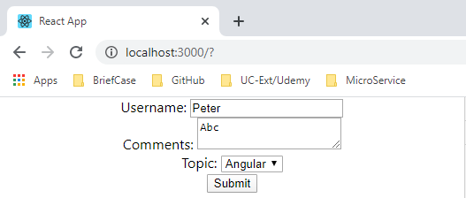
21.6 Keep Submit Data
https://www.youtube.com/watch?v=7Vo_VCcWupQ&list=PLC3y8-rFHvwgg3vaYJgHGnModB54rxOk3&index=21
JavaScript Function:
Add event.preventDefault().
After click Submit button, the original state is kept.

Slide 33
21.7 Summary of Form

Slide 34
21.7 Summary of Form
https://www.youtube.com/watch?v=7Vo_VCcWupQ&list=PLC3y8-rFHvwgg3vaYJgHGnModB54rxOk3&index=21
Summary of Form:
Create form with onSubmit:
<form onSubmit= { this.handleSubmit } >
</form>
handleSubmit = (event) => {
event.preventDefault()
}
Three HTML elements in Forms: text, text area, select.
Use event.preventDeafult() to keep the original data in the HTML elements.

Slide 35
End of Chapter

