Slide 1

23 Mounting Lifecycle Methods
Peter H. Chen

Slide 2
23 Mounting Lifecycle Methods
https://www.youtube.com/watch?v=KDXZibVdiEI&list=PLC3y8-rFHvwgg3vaYJgHGnModB54rxOk3&index=23
Component Mounting Lifecycle Methods:
We take a look of Component Mounting Lifecycle Methods.
Mounting lifecycle methods are called when an instance of a component is being created and inserted into the DOM.
We will be going though these methods in the order they are invoked.

Slide 3
23 Mounting Lifecycle Methods
https://www.youtube.com/watch?v=KDXZibVdiEI&list=PLC3y8-rFHvwgg3vaYJgHGnModB54rxOk3&index=23
Component Mounting Lifecycle Methods:
The constructor is a special function that will be get called whenever a new component is created.
What is the constructor used for?
The constructor is prefect for initializing state or binding the event handlers to the class instance.
What should do in a constructor, is cause side effects, for example, you should never make HTTP requests within a constructor.
There are two important point to keep in mind when it comes to define your own constructor.
Mounting Lifecycle Methods
constructor (props)
A special function that will get called whenever a new component is created.
Initializing state
Binding the event handlers

Slide 4
23 Mounting Lifecycle Methods
https://www.youtube.com/watch?v=KDXZibVdiEI&list=PLC3y8-rFHvwgg3vaYJgHGnModB54rxOk3&index=23
Component Mounting Lifecycle Methods:
The constructor is a special function that will be get called whenever a new component is created.
What is the constructor used for?
The constructor is prefect for initializing state or binding the event handlers to the class instance.
What should not do in a constructor which causes the side effects, for example, you should never make HTTP requests inside the constructor.
Mounting Lifecycle Methods
constructor (props)
A special function that will get called whenever a new component is created.
Initializing state
Binding the event handlers
Do not cause side effects, for example, never make HTTP requests inside the constructor

Slide 5
23 Mounting Lifecycle Methods
https://www.youtube.com/watch?v=KDXZibVdiEI&list=PLC3y8-rFHvwgg3vaYJgHGnModB54rxOk3&index=23
Component Mounting Lifecycle Methods:
There are also two important points to keep in mind when it comes to defining your own constructor.
The first one, is that you have to call a special function called super (). The super() will call the base class constructor.
In our component, we have access to this.props only after we have initiallty called super(props) passing in the props as the argument.
The second point is that constructor is the only place where you are expected to change or set the state by directly overwriting this.state field. In all situation, you use this.setState().
Mounting Lifecycle Methods
constructor (props)
A special function that will get called whenever a new component is created.
Initializing state
Binding the event handlers
Do not cause side effects, for example, never make HTTP requests inside the constructor
super (props)
Directly overwrite this.state.

Slide 6
23 Mounting Lifecycle Methods
https://www.youtube.com/watch?v=KDXZibVdiEI&list=PLC3y8-rFHvwgg3vaYJgHGnModB54rxOk3&index=23
Component Mounting Lifecycle Methods:
As a constructor, set initial state, find event handler, and do not cause any side effects, for example, making HTTP or Ajax calls.

Slide 7
23 Mounting Lifecycle Methods
https://www.youtube.com/watch?v=KDXZibVdiEI&list=PLC3y8-rFHvwgg3vaYJgHGnModB54rxOk3&index=23
Component Mounting Lifecycle Methods:
The second method we have is a static method getDerivedStateFromProps (props, state).
The React documentation classifies this method as a rarely used lifecycle method.
This method is basically used when the state of the component depends on changes in props over time.
Let’s say you have a component but the initial state of the component depends on the props being passed to the component.
In this situation, you can use this method to set the state.
Since this method is a static method, it does not have access to ‘this’ keyword.
You cannot call this.setState in the method. In stead, you simple have to return an object that represents the new state of the component.
Mounting Lifecycle Methods
constructor (props)
When the state of the component depends on changes in props over time.
static getDerivedStateFromProps (props, state)

Slide 8
23 Mounting Lifecycle Methods
https://www.youtube.com/watch?v=KDXZibVdiEI&list=PLC3y8-rFHvwgg3vaYJgHGnModB54rxOk3&index=23
Component Mounting Lifecycle Methods:
Again, you should not do is cause side effect, for example, fetching data from an endpoint.
So, getDerivedStateFromProps() use it when state depends on changes in props over time and also did not cause any side effects.
Mounting Lifecycle Methods
constructor (props)
When the state of the component depends on changes in props over time.
static getDerivedStateFromProps (props, state)
Set the state
Do not cause side effect, e.g., HTTP requests

Slide 9
23 Mounting Lifecycle Methods
https://www.youtube.com/watch?v=KDXZibVdiEI&list=PLC3y8-rFHvwgg3vaYJgHGnModB54rxOk3&index=23
Component Mounting Lifecycle Methods:
The third method is the render method.
By now, we are very familiar with render() method.
The render() method is the only required method in the class component.
In the render() method, we simply read this.props and this.state and return JSX which describes the UI.
The render() function is a pure function for given props and state, it should always render the same UI what you should not do.
Mounting Lifecycle Methods
constructor (props)
static getDerivedStateFromProps (props, state)
Render()

Slide 10
23 Mounting Lifecycle Methods
https://www.youtube.com/watch?v=KDXZibVdiEI&list=PLC3y8-rFHvwgg3vaYJgHGnModB54rxOk3&index=23
Component Mounting Lifecycle Methods:
Here, is changing the state of the component or interacting with theedom or making any Ajax calls.
Since it is the render () method, JSX which also contains the other children components right after the parent render method, the children components lifecycle methods are also executed. We will see the order of execution next.
Mounting Lifecycle Methods
constructor (props)
static getDerivedStateFromProps (props, state)
Only required method
Render()
Read props & state and return JSX.
Do not cause side effect, e.g., HTTP requests
Children components lifecycle methods are also executed

Slide 11
23 Mounting Lifecycle Methods
https://www.youtube.com/watch?v=KDXZibVdiEI&list=PLC3y8-rFHvwgg3vaYJgHGnModB54rxOk3&index=23
Component Mounting Lifecycle Methods:
The render method read props and state and return the JSX.
Mounting Lifecycle Methods
constructor (props)
static getDerivedStateFromProps (props, state)
Only required method
Render()
Read props & state and return JSX.
Do not cause side effect, e.g., HTTP requests
Children components lifecycle methods are also executed

Slide 12
23 Mounting Lifecycle Methods
https://www.youtube.com/watch?v=KDXZibVdiEI&list=PLC3y8-rFHvwgg3vaYJgHGnModB54rxOk3&index=23
Component Mounting Lifecycle Methods:
The final phase is componentDidMount().
This method will be called only once in the whole Lifecyle of a given component and it invoked immediately after a component and all its children components have been rendered to the DOM.
Mounting Lifecycle Methods
constructor (props)
static getDerivedStateFromProps (props, state)
render ()
Invoked immediately after a component and all its children components have been rendered to the DOM
Cause side effects, e.g., interact with the DOM or perform any Ajax calls to load data.
componentDidMount()
Do not cause side effect, e.g., HTTP requests
Children components lifecycle methods are also executed

Slide 13
23 Mounting Lifecycle Methods
https://www.youtube.com/watch?v=KDXZibVdiEI&list=PLC3y8-rFHvwgg3vaYJgHGnModB54rxOk3&index=23
Component Mounting Lifecycle Methods:
Now, we understand the four method in mounting lifecycle method.
We know what can be done in each of the method.
Let go through the code with order of execution.
Mounting Lifecycle Methods
constructor (props)
static getDerivedStateFromProps (props, state)
render ()
componentDidMount()

Slide 14
23 Mounting Lifecycle Methods
https://www.youtube.com/watch?v=KDXZibVdiEI&list=PLC3y8-rFHvwgg3vaYJgHGnModB54rxOk3&index=23
Component Mounting Lifecycle Methods:
This method is the perfect place to cause side-effect you can interact with the DOM or perform any Ajax calls to load data.
So, componentDidMount () is a perfect place to perform initialization that requires DOM nodes and also load data by making Network request (Http request or Ajax calls).
Mounting Lifecycle Methods
constructor (props)
static getDerivedStateFromProps (props, state)
render ()
componentDidMount()
Invoked immediately after a component and all its children components have been rendered to the DOM
componentDidMount () is the perfect place to cause side effects, e.g., interact with the DOM or perform any Http or Ajax calls to load data.

Slide 15
23.1 LifecycleA.js

Slide 16
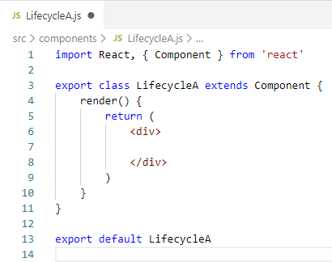
23.1 LifecycleA.js
https://www.youtube.com/watch?v=KDXZibVdiEI&list=PLC3y8-rFHvwgg3vaYJgHGnModB54rxOk3&index=23
Component Mounting Lifecycle Methods:
Create ./compoents/LifecycleA.js
Type ‘rce’ (React Class Component ES7)

Slide 17
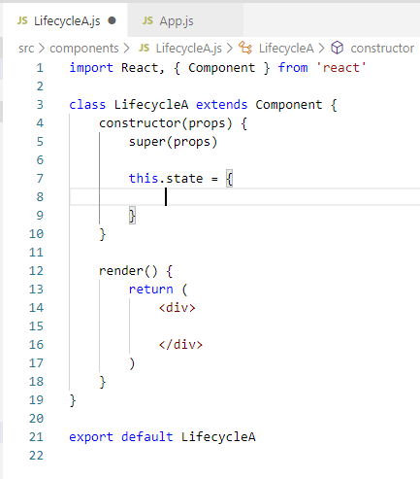
23.1 LifecycleA.js
https://www.youtube.com/watch?v=KDXZibVdiEI&list=PLC3y8-rFHvwgg3vaYJgHGnModB54rxOk3&index=23
Component Mounting Lifecycle Methods:
Create ./compoents/LifecycleA.js
Type ‘rce’ (React Class Component ES7)
Type ‘rconst’ (React Constructor)

Slide 18
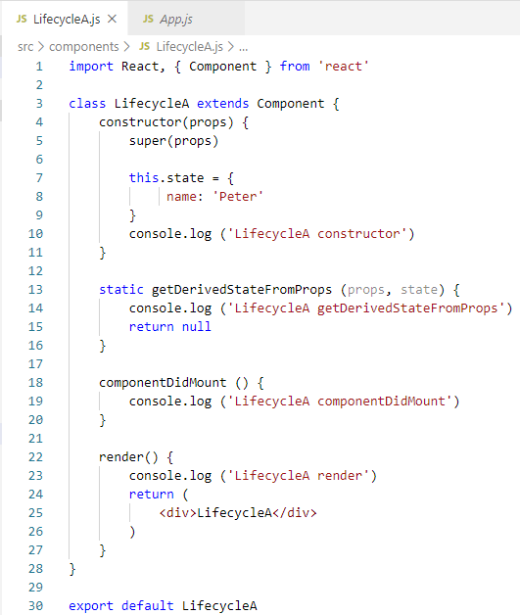
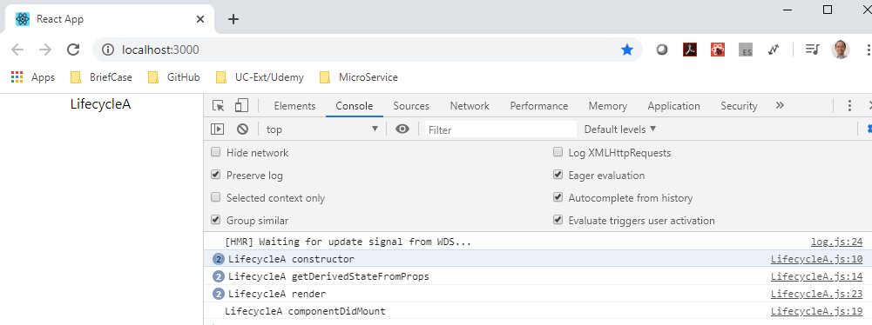
23.1 LifecycleA.js
https://www.youtube.com/watch?v=KDXZibVdiEI&list=PLC3y8-rFHvwgg3vaYJgHGnModB54rxOk3&index=23
Component Mounting Lifecycle Methods:
Create ./compoents/LifecycleA.js
Type ‘rce’ (React Class Component ES7)
Type ‘rconst’ (React Constructor)

Slide 19
23.2 LifecycleB.js

Slide 20
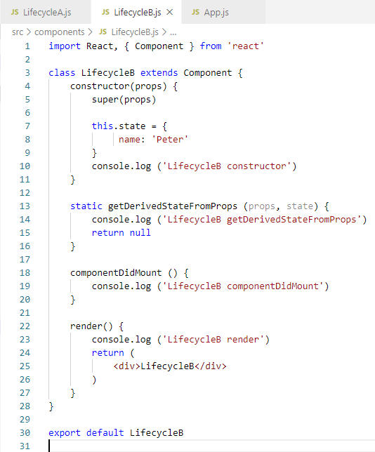
23.2 LifecycleB.js
https://www.youtube.com/watch?v=KDXZibVdiEI&list=PLC3y8-rFHvwgg3vaYJgHGnModB54rxOk3&index=23
Component Mounting Lifecycle Methods:
We have more than one child components: LifecycleA anf LifecycleB.
We create ‘components/LifecycleB.js’

Slide 21
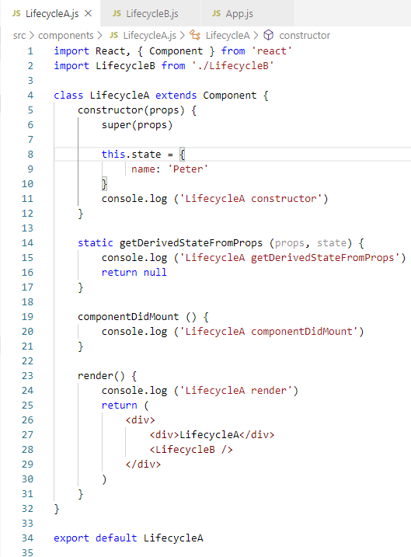
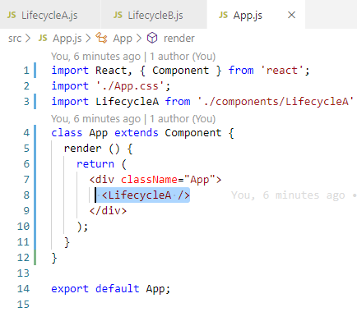
23.2 LifecycleB.js
https://www.youtube.com/watch?v=KDXZibVdiEI&list=PLC3y8-rFHvwgg3vaYJgHGnModB54rxOk3&index=23
Component Mounting Lifecycle Methods:
Include LifecycleB after LifecycleA.

Slide 22
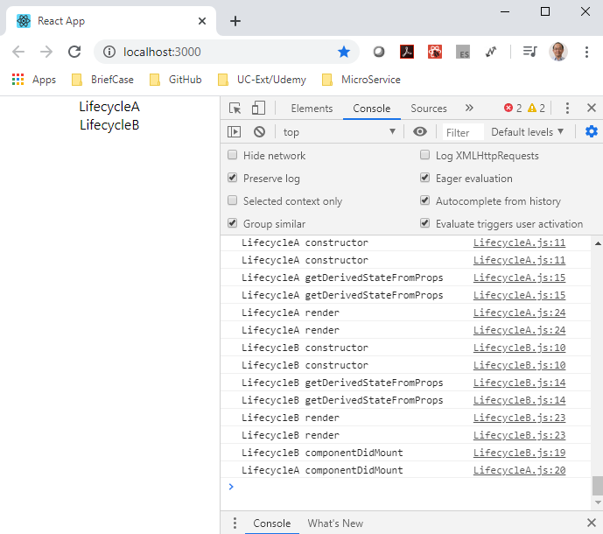
23.2 LifecycleB.js
https://www.youtube.com/watch?v=KDXZibVdiEI&list=PLC3y8-rFHvwgg3vaYJgHGnModB54rxOk3&index=23
Component Mounting Lifecycle Methods:
> npm start (Why the constructor and etc. called twice?)

Slide 23
End of Chapter

