Slide 1

24 Updating Lifecycle Methods
Peter H. Chen

Slide 2
24 Updating Lifecycle Methods
https://www.youtube.com/watch?v=DyPkojd1fas&list=PLC3y8-rFHvwgg3vaYJgHGnModB54rxOk3&index=24
Component Updating Lifecycle Methods:
When a component is being prerendered because of changes to either props state again.
We have total five methods but out of five, three are fall into the categories of rarely used methods.
We will discuss all five of them.
The first method is static getDerivedStateFromProps (props, state). It receives props and state as its parameter and has to return either null or an object that represents the updated.
Method is called every time a component is re-render and as we already discussed.
This method is used when the state depends on the props of the component.
You should not cause any side effects.
Updating Lifecycle Methods
static getDerivedStateFromProps (props, state)
Method is called every time a component is re-rendered
Set the state
Do not cause any side effects, e.g., HTTP requests.

Slide 3
24 Updating Lifecycle Methods
https://www.youtube.com/watch?v=DyPkojd1fas&list=PLC3y8-rFHvwgg3vaYJgHGnModB54rxOk3&index=24
Component Updating Lifecycle Methods:
The second method in the updating phase is shoudlCompoentUpdate() method. This method receives the updated props and state. The purpose of this method is clear from its name. It dictates (manage by force) if all of the components should be re-render or not.
By default, all class components will re-render whenever the props they receive or their state changes. This method can prevent that default behavior by returning false.
What you can do in this method is compare the existing props and state values with the nextProps and nextState and return true or false to let React know whether the component should updates or not.
So this method is basically for performance optimization.
What you should avoid is causing any side effects or calling
Updating Lifecycle Methods
static getDerivedStateFromProps (props, state)
Dictates if the component should re-render or not
shouldComponentUpdate(nextProps, nextState)
Performance optimization
Do not cause any side effects, e.g., HTTP requests.
Calling the setState method.

Slide 4
24 Updating Lifecycle Methods
https://www.youtube.com/watch?v=DyPkojd1fas&list=PLC3y8-rFHvwgg3vaYJgHGnModB54rxOk3&index=24
Component Updating Lifecycle Methods:
The third method is render()
The render() is the only required method.
The render() read props and state and return JSX which describes the UI.
Avoid changing the state or interacting with the DOM in the render method.
Updating Lifecycle Methods
static getDerivedStateFromProps (props, state)
shouldComponentUpdate(nextProps, nextState)
Only required method
render()
Read props and state and return JSX.
Do not change state or interact with DOM or make Ajax calls.

Slide 5
24 Updating Lifecycle Methods
https://www.youtube.com/watch?v=DyPkojd1fas&list=PLC3y8-rFHvwgg3vaYJgHGnModB54rxOk3&index=24
Component Updating Lifecycle Methods:
The fourth method is called getSnapshotBeforeUpdate().
This method accepts previous props and pervious state as its parameters.
Calls right before the changes from virtual DOM are to be reflected in the DOM.
This is again is the method that React documentation classifies as a rarely used method.
You would use this method to capture some information from the DOM, e.g., you can read the user’s scroll position and after update maintain that scroll position by performing some calculations.
Updating Lifecycle Methods
static getDerivedStateFromProps (props, state)
shouldComponentUpdate(nextProps, nextState)
Called right before the changes from the virtual DOM are to be reflected in the DOM.
render()
Capture some information from the DOM.
getSnapshotBeforeUpdate(prevProps, prevState)

Slide 6
24 Updating Lifecycle Methods
https://www.youtube.com/watch?v=DyPkojd1fas&list=PLC3y8-rFHvwgg3vaYJgHGnModB54rxOk3&index=24
Component Updating Lifecycle Methods:
This method will either return null or return a value.
The returned value will be passed as the third parameter to the next method.
The getSnapshotBeforeUpdate () used to read current DOM state and returns a value or not.
Updating Lifecycle Methods
static getDerivedStateFromProps (props, state)
shouldComponentUpdate(nextProps, nextState)
Called right before the changes from the virtual DOM are to be reflected in the DOM.
render()
Capture some information from the DOM.
getSnapshotBeforeUpdate(prevProps, prevState)
Method will either return null or return a value.
Returned value will be passed as the third parameter to the next method.

Slide 7
24 Updating Lifecycle Methods
https://www.youtube.com/watch?v=DyPkojd1fas&list=PLC3y8-rFHvwgg3vaYJgHGnModB54rxOk3&index=24
Component Updating Lifecycle Methods:
The final method in the update lifecycle is componentDidUpdate()
This method is called after the render is finished in the re-render cycles. This mean you can be sure that the component and all its sub components have properly rendered itself after the update.
Updating Lifecycle Methods
static getDerivedStateFromProps (props, state)
shouldComponentUpdate(nextProps, nextState)
render()
getSnapshotBeforeUpdate(prevProps, prevState)
Called after the render is finished in the re-render cycles
componentDidUpdate(prevProps, prevState, snapshot)

Slide 8
24 Updating Lifecycle Methods
https://www.youtube.com/watch?v=DyPkojd1fas&list=PLC3y8-rFHvwgg3vaYJgHGnModB54rxOk3&index=24
Component Updating Lifecycle Methods:
This method accepts three parameters: prevProps, prevState, and snapshot.
This method is guaranteed to be called once in each re-render.
What we can do is cause effects that is you can make Ajax calls but before making the call.
Updating Lifecycle Methods
static getDerivedStateFromProps (props, state)
shouldComponentUpdate(nextProps, nextState)
render()
getSnapshotBeforeUpdate(prevProps, prevState)
componentDidUpdate(prevProps, prevState, snapshot)
Called after the render is finished in the re-render cycles
Cause side effects.

Slide 9
24 Updating Lifecycle Methods
https://www.youtube.com/watch?v=DyPkojd1fas&list=PLC3y8-rFHvwgg3vaYJgHGnModB54rxOk3&index=24
Component Updating Lifecycle Methods:
You need to compare the previous props with the new props and decide whether to make the Ajax call or not.
If you are not comparing you are making unwanted requests which is not really a good idea.
So componentDidUpdate() called once after the component has re-rendered and suitable to me Ajax calls based on the previous and current props value.
Updating Lifecycle Methods
static getDerivedStateFromProps (props, state)
shouldComponentUpdate(nextProps, nextState)
render()
getSnapshotBeforeUpdate(prevProps, prevState)
componentDidUpdate(prevProps, prevState, snapshot)
Called after the render is finished in the re-render cycles
Cause side effects.

Slide 10
24 Updating Lifecycle Methods
https://www.youtube.com/watch?v=DyPkojd1fas&list=PLC3y8-rFHvwgg3vaYJgHGnModB54rxOk3&index=24
Component Updating Lifecycle Methods:
You need to compare the previous props with the new props and decide whether to make the Ajax call or not.
If you are not comparing you are making unwanted requests which is not really a good idea.
So componentDidUpdate() called once after the component has re-rendered and suitable to me Ajax calls based on the previous and current props value.
Updating Lifecycle Methods
static getDerivedStateFromProps (props, state)
shouldComponentUpdate(nextProps, nextState)
render()
getSnapshotBeforeUpdate(prevProps, prevState)
componentDidUpdate(prevProps, prevState, snapshot)
Called after the render is finished in the re-render cycles
Cause side effects.

Slide 11
24.1 Order of Execution
Peter H. Chen

Slide 12
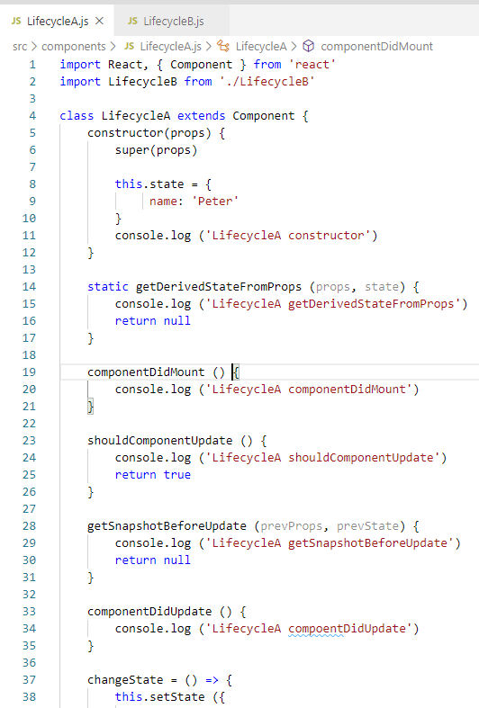
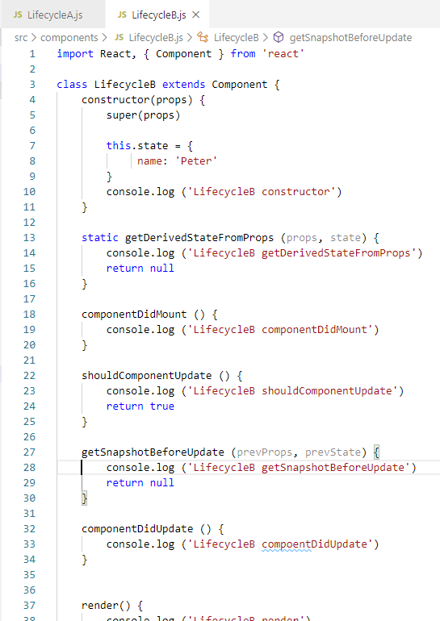
24.1 Order of Execution
https://www.youtube.com/watch?v=DyPkojd1fas&list=PLC3y8-rFHvwgg3vaYJgHGnModB54rxOk3&index=24
Component Updating Lifecycle Methods:
LifecycleA.js and LifecycleB.js

Slide 13
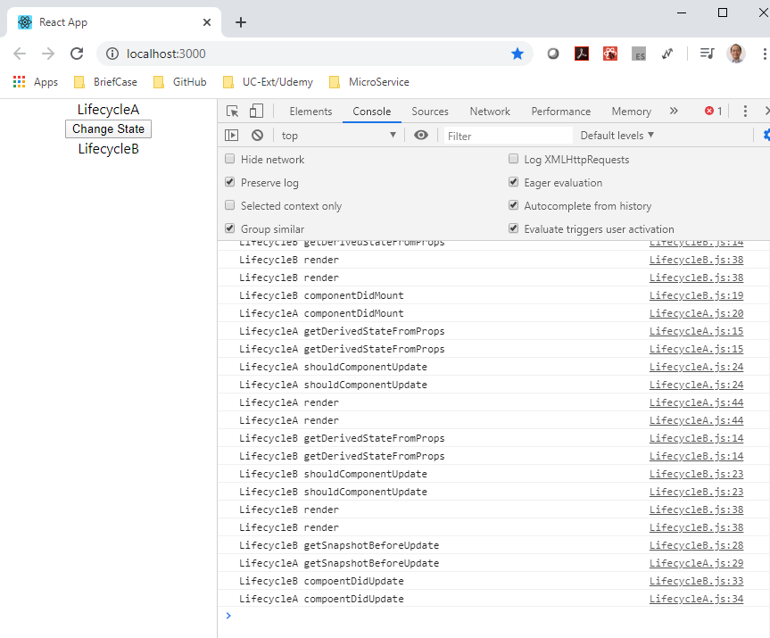
24.1 Order of Execution
https://www.youtube.com/watch?v=DyPkojd1fas&list=PLC3y8-rFHvwgg3vaYJgHGnModB54rxOk3&index=24
Component Updating Lifecycle Methods:
> npm start
Click Change state button, now the update life cycle methods are now logged.

Slide 14
24.1 Order of Execution
https://www.youtube.com/watch?v=DyPkojd1fas&list=PLC3y8-rFHvwgg3vaYJgHGnModB54rxOk3&index=24
Component Updating Lifecycle Methods:
render() and componentUpdate() are the more commonly used methods during the update lifecycle. Other methods are rarely used.

Slide 15
24.2 Unmounting Phase Method
Peter H. Chen

Slide 16
24.2 Unmounting Phase Method
https://www.youtube.com/watch?v=DyPkojd1fas&list=PLC3y8-rFHvwgg3vaYJgHGnModB54rxOk3&index=24
Unmounting Phase Method:
componentWillUnmount()
Method is invoked immediately before a component is unmounted and destroyed
Cancelling any network requests, requesting event handlers, cancelling any subscriptions and also invalidating timers.
Do not call the setState method.

Slide 17
24.3 Error Handling Phase Method
Peter H. Chen

Slide 18
24.3 Error Handling Phase Method
https://www.youtube.com/watch?v=DyPkojd1fas&list=PLC3y8-rFHvwgg3vaYJgHGnModB54rxOk3&index=24
Error Handling Phase Method:
Static getDerivedStateFromError (error)
componentDidCatch(error, info)
When there is an error either during rendering, in a lifecycle method, or in the constructor of any child component.

Slide 19
End of Chapter

