Slide 1

25 Fragment
Peter H. Chen

Slide 2
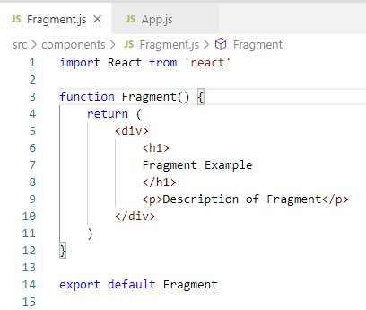
25 Fragment
https://www.youtube.com/watch?v=bHdh1T0-US4&list=PLC3y8-rFHvwgg3vaYJgHGnModB54rxOk3&index=25
Fragment:
We have the basic React practice.
We will focus on some special topic in the official React Documentation.
Fragment is a group of list of children elements without adding extra nodes to the DOM.
Create ./components/Fragment.js
Type ‘rfce’ (React Functional Component ES7) and add the <h1><p> in <div>.

Slide 3
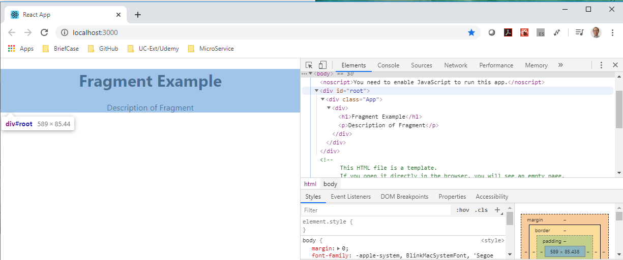
25 Fragment
https://www.youtube.com/watch?v=bHdh1T0-US4&list=PLC3y8-rFHvwgg3vaYJgHGnModB54rxOk3&index=25
Fragment:
> npm start
<Fn> + F12.
Inspect the element. You can see the <div> tag included in the DOM tree.

Slide 4
25.1 React.Fragment

Slide 5
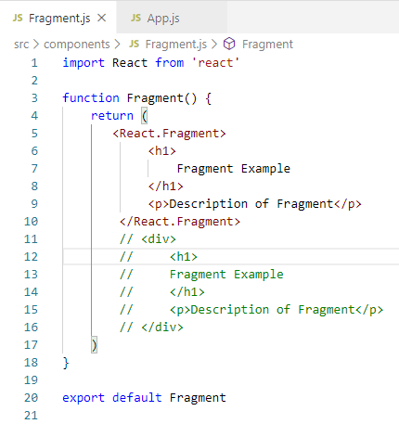
25.1 React.Fragment
https://www.youtube.com/watch?v=bHdh1T0-US4&list=PLC3y8-rFHvwgg3vaYJgHGnModB54rxOk3&index=25
Fragment:
Add <React.Fragment>.

Slide 6
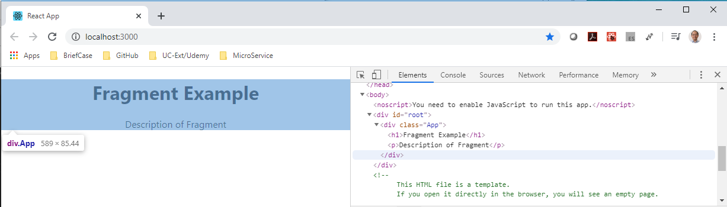
25.1 React.Fragment
https://www.youtube.com/watch?v=bHdh1T0-US4&list=PLC3y8-rFHvwgg3vaYJgHGnModB54rxOk3&index=25
Fragment:
Use <React.Fragment>, There is no longer have <div> tag between <App> tag and <h1>.

Slide 7
25.2 Table and Column

Slide 8
25.2 Table and Column
https://www.youtube.com/watch?v=bHdh1T0-US4&list=PLC3y8-rFHvwgg3vaYJgHGnModB54rxOk3&index=25
Fragment:
Create Table.js and Columns.js
Type ‘rfce’ (React Functional Component ES7).

Slide 9
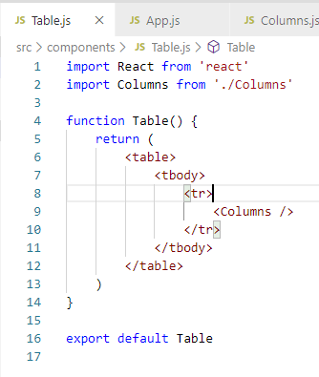
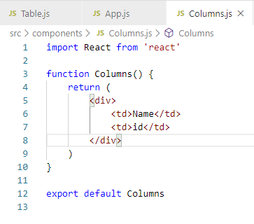
25.2 Table and Column
https://www.youtube.com/watch?v=bHdh1T0-US4&list=PLC3y8-rFHvwgg3vaYJgHGnModB54rxOk3&index=25
Fragment:
<table>
<tbody>
<tr>
<td>

Slide 10
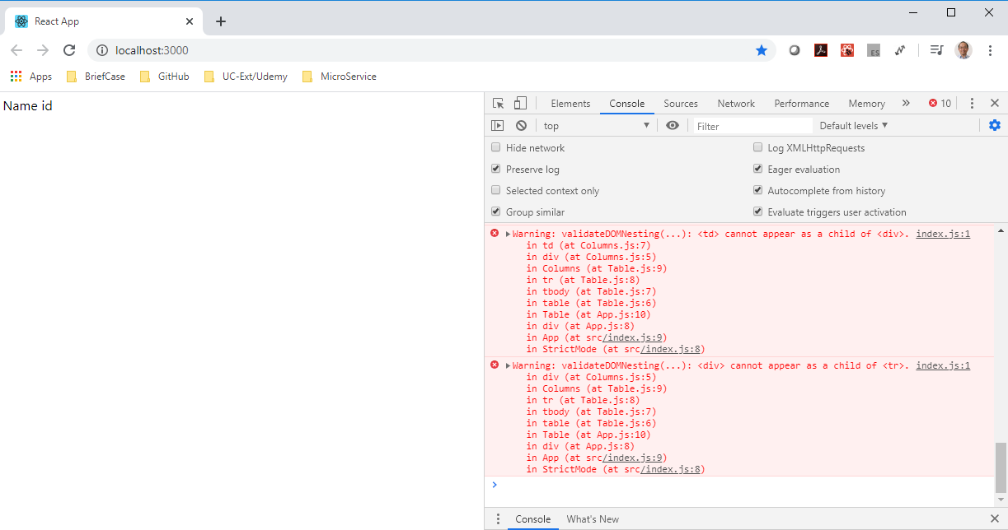
25.2 Table and Column
https://www.youtube.com/watch?v=bHdh1T0-US4&list=PLC3y8-rFHvwgg3vaYJgHGnModB54rxOk3&index=25
Fragment:
Look at the console Error: <td> cannot appear child of <div>.

Slide 11
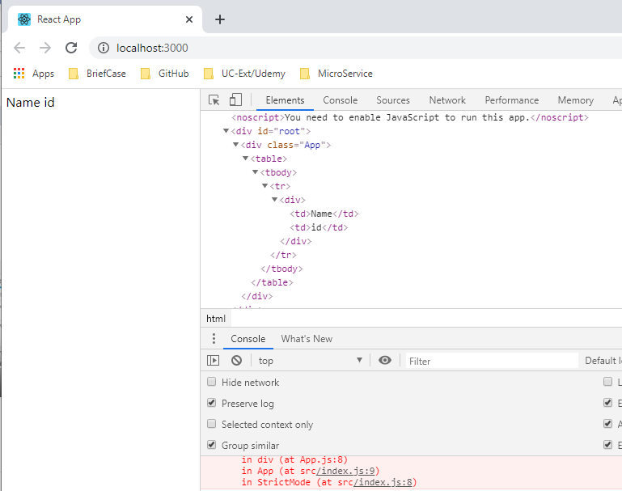
25.2 Table and Column
https://www.youtube.com/watch?v=bHdh1T0-US4&list=PLC3y8-rFHvwgg3vaYJgHGnModB54rxOk3&index=25
Fragment:
Inspect the element in the DOM tree. You can see the <td> ... </td> in the <div> tag.
It is wrong to place the <td> as the child of the <div> tag. Replace the <div> tag with <React.Fragment>

Slide 12
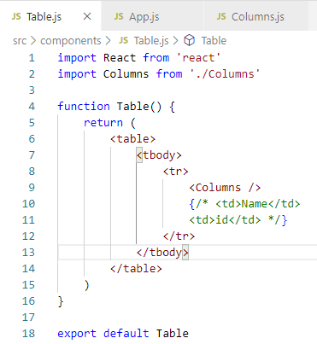
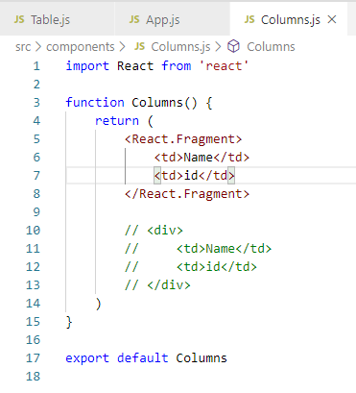
25.2 Table and Column
https://www.youtube.com/watch?v=bHdh1T0-US4&list=PLC3y8-rFHvwgg3vaYJgHGnModB54rxOk3&index=25
Fragment:
Inspect the element in the DOM tree. You can see the <td> ... </td> in the <div> tag.
It is wrong to place the <td> as the child of the <div> tag. Replace the <div> tag with <React.Fragment>

Slide 13
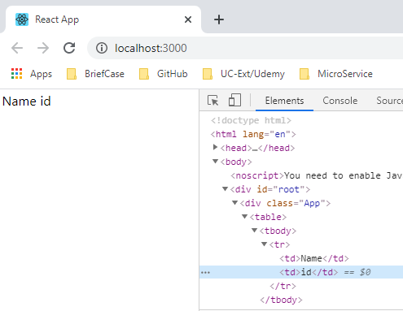
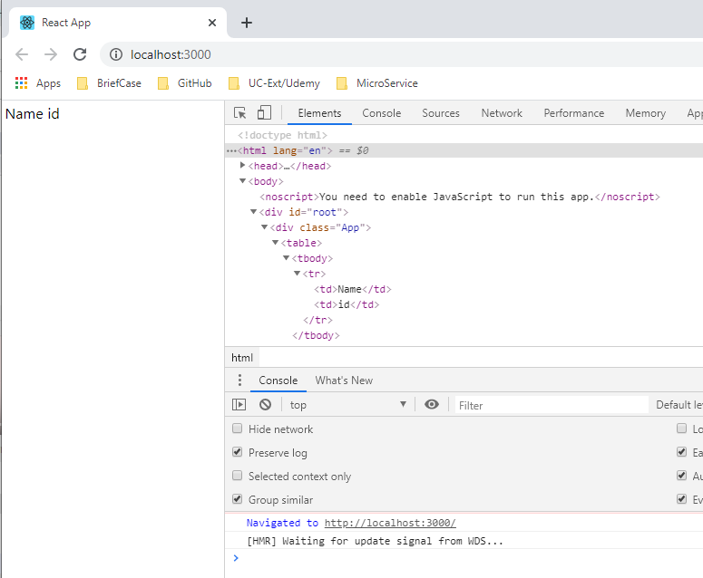
25.2 Table and Column
https://www.youtube.com/watch?v=bHdh1T0-US4&list=PLC3y8-rFHvwgg3vaYJgHGnModB54rxOk3&index=25
Fragment:
Click “Inspect” Element and select element “id”.
The <div> is removed and <td> is inside the <tr>. The error message is gone.

Slide 14
25.3 Fragment/Map Function

Slide 15
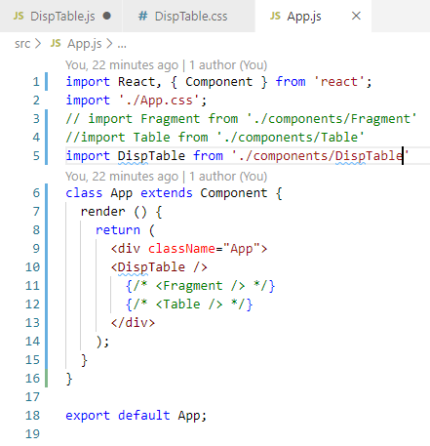
25.3 Fragment/Map Function
https://dev.to/abdulbasit313/an-easy-way-to-create-a-customize-dynamic-table-in-react-js-3igg
Dynamic Display React Table:
https://dev.to/abdulbasit313/an-easy-way-to-create-a-customize-dynamic-table-in-react-js-3igg

Slide 16
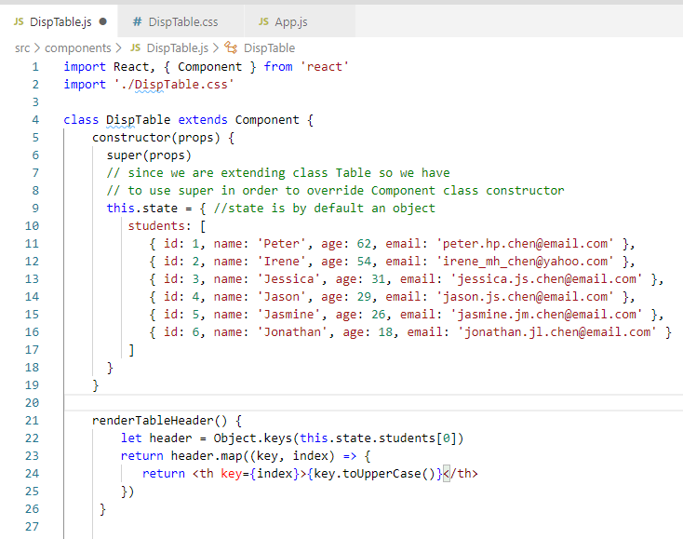
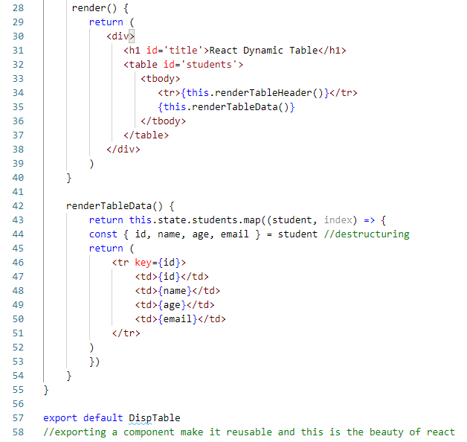
25.3 Fragment/Map Function
https://dev.to/abdulbasit313/an-easy-way-to-create-a-customize-dynamic-table-in-react-js-3igg
Dynamic Display React Table:
https://dev.to/abdulbasit313/an-easy-way-to-create-a-customize-dynamic-table-in-react-js-3igg

Slide 17
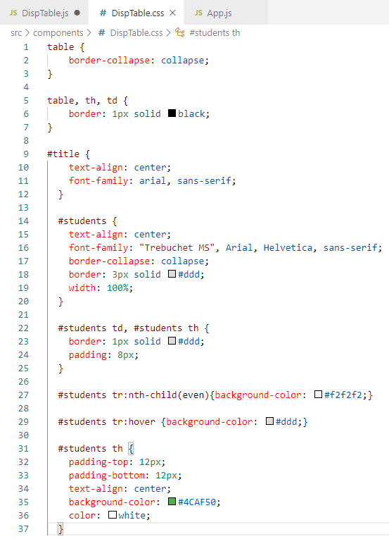
25.3 Fragment/Map Function
https://dev.to/abdulbasit313/an-easy-way-to-create-a-customize-dynamic-table-in-react-js-3igg
Dynamic Display React Table:
DispTable.css

Slide 18
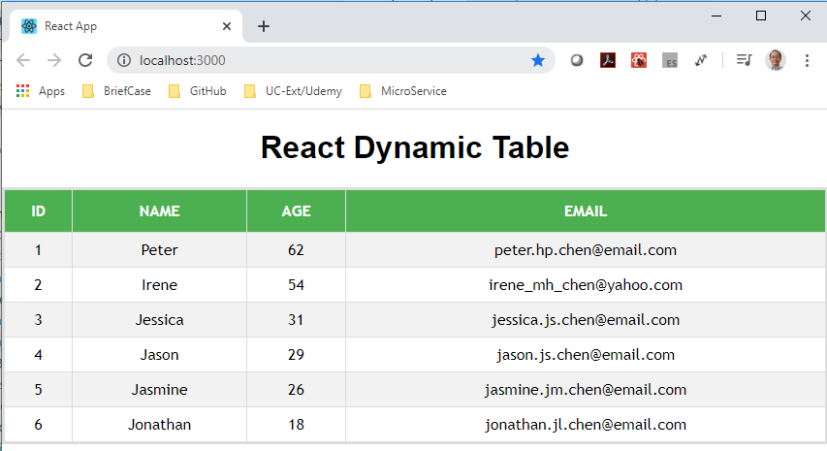
25.3 Fragment/Map Function
https://dev.to/abdulbasit313/an-easy-way-to-create-a-customize-dynamic-table-in-react-js-3igg
Display a Simple Table:
https://dev.to/abdulbasit313/an-easy-way-to-create-a-customize-dynamic-table-in-react-js-3igg

Slide 19
End of Chapter

