Slide 1

26 Pure Component
Peter H. Chen

Slide 2
26 Pure Component
https://www.youtube.com/watch?v=YCRuTT31qR0&list=PLC3y8-rFHvwgg3vaYJgHGnModB54rxOk3&index=26
Pure Component
Create ./components/PureComp.js for pure component.
Create ./components/RegComp.js for regular component.
Creare ./components/ParentComp.js for parent component.
Type ‘rpce’ (React Pure Component ES7)
We import { PureComponent } from ‘react’
What is the difference of Pure Component and Class Component?

Slide 3
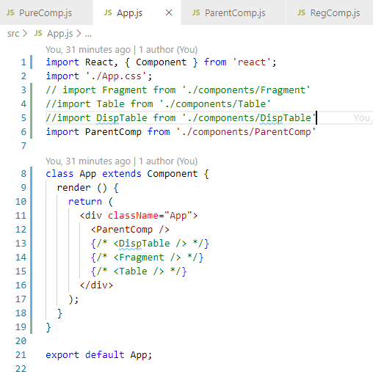
26 Pure Component
https://www.youtube.com/watch?v=YCRuTT31qR0&list=PLC3y8-rFHvwgg3vaYJgHGnModB54rxOk3&index=26
Pure Component
App.js

Slide 4
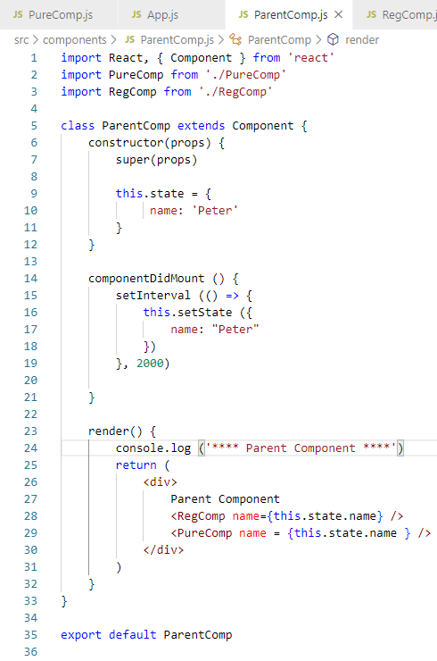
26 Pure Component
https://www.youtube.com/watch?v=YCRuTT31qR0&list=PLC3y8-rFHvwgg3vaYJgHGnModB54rxOk3&index=26
Pure Component
ParentComp.js

Slide 5
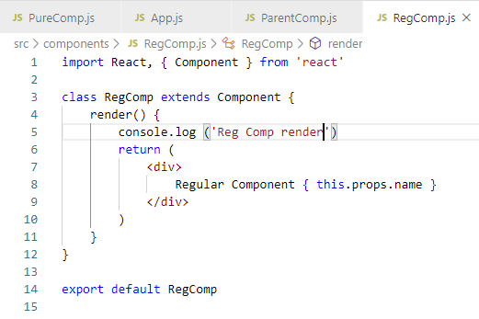
26 Pure Component
https://www.youtube.com/watch?v=YCRuTT31qR0&list=PLC3y8-rFHvwgg3vaYJgHGnModB54rxOk3&index=26
Pure Component
RegComp.js

Slide 6
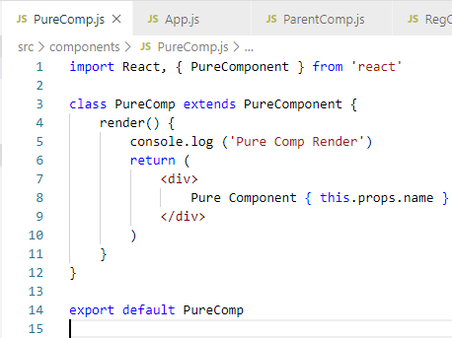
26 Pure Component
https://www.youtube.com/watch?v=YCRuTT31qR0&list=PLC3y8-rFHvwgg3vaYJgHGnModB54rxOk3&index=26
Pure Component
PureComp.js

Slide 7
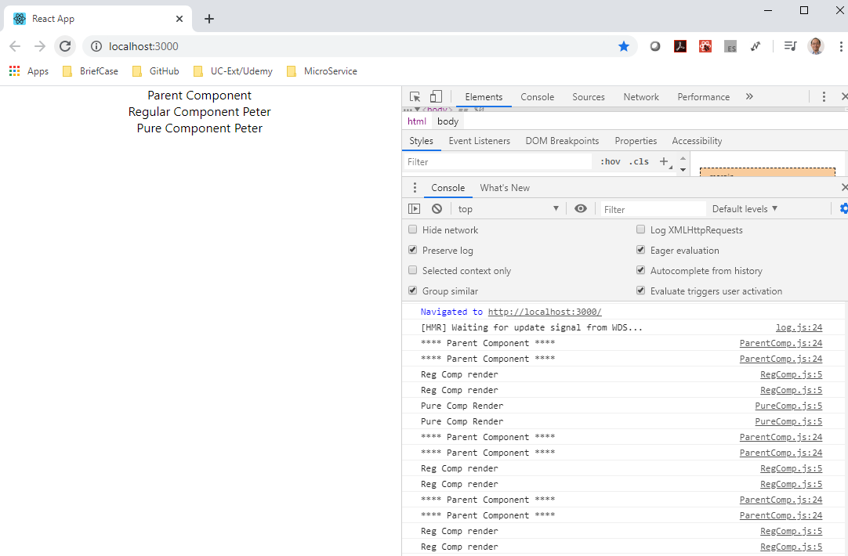
26 Pure Component
https://www.youtube.com/watch?v=YCRuTT31qR0&list=PLC3y8-rFHvwgg3vaYJgHGnModB54rxOk3&index=26
Pure Component
SetInterval is for Regular component, not for Pure Component.

Slide 8
26.1 Pure vs. Regular Component

Slide 9
26.1 Pure vs. Regular Component
https://www.youtube.com/watch?v=YCRuTT31qR0&list=PLC3y8-rFHvwgg3vaYJgHGnModB54rxOk3&index=26
Pure Component
Regular Component
A regular component does not implement the shouldComponentUpdate method.
It always returns true by default.
Pure Component
A regular component, on the other hand, implement the shouldComponentUpdate method
with a shallow props and state comparison.

Slide 10
26.1 Pure vs. Regular Component
https://www.youtube.com/watch?v=YCRuTT31qR0&list=PLC3y8-rFHvwgg3vaYJgHGnModB54rxOk3&index=26
Shallow Comparison (SC):
Primitive Types
For two primitive types a and b in numbers, strings, and Boolean.
a (SC) b returns true if a and b have the same value and are of the same type.
e.g., string ‘Peter’ (SC) string ‘Peter’ return true
Complex Types
For two complex types a and b in numbers, strings, and Boolean.
a (SC) b returns true if a and b reference the exact object.
e.g.,
var a = [1, 2, 3];
var b = [1, 2, 3];
var c = a;
var ab_eq = (a === b); // false
var ac_eq = (a === c); // true
e.g.,
var a = { x:1, y: 2 };
var b = { x:1, y: 2 };
var c = a;
var ab_eq = (a === b); // false
var ac_eq = (a === c); // true

Slide 11
26.1 Pure vs. Regular Component
https://www.youtube.com/watch?v=YCRuTT31qR0&list=PLC3y8-rFHvwgg3vaYJgHGnModB54rxOk3&index=26
Pure Component
A pure component implement shouldComponentUpdate with a shallow porp and state comparison.
Difference?
SC of prevState with currentState
SC of prevProps with currentProps
Re-render component

Slide 12
26.2 Summary of Pure Component

Slide 13
26.2 Summary of Pure Component
https://www.youtube.com/watch?v=YCRuTT31qR0&list=PLC3y8-rFHvwgg3vaYJgHGnModB54rxOk3&index=26
Summary of Pure Component
We can create a component by extending the PureCompoent class.
A PureComponent implements the shouldComponentUpdate lifecycle method by performing a shallow comparison on the props and state of the component.
If there is no difference, the component is not re-rendered- Performance boost.
It is a good idea to ensure that all the children components are also pure to avoid unexpected behavior.
Never mutate the state. Always return a new object that reflects the new state.
It is safe to use regular components most of the time unless you have a performance need in some components.

Slide 14
End of Chapter

