Slide 1

28 Refs
Peter H. Chen

Slide 2
28 Refs
https://www.youtube.com/watch?v=FXa9mMTKOu8&index=28&list=PLC3y8-rFHvwgg3vaYJgHGnModB54rxOk3
This section discussed the concepts of Refs in React.
Refs make it possible to access the DOM node directly with React.
For understanding, we take a look at one of common use cases which is focusing a text input.
For example, we have a login form. As soon as the page is loaded. Let’s say, by default, we want the user name input field to be focused.
Let’s see how to achieve that with refs.

Slide 3
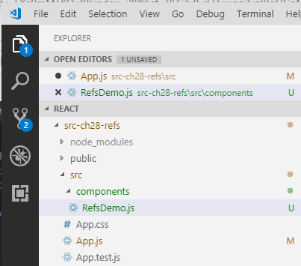
28 Refs
https://www.youtube.com/watch?v=FXa9mMTKOu8&index=28&list=PLC3y8-rFHvwgg3vaYJgHGnModB54rxOk3
We create a new file called Components/RefsDemo.js

Slide 4
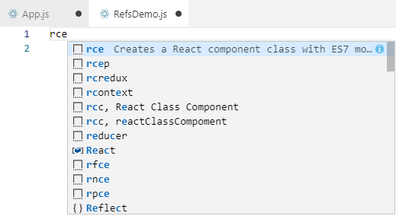
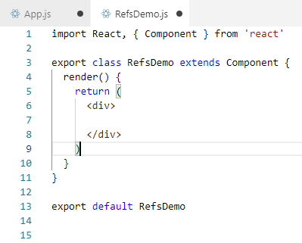
28 Refs
https://www.youtube.com/watch?v=FXa9mMTKOu8&index=28&list=PLC3y8-rFHvwgg3vaYJgHGnModB54rxOk3
Within the RefsDemo.js, use rce (React Create component with ES7)

Slide 5
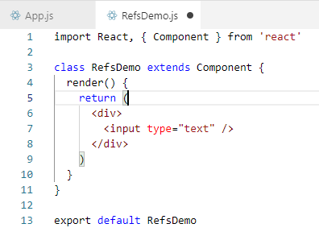
28 Refs
https://www.youtube.com/watch?v=FXa9mMTKOu8&index=28&list=PLC3y8-rFHvwgg3vaYJgHGnModB54rxOk3
We are going to add the input element.
Remove the export of the component and export default Module RefsDemo.

Slide 6
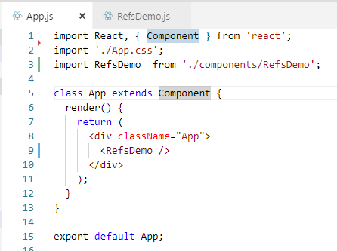
28 Refs
https://www.youtube.com/watch?v=FXa9mMTKOu8&index=28&list=PLC3y8-rFHvwgg3vaYJgHGnModB54rxOk3
Then import the component RefsDemo at App Component.

Slide 7
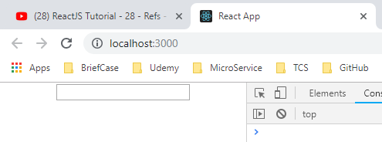
28 Refs
https://www.youtube.com/watch?v=FXa9mMTKOu8&index=28&list=PLC3y8-rFHvwgg3vaYJgHGnModB54rxOk3
> npm start
Refresh browser. We have the input text field display.

Slide 8
28 Refs
https://www.youtube.com/watch?v=FXa9mMTKOu8&index=28&list=PLC3y8-rFHvwgg3vaYJgHGnModB54rxOk3
We want to achieve this input text field be focused as soon as the input test field is displayed.
Using Refs, we can do this in three simple steps.

Slide 9
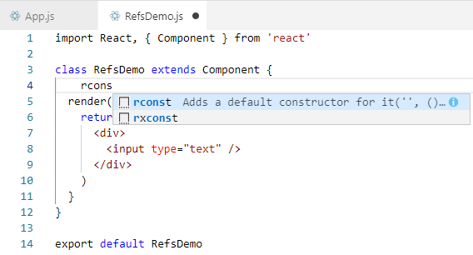
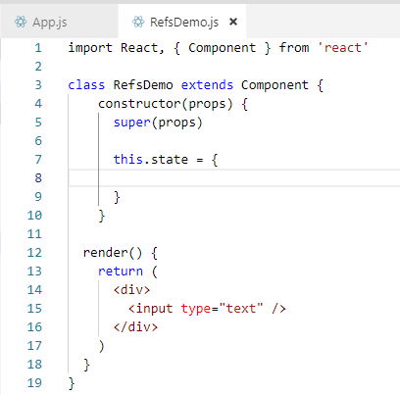
28 Refs
https://www.youtube.com/watch?v=FXa9mMTKOu8&index=28&list=PLC3y8-rFHvwgg3vaYJgHGnModB54rxOk3
The First Step is to create a refs. We do that using create ref method.
Create a constructor by “rcons” (React Constructor)

Slide 10
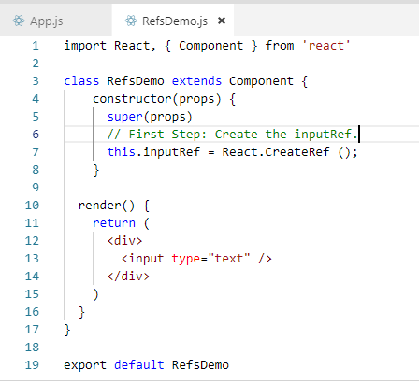
28 Refs
https://www.youtube.com/watch?v=FXa9mMTKOu8&index=28&list=PLC3y8-rFHvwgg3vaYJgHGnModB54rxOk3
We create a property this.inputRef.
We assign this.inputRef = CreateRef ();
It is common to create refs in the constructor so that they can be referenced throughout the component.

Slide 11
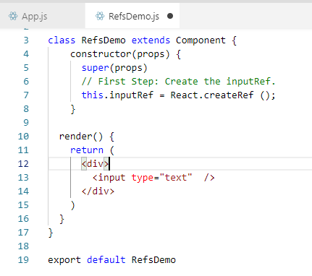
28 Refs
https://www.youtube.com/watch?v=FXa9mMTKOu8&index=28&list=PLC3y8-rFHvwgg3vaYJgHGnModB54rxOk3
The Second Step is to attach this ref to our input element in the render method.
To attach ref, we make use the of the reserved of attribute.
So in the input element, ref is equal to within the curly braces the ref we have created which is this.inputRef.
Now, we have the reference to the input element.

Slide 12
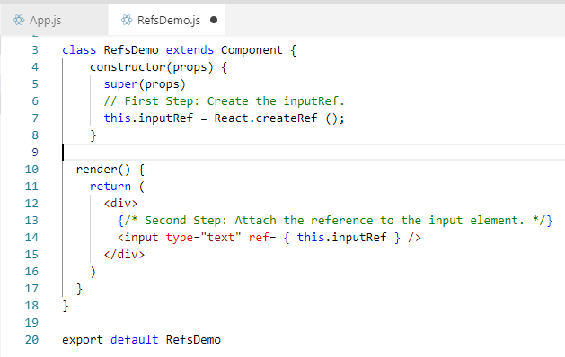
28 Refs
https://www.youtube.com/watch?v=FXa9mMTKOu8&index=28&list=PLC3y8-rFHvwgg3vaYJgHGnModB54rxOk3
The Second Step is to attach this ref to our input element in the render method.
To attach ref, we make use the of the reserved of attribute.
So in the input element, ref is equal to within the curly braces the ref we have created which is this.inputRef.
Now, we have the reference to the input element.

Slide 13
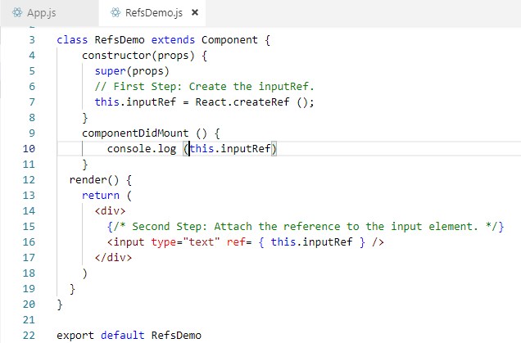
28 Refs
https://www.youtube.com/watch?v=FXa9mMTKOu8&index=28&list=PLC3y8-rFHvwgg3vaYJgHGnModB54rxOk3
The Third Step (and the Final Step), is to call the focus method on this input element.
But First, let’s find out what exactly does the property this.inputRef hold after a reference is created.
We are going to add the componentDidMount LifeCycle hook. Within the hook, we will simple console.log (this.inputRef).

Slide 14
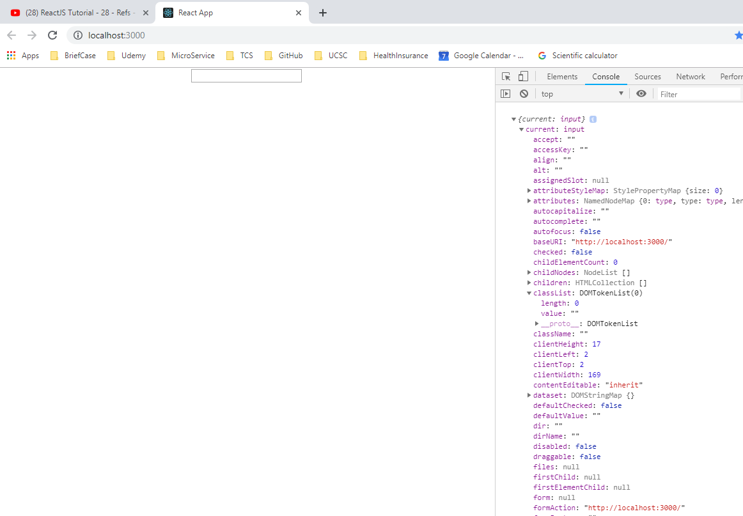
28 Refs
https://www.youtube.com/watch?v=FXa9mMTKOu8&index=28&list=PLC3y8-rFHvwgg3vaYJgHGnModB54rxOk3
Refresh browser.
Check with property called current of type input and this current property point to actual DOM node. So the focus on the input element in componentDidMount, we simple call the focus method on the current property.

Slide 15
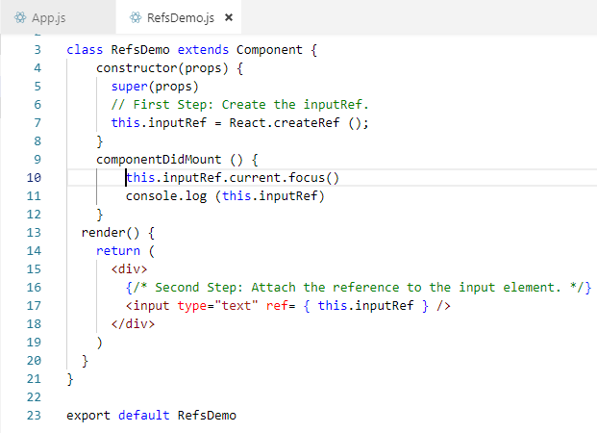
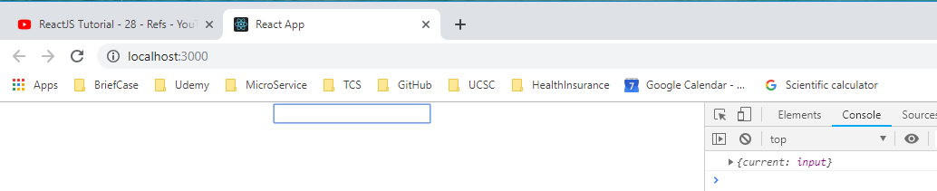
28 Refs
https://www.youtube.com/watch?v=FXa9mMTKOu8&index=28&list=PLC3y8-rFHvwgg3vaYJgHGnModB54rxOk3
Go back to the componentDidMount().
Add call this.inputRef.current.focus().
Refresh the browser.
You can see the input element has the focus.

Slide 16
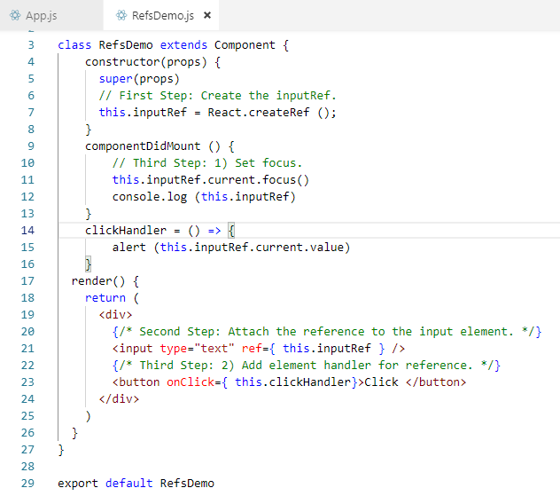
28 Refs
https://www.youtube.com/watch?v=FXa9mMTKOu8&index=28&list=PLC3y8-rFHvwgg3vaYJgHGnModB54rxOk3
This is the refs used in the input field.
The second use of refs is to fetch the input value.
Go back the input text and create a button with a text click and a click event handler on click.
It is equal to this.clickhandler.

Slide 17
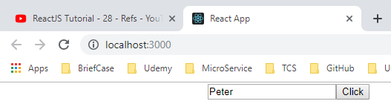
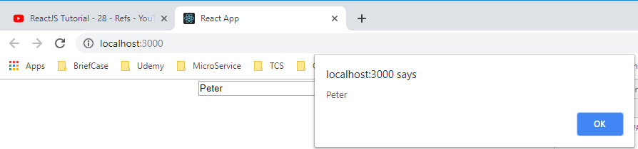
28 Refs
https://www.youtube.com/watch?v=FXa9mMTKOu8&index=28&list=PLC3y8-rFHvwgg3vaYJgHGnModB54rxOk3
Refresh the browser
Enter text and click OK.

Slide 18
28 Refs
https://www.youtube.com/watch?v=FXa9mMTKOu8&index=28&list=PLC3y8-rFHvwgg3vaYJgHGnModB54rxOk3
This is to use createRef () to create Refs.
React also support the second way to set refs which is called the callback refs.

Slide 19
End of Chapter

