Slide 1

34 Higher Order Components 2
Peter H. Chen

Slide 2
34 Higher Order Components 2
https://www.youtube.com/watch?v=rsBQj6X7UK8&list=PLC3y8-rFHvwgg3vaYJgHGnModB54rxOk3&index=34
Why Higher Order Components?
To share the common functionality between components
The Higher Order Components (HOC) is a pattern where a function takes a component as an argument and returns a new component.
In simple code, it will look something like this:
const NewCompoent = highOrderComponent (originalComponent)
const EnhanceCompoent = highOrderComponent (originalComponent)
From a non-technical point of view, we have Iron Main = With Suite (Passing Tony Stark as the passing parameter).
We have Iron Man as an enhanced component of Tony Stark.
const IronMan = withSuit (TonyStark)

Slide 3
34.1 Share the Name

Slide 4
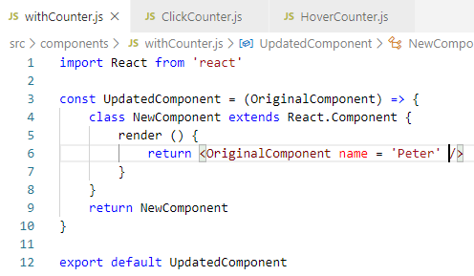
34.1 Share the Name
https://www.youtube.com/watch?v=rsBQj6X7UK8&list=PLC3y8-rFHvwgg3vaYJgHGnModB54rxOk3&index=34
HOC Code: Share the Name for Click and Hover Counter
Create ./component/WithCounter.js
The arrow function passed in the OrignalCompoent.
The NewCompoent is defined as return the OrginalComponent with the arrow function.

Slide 5
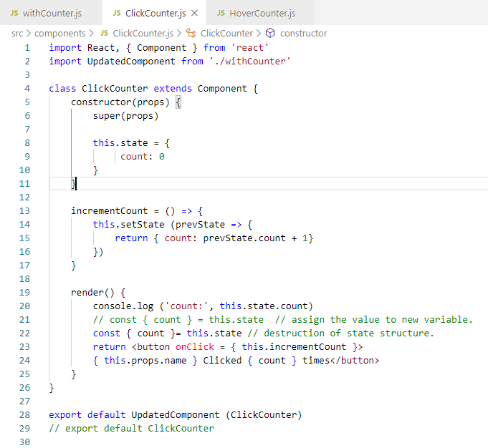
34.1 Share the Name
https://www.youtube.com/watch?v=rsBQj6X7UK8&list=PLC3y8-rFHvwgg3vaYJgHGnModB54rxOk3&index=34
HOC Code: Share the Name for Click and Hover Counter
Now, we apply this pattern to our clickCounter and HoverCounter.
In ClickCounter, we import UpdatedComponent from ‘./withCounter’
We get parameter { this.props.name}

Slide 6
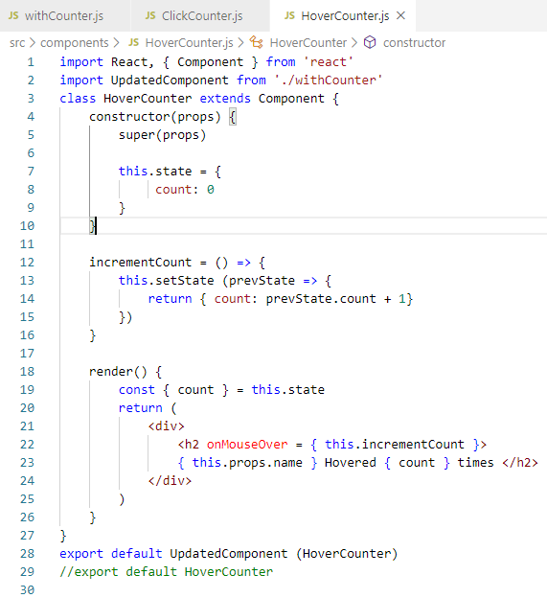
34.1 Share the Name
https://www.youtube.com/watch?v=rsBQj6X7UK8&list=PLC3y8-rFHvwgg3vaYJgHGnModB54rxOk3&index=34
HOC Code: Share the Name for Click and Hover Counter
Now, we apply this pattern to our clickCounter and HoverCounter.
In ClickCounter, we import UpdatedComponent from ‘./withCounter’
We get parameter { this.props.name}

Slide 7
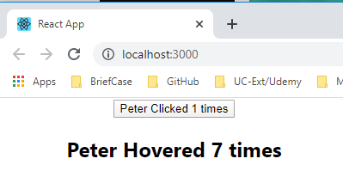
34.1 Share the Name
https://www.youtube.com/watch?v=rsBQj6X7UK8&list=PLC3y8-rFHvwgg3vaYJgHGnModB54rxOk3&index=34
HOC Code: Share the Name for Click and Hover Counter
> npm start

Slide 8
34.2 Share the Counter

Slide 9
34.2 Share the Counter
https://www.youtube.com/watch?v=rsBQj6X7UK8&list=PLC3y8-rFHvwgg3vaYJgHGnModB54rxOk3&index=34
Share the Counter
We have share the name for both click component and hover component.
Now, we want to share the counter for click component and hover component.
Copy the constructor and increment function from the clickCounter.
These functions will be shared with ClickCounter and HoverCounter. These are the common functionalities we want to share.
We will remove constructor and increment code from clickCounter and HoverCounter.

Slide 10
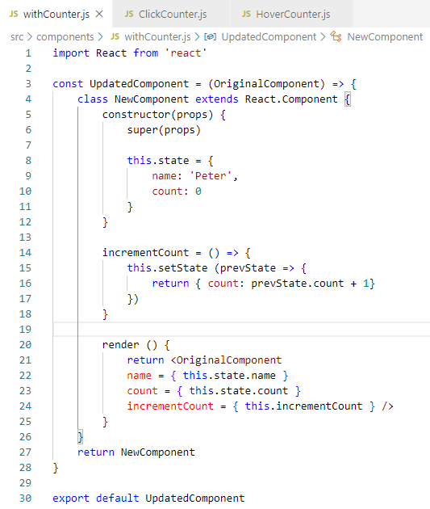
34.2 Share the Counter
https://www.youtube.com/watch?v=rsBQj6X7UK8&list=PLC3y8-rFHvwgg3vaYJgHGnModB54rxOk3&index=34
Share the Counter
withCounter.js: Share constructor and incrementCount.
Redner name, count, and incrementCount.

Slide 11
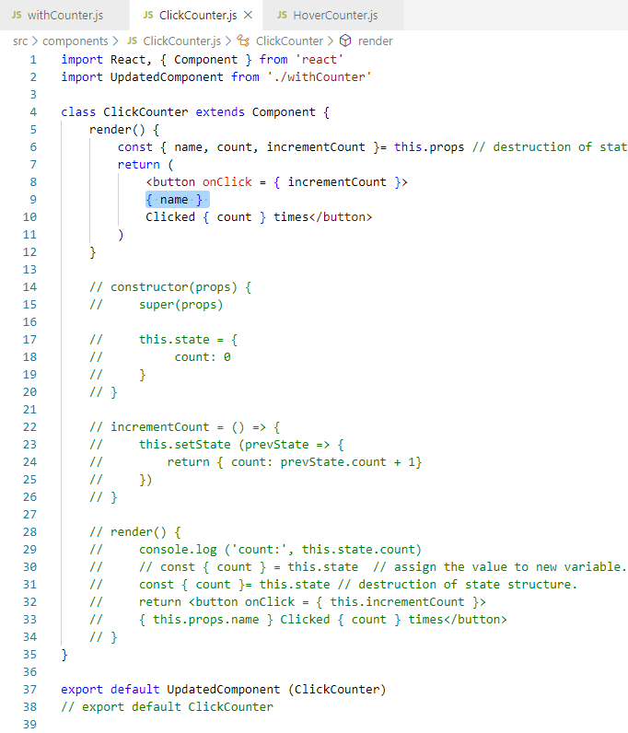
34.2 Share the Counter
https://www.youtube.com/watch?v=rsBQj6X7UK8&list=PLC3y8-rFHvwgg3vaYJgHGnModB54rxOk3&index=34
Share the Counter
clickCounter.js: render function destruct this.props and get incrementCount, name, and count.

Slide 12
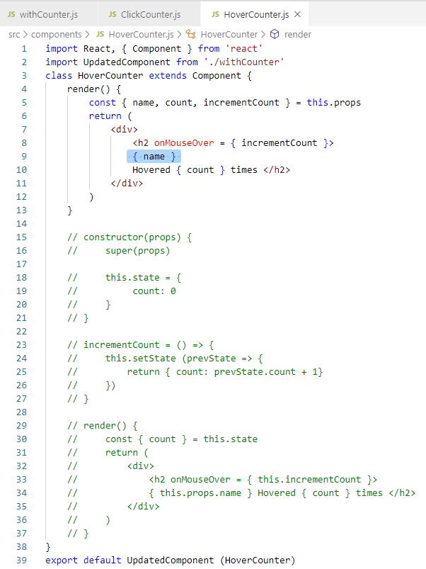
34.2 Share the Counter
https://www.youtube.com/watch?v=rsBQj6X7UK8&list=PLC3y8-rFHvwgg3vaYJgHGnModB54rxOk3&index=34
Share the Counter
hoverCounter.js: render function destruct this.props and get incrementCount, name, and count.

Slide 13
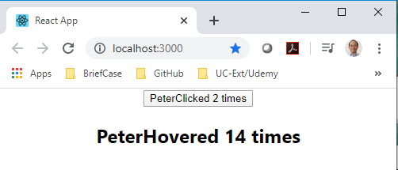
34.2 Share the Counter
https://www.youtube.com/watch?v=rsBQj6X7UK8&list=PLC3y8-rFHvwgg3vaYJgHGnModB54rxOk3&index=34
Share the Counter
> npm start
The counter is working again.
The difference is that we are using the share code instead of separate code in each clickCounter and hoverCounter.

Slide 14
34.3 Summary of HOC

Slide 15
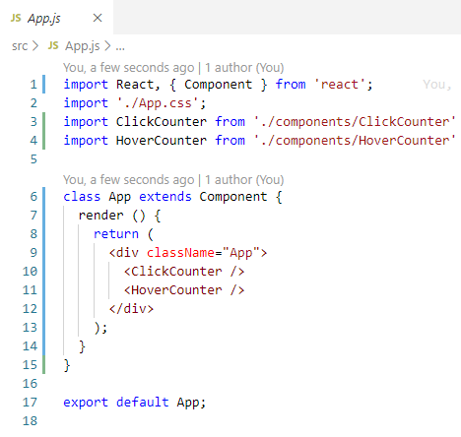
34.3 Summary of HOC
https://www.youtube.com/watch?v=rsBQj6X7UK8&list=PLC3y8-rFHvwgg3vaYJgHGnModB54rxOk3&index=34
Summary of HOC:
At top, we have ClickCounter and HoverCounter Components.

Slide 16
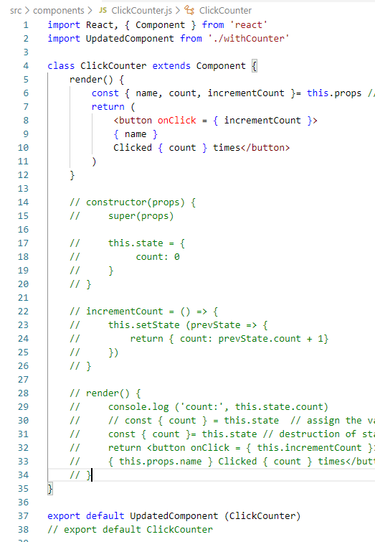
34.3 Summary of HOC
https://www.youtube.com/watch?v=rsBQj6X7UK8&list=PLC3y8-rFHvwgg3vaYJgHGnModB54rxOk3&index=34
Summary of HOC:
ClickCounter: export HOC.
export UpdatedComponent (ClickCounter)

Slide 17
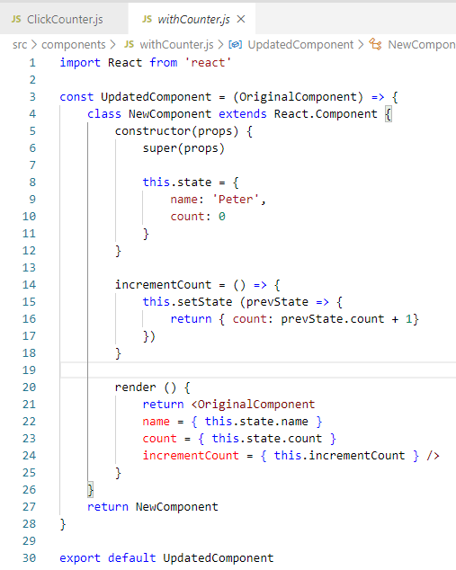
34.3 Summary of HOC
https://www.youtube.com/watch?v=rsBQj6X7UK8&list=PLC3y8-rFHvwgg3vaYJgHGnModB54rxOk3&index=34
Summary of HOC:
withCounter: Pass in the OrginalCompoent and return NewComponent.
The withCounter maintain the state by constructor and incrementCount.
The parameters are passed the render function and passed to the props (parameters) of OriginalComponent and then return to NewComponent.

Slide 18
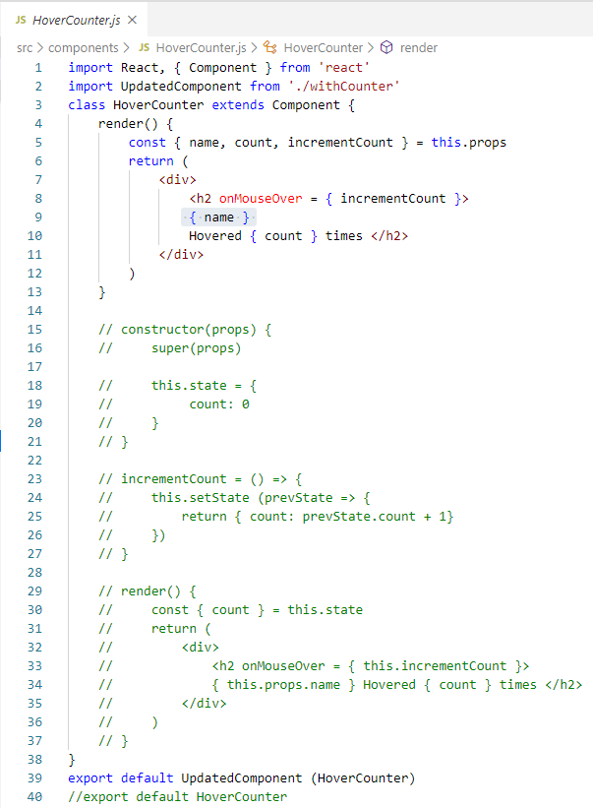
34.3 Summary of HOC
https://www.youtube.com/watch?v=rsBQj6X7UK8&list=PLC3y8-rFHvwgg3vaYJgHGnModB54rxOk3&index=34
Summary of HOC:
hoverCounter: The same execution flow also happen for the hoverCounter.

Slide 19
End of Chapter

