Slide 1

39 Context 2
Peter H. Chen

Slide 2
39 Context 2
https://www.youtube.com/watch?v=lTjQjWemKgE&list=PLC3y8-rFHvwgg3vaYJgHGnModB54rxOk3&index=39
React Context
The context (con: together, text: weave) means connect together .
Context provides a way to pass data through the component tree without having to pass props down manually at every level.
AppComponent
username
username
username
username
A
B
C
username
username
D
E
username
F

Slide 3
39 Context 2
https://www.youtube.com/watch?v=lTjQjWemKgE&list=PLC3y8-rFHvwgg3vaYJgHGnModB54rxOk3&index=39
React Context
In this discussion, we will implement a user context which will enable every level to read a prop that is passed at the top level.
We will consider the rightmost part of the component tree that is compoents, C, E, and F.
We will pass username value from AppComponent and read that value in component F using context.
AppComponent
username
username
A
B
C
username
D
E
username
F

Slide 4
39.1 Create Component Tree

Slide 5
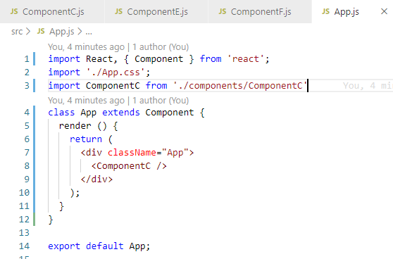
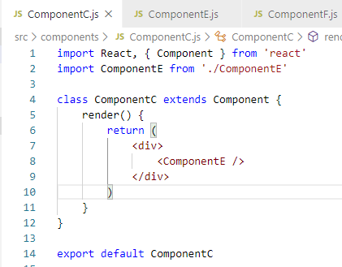
39.1 React Context 2
https://www.youtube.com/watch?v=lTjQjWemKgE&list=PLC3y8-rFHvwgg3vaYJgHGnModB54rxOk3&index=39
Component Tree:
Create ComponentC.js, CompoentE.js, and ComponentF.js.
In App.js, we have ComponentC. In ComponentC, we have Component E.

Slide 6
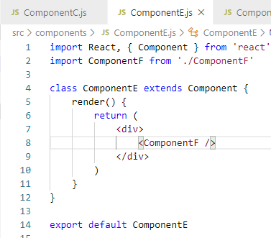
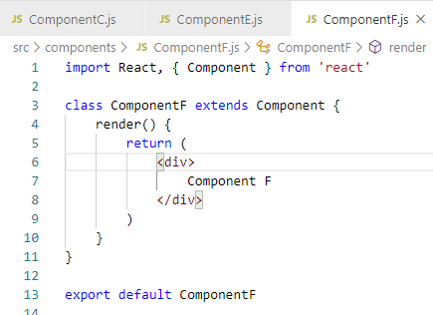
39.1 React Context 2
https://www.youtube.com/watch?v=lTjQjWemKgE&list=PLC3y8-rFHvwgg3vaYJgHGnModB54rxOk3&index=39
Component Tree:
In ComponentE, we have ComponentF.
In ComponentF, we display Component F.

Slide 7
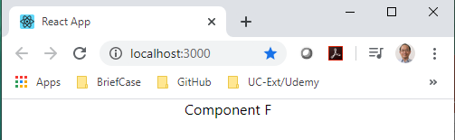
39.1 React Context 2
https://www.youtube.com/watch?v=lTjQjWemKgE&list=PLC3y8-rFHvwgg3vaYJgHGnModB54rxOk3&index=39
Component Tree:
> npm start
AppComponent
username
username
C
username
E
username
F

Slide 8
39.1 React Context 2
https://www.youtube.com/watch?v=lTjQjWemKgE&list=PLC3y8-rFHvwgg3vaYJgHGnModB54rxOk3&index=39
Component Tree:
Now, how to pass data from App Component to ComponentF using context.
There are three steps to implement when making use of context.
Create the context.
Provide a context value.
Consume the context value in the necessary component.
AppComponent
username
username
C
username
E
username
F

Slide 9
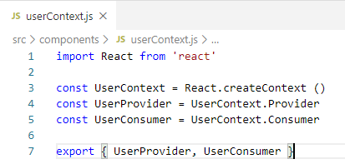
39.1 React Context 2
https://www.youtube.com/watch?v=lTjQjWemKgE&list=PLC3y8-rFHvwgg3vaYJgHGnModB54rxOk3&index=39
Component Tree:
Started from step 1:
1. userCreate Conext.js
Create and export the User Provider and User Consumer
AppComponent
username
username
C
username
E
username
F

Slide 10
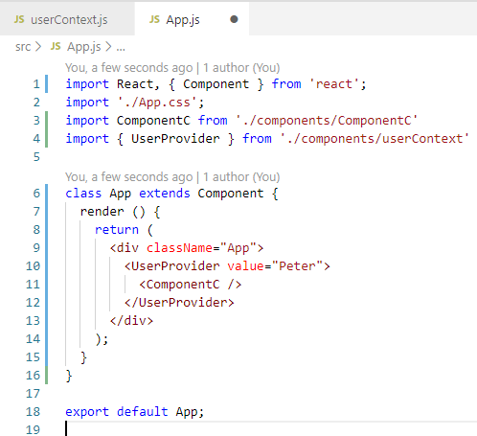
39.1 React Context 2
https://www.youtube.com/watch?v=lTjQjWemKgE&list=PLC3y8-rFHvwgg3vaYJgHGnModB54rxOk3&index=39
Component Tree:
2. User Provider
We need to provide this user context.
The place you provide the is import because only the descendent component can consume it.
App Component is a good place because all components are under the App.
We use the component <UserProvider> to wrap the ComponentC and pass the data value=“peter”.
We complete the step 2.

Slide 11
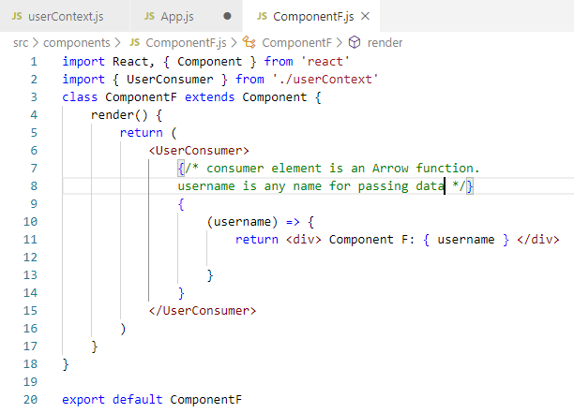
39.1 React Context 2
https://www.youtube.com/watch?v=lTjQjWemKgE&list=PLC3y8-rFHvwgg3vaYJgHGnModB54rxOk3&index=39
Component Tree:
3. Consume Data
Final step is to consume the username in the desired component.
For our example, we have to consume the username value in ComponentF.
In ComponentF.js, we need to user consumer components.

Slide 12
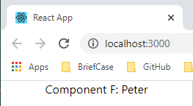
39.1 React Context 2
https://www.youtube.com/watch?v=lTjQjWemKgE&list=PLC3y8-rFHvwgg3vaYJgHGnModB54rxOk3&index=39
Component Tree:
> npm start

Slide 13
39.2 Summary of Context

Slide 14
39.2 Summary of Context
https://www.youtube.com/watch?v=lTjQjWemKgE&list=PLC3y8-rFHvwgg3vaYJgHGnModB54rxOk3&index=39
Summary Creation of Context of Component Tree:
There are three steps
Create the context.
Provide a context value.
Consume the context value in the necessary component.
AppComponent
username
C
E
username
F

Slide 15
End of Chapter

