Slide 1

41 HTTP and React
Peter H. Chen

Slide 2
41 HTTP and React
https://www.youtube.com/watch?v=GTmjthNvrxY&list=PLC3y8-rFHvwgg3vaYJgHGnModB54rxOk3&index=41
HTTP and React:
Next step is to understand how React work with HTTP.
We discuss how HTTP requests are generally handled in a React application.
We will discuss GET and POST request in the next two discussions.
When you build web applications, you have to reach out the server to fetch some data or send some data based on user interaction.
This web application is a React Application.
React App
Fetch
Web Application
Server
Send

Slide 3
41 HTTP and React
https://www.youtube.com/watch?v=GTmjthNvrxY&list=PLC3y8-rFHvwgg3vaYJgHGnModB54rxOk3&index=41
HTTP and React:
In the first discussion, we know that React is a library for building user interfaces.
React is not concerned about the HTTP.
This raises a very important question.
How do we make AJAX request in React?
Or how do we make the API call in React?
First, React itself does not have a particular way to fetch or send data to the server.
In fact, as far as React is concerned, it does not even have to know that there is a server in the picture
React App
?
Fetch
Web Application
Server
Send

Slide 4
41 HTTP and React
https://www.youtube.com/watch?v=GTmjthNvrxY&list=PLC3y8-rFHvwgg3vaYJgHGnModB54rxOk3&index=41
HTTP and React:
React components simply read props, read/write state, and render the UI.
Therefore, to use some data from the server, you just have to get the data into your components, i.e., props or state.
Now, if React is not going to handle the requests, who will be doing that?
React App
Props & state
?
Fetch
Web Application
Server
Send

Slide 5

41 HTTP and React
https://www.youtube.com/watch?v=GTmjthNvrxY&list=PLC3y8-rFHvwgg3vaYJgHGnModB54rxOk3&index=41
HTTP and React:
This is where you have to make use of an HTTP Library.
There are a few popular ones out there, e.g., axios is one of the best.
The fetch API is also a good consideration as it is more standardized.
For our understanding, we will stick to axios.
Our focus is not on the library we use, but how we use it with React.
We will add the axios package to our application.
React App
HTTP Library
Fetch
Web Application
Server
Send
axios

Slide 6
41.1 Axis Package

Slide 7
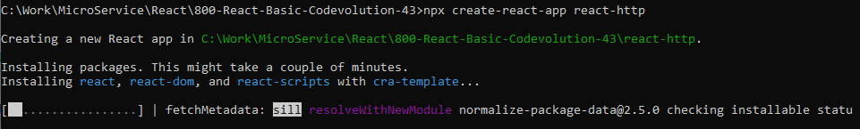

41.1 Axis Package
https://www.youtube.com/watch?v=GTmjthNvrxY&list=PLC3y8-rFHvwgg3vaYJgHGnModB54rxOk3&index=41
Add axios package to application:
When we create the react app, we use the command
> npx create-react-app react-http
> cd react-http
> npm install axios

Slide 8
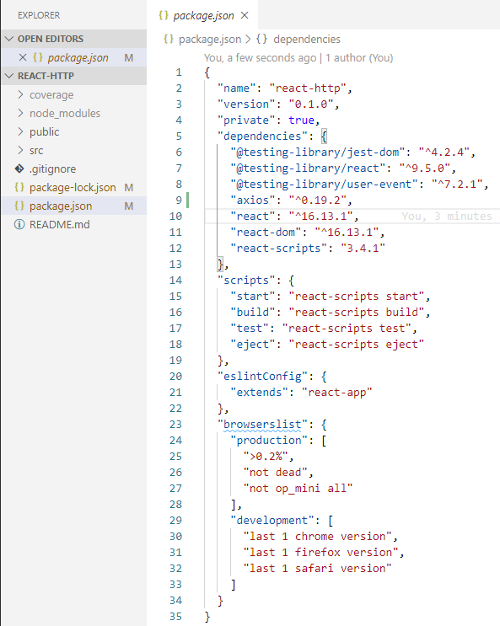
41.1 Axis Package
https://www.youtube.com/watch?v=GTmjthNvrxY&list=PLC3y8-rFHvwgg3vaYJgHGnModB54rxOk3&index=41
Open package.json
Verify dependencies “axios”.
We have axios HTTP library.
We can now make HTTP requests from our application.

Slide 9
End of Chapter

