Slide 1

42 HTTP GET
Peter H. Chen

Slide 2
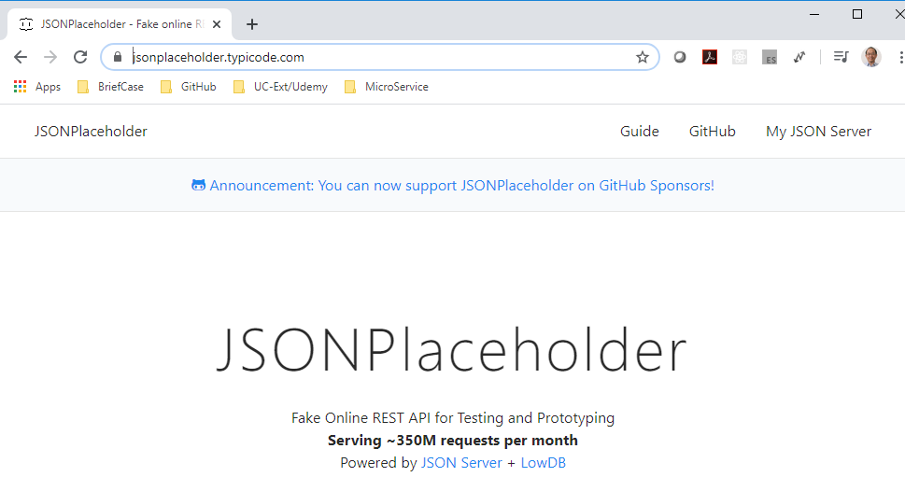
42.1 HTTP GET
https://www.youtube.com/watch?v=NEYrSUM4Umw&list=PLC3y8-rFHvwgg3vaYJgHGnModB54rxOk3&index=42
HTTP GET:
We discuss how to make GET request using Axios and render the data in the React Component.
To fetch the data, we need to have an API endpoint. For the API endpoint, we will be making use of JSON placeholder.
https://jsonplaceholder.typicode.com/

Slide 3
42.1 HTTP GET
https://www.youtube.com/watch?v=NEYrSUM4Umw&list=PLC3y8-rFHvwgg3vaYJgHGnModB54rxOk3&index=42
HTTP GET:
As you can see here. We use JSON Placeholder.
JSON Placeholder is a fake online REST API for testing and prototyping.
We will focus on fetching data in our React application and not focus on creating an API.

Slide 4
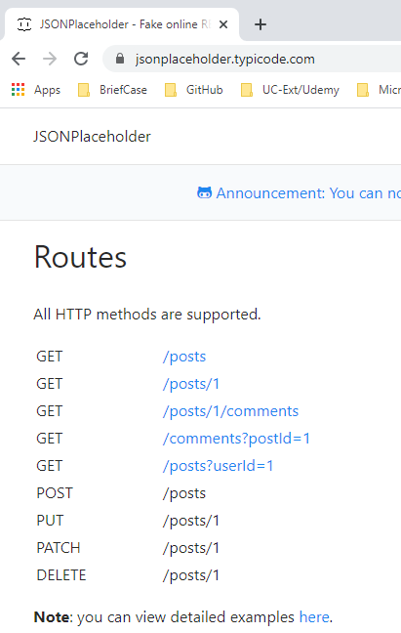
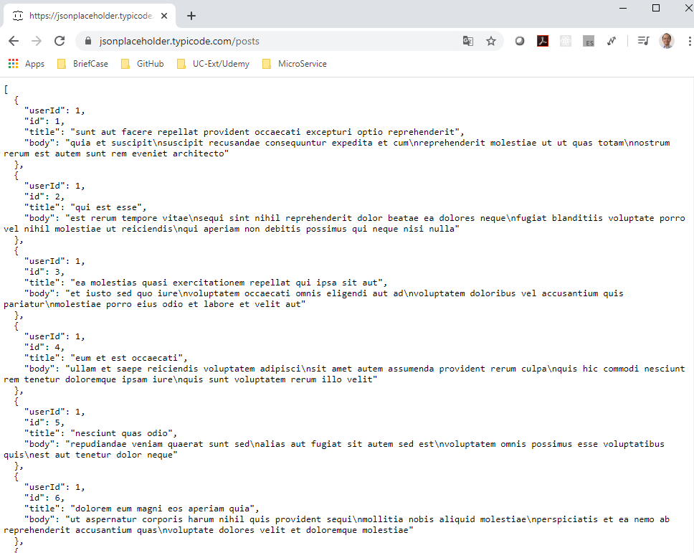
42.1 HTTP GET
https://www.youtube.com/watch?v=NEYrSUM4Umw&list=PLC3y8-rFHvwgg3vaYJgHGnModB54rxOk3&index=42
HTTP GET:
If you scroll down to the routes section, you can see the possible HTTP requests you can make.
In this discussion, we will make a GET request to /posts.

Slide 5
42.1 HTTP GET
https://www.youtube.com/watch?v=NEYrSUM4Umw&list=PLC3y8-rFHvwgg3vaYJgHGnModB54rxOk3&index=42
HTTP GET:
The “GET /posts” will fetch an array of posts to display in the UI.
We go back the VS code.

Slide 6
41.1 Create Components

Slide 7
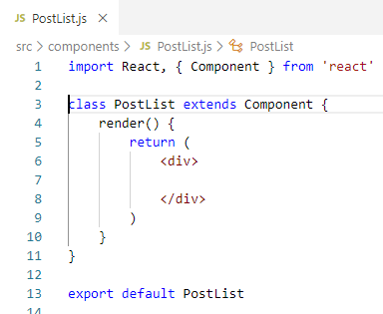
42.1 HTTP GET
https://www.youtube.com/watch?v=NEYrSUM4Umw&list=PLC3y8-rFHvwgg3vaYJgHGnModB54rxOk3&index=42
HTTP GET:
Create a new components and file, in the src/components/PostList.js
Type ‘rce’ to create a Class Component.
React 16.8 has the Hook. However, we use HTTP and Class Component.
Remove the “export”, the class component as below.

Slide 8
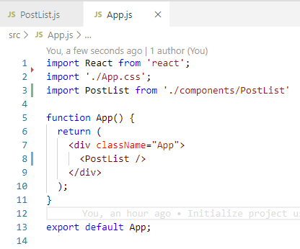
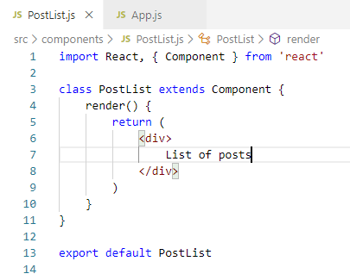
42.1 HTTP GET
https://www.youtube.com/watch?v=NEYrSUM4Umw&list=PLC3y8-rFHvwgg3vaYJgHGnModB54rxOk3&index=42
HTTP GET:
Create a new components and file, in the src/components/PostList.js
Type ‘rce’ to create a Class Component.
React 16.8 has the Hook. However, we use HTTP and Class Component.
Remove the “export”, the class component as below.
Add <PostList /> for App.js

Slide 9
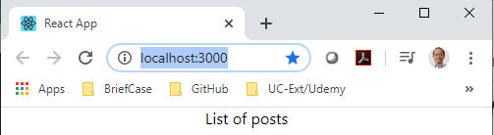
42.1 HTTP GET
https://www.youtube.com/watch?v=NEYrSUM4Umw&list=PLC3y8-rFHvwgg3vaYJgHGnModB54rxOk3&index=42
HTTP GET:
> npm start
Check the display of “List of posts”

Slide 10
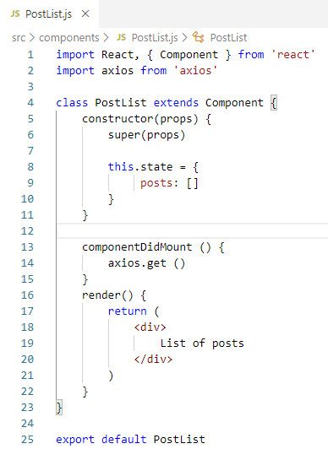
42.1 HTTP GET
https://www.youtube.com/watch?v=NEYrSUM4Umw&list=PLC3y8-rFHvwgg3vaYJgHGnModB54rxOk3&index=42
HTTP GET:
First Step: For data fetching, we import axios library and post in the PostList component.
> import axios from ‘axios’
Second Step: Type rconst (React constructor) to create state to store the data.
Third Step: We use axios to make a get request to JSON Placeholder API. The question is: Where do we place the code to make the GET request?
The answer is to put in the lifecycle method “componentDidMount”. This method is only executed once during the components lifetime. It is a perfect place for our GET request. To make a GET request, we invoke the GET method on the axios library. The axios.get() accepts the API endpoint as its argument.

Slide 11
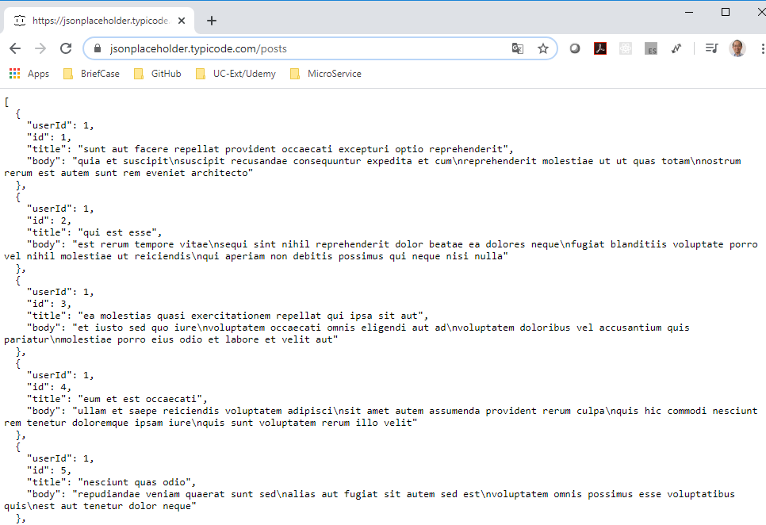
42.1 HTTP GET
https://www.youtube.com/watch?v=NEYrSUM4Umw&list=PLC3y8-rFHvwgg3vaYJgHGnModB54rxOk3&index=42
HTTP GET:
Go back to JSON Placeholder browser, click the GET /posts and get the URL address bar “https://jsonplaceholder.typicode.com/posts”.

Slide 12
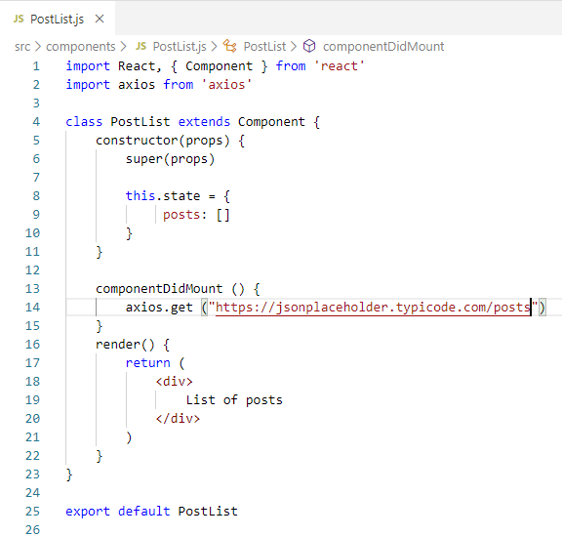
42.1 HTTP GET
https://www.youtube.com/watch?v=NEYrSUM4Umw&list=PLC3y8-rFHvwgg3vaYJgHGnModB54rxOk3&index=42
HTTP GET:
Copy the JSON Placehodler address to
> axios.get (“https://jsonplaceholder.typicode.com/posts” )

Slide 13
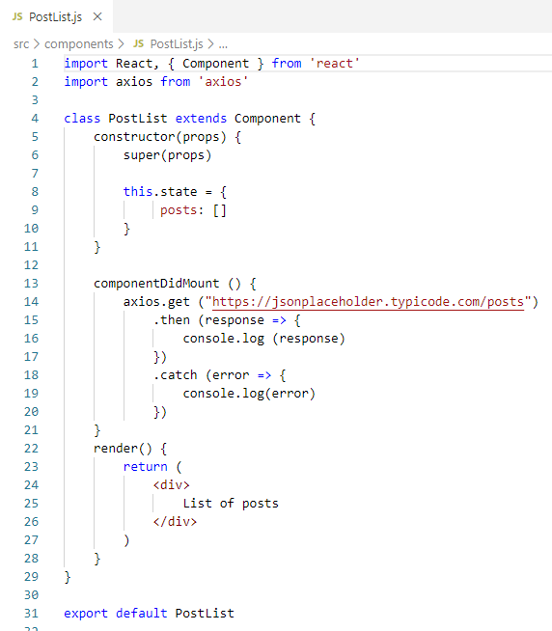
42.1 HTTP GET
https://www.youtube.com/watch?v=NEYrSUM4Umw&list=PLC3y8-rFHvwgg3vaYJgHGnModB54rxOk3&index=42
HTTP GET:
Now, we made a get request.
How do we access the data that is returned?
The axios is a promise based library. We can add then and catch blocks.
The “then()” accepts an arrow functions as tis argument which access to the response. If something went wrong, we can catch it in the console.
> axis.get(“URL”)
> .then (response => {
> console.log (response)
> } )
> .catch (error => {
> console.log (error)
> })

Slide 14
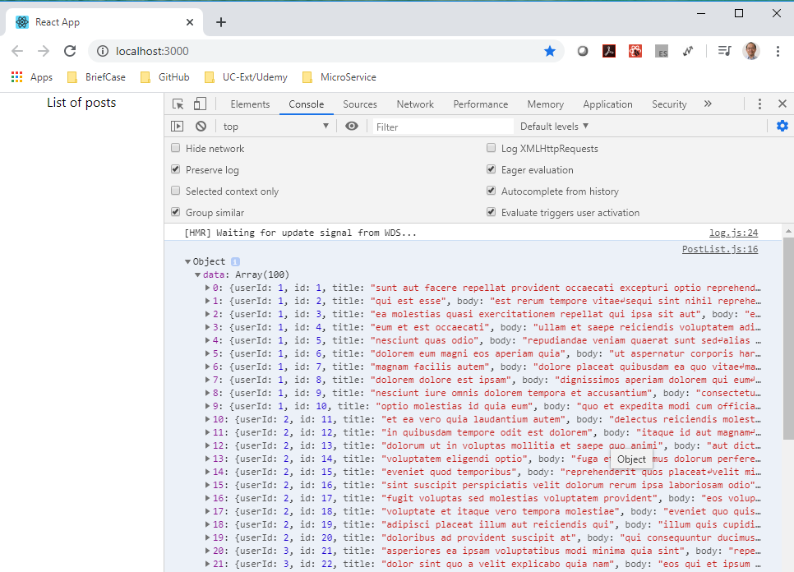
42.1 HTTP GET
https://www.youtube.com/watch?v=NEYrSUM4Umw&list=PLC3y8-rFHvwgg3vaYJgHGnModB54rxOk3&index=42
HTTP GET:
Go back the browser and check the data in the console.
The HTTP request is working now. The object.data store the array.

Slide 15
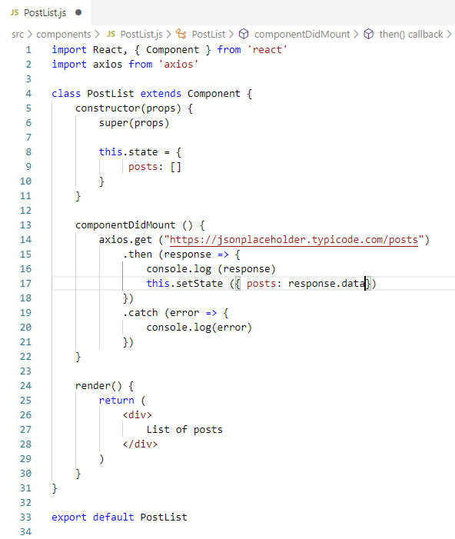
42.1 HTTP GET
https://www.youtube.com/watch?v=NEYrSUM4Umw&list=PLC3y8-rFHvwgg3vaYJgHGnModB54rxOk3&index=42
HTTP GET:
Go back to VS Code React to store the request data.
> this.setState ({
> posts: response.data
> })

Slide 16
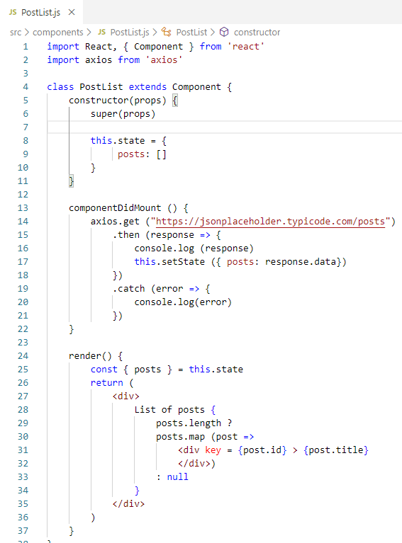
42.1 HTTP GET
https://www.youtube.com/watch?v=NEYrSUM4Umw&list=PLC3y8-rFHvwgg3vaYJgHGnModB54rxOk3&index=42
HTTP GET:
In the render method, we need to destructing the state property.
> const { posts } = this.state
Then, display this list of posts using map method.
> <div>
> {
> posts.length ?
> posts.map (post =>
> <div key = {post.id} > { post.title} </div>)
> : null
> }
> </div>

Slide 17
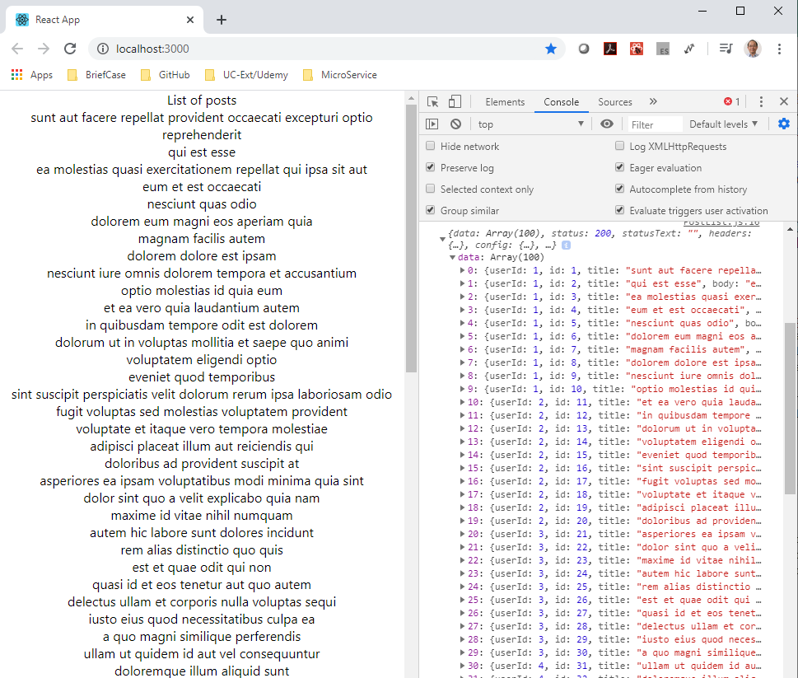
42.1 HTTP GET
https://www.youtube.com/watch?v=NEYrSUM4Umw&list=PLC3y8-rFHvwgg3vaYJgHGnModB54rxOk3&index=42
HTTP GET:
Go back to browser and verify data is display on browser as below.

Slide 18
41.2 Summary of HTTP Get

Slide 19
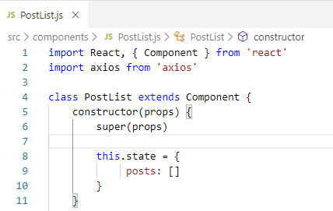
42.2 Summary of HTTP Get
https://www.youtube.com/watch?v=NEYrSUM4Umw&list=PLC3y8-rFHvwgg3vaYJgHGnModB54rxOk3&index=42
Summary of HTTP Get:
We start the constructor, we have the state property called “posts: []”
The posts is an empty array.

Slide 20
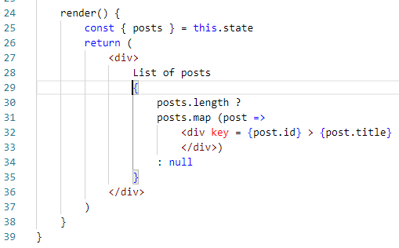
42.2 Summary of HTTP Get
https://www.youtube.com/watch?v=NEYrSUM4Umw&list=PLC3y8-rFHvwgg3vaYJgHGnModB54rxOk3&index=42
Summary of HTTP Get:
The control flow go to the render() method.
The text “List of posts” is display.
The actual list is not render because the array is an empty array at this moment.

Slide 21
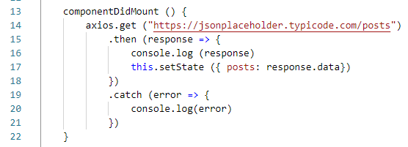
42.2 Summary of HTTP Get
https://www.youtube.com/watch?v=NEYrSUM4Umw&list=PLC3y8-rFHvwgg3vaYJgHGnModB54rxOk3&index=42
Summary of HTTP Get:
Then, the control flow goes to componentDidMount()
We make the get request to the API endpoint.
When the data is received, we then update the state.posts property.
When the state change, the component will be re-rendered.

Slide 22
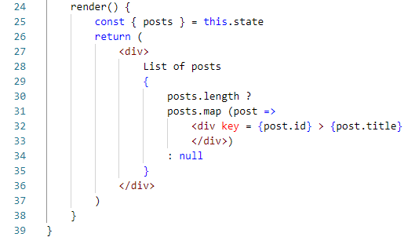
42.2 Summary of HTTP Get
https://www.youtube.com/watch?v=NEYrSUM4Umw&list=PLC3y8-rFHvwgg3vaYJgHGnModB54rxOk3&index=42
Summary of HTTP Get:
The time, the array is not empty.
Therefore, the list of titles are rendered into the browser.

Slide 23
41.3 Error of HTTP Get

Slide 24
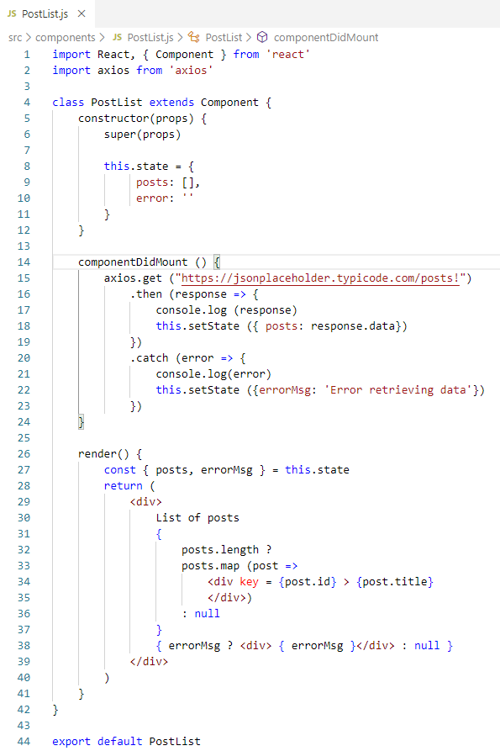
42.3 Error of HTTP Get
https://www.youtube.com/watch?v=NEYrSUM4Umw&list=PLC3y8-rFHvwgg3vaYJgHGnModB54rxOk3&index=42
Error of HTTP Get:
Now we need to handle the error of get.
Code as right.
Test the error: Add “URL with extra “!” (invalid URL)

Slide 25
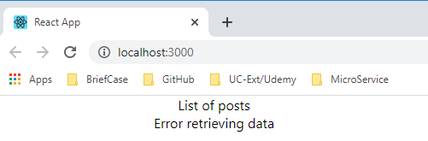
42.3 Error of HTTP Get
https://www.youtube.com/watch?v=NEYrSUM4Umw&list=PLC3y8-rFHvwgg3vaYJgHGnModB54rxOk3&index=42
Error of HTTP Get:
Refresh with Error message display
Error of HTTP Get:
Correct the URL and fix the error.

Slide 26
End of Chapter

