Slide 1

48 useState with Array
Peter H. Chen

Slide 2
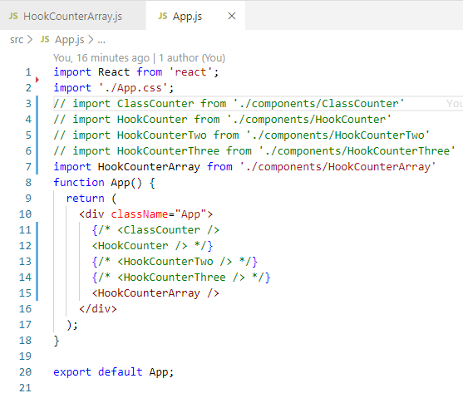
48 useState with Array
https://www.youtube.com/watch?v=RZ5wKYbOM_I&list=PLC3y8-rFHvwgg3vaYJgHGnModB54rxOk3&index=48
useState with Array
Import HookCountArry from ‘./components/HookCountArray’
<HookCounterArray />

Slide 3
48.1 Add Item to Array

Slide 4
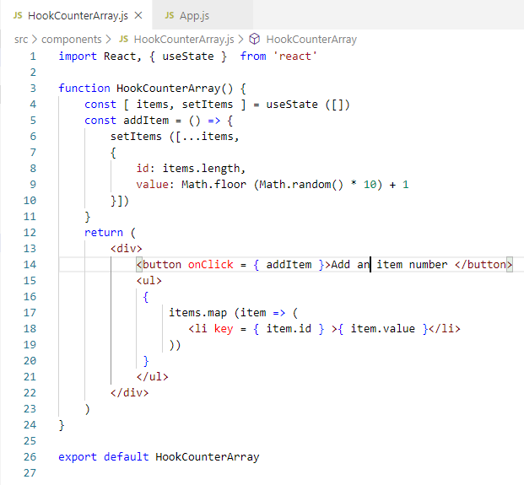
48.1 Add Item to Array
https://www.youtube.com/watch?v=RZ5wKYbOM_I&list=PLC3y8-rFHvwgg3vaYJgHGnModB54rxOk3&index=48
In HookCountArray.js:
Type ‘rfce’ (React Functional Component ES7)
Import React, {useState} from ‘react’
const [ items, setItems ] = useState ([])
Since we are going to work on array, the initial value for array is an empty array [].

Slide 5
48.1 Add Item to Array
https://www.youtube.com/watch?v=RZ5wKYbOM_I&list=PLC3y8-rFHvwgg3vaYJgHGnModB54rxOk3&index=48
In HookCountArray.js:
Next, we render the items in the JSX.
Add map function:
Items.map (item => (
<li key = { item.id } > { item.value } <li>
))
Add onCLick function:
<button onClick = { addItem } Add an item number </button>

Slide 6
48.1 Add Item to Array
https://www.youtube.com/watch?v=RZ5wKYbOM_I&list=PLC3y8-rFHvwgg3vaYJgHGnModB54rxOk3&index=48
In HookCountArray.js:
Next, arrow function:
const addItem = () => {
setItems ( […items,
{
id: items.length,
value: Math.floor (Math.random() * 10 ) + 1
}])
}

Slide 7
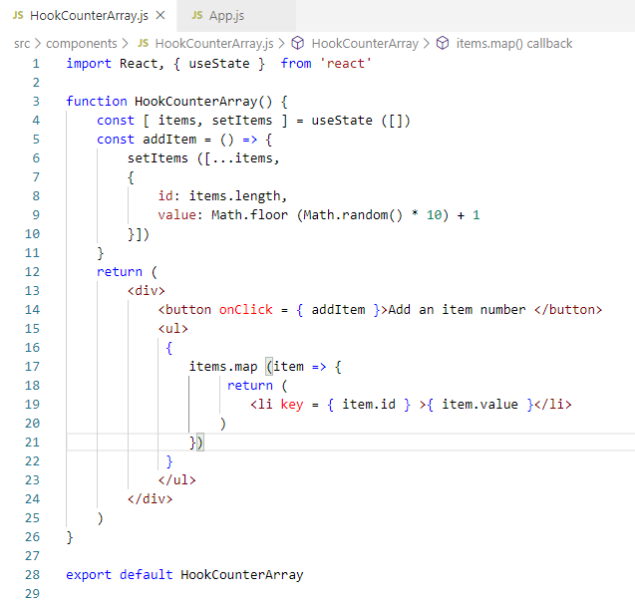
48.1 Add Item to Array
https://www.youtube.com/watch?v=RZ5wKYbOM_I&list=PLC3y8-rFHvwgg3vaYJgHGnModB54rxOk3&index=48
In HookCountArray.js:
If map function in Arrow function syntax:
items.map (item => {
return ( …)
})
Need a return statement.

Slide 8
48.1 Add Item to Array
https://www.youtube.com/watch?v=RZ5wKYbOM_I&list=PLC3y8-rFHvwgg3vaYJgHGnModB54rxOk3&index=48
In HookCountArray.js:
Expand the Array with spread operator …items
setItems ([…items, {
id: …, value: … ]}

Slide 9
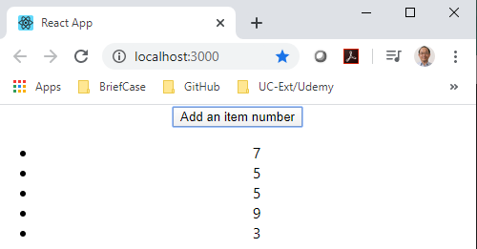
48.1 Add Item to Array
https://www.youtube.com/watch?v=RZ5wKYbOM_I&list=PLC3y8-rFHvwgg3vaYJgHGnModB54rxOk3&index=48
Add Item to Array:
Click button “Add an Item number”

Slide 10
48.2 Summary of Array

Slide 11
48.2 Summary of useState Hook
https://www.youtube.com/watch?v=RZ5wKYbOM_I&list=PLC3y8-rFHvwgg3vaYJgHGnModB54rxOk3&index=48
Summary – useState Hook
The useState Hook lets you add state to functional components.
In side the functional component, you create a single piece of state
In class components, the state is always an object. You can store the properties on that object.
With the useState Hook, the state does not have to be an object.
The state can be an array, a number, a Boolean, a string, an object, and etc.
The useState Hook return an array with 2 elements.
The first element is the current value of the state, and the second element is a state setter function.
You call the setter function with a new value to set the state which will in turn cause the component to re-render.
In case, your new state value depends on the previous state? You can pass a function to the setter function. The setter function will receive the previous state as its argument.

Slide 12
48.2 Summary of useState Hook
https://www.youtube.com/watch?v=RZ5wKYbOM_I&list=PLC3y8-rFHvwgg3vaYJgHGnModB54rxOk3&index=48
Summary – useState Hook
Finally, when you dealing with objects or arrays, always make sure to spread your state variable and then call setter function.

Slide 13
End of Chapter

