Slide 1

50 useEffect After Render
Peter H. Chen

Slide 2
50 useEffect After Render
https://www.youtube.com/watch?v=nAuWOnFMlOw&list=PLC3y8-rFHvwgg3vaYJgHGnModB54rxOk3&index=50
useEffect after Render
We know useEffect Hook is used for causing side effect in functional components.
The useEffect is capable of handling componentDidMount, componentDidUpdate, and componentWillUnmount lifecycle methods for capable of doing in class components.
In this discussion, we use the useEffect Hook to mimic componentDidMount, componentDidUpdate, but in functional component.
We can look at the code like in a Class Component.
We already have the class component called ClassCounterOne.

Slide 3
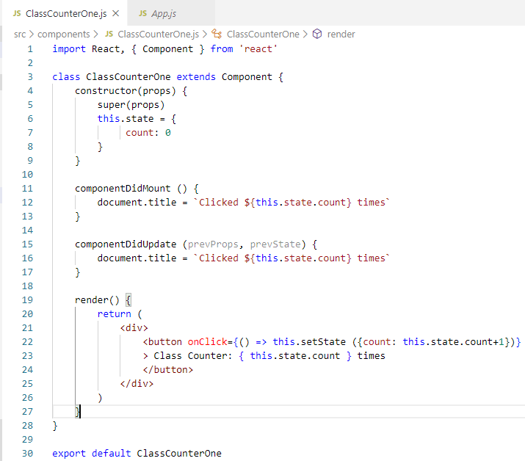
50 useEffect After Render
https://www.youtube.com/watch?v=nAuWOnFMlOw&list=PLC3y8-rFHvwgg3vaYJgHGnModB54rxOk3&index=50
useEffect after Render
Look at ClassCounterOne.js.
In the constructor, we initialize the count value to 0.
componentDidMount() set the document tile to count value.
Click the button, the counter value increase by one.
Then, comonDidUpdate update the document title.

Slide 4
50.1 Functional Component

Slide 5
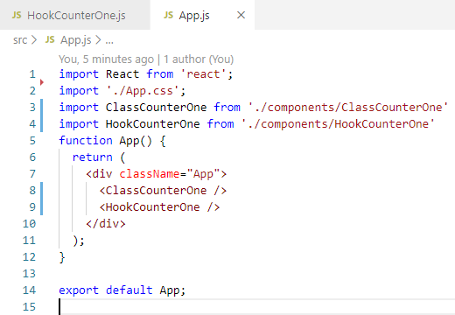
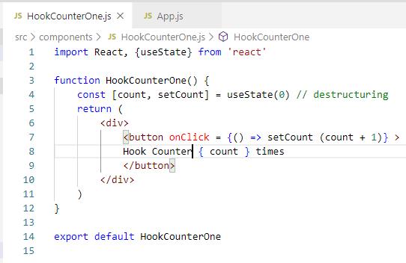
50.1 Functional Components
https://www.youtube.com/watch?v=nAuWOnFMlOw&list=PLC3y8-rFHvwgg3vaYJgHGnModB54rxOk3&index=50
useEfect after Render
Import HookCounterOne
<HookCounterOne />

Slide 6
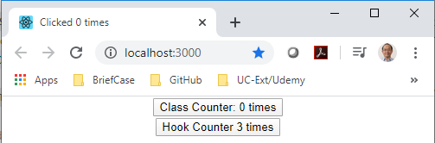
50.1 Functional Components
https://www.youtube.com/watch?v=nAuWOnFMlOw&list=PLC3y8-rFHvwgg3vaYJgHGnModB54rxOk3&index=50
useEfect after Render
> npm start
Click Hook Counter button will increase the count.
This is nothing new.
But we want is update the title.

Slide 7
50.2 useEffect Hook

Slide 8
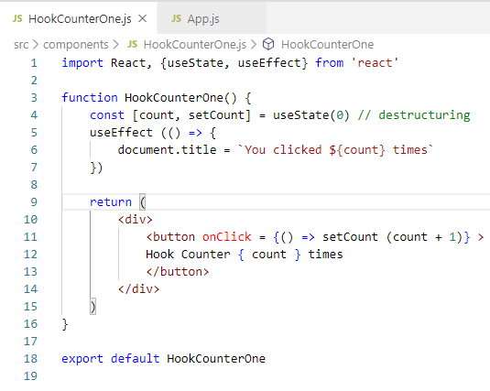
50.2 useEffect Hook
https://www.youtube.com/watch?v=nAuWOnFMlOw&list=PLC3y8-rFHvwgg3vaYJgHGnModB54rxOk3&index=50
useEfect after Render
Import useEffect
useEffect ({
document.title = ` clicked $ {count} `
})

Slide 9
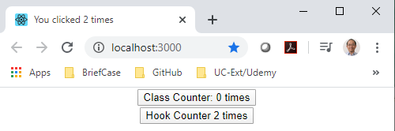
50.2 useEffect Hook
https://www.youtube.com/watch?v=nAuWOnFMlOw&list=PLC3y8-rFHvwgg3vaYJgHGnModB54rxOk3&index=50
useEfect after Render
> npm start
Click Hook Counter button will increase the count.
The title display the count times.

Slide 10
50.3 Summary of useEffect

Slide 11
50.3 Summary of useEffect
https://www.youtube.com/watch?v=nAuWOnFMlOw&list=PLC3y8-rFHvwgg3vaYJgHGnModB54rxOk3&index=50
useEfect after Render
Import { useEffect }
…
useEffect (
document.title = ` ${count } times`
)

Slide 12
End of Chapter

