Slide 1

51 Conditional Run Effect
Peter H. Chen

Slide 2
51 Conditional Run Effect
https://www.youtube.com/watch?v=nAuWOnFMlOw&list=PLC3y8-rFHvwgg3vaYJgHGnModB54rxOk3&index=50
Conditional Run Effect
In the useEffect, we learned one import point, useEffect Hook is called after every single render.
In some cases, applying the effect after every render might create a performance problem. We need a way to conditionally run an effect from a functional component.
Let’s take an example to understand how to do that.

Slide 3
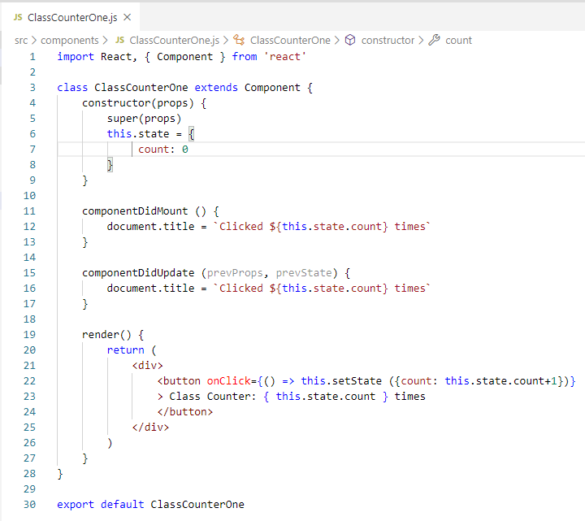
51 Conditional Run Effect
https://www.youtube.com/watch?v=nAuWOnFMlOw&list=PLC3y8-rFHvwgg3vaYJgHGnModB54rxOk3&index=50
Conditional Run Effect
We will walk through the Class component (ClassCountOne.js) and then useEffect Hook in functional components.
In the class components, we have a state variable count initialized to 0.
In the render function, we have a button and onClick of that button. We increment the count value by 1.

Slide 4
51.1 Class Component Example

Slide 5
51.1 Class Component Example
https://www.youtube.com/watch?v=nAuWOnFMlOw&list=PLC3y8-rFHvwgg3vaYJgHGnModB54rxOk3&index=50
Conditional Run Effect
When the value increment, the state changes which causes the component to re-render and componentDidUpdate will execute setting the document title to the updated counter value.
It is very straightforward.

Slide 6
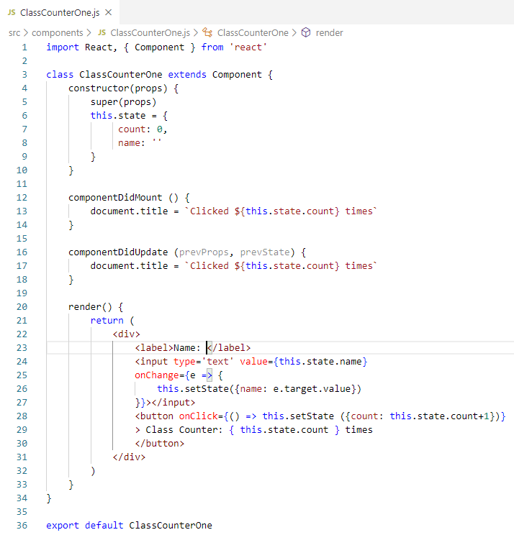
51.1 Class Component Example
https://www.youtube.com/watch?v=nAuWOnFMlOw&list=PLC3y8-rFHvwgg3vaYJgHGnModB54rxOk3&index=50
Conditional Run Effect
Now, we are going to add a text input to this class component which will accept a name from the user.
To start off, we create a state variable name initialized to an empty string.
IN the JSX, add an input element <input type =“text” value={ this.state.name } onChange = { e => this.setState ({name: e.target.value })

Slide 7
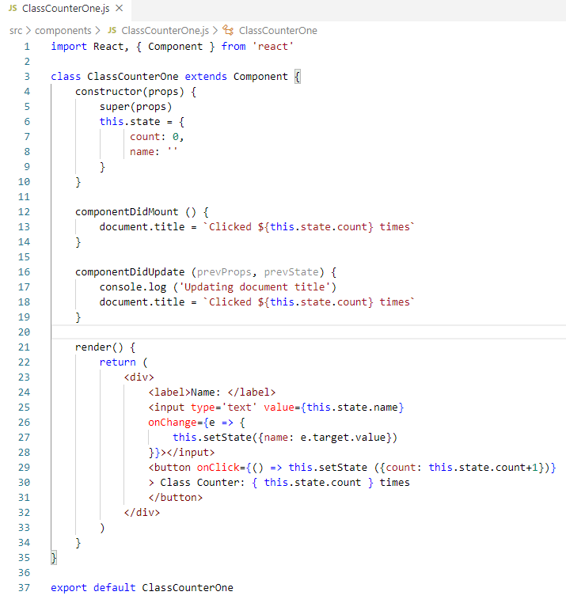
51.1 Class Component Example
https://www.youtube.com/watch?v=nAuWOnFMlOw&list=PLC3y8-rFHvwgg3vaYJgHGnModB54rxOk3&index=50
Conditional Run Effect
In the componentDidUpdate, we add console.log (‘Updating document title’)
Save the file.

Slide 8
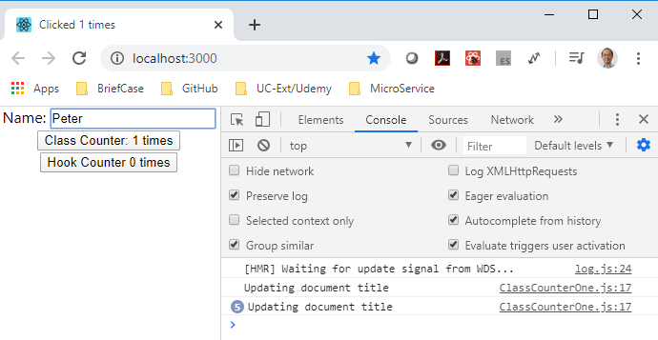
51.1 Class Component Example
https://www.youtube.com/watch?v=nAuWOnFMlOw&list=PLC3y8-rFHvwgg3vaYJgHGnModB54rxOk3&index=50
Conditional Run Effect
> npm start
Click “Class Counter x times”, we have log “Updating document tile” once.
When we type in Name Text, we have “Updating document tile” five times. We need to fix this.

Slide 9
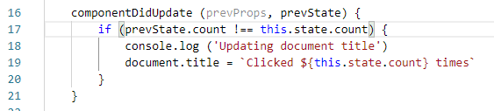
51.1 Class Component Example
https://www.youtube.com/watch?v=nAuWOnFMlOw&list=PLC3y8-rFHvwgg3vaYJgHGnModB54rxOk3&index=50
Conditional Run Effect
We need to fix the componentDidUpdate()
if (prevState.count != this.state.count) {
update the document title.
}

Slide 10
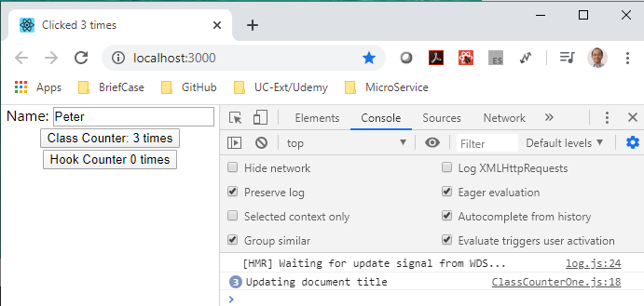
51.1 Class Component Example
https://www.youtube.com/watch?v=nAuWOnFMlOw&list=PLC3y8-rFHvwgg3vaYJgHGnModB54rxOk3&index=50
Conditional Run Effect
> npm start
Only Click button, the console is updated. The input text is ignored.

Slide 11
51.2 Functional Component

Slide 12
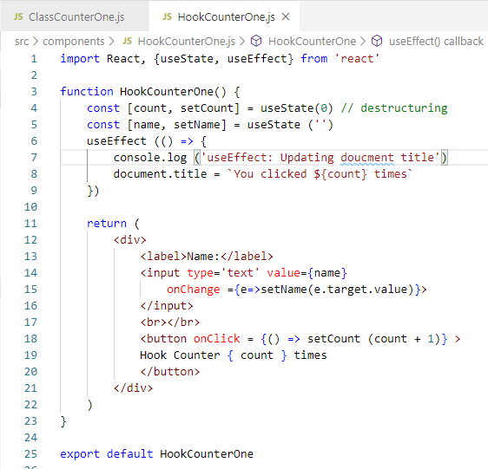
51.2 Functional Components
https://www.youtube.com/watch?v=8DYlzVUTC7s&list=PLC3y8-rFHvwgg3vaYJgHGnModB54rxOk3&index=51
Functional Components:
Let’s got back to HooCounterOne.js

Slide 13
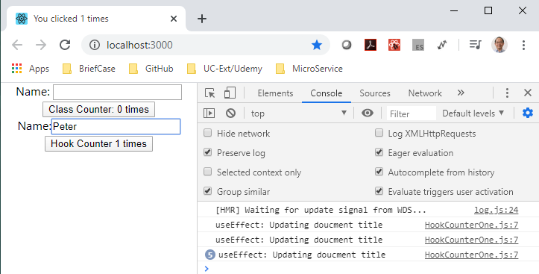
51.2 Functional Components
https://www.youtube.com/watch?v=8DYlzVUTC7s&list=PLC3y8-rFHvwgg3vaYJgHGnModB54rxOk3&index=51
Functional Components:
> npm start
Type ‘Peter’, the useEffect called five times. This is not optimized. We need to fix.

Slide 14
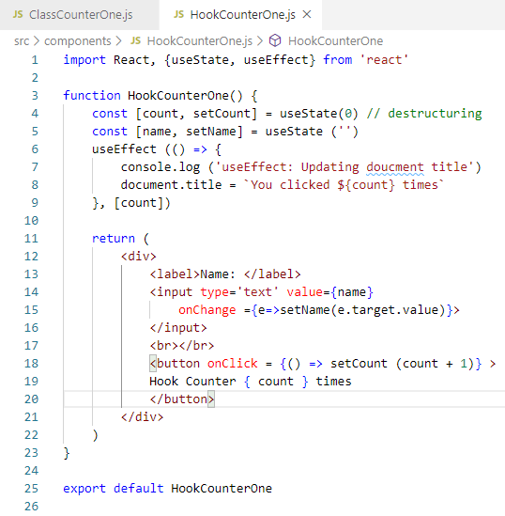
51.2 Functional Components
https://www.youtube.com/watch?v=8DYlzVUTC7s&list=PLC3y8-rFHvwgg3vaYJgHGnModB54rxOk3&index=51
Functional Components:
How to add the conditional for useEffect?
We add anther array [count] for useEffect( () => {}, [count])

Slide 15
51.2 Functional Components
https://www.youtube.com/watch?v=8DYlzVUTC7s&list=PLC3y8-rFHvwgg3vaYJgHGnModB54rxOk3&index=51
Functional Components:
> npm start
The useEffect() will not call the count does not change.

Slide 16
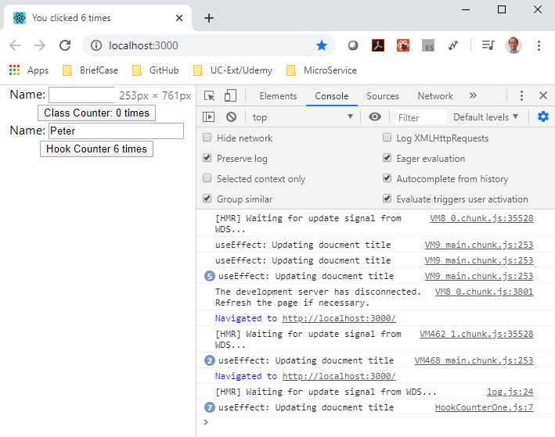
51.2 Functional Components
https://www.youtube.com/watch?v=8DYlzVUTC7s&list=PLC3y8-rFHvwgg3vaYJgHGnModB54rxOk3&index=51
Functional Components:
> npm start
The useEffect() will not call the count does not change.

Slide 17
End of Chapter

