Slide 1

52 Run Effect Once
Peter H. Chen

Slide 2
52 Run Effect Once
https://www.youtube.com/watch?v=BH4xvzHa7H8&list=PLC3y8-rFHvwgg3vaYJgHGnModB54rxOk3&index=52
Conditional Run Effect
In the last discussion, we discuss the conditional useEffect with count state change.
We discuss run useEffect only once.

Slide 3
52.1 Class Component

Slide 4
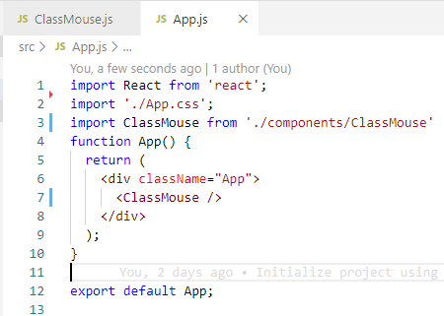
52.1 Class Component
https://www.youtube.com/watch?v=BH4xvzHa7H8&list=PLC3y8-rFHvwgg3vaYJgHGnModB54rxOk3&index=52
Conditional Run Effect
We make example of the Class Component (ClassMouse.js).
In Class Component, We use componentDidMount to run only once.

Slide 5
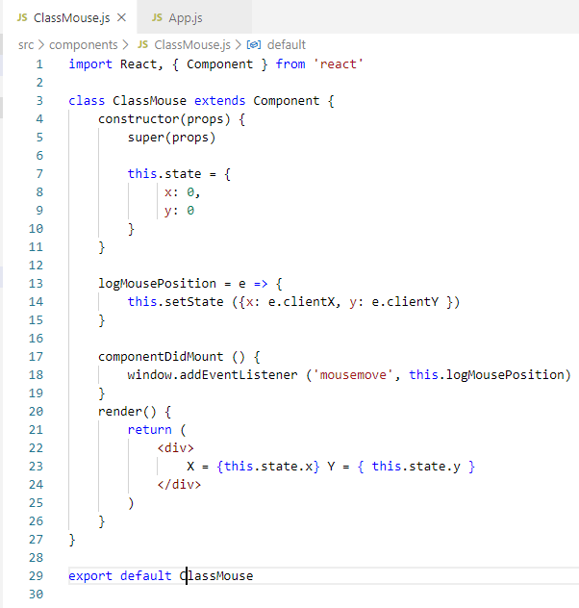
52.1 Class Component Example
https://www.youtube.com/watch?v=BH4xvzHa7H8&list=PLC3y8-rFHvwgg3vaYJgHGnModB54rxOk3&index=52
Conditional Run Effect
constructor: set x:0, y:0
componentDidMout: {
window.addEventListener (‘mouseMove’, this.log}
}
Render ()
X: { this.state.x} Y: { this.state.y}

Slide 6
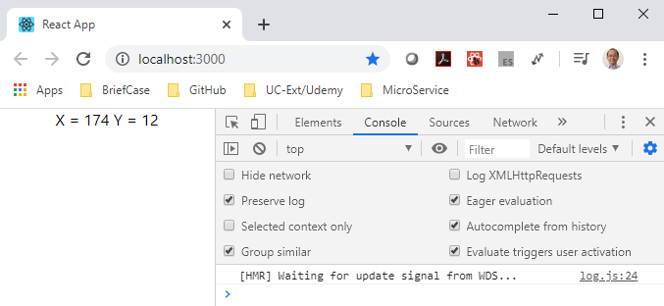
52.1 Class Component Example
https://www.youtube.com/watch?v=BH4xvzHa7H8&list=PLC3y8-rFHvwgg3vaYJgHGnModB54rxOk3&index=52
Run Effect Once
> npm start
The componetDidMount only execute once.

Slide 7
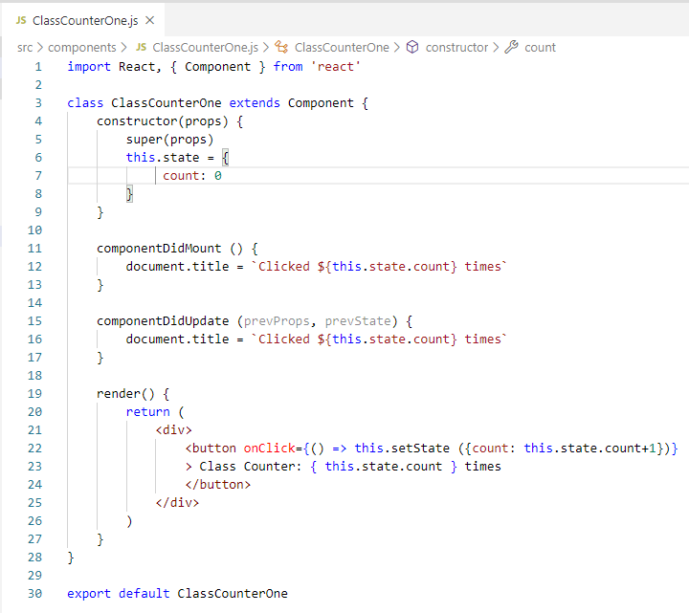
52.1 Class Component Example
https://www.youtube.com/watch?v=BH4xvzHa7H8&list=PLC3y8-rFHvwgg3vaYJgHGnModB54rxOk3&index=52
Conditional Run Effect
When the value increment, the state changes which causes the component to re-render and componentDidUpdate will execute setting the document title to the updated counter value.
It is very straightforward.

Slide 8
52.2 Functional Component

Slide 9
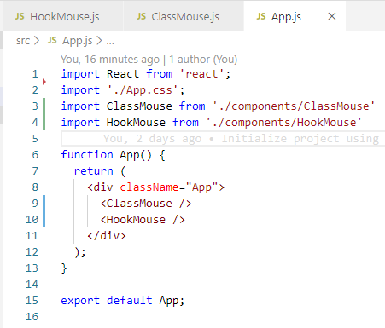
52.2 Functional Component
https://www.youtube.com/watch?v=BH4xvzHa7H8&list=PLC3y8-rFHvwgg3vaYJgHGnModB54rxOk3&index=52
Conditional Run Effect
Add Class and Hook
<ClassMouse />
<HookMouse />

Slide 10
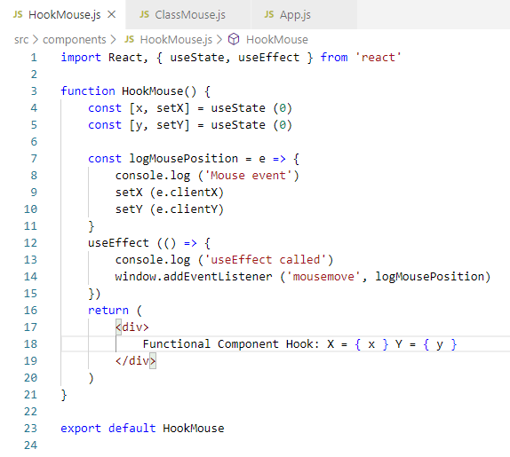
52.2 Functional Component
https://www.youtube.com/watch?v=BH4xvzHa7H8&list=PLC3y8-rFHvwgg3vaYJgHGnModB54rxOk3&index=52
Conditional Run Effect
Functional Component with useEffect.
Type ‘rfce’ (React Functional Component ES7)
Import [useState, useEffect]
Destruct x, setX; y, setY.
Render
useEffect after render for window addEventListener

Slide 11
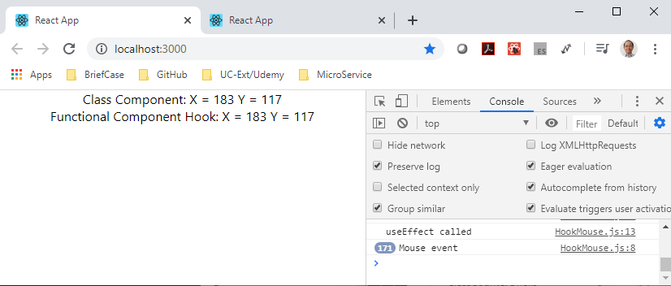
52.2 Functional Component
https://www.youtube.com/watch?v=BH4xvzHa7H8&list=PLC3y8-rFHvwgg3vaYJgHGnModB54rxOk3&index=52
Conditional Run Effect
useEffect just called once.
You can find the X, Y is changesince we add the EventListener.

Slide 12
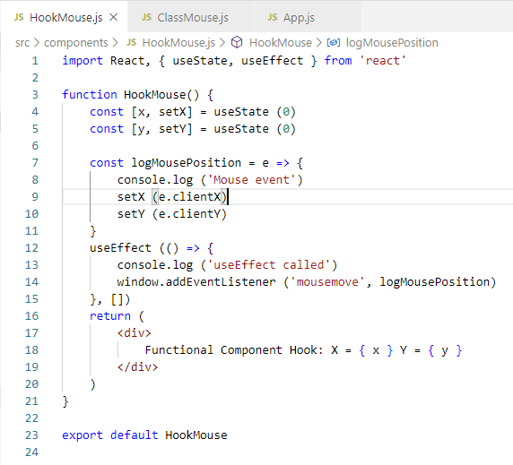
52.2 Functional Component
https://www.youtube.com/watch?v=BH4xvzHa7H8&list=PLC3y8-rFHvwgg3vaYJgHGnModB54rxOk3&index=52
Conditional Run Effect
useEffect just called once.
We can add the second empty ([]) array (This is optional in release 16.13 since the useEffect only called once). The result is the same.

Slide 13
52.3 Summary of useEffect

Slide 14
52.3 Summary of useEffect
https://www.youtube.com/watch?v=BH4xvzHa7H8&list=PLC3y8-rFHvwgg3vaYJgHGnModB54rxOk3&index=52
Summary of useEffect
We mimic the componentDidMount by useEffect.
Just call once after the render using the empty arrary as the second parameter of useEffect.

Slide 15
End of Chapter

