Slide 1

53 useEffect Cleanup
Peter H. Chen

Slide 2
53 useEffect Cleanup
https://www.youtube.com/watch?v=DTlmk6QeOHY&list=PLC3y8-rFHvwgg3vaYJgHGnModB54rxOk3&index=53
useEffect Cleanup
This discussion simulate the componentWillUnmount Class Component with useEffect of Functional Component.
We make example of the Class Component (MouseContainer.js).
In Class Component, We use componentWillMount to run only once.

Slide 3
53.1 Class Component

Slide 4
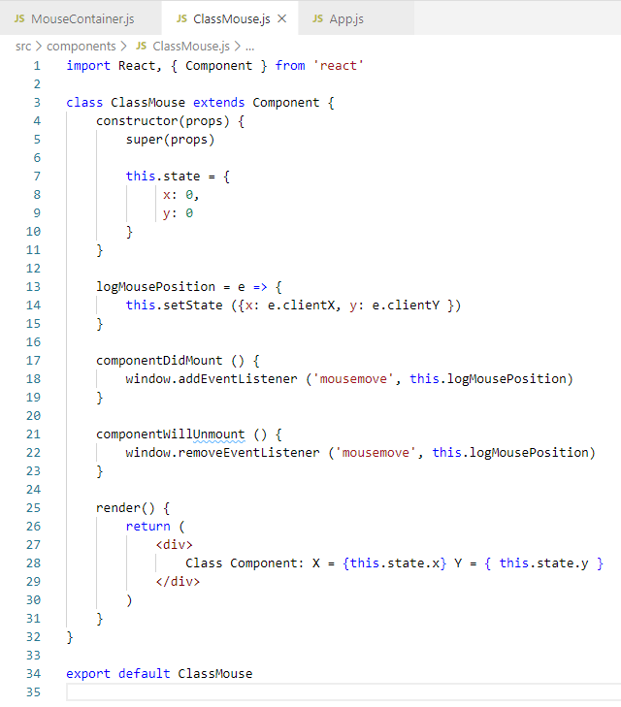
53.1 Class Component
https://www.youtube.com/watch?v=DTlmk6QeOHY&list=PLC3y8-rFHvwgg3vaYJgHGnModB54rxOk3&index=53
ClassMouse.js
In the class Component, in the componentWillUnmount, add
window.removeEventListener (‘remove’, thislogMusePosition)
How do we make this functionality in functional component?

Slide 5
53.2 Functional Component

Slide 6
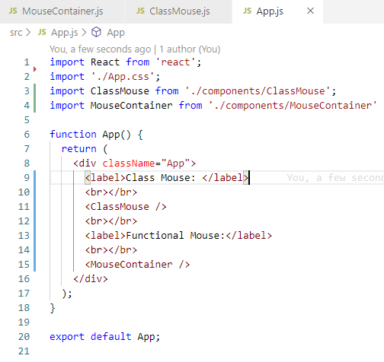
53.2 Functional Component
https://www.youtube.com/watch?v=DTlmk6QeOHY&list=PLC3y8-rFHvwgg3vaYJgHGnModB54rxOk3&index=53
App.js
Import MouseContainer

Slide 7
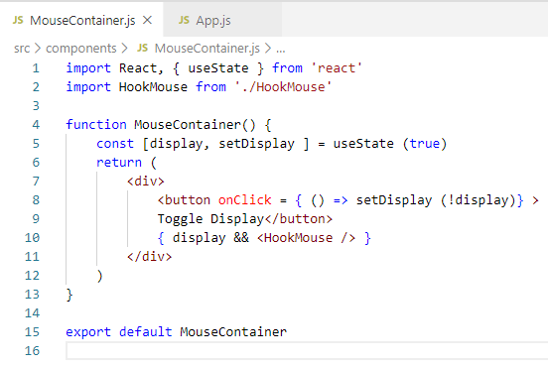
53.2 Functional Component
https://www.youtube.com/watch?v=DTlmk6QeOHY&list=PLC3y8-rFHvwgg3vaYJgHGnModB54rxOk3&index=53
MousContainer.js
setDisplay (!display)
Toggle display: { display && <HookMouse /> }

Slide 8
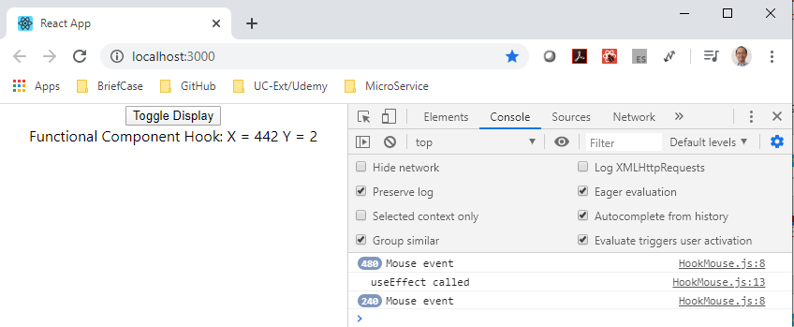
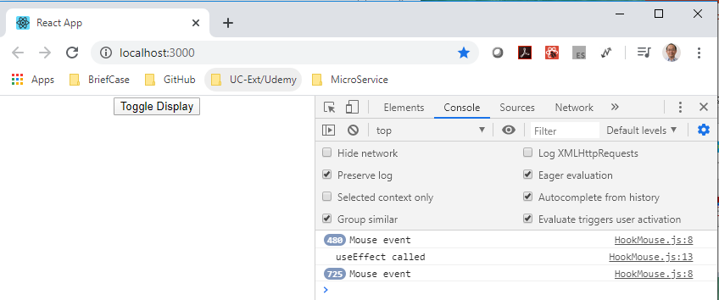
53.2 Functional Component
https://www.youtube.com/watch?v=DTlmk6QeOHY&list=PLC3y8-rFHvwgg3vaYJgHGnModB54rxOk3&index=53
MousContainer.js
> npm start
Click the button “toggle display” to show/hide the <HookMouse />

Slide 9
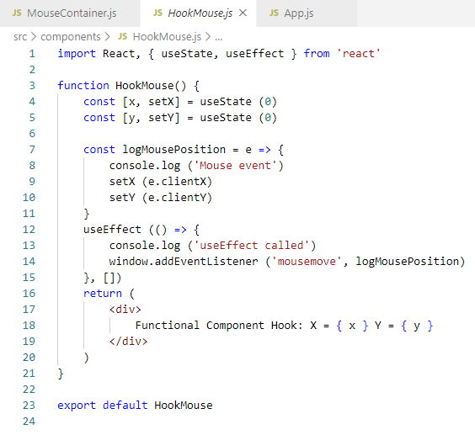
53.2 Functional Component
https://www.youtube.com/watch?v=DTlmk6QeOHY&list=PLC3y8-rFHvwgg3vaYJgHGnModB54rxOk3&index=53
MousContainer.js
When you unmount the component <MouseContainer />, the console.log still display the mouse event information.
How to solve the memory leak?
When you unmount the component <MouseContainer />, make sure you cancel all your subscriptions and listeners. In other words, cleanup after your component.

Slide 10
53.3 Remove Mouse Event

Slide 11
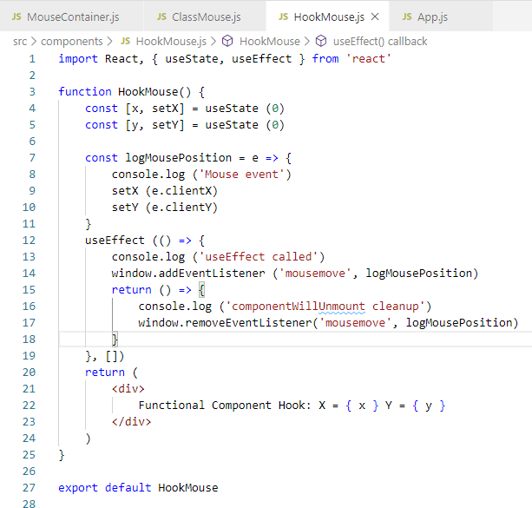
53.3 Remove Mouse Event
https://www.youtube.com/watch?v=DTlmk6QeOHY&list=PLC3y8-rFHvwgg3vaYJgHGnModB54rxOk3&index=53
MousContainer.js
By the way, the Mouse event is been logged from Hook.
How do we handle the clean up code?
i.e., window.removeEvent() in the Class Component.
It is pretty simple, in the useEffect, we can put cleanup function in the return arrow function [() => { }]

Slide 12
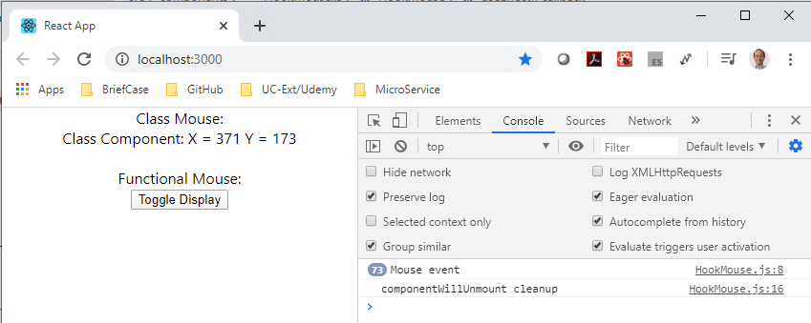
53.3 Remove Mouse Event
https://www.youtube.com/watch?v=DTlmk6QeOHY&list=PLC3y8-rFHvwgg3vaYJgHGnModB54rxOk3&index=53
MousContainer.js
> npm start
Click button “Toggle Display”, the mouse event is unmount in the return arrow in the useEffect().

Slide 13
End of Chapter

