Slide 1

54 useEffect Incorrect Dependency
Peter H. Chen

Slide 2
54 useEffect Incorrect Dependency
https://www.youtube.com/watch?v=SP-NrbQHFww&list=PLC3y8-rFHvwgg3vaYJgHGnModB54rxOk3&index=54
useEffect Incorrect Dependency
IntervalClassCounter.js

Slide 3
54.1 Class Component

Slide 4
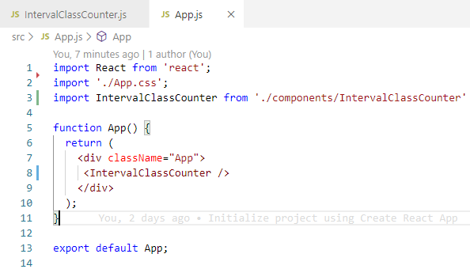
54.1 Class Component
https://www.youtube.com/watch?v=SP-NrbQHFww&list=PLC3y8-rFHvwgg3vaYJgHGnModB54rxOk3&index=54
App.js
Import IntervalClassCounter
<IntervalClassCounter />

Slide 5
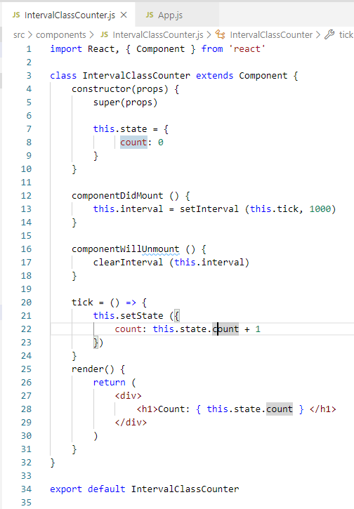
54.1 Class Component
https://www.youtube.com/watch?v=SP-NrbQHFww&list=PLC3y8-rFHvwgg3vaYJgHGnModB54rxOk3&index=54
IntervalClassCounter.js:
Type ‘rce’ (React Class Compoent ES7)
Initialize count:this.state { count: 0}
componentDidMount () {
this.interval = setInterval (this.tick, 1000)
}
componentWillUnmount () {
clearInterval (this.interval)
}
// every second, the tick increment by 1
tick = () => {
this.setState (cout: this.state.count + 1)
}
render() { <h1>{this.state.count} </h1> }

Slide 6
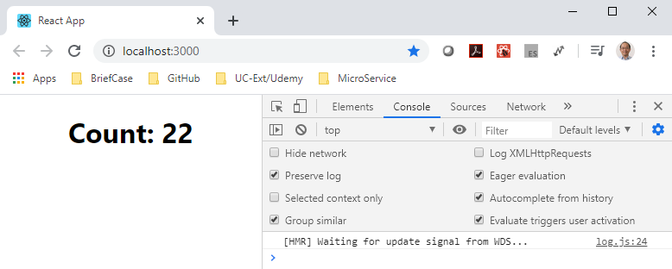
54.1 Class Component
https://www.youtube.com/watch?v=SP-NrbQHFww&list=PLC3y8-rFHvwgg3vaYJgHGnModB54rxOk3&index=54
IntervalClassCounter.js
> npm start

Slide 7
54.2 Functional Component

Slide 8
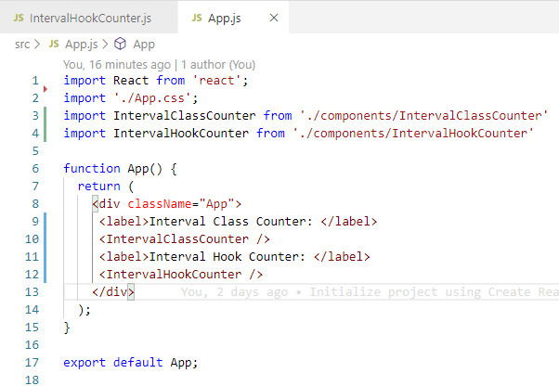
54.2Functional Component
https://www.youtube.com/watch?v=SP-NrbQHFww&list=PLC3y8-rFHvwgg3vaYJgHGnModB54rxOk3&index=54
App.js
Import IntervalHookCounter
<IntervalHookCounter />

Slide 9
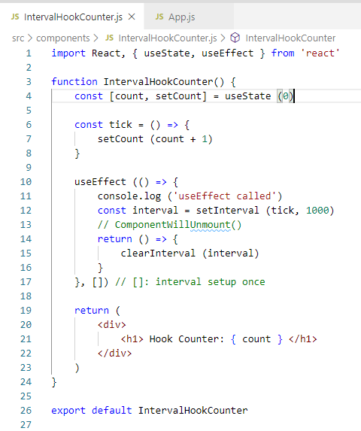
54.2Functional Component
https://www.youtube.com/watch?v=SP-NrbQHFww&list=PLC3y8-rFHvwgg3vaYJgHGnModB54rxOk3&index=54
IntervalHookCounter.js
const [count, setCount] = useState (0)
const tick = () => {
setCount (count + 1)
}
useEffect (() => {
const interval = setInterval (tick, 1000)
return () => { clearInterval (interval)}
}, []) // []: interval setup once
return ( <h1> { count } </h1>)

Slide 10
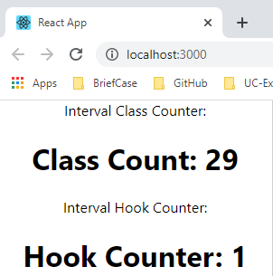
54.2Functional Component
https://www.youtube.com/watch?v=SP-NrbQHFww&list=PLC3y8-rFHvwgg3vaYJgHGnModB54rxOk3&index=54
IntervalClassCounter.js
> npm start
Class counter is working
Hook counter does not work

Slide 11
54.3 Dependency List

Slide 12
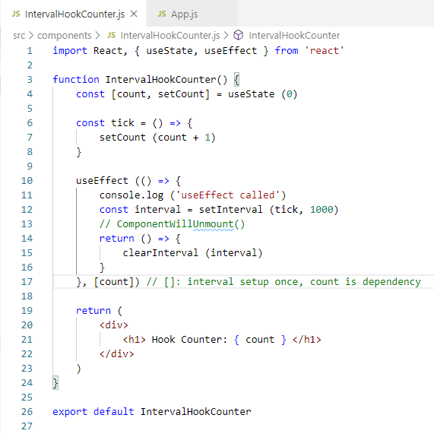
54.3 Dependency List
https://www.youtube.com/watch?v=SP-NrbQHFww&list=PLC3y8-rFHvwgg3vaYJgHGnModB54rxOk3&index=54
IntervalClassCounter.js
count value is set to 0 and increment to 1 through different render cycles.
If you wan to watch a variable, just add it to the dependency array.
It is a common mistake to leave out the dependency list empty.
Now, we add count as the dependency.

Slide 13
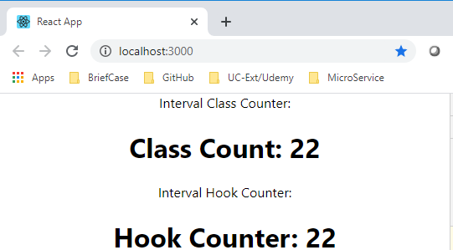
54.3 Dependency List
https://www.youtube.com/watch?v=SP-NrbQHFww&list=PLC3y8-rFHvwgg3vaYJgHGnModB54rxOk3&index=54
IntervalClassCounter.js
> npm start
Class counter is working
Hook counter is working as well.

Slide 14
54.4 Use PervCount

Slide 15
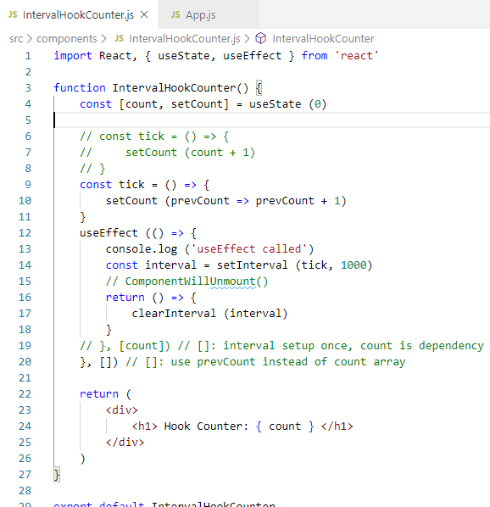
54.4 Use PervCount
https://www.youtube.com/watch?v=SP-NrbQHFww&list=PLC3y8-rFHvwgg3vaYJgHGnModB54rxOk3&index=54
IntervalClassCounter.js
setCount (prevCOunt => prevCount + 1)
useEffect( () => {
}, [])

Slide 16
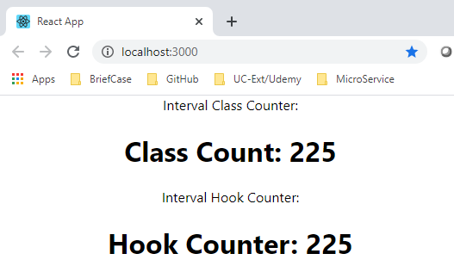
54.4 Use PervCount
https://www.youtube.com/watch?v=SP-NrbQHFww&list=PLC3y8-rFHvwgg3vaYJgHGnModB54rxOk3&index=54
IntervalClassCounter.js
> npm start
Class counter is working
Hook counter is working as well.

Slide 17
54.5 Summary of Incorrect Dependency

Slide 18
54.5 Summary of Incorrect Dependency
https://www.youtube.com/watch?v=SP-NrbQHFww&list=PLC3y8-rFHvwgg3vaYJgHGnModB54rxOk3&index=54
Summary of Incorrect Dependency
Your problem may be different from counter array.
So, always think before specify an empty dependency array.
Sometimes, you might want to call a function with a useEffect.
Put the function inside the useEffect() and put the [property] as array.
function doSomething () {
console.log (someProp)
}
useEffect (() => {
doSoemthing ()
…
}
useEffect (() => {
function doSomething () {
console.log (someProp)
}
…
}, [someProp])

Slide 19
54.5 Summary of Incorrect Dependency
https://www.youtube.com/watch?v=SP-NrbQHFww&list=PLC3y8-rFHvwgg3vaYJgHGnModB54rxOk3&index=54
Summary of Incorrect Dependency
Multiple useEffects
You can have multiple useEffects in the functional component.

Slide 20
End of Chapter

