Slide 1

55 Fetch Data with useEffect 01
Peter H. Chen

Slide 2
55 Fetch Data with useEffect 01
https://www.youtube.com/watch?v=bYFYF2GnMy8&list=PLC3y8-rFHvwgg3vaYJgHGnModB54rxOk3&index=55
Fetch Data with useEffec: Part 1
We already discussed the useState and useEffect.
Let’s apply the acquired knowledge to see how to fetch data from API endpoint.
The React suspense will replace the data fetching:
https://reactjs.org/docs/concurrent-mode-suspense.html

Slide 3
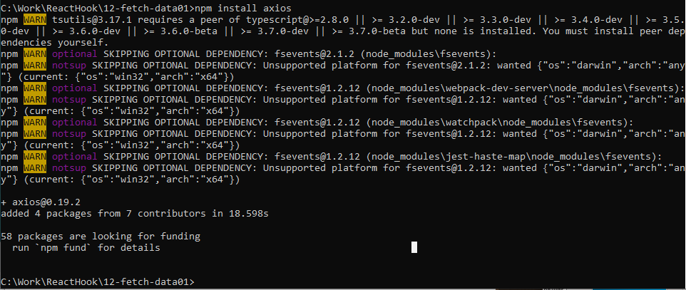
55 Fetch Data with useEffect 01
https://www.youtube.com/watch?v=bYFYF2GnMy8&list=PLC3y8-rFHvwgg3vaYJgHGnModB54rxOk3&index=55
Fetch Data with useEffec: Part 1
First step is to install the axios package.
> cd 12-fetch-data01
> npm install axios

Slide 4
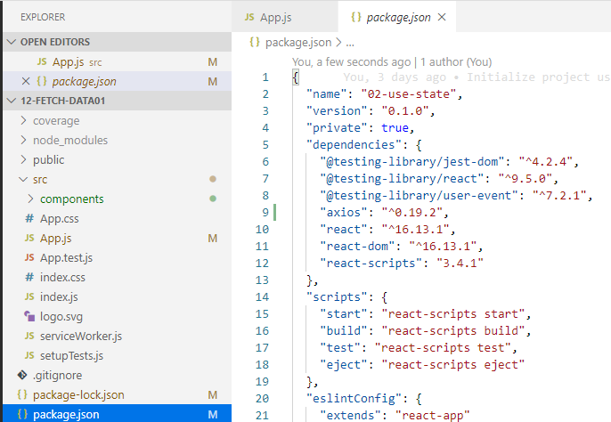
55 Fetch Data with useEffect 01
https://www.youtube.com/watch?v=bYFYF2GnMy8&list=PLC3y8-rFHvwgg3vaYJgHGnModB54rxOk3&index=55
Fetch Data with useEffec: Part 1
Once install is complete, check the package.json for the axios.

Slide 5
55.1 Data Fetching with useEffect

Slide 6
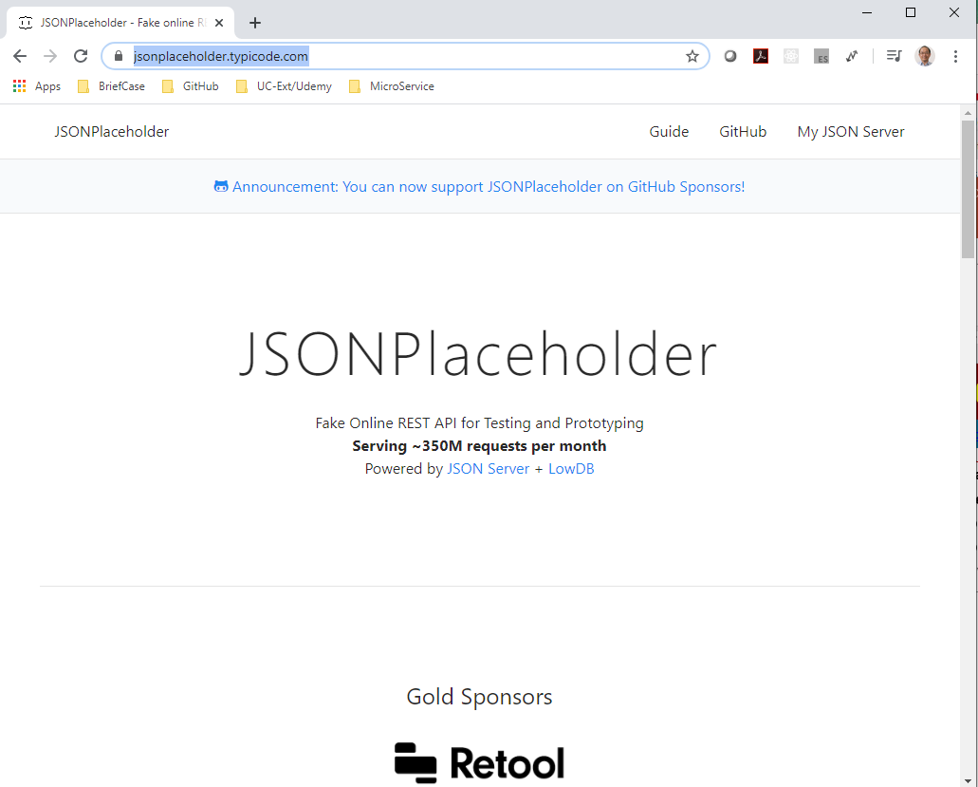
55.1 Data Fetching with useEffect
https://www.youtube.com/watch?v=bYFYF2GnMy8&list=PLC3y8-rFHvwgg3vaYJgHGnModB54rxOk3&index=55
DataFecthing.js
Type ‘rfce’ (React Functional Component ES7).
Import React, {useState, useEffect} from ‘react’
Import axios from ‘axios’
We will fetch data from JSON placeholder:
https://jsonplaceholder.typicode.com/

Slide 7
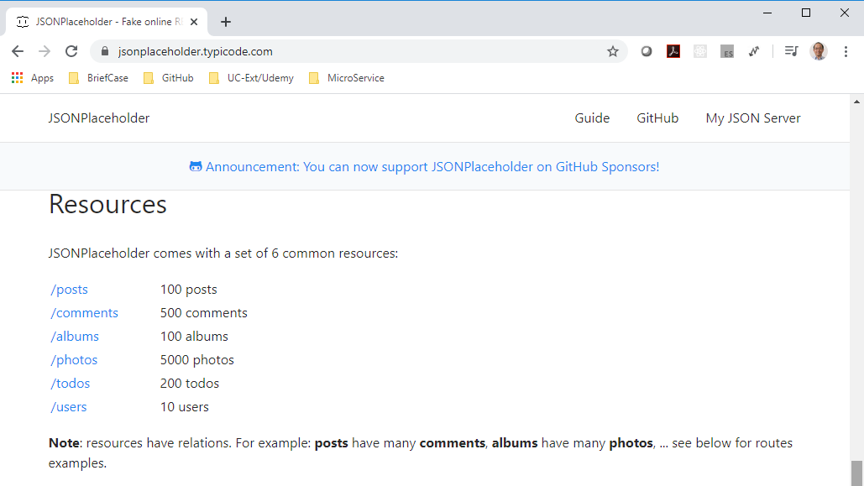
55.1 Data Fetching with useEffect
https://www.youtube.com/watch?v=bYFYF2GnMy8&list=PLC3y8-rFHvwgg3vaYJgHGnModB54rxOk3&index=55
DataFecthing.js
When you scroll down, you see the resources.
The first endpoint “/post” gives us 100 posts if you click on the link.

Slide 8
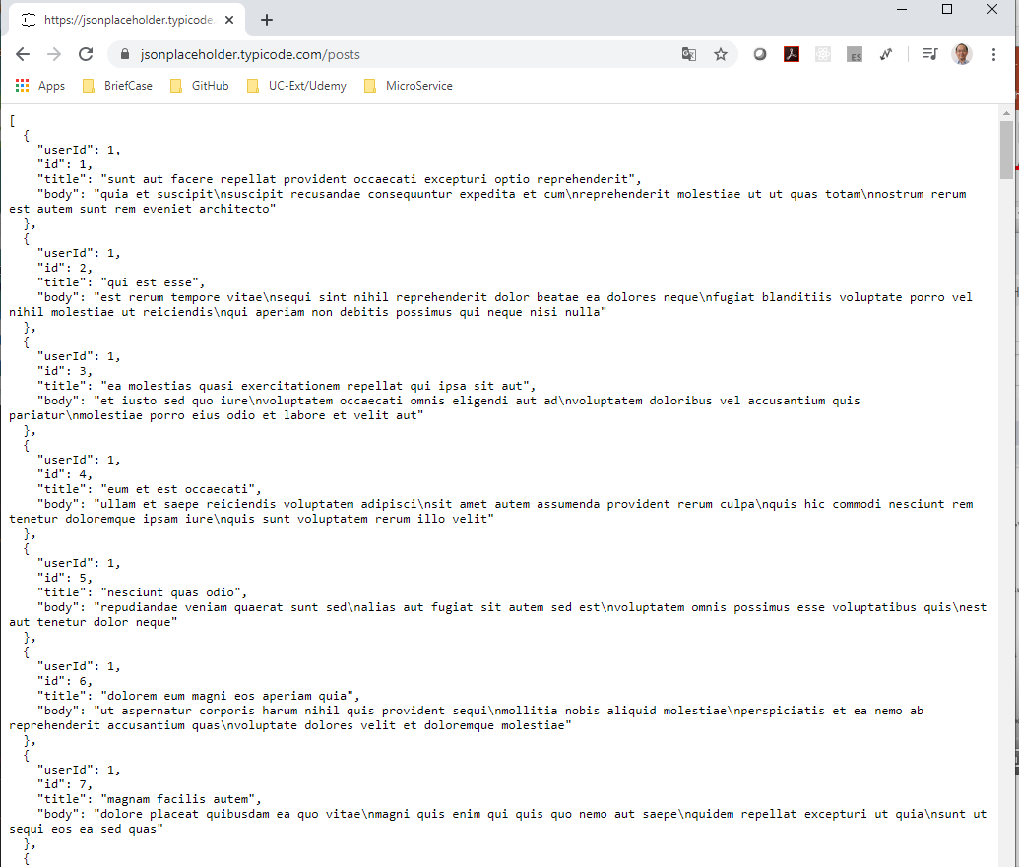
55.1 Data Fetching with useEffect
https://www.youtube.com/watch?v=bYFYF2GnMy8&list=PLC3y8-rFHvwgg3vaYJgHGnModB54rxOk3&index=55
DataFecthing.js
You can see the JSON data.

Slide 9
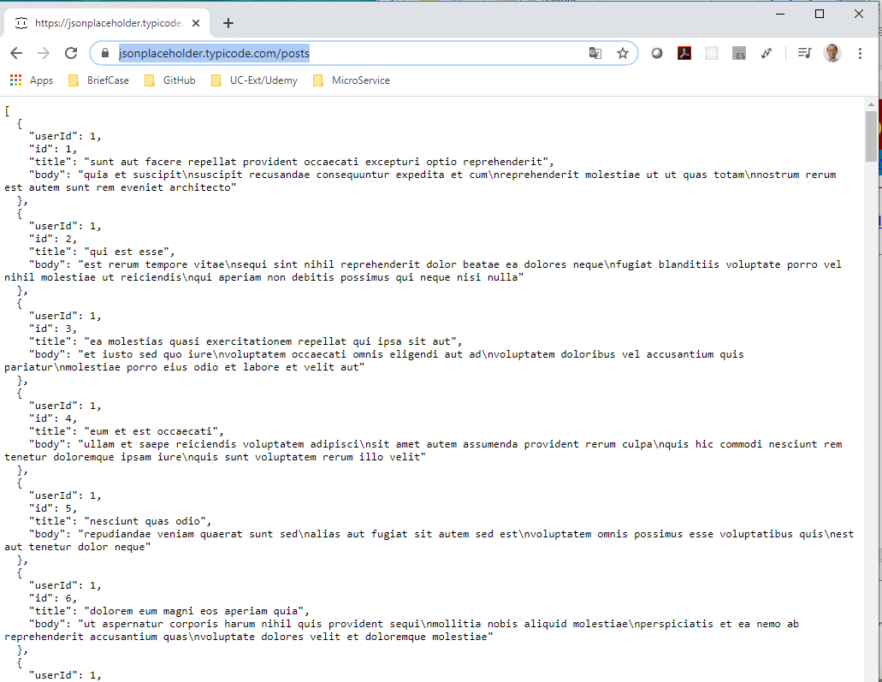
55.1 Data Fetching with useEffect
https://www.youtube.com/watch?v=bYFYF2GnMy8&list=PLC3y8-rFHvwgg3vaYJgHGnModB54rxOk3&index=55
DataFecthing.js
The URL (https://jsonplaceholder.typicode.com/posts) is the URL we need to make a GET request to in order to fetch this data.

Slide 10
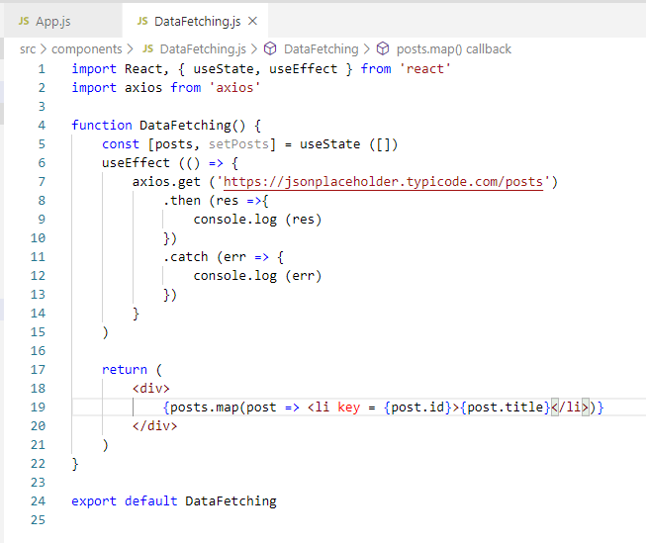
55.1 Data Fetching with useEffect
https://www.youtube.com/watch?v=bYFYF2GnMy8&list=PLC3y8-rFHvwgg3vaYJgHGnModB54rxOk3&index=55
DataFecthing.js
Let’s go back the VS code and fetch this array of posts.
First, we are going to create a new state variable.
const [posts, setPosts ] = useState ([])

Slide 11
55.1 Data Fetching with useEffect
https://www.youtube.com/watch?v=bYFYF2GnMy8&list=PLC3y8-rFHvwgg3vaYJgHGnModB54rxOk3&index=55
DataFecthing.js
Fetch the data from endpoint by
useEffect ( () => {
axios.get (‘url’) {
// axios return a promise
.then (res => {
console.log (res)
})
.catch(err => {
console.log (err)
})
})

Slide 12
55.1 Data Fetching with useEffect
https://www.youtube.com/watch?v=bYFYF2GnMy8&list=PLC3y8-rFHvwgg3vaYJgHGnModB54rxOk3&index=55
DataFecthing.js
Render the list of posts in the browser.
<ul>
{ posts.map (post => <li key = post.id> {post.title} </li>
)}
</ul>

Slide 13
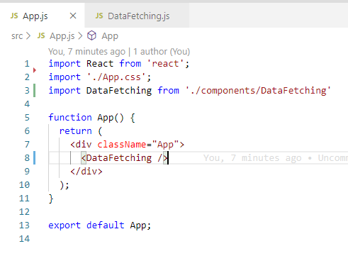
55.1 Data Fetching with useEffect
https://www.youtube.com/watch?v=bYFYF2GnMy8&list=PLC3y8-rFHvwgg3vaYJgHGnModB54rxOk3&index=55
App.js
Import DataFteching
<DataFetching />

Slide 14
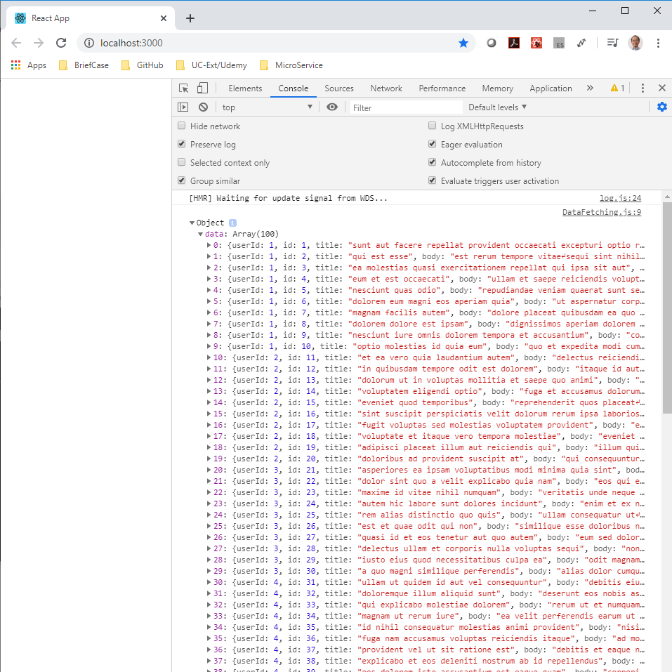
55.1 Data Fetching with useEffect
https://www.youtube.com/watch?v=bYFYF2GnMy8&list=PLC3y8-rFHvwgg3vaYJgHGnModB54rxOk3&index=55
DataFecthing.js
> npm start
> fn + F12
Check the data in the console.

Slide 15
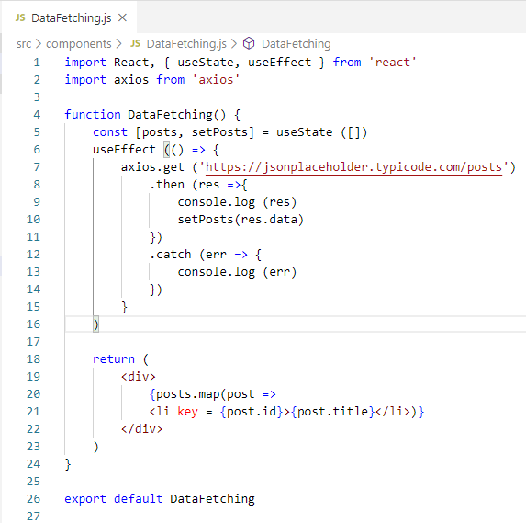
55.1 Data Fetching with useEffect
https://www.youtube.com/watch?v=bYFYF2GnMy8&list=PLC3y8-rFHvwgg3vaYJgHGnModB54rxOk3&index=55
DataFecthing.js
Set the response data for render by setPosts (res.data)

Slide 16
55.2 Set Data for Render

Slide 17
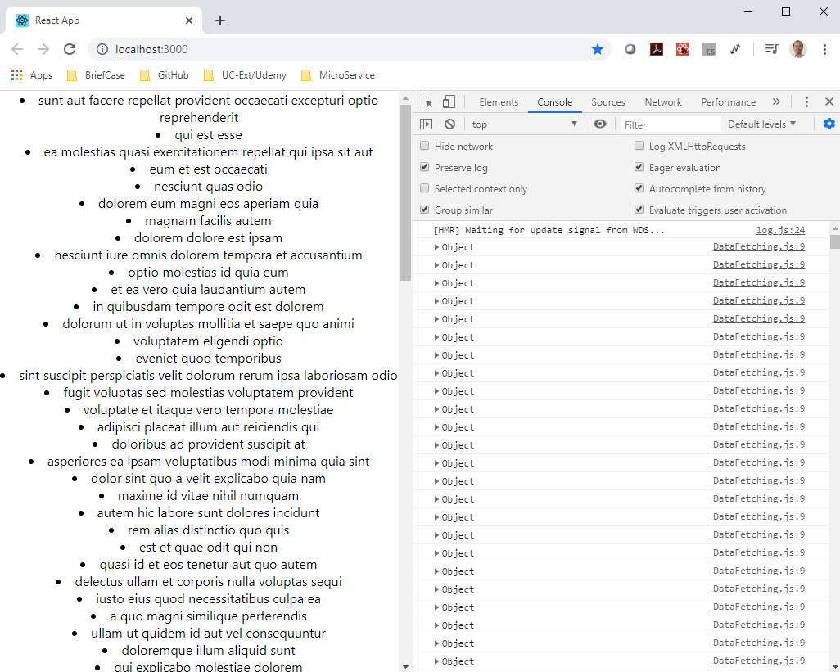
55.2 Set Data for Render
https://www.youtube.com/watch?v=bYFYF2GnMy8&list=PLC3y8-rFHvwgg3vaYJgHGnModB54rxOk3&index=55
DataFecthing.js
> npm start
You can see the data is displayed.
However, there are infinity loop in the console.

Slide 18
55.3 Fetch Data Once

Slide 19
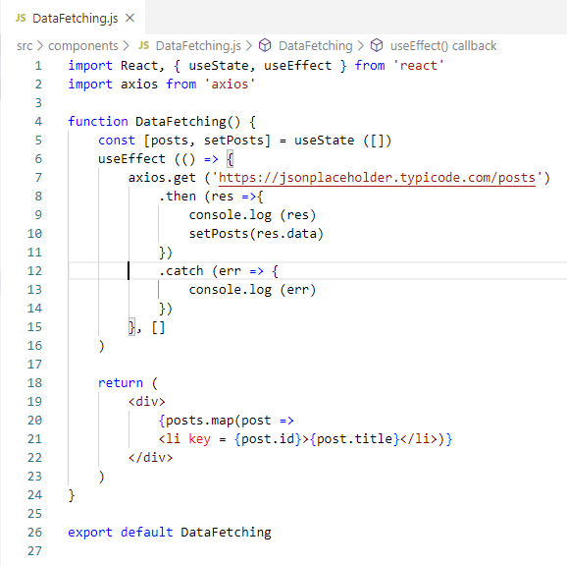
55.3 Fetch Data Once
https://www.youtube.com/watch?v=bYFYF2GnMy8&list=PLC3y8-rFHvwgg3vaYJgHGnModB54rxOk3&index=55
Fetch Data Once on ComponentDidMount
We want to data to be fetched only once on componentDidMount.
How should we do in useEffect?
To achieve that, we specify an empty dependency list in the useEffect.
Now, The second parameter is an empty array.

Slide 20
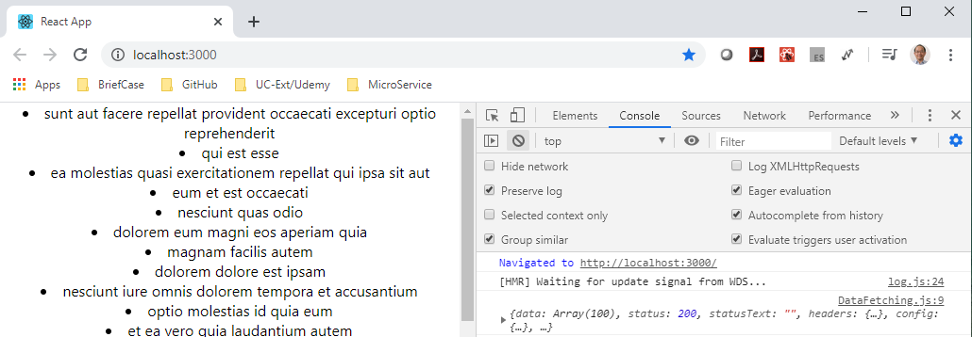
55.3 Fetch Data Once
https://www.youtube.com/watch?v=bYFYF2GnMy8&list=PLC3y8-rFHvwgg3vaYJgHGnModB54rxOk3&index=55
Fetch Data Once on ComponentDidMount
> npm start
You can see the console only fetch the data once.

Slide 21
End of Chapter

