Slide 1

56 Fetch Data by ID
Peter H. Chen

Slide 2
56 Fetch Data by ID
https://www.youtube.com/watch?v=1tfd6ANaNRY&list=PLC3y8-rFHvwgg3vaYJgHGnModB54rxOk3&index=56
Fetch Data by ID
In this discussion, we fetch individual posts by passing in the post ID to the get request.

Slide 3
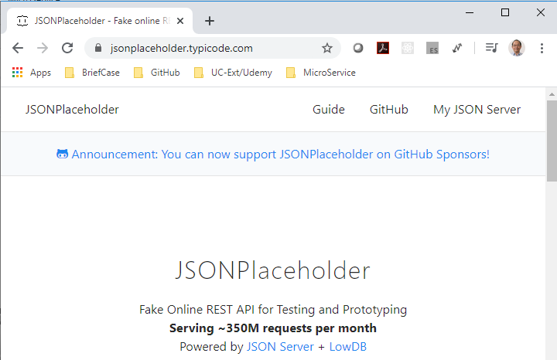
56 Fetch Data by ID
https://www.youtube.com/watch?v=1tfd6ANaNRY&list=PLC3y8-rFHvwgg3vaYJgHGnModB54rxOk3&index=56
Fetch Data by ID
Go back the JSON placeholder.com.

Slide 4
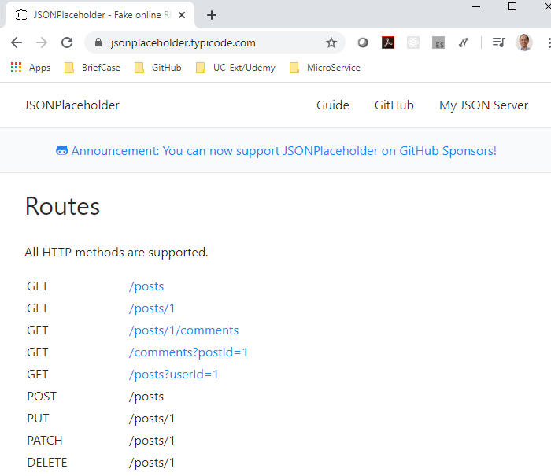
56 Fetch Data by ID
https://www.youtube.com/watch?v=1tfd6ANaNRY&list=PLC3y8-rFHvwgg3vaYJgHGnModB54rxOk3&index=56
Fetch Data by ID
Scroll down to the Routes Section and click /posts/1.

Slide 5
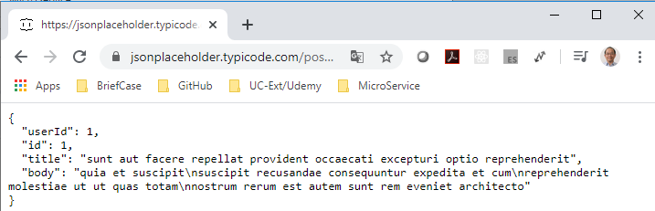
56 Fetch Data by ID
https://www.youtube.com/watch?v=1tfd6ANaNRY&list=PLC3y8-rFHvwgg3vaYJgHGnModB54rxOk3&index=56
Fetch Data by ID
Select GET “posts/1”

Slide 6
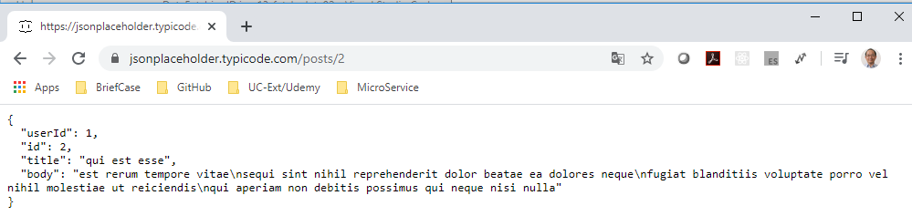
56 Fetch Data by ID
https://www.youtube.com/watch?v=1tfd6ANaNRY&list=PLC3y8-rFHvwgg3vaYJgHGnModB54rxOk3&index=56
Fetch Data by ID
Select GET “posts/2”
To retrieve the individual post by post ID, we just have to append “id” to current url.
We need to modify the useEffect Hook with pass “url/id”.

Slide 7
56.1 First Step

Slide 8
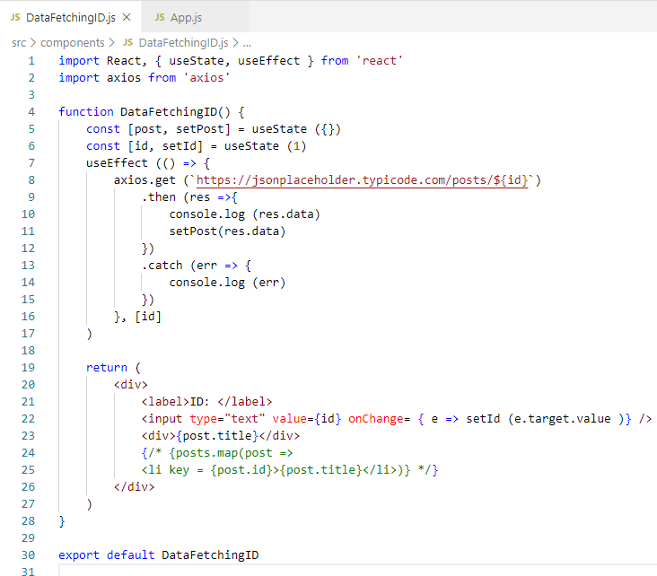
56.1 First Step
https://www.youtube.com/watch?v=1tfd6ANaNRY&list=PLC3y8-rFHvwgg3vaYJgHGnModB54rxOk3&index=56
Fetch Data with useEffec: Part 2
First Step:
We need to create an input element that will accept a post ID from user Input.
In the JSX, before the list of posts. We need to add input element.
<input type =“text” value = {id} onChange = {e => setId (e.target.value} />

Slide 9
56.2 Second Step

Slide 10
56.2 Second Step
https://www.youtube.com/watch?v=1tfd6ANaNRY&list=PLC3y8-rFHvwgg3vaYJgHGnModB54rxOk3&index=56
Fetch Data with useEffec: Part 2
Second Step:
Set default empty list:
const [post, setPost] = setState ({})
Set Id = 1.
const [id, setId] = useState (1)

Slide 11
56.3 Third Step

Slide 12
56.3 Third Step
https://www.youtube.com/watch?v=1tfd6ANaNRY&list=PLC3y8-rFHvwgg3vaYJgHGnModB54rxOk3&index=56
Fetch Data with useEffec: Part 2
Third Step:
We need ${}: Change ‘’ into backtick `` for template literal.
We append the id .get(`…/${id}`)
When we make a request, we get a single post in stead of an array of posts.
Keep the value in the second list.

Slide 13
56.4 Fourth Step

Slide 14
56.4 Fourth Step
https://www.youtube.com/watch?v=1tfd6ANaNRY&list=PLC3y8-rFHvwgg3vaYJgHGnModB54rxOk3&index=56
Fetch Data with useEffec: Part 2
Fourth Step:
Change the state variable from posts into post.
const [post, setPost] = useState ({})
setPost (res.data)
In the render, we do not need to map array posts into single post.
<div> post.title </div>

Slide 15
56.5 Fifth Step

Slide 16
56.5 Fifth Step
https://www.youtube.com/watch?v=1tfd6ANaNRY&list=PLC3y8-rFHvwgg3vaYJgHGnModB54rxOk3&index=56
Fetch Data with useEffec: Part 2
Fifth Step:
In the render, we do not need to map array posts into single post.
<div> post.title </div>

Slide 17
56.6 Verify Result

Slide 18
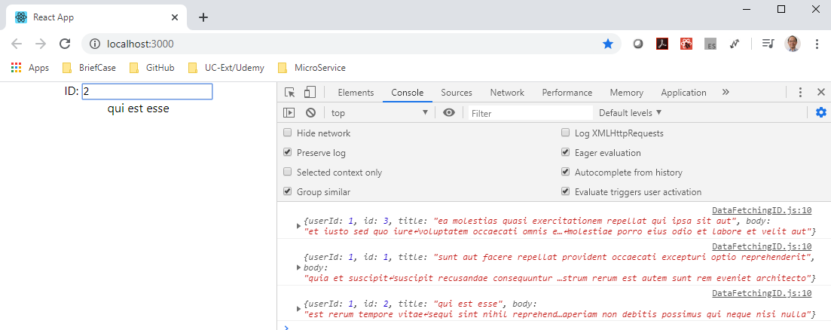
56.6 Verify Result
https://www.youtube.com/watch?v=1tfd6ANaNRY&list=PLC3y8-rFHvwgg3vaYJgHGnModB54rxOk3&index=56
Fetch Data with useEffec: Part 2
> npm start
Enter id 1, 2, 3, and etc. Check the display

Slide 19
End of Chapter

