Slide 1

57 Fetch Data by Click Button
Peter H. Chen

Slide 2
57 Fetch Data by Click Button
https://www.youtube.com/watch?v=zm_09NER-R0&list=PLC3y8-rFHvwgg3vaYJgHGnModB54rxOk3&index=57
Fetch Data by Click Button
In this discussion, we will fetch data which is triggered by button click.
We will create a button and a handler.
In the handler, we made a GET request.
We want to understand what is the difference between the useEffect Hook and click Handle.
The display value is change only based on the button click.
The only value changed here is the post ID.

Slide 3
57.1 First Step

Slide 4
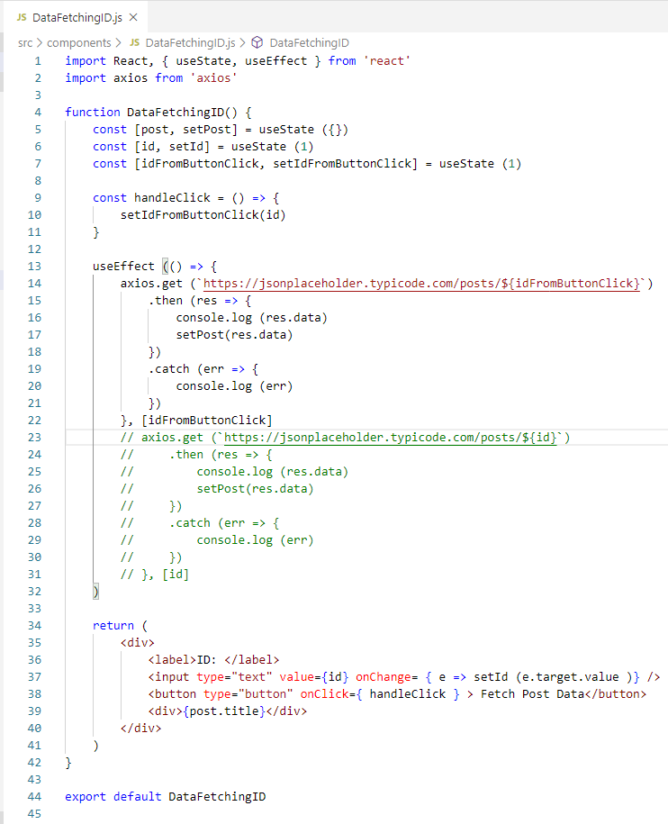
57.1 First Step
https://www.youtube.com/watch?v=zm_09NER-R0&list=PLC3y8-rFHvwgg3vaYJgHGnModB54rxOk3&index=57
Fetch Data by Click Button
We create a new state variable.
const [idFromButonClick, setIdFromButtonClick] = useState (1)

Slide 5
57.2 Second Step

Slide 6
57.2 Second Step
https://www.youtube.com/watch?v=zm_09NER-R0&list=PLC3y8-rFHvwgg3vaYJgHGnModB54rxOk3&index=57
Fetch Data by Click Button
Second Step:
Add the button after the input element:
<button type=“button” onClick = { handleClick }>Fetch Post Data</button>

Slide 7
57.3 Third Step

Slide 8
57.3 Third Step
https://www.youtube.com/watch?v=zm_09NER-R0&list=PLC3y8-rFHvwgg3vaYJgHGnModB54rxOk3&index=57
Fetch Data by Click Button
Third Step:
Add Function handleClick. We pass in the current ID value in setIdFromButtonClick (id).
const handleClick = () => {
setIdFromButtonClick(id)
}

Slide 9
57.4 Fourth Step

Slide 10
57.4 Fourth Step
https://www.youtube.com/watch?v=zm_09NER-R0&list=PLC3y8-rFHvwgg3vaYJgHGnModB54rxOk3&index=57
Fetch Data by Click Button
Fourth Step:
We must let the useEffect Hook know, now, useEffect Hook is dependent on the ID from button click value instead of regular ID from text field. The idFromButtonClick.
useEffect (() => {
…
}, [idFromButtonClick])

Slide 11
57.5 Verify Button Click

Slide 12
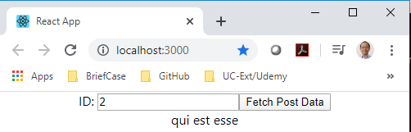
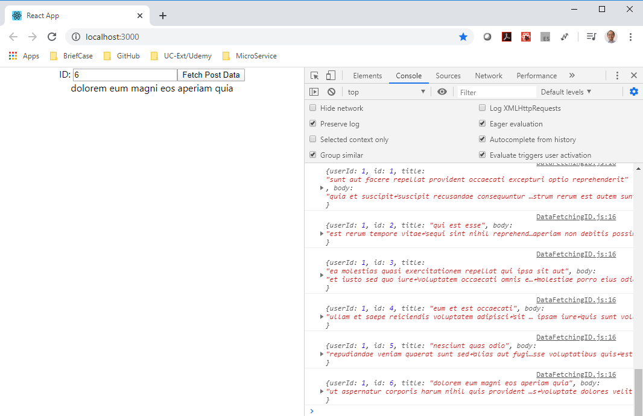
57.5 Verify Button Click
https://www.youtube.com/watch?v=zm_09NER-R0&list=PLC3y8-rFHvwgg3vaYJgHGnModB54rxOk3&index=57
Fetch Data by Click Button
> npm start

Slide 13
End of Chapter

