Slide 1

59 useContext Hook 02
Peter H. Chen

Slide 2
59 useContext Hook 02
https://www.youtube.com/watch?v=tEqNSOhCHLU&list=PLC3y8-rFHvwgg3vaYJgHGnModB54rxOk3&index=59
Context:
We will consider the rightmost part of the component tree.
The component tree C, E, and F are passed the username prop.
AppComponent
username
username
A
B
C
username
D
E
username
F

Slide 3
59 useContext Hook 02
https://www.youtube.com/watch?v=tEqNSOhCHLU&list=PLC3y8-rFHvwgg3vaYJgHGnModB54rxOk3&index=59
Context:
Context provides a way to pass data through the component tree without having to pass props down manually at every level.
We discussed there is a problem to pass the props through several levels in the component tree.
We will understand the problem by using both old way context API and new way useContext Hook.
AppComponent
username
username
A
B
C
username
D
E
username
F

Slide 4
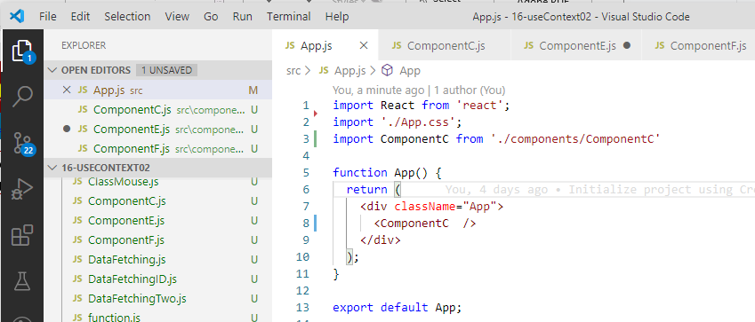
59 useContext Hook 02
https://www.youtube.com/watch?v=tEqNSOhCHLU&list=PLC3y8-rFHvwgg3vaYJgHGnModB54rxOk3&index=59
Context:
Create ComponentC.js, CompoentE.js, and CompoentF.js.

Slide 5
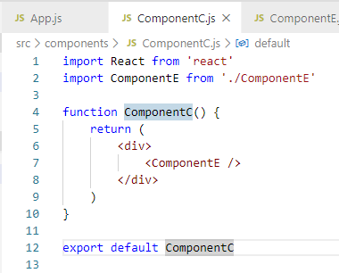
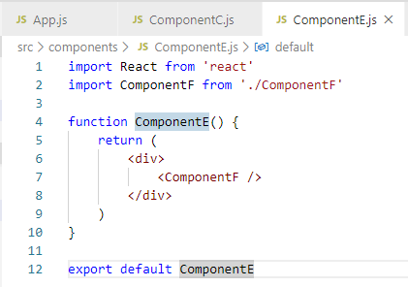
59 useContext Hook 02
https://www.youtube.com/watch?v=tEqNSOhCHLU&list=PLC3y8-rFHvwgg3vaYJgHGnModB54rxOk3&index=59
Context:
ComponentC import ComponentE.
ComponentE import ComponentF.

Slide 6
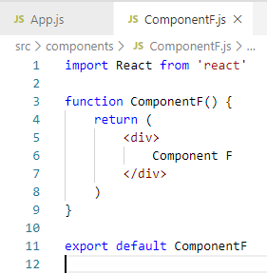
59 useContext Hook 02
https://www.youtube.com/watch?v=tEqNSOhCHLU&list=PLC3y8-rFHvwgg3vaYJgHGnModB54rxOk3&index=59
Context:
ComponentF displays ‘Component F’

Slide 7
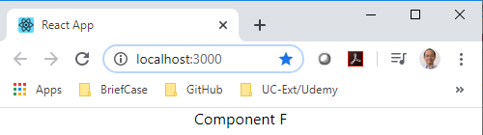
59 useContext Hook 02
https://www.youtube.com/watch?v=tEqNSOhCHLU&list=PLC3y8-rFHvwgg3vaYJgHGnModB54rxOk3&index=59
Context:
> nm start

Slide 8
59.1 Step 1

Slide 9
59.1 Step 1
https://www.youtube.com/watch?v=tEqNSOhCHLU&list=PLC3y8-rFHvwgg3vaYJgHGnModB54rxOk3&index=59
Context:
Step one: Create the Context.
In top AppCompoent, create the context.
const UserContext = React.createContext()

Slide 10
59.2 Step 2

Slide 11
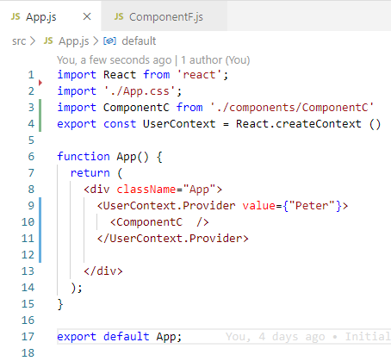
59.2 Step 2
https://www.youtube.com/watch?v=tEqNSOhCHLU&list=PLC3y8-rFHvwgg3vaYJgHGnModB54rxOk3&index=59
Context:
Step two: We need to provide this context with a value.
The provider must wrap the children components for the value to be available.
We wrap component;
<UserContex.Provider>
<ComponentC />
</UserContext.Provide>
We need to provide the context value, for example,
<UserContex.Provider value={“Peter”}>
<ComponentC />
</UserContext.Provide>
We also need to “export const UserContext”

Slide 12
59.3 Step 3

Slide 13
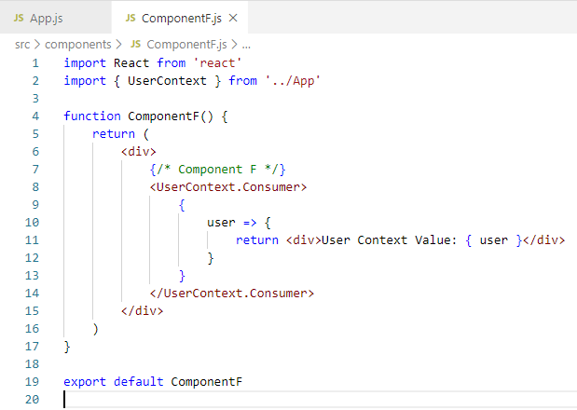
59.3 Step 3
https://www.youtube.com/watch?v=tEqNSOhCHLU&list=PLC3y8-rFHvwgg3vaYJgHGnModB54rxOk3&index=59
Context:
Step Three:
import { UserContext } from ‘../App’
<div>
<UserContext.Consumer>
{
user => {
return
<div>
User Context Value: { user}
</div>
}
}
</UserContext.Consumer>
</div>

Slide 14
59.4 Verify Context

Slide 15
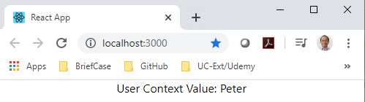
59.4 Verify Context
https://www.youtube.com/watch?v=tEqNSOhCHLU&list=PLC3y8-rFHvwgg3vaYJgHGnModB54rxOk3&index=59
Context:
> npm start
The Provide give data from AppCompoent.
The Consumer take data out of compoentF.

Slide 16
59.5 Multiple Context: Provider

Slide 17
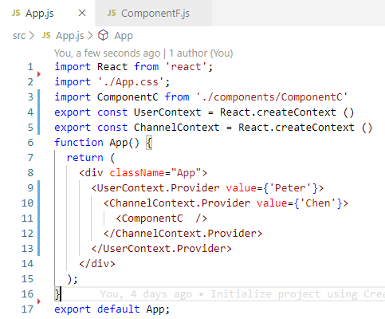
59.5 Multiple Context: Provider
https://www.youtube.com/watch?v=tEqNSOhCHLU&list=PLC3y8-rFHvwgg3vaYJgHGnModB54rxOk3&index=59
Context:
Create another context:
export const UserContext = React.createContext()
export const ChannelContext = React.createContext()

Slide 18
59.5 Multiple Context: Provider
https://www.youtube.com/watch?v=tEqNSOhCHLU&list=PLC3y8-rFHvwgg3vaYJgHGnModB54rxOk3&index=59
Context:
<UserContext.Provideer value={‘Peter’}>
<ChannelContext.Provider value = {‘Chen’}>
<ComponentC />
</ChannelContext.Provider>
</UserContext.Provideer>

Slide 19
59.6 Multiple Context: Consumer

Slide 20
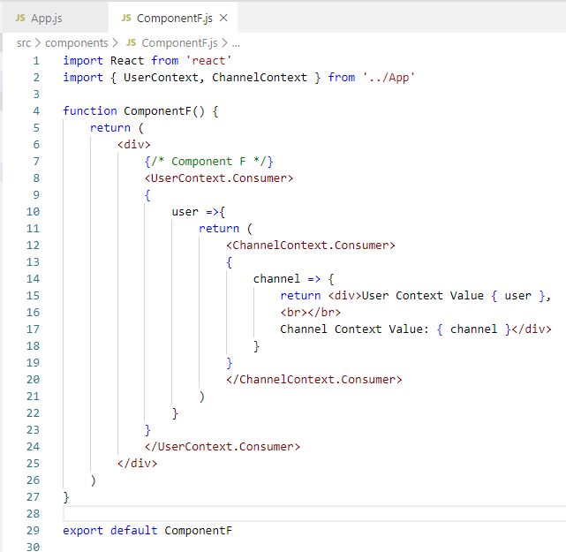
59.6 Multiple Context: Consumer
https://www.youtube.com/watch?v=tEqNSOhCHLU&list=PLC3y8-rFHvwgg3vaYJgHGnModB54rxOk3&index=59
Context:
Provider

Slide 21
59.7 Verify Multiple Context

Slide 22
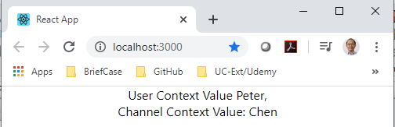
59.7 Verify Multiple Context
https://www.youtube.com/watch?v=tEqNSOhCHLU&list=PLC3y8-rFHvwgg3vaYJgHGnModB54rxOk3&index=59
Context:
> npm start

Slide 23
End of Chapter

