Slide 1

60 useContext Hook 03
Peter H. Chen

Slide 2
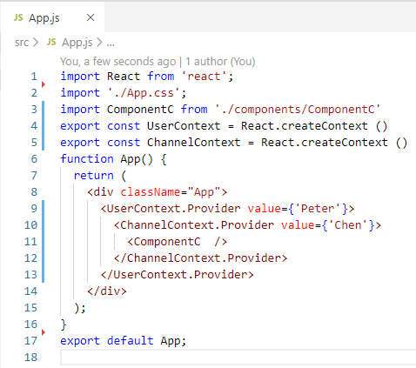
60 useContext Hook 03
https://www.youtube.com/watch?v=UjjtvroahBU&list=PLC3y8-rFHvwgg3vaYJgHGnModB54rxOk3&index=60
Context:
In this discussion, we will make the render context with useContext.
We have three steps to creating and consuming a context value.
Step one: Create a context using the create context method.
Step two: We provide the context value at a high level in the component.
We will not modify the Step 1 and Step 2, i.e., keep step 1 and step 2 the same, no modification required for provider.
We only simply the consumer code in Step 3.

Slide 3
60.1 Modify Consumer Code

Slide 4
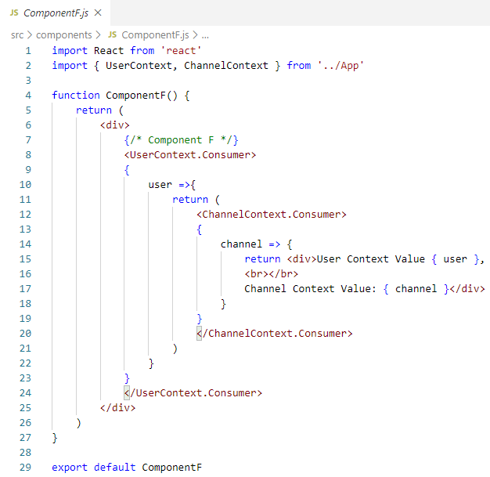
60.1 Modify Consumer Code
https://www.youtube.com/watch?v=UjjtvroahBU&list=PLC3y8-rFHvwgg3vaYJgHGnModB54rxOk3&index=60
Context:
Step three:
We consume the context value using the render props pattern.
The codes look too long and hard too read.

Slide 5
60.2 Import Context

Slide 6
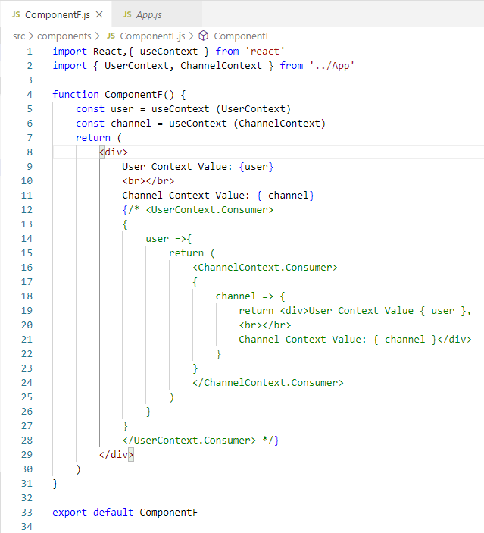
60.2 Import Context
https://www.youtube.com/watch?v=UjjtvroahBU&list=PLC3y8-rFHvwgg3vaYJgHGnModB54rxOk3&index=60
Context:
First:
Import { userContext, ChannelContext } from ‘../App’

Slide 7
60.3 useContext

Slide 8
60.3 useContext
https://www.youtube.com/watch?v=UjjtvroahBU&list=PLC3y8-rFHvwgg3vaYJgHGnModB54rxOk3&index=60
Context:
Second:
const user = useContext (UserContext)
const channel = useContext (ChannelContext)

Slide 9
60.4 Render Context

Slide 10
60.4 Render Context
https://www.youtube.com/watch?v=UjjtvroahBU&list=PLC3y8-rFHvwgg3vaYJgHGnModB54rxOk3&index=60
Context:
Third: Render the context value
{ user }
{ channel }

Slide 11
60.5 Verify Display

Slide 12
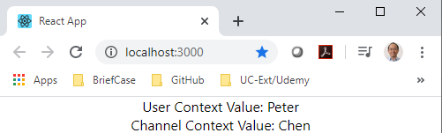
60.5 Verify Display
https://www.youtube.com/watch?v=UjjtvroahBU&list=PLC3y8-rFHvwgg3vaYJgHGnModB54rxOk3&index=60
Context:
> npm start

Slide 13
60.6 Summary of useContext

Slide 14
60.6 Summary of useContext
https://www.youtube.com/watch?v=UjjtvroahBU&list=PLC3y8-rFHvwgg3vaYJgHGnModB54rxOk3&index=60
Summary of useContext
In the top component,
Create Context and
provide the multiple context values.
In the consumer component,
import the created context
use useContext to create the multiple context values.
Render the multiple context values.

Slide 15
End of Chapter

