Slide 1

61 useReducer Hook
Peter H. Chen

Slide 2
61 useReducer Hook
https://www.youtube.com/watch?v=cVYp4u1m6iA&list=PLC3y8-rFHvwgg3vaYJgHGnModB54rxOk3&index=61
useRedcuer Hook:
We have discussed three Hooks: useState Hook, useEffect Hook, and useContext Hook.
In this discussion, we discuss useReducer Hook.

Slide 3
61 useReducer Hook
https://www.youtube.com/watch?v=cVYp4u1m6iA&list=PLC3y8-rFHvwgg3vaYJgHGnModB54rxOk3&index=61
What is useReducer?
useReducer is a Hook that is used for state management.
We already have useState for state management.
The useReducer is an alternative to useState.
The next question is What is the difference between the useState and useReducer?
useState is built using useReducer.
useReducer is a more primitive Hook compared to useState.
This brings us the most important question, if both of them are used for management state,
When to use useReducer vs. useState?
We will come back to this question after we go though all the examples.
We will understand the answer after we understand the various details about the useReducer.
Right now, we just understand one statement: useReducer is a Hook for state management in React.

Slide 4
61 useReducer Hook
https://www.youtube.com/watch?v=cVYp4u1m6iA&list=PLC3y8-rFHvwgg3vaYJgHGnModB54rxOk3&index=61
Review the Hooks
useState: state
useEffect: side Effect
useContext: Context API.
useReducer: reducers
What is reducer?
I you know Redux, it is easier to understand the Reducer.
JavaScript have built-in function on Array instance, for example, forEach, map, and reduce.

Slide 5
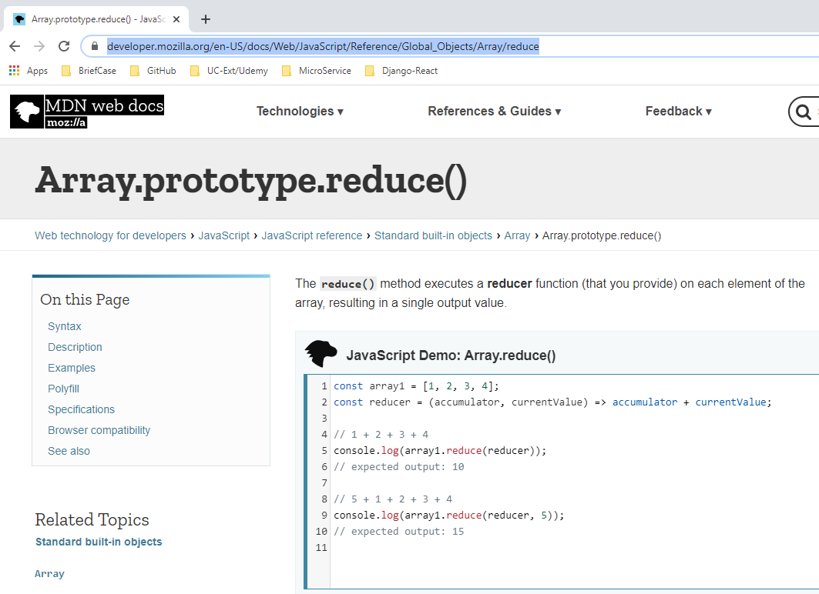
61 useReducer Hook
https://www.youtube.com/watch?v=cVYp4u1m6iA&list=PLC3y8-rFHvwgg3vaYJgHGnModB54rxOk3&index=61
Let’s focus on the Reduce function.
Check the MDN web docs for Array.proptotype.reduce()
https://developer.mozilla.org/en-US/docs/Web/JavaScript/Reference/Global_Objects/Array/reduce

Slide 6
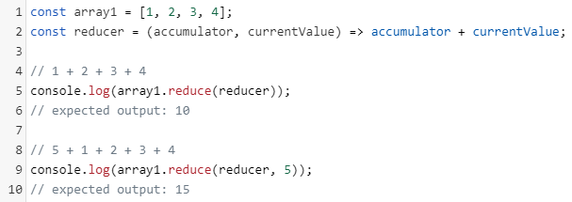
61 useReducer Hook
https://www.youtube.com/watch?v=cVYp4u1m6iA&list=PLC3y8-rFHvwgg3vaYJgHGnModB54rxOk3&index=61
Reducer:
If you read the reducer description, it said:
The reducer() method executes a reducer function (that you provide) on each element of the array, resulting in a single output value.
In the below example:
Line 1 is an array of four numbers, 1, 2, 3, and 4.
Line 2 is a function called reducer which accepts two parameters: accumulator and current Value, and return a single value which is the summation of two parameters.
Line 5 is the log statement of reduce function call.

Slide 7
61 useReducer Hook
https://www.youtube.com/watch?v=cVYp4u1m6iA&list=PLC3y8-rFHvwgg3vaYJgHGnModB54rxOk3&index=61
Reducer:
Line 9 is the second form of the reduced method, which accepts the initial value 5 for the accumulator parameter.
The reduce method takes two parameters, the first parameter is the reducer function and the second parameter is the initial value that the reducer function can make use of.
The reducer function itself again accepts two parameters, and reduces them down to a single value and then return the value.

Slide 8
61 useReducer Hook
https://www.youtube.com/watch?v=cVYp4u1m6iA&list=PLC3y8-rFHvwgg3vaYJgHGnModB54rxOk3&index=61
Reducer:
In line 5 and 9, the reducer takes two values and returns one value which is the summation.

Slide 9
61 useReducer Hook
https://www.youtube.com/watch?v=cVYp4u1m6iA&list=PLC3y8-rFHvwgg3vaYJgHGnModB54rxOk3&index=61
reduce vs. useReducer
There is a big similarity between the reduce and the useReducer Hook.
In the JavaScript reduce function, we have two parameter, one reduce method and one initial value for the accumulator.
Similarly, with useReducer, we again, have two parameters, the first parameter is a reducer function, and second parameter is the initial state.
reduce in JavaScript | useReducer in React
array.reduce (reducer, intialValue) | useReducer (reducer, initialState)

Slide 10
61 useReducer Hook
https://www.youtube.com/watch?v=cVYp4u1m6iA&list=PLC3y8-rFHvwgg3vaYJgHGnModB54rxOk3&index=61
reduce vs. useReducer
With the reducer function, with the simplest form, it accepts two parameters, which are the accumulator and item value and return a single value.
With the useReducer, the reducer function accepts two parameters, but this time, the parameters are the current state and something called action. The reducer is return the new state.
The action parameter is what dictates (exactly write down what it heard) the state transition.
reduce in JavaScript | useReducer in React
array.reduce (reducer, intialValue) | useReducer (reducer, initialState)
singleValue = reducer (accumulator, itemValue) | newState = reducer (currentState, action)

Slide 11
61 useReducer Hook
https://www.youtube.com/watch?v=cVYp4u1m6iA&list=PLC3y8-rFHvwgg3vaYJgHGnModB54rxOk3&index=61
reduce vs. useReducer
Next, we discuss the return value. The reduce method return a single value.
The useReduce Hook, on the other hand, returns a pair of values, the newState and something called a dispatch method which is basically used to specify the action.
reduce in JavaScript | useReducer in React
array.reduce (reducer, intialValue) | useReducer (reducer, initialState)
singleValue = reducer (accumulator, itemValue) | newState = reducer (currentState, action)
return method returns a single value | useReduce returns a pair of values. [newState, dispatch]

Slide 12
61 useReducer Hook
https://www.youtube.com/watch?v=cVYp4u1m6iA&list=PLC3y8-rFHvwgg3vaYJgHGnModB54rxOk3&index=61
reduce vs. useReducer
Now, the syntax, what and why if the useReducer should be clear.
reduce in JavaScript | useReducer in React
array.reduce (reducer, intialValue) | useReducer (reducer, initialState)
singleValue = reducer (accumulator, itemValue) | newState = reducer (currentState, action)
return method returns a single value | useReduce returns a pair of values. [newState, dispatch]

Slide 13
61 useReducer Hook
https://www.youtube.com/watch?v=cVYp4u1m6iA&list=PLC3y8-rFHvwgg3vaYJgHGnModB54rxOk3&index=61
useReducer Summary
useReducer is Hook that is used for state management in React.
Similar to useState being related to component state, useEffect related to side effect, useContext related to context API, the useReducer is related to reducer functions.
The useReducer (reducer, initialState) function accepts two parameters, a reducer function and a initial state.
The reducer (currentState, action) function also accepts two parameters which are the current state and the action depending on the value of current state and the action. The reducer function will return a new state. So basically, changing the state in the React components.

Slide 14
End of Chapter

