Slide 1

62 Simple State and Action
Peter H. Chen

Slide 2
62 Simple State and Action
https://www.youtube.com/watch?v=IHJ-TO_1nME&list=PLC3y8-rFHvwgg3vaYJgHGnModB54rxOk3&index=62
useRedcuer Hook: Simple State and Action
We have discussed three Hooks: useState Hook, useEffect Hook, and useContext Hook.
In this discussion, we discuss useReducer Hook.

Slide 3
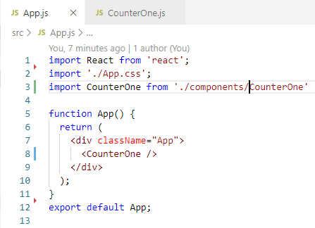
62 Simple State and Action
https://www.youtube.com/watch?v=IHJ-TO_1nME&list=PLC3y8-rFHvwgg3vaYJgHGnModB54rxOk3&index=62
useRedcuer Hook: Simple State and Action
App.js:
Import CounterOne
<CounterOne />

Slide 4
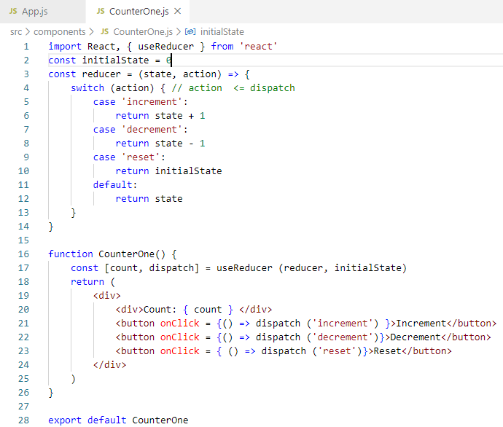
62 Simple State and Action
https://www.youtube.com/watch?v=IHJ-TO_1nME&list=PLC3y8-rFHvwgg3vaYJgHGnModB54rxOk3&index=62
useRedcuer Hook: Simple State and Action
CounterOne.js:
Create
<button>Increment</button>
<button>Decrement</button>
<button>Reset</button>
We want to useRedcuer to reduce the replication.

Slide 5
62 Simple State and Action
https://www.youtube.com/watch?v=IHJ-TO_1nME&list=PLC3y8-rFHvwgg3vaYJgHGnModB54rxOk3&index=62
useRedcuer Hook: Simple State and Action
Step 1: define the useReducer, reducer, and initialState
const initialState = 0

Slide 6
62 Simple State and Action
https://www.youtube.com/watch?v=IHJ-TO_1nME&list=PLC3y8-rFHvwgg3vaYJgHGnModB54rxOk3&index=62
useRedcuer Hook: Simple State and Action
Step 2: define initial state and reducer function
const reducer = (state, action) => {
// To make newState, we need action to make it happened. The action function
// transforms state into newState. The action can be increment, decrement, and reset
switch (action) {
case ‘increment’:
return state + 1
case ‘decrement’:
return state - 1
case ‘reset’:
return initialState
default:
return state
}
// return newState
}

Slide 7
62 Simple State and Action
https://www.youtube.com/watch?v=IHJ-TO_1nME&list=PLC3y8-rFHvwgg3vaYJgHGnModB54rxOk3&index=62
useRedcuer Hook: Simple State and Action
Step 3:
const [count, dispatch] = useReducer (reducer, initialState)
// The useReducer return the count and dispatch.
// The dispatch is a Click callback function to accept action and to execute
// the code corresponding to a particular action.
// In JSX, <div>… </div>
<div>
<div>Count: { count } </div>
<button onClick = {() => dispatch (‘increment’)}>Increment</button>
<button onCLick = {() => dispatch(‘decrement’)}>Decrement</button>
<button onClick = {() => dispatch (‘reset’)}>Reset</button>
</div>

Slide 8
62.1 Verify Display

Slide 9
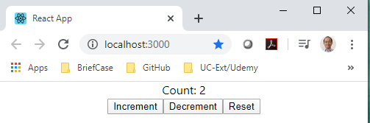
62.1 Verify Display
https://www.youtube.com/watch?v=IHJ-TO_1nME&list=PLC3y8-rFHvwgg3vaYJgHGnModB54rxOk3&index=62
Verify Display:
> npm start

Slide 10
End of Chapter

