Slide 1

63 Complex State and Action
Peter H. Chen

Slide 2
63 Complex State and Action
https://www.youtube.com/watch?v=uX7lxFrWUbA&list=PLC3y8-rFHvwgg3vaYJgHGnModB54rxOk3&index=63
useReducer Hook: Simple State and Action
We discussed the second example of useReducer.
Instead of simple State and Action, we use a state object and action object.
This is the pattern similar to all the Redux users.

Slide 3
63 Complex State and Action
https://www.youtube.com/watch?v=uX7lxFrWUbA&list=PLC3y8-rFHvwgg3vaYJgHGnModB54rxOk3&index=63
useReducer Hook: Simple State and Action
Create CounterTwo.js
Copy CounterOne.js to CounterTwo.js

Slide 4
63.1 Change State Object

Slide 5
63.1 Change State Object
https://www.youtube.com/watch?v=uX7lxFrWUbA&list=PLC3y8-rFHvwgg3vaYJgHGnModB54rxOk3&index=63
useReducer Hook: Simple State and Action
const initialState = {
firstCounter: 0
}
Render the counter property:
<div> Count: { count.firstCounter } </div>
<button onClick = {() =>dispatch ({type: ‘increment’})}> Increment</button>
<button onClick = {() =>dispatch ({type: ‘decrement’})}> Decrement</button>
<button onClick = {() =>dispatch ({type: ‘reset’})}> Reset</button>

Slide 6
63.1 Change State Object
https://www.youtube.com/watch?v=uX7lxFrWUbA&list=PLC3y8-rFHvwgg3vaYJgHGnModB54rxOk3&index=63
useReducer Hook: Simple State and Action
const reducer = (state, action) => {
switch (action.type) {
case ‘increment’:
return { firstCounter: state.firstCounter + 1 }
case ‘decrement’:
return { firstCounter: state.firstCounter - 1 }
case ‘reset’:
return initialState
default:
return state.
}
}

Slide 7
63.2 Verify Object

Slide 8
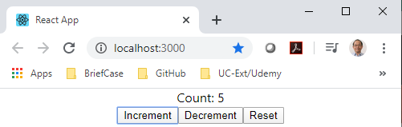
63.2 Verify Object
https://www.youtube.com/watch?v=uX7lxFrWUbA&list=PLC3y8-rFHvwgg3vaYJgHGnModB54rxOk3&index=63
Verify Display:
> npm start

Slide 9
63.3 Increment Parameter

Slide 10
63.3 Increment Parameter
https://www.youtube.com/watch?v=uX7lxFrWUbA&list=PLC3y8-rFHvwgg3vaYJgHGnModB54rxOk3&index=63
useReducer Hook: Simple State and Action
const initialState = {
firstCounter: 0
}
Render the counter property:
<div> Count: { count.firstCounter } </div>
<button onClick = {() =>dispatch ({type: ‘increment’, value: 1})}> Increment</button>
<button onClick = {() =>dispatch ({type: ‘decrement’, value: 1})}> Decrement</button>
<button onClick = {() =>dispatch ({type: ‘increment’, value: 5})}> Increment 5</button>
<button onClick = {() =>dispatch ({type: ‘decrement’, value: 5})}> Decrement 5</button>
<button onClick = {() =>dispatch ({type: ‘reset’})}> Reset</button>

Slide 11
63.3 Increment Parameter
https://www.youtube.com/watch?v=uX7lxFrWUbA&list=PLC3y8-rFHvwgg3vaYJgHGnModB54rxOk3&index=63
useReducer Hook: Simple State and Action
const reducer = (state, action) => {
switch (action.type) {
case ‘increment’:
return { firstCounter: state.firstCounter + action.value }
case ‘decrement’:
return { firstCounter: state.firstCounter - action.value }
case ‘reset’:
return initialState
default:
return state.
}
}

Slide 12
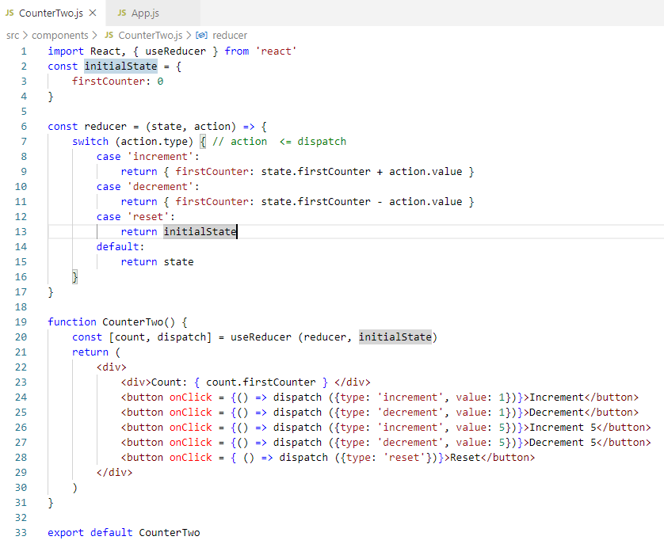
63.3 Increment Parameter
https://www.youtube.com/watch?v=uX7lxFrWUbA&list=PLC3y8-rFHvwgg3vaYJgHGnModB54rxOk3&index=63
useReducer Hook: Simple State and Action

Slide 13
63.4 Verify Object

Slide 14
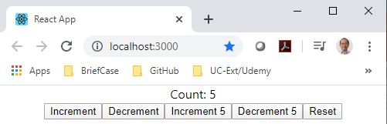
63.4 Verify Object
https://www.youtube.com/watch?v=uX7lxFrWUbA&list=PLC3y8-rFHvwgg3vaYJgHGnModB54rxOk3&index=63
Verify Display:
> npm start

Slide 15
63.3 Increment Parameter
https://www.youtube.com/watch?v=uX7lxFrWUbA&list=PLC3y8-rFHvwgg3vaYJgHGnModB54rxOk3&index=63
useReducer Hook: Simple State and Action
const reducer = (state, action) => {
switch (action.type) {
case ‘increment’:
return { …state, firstCounter: state.firstCounter + action.value }
case ‘decrement’:
return {…state, firstCounter: state.firstCounter - action.value }
case ‘increment2’:
return { …state, secondCounter: state.secondCounter + action.value }
case ‘decrement2’:
return { …state, secomdCounter: state.secondCounter - action.value }
case ‘reset’:
return initialState
default:
return state.
}
}

Slide 16
63.3 Increment Parameter
https://www.youtube.com/watch?v=uX7lxFrWUbA&list=PLC3y8-rFHvwgg3vaYJgHGnModB54rxOk3&index=63
useReducer Hook: Simple State and Action
const initialState = {
firstCounter: 0
secondCounter: 10
}
Render the counter property:
<div> First Counter: { count.firstCounter } </div>
<div> Second Counter: { count.secondCounter } </div>
<button onClick = {() =>dispatch ({type: ‘increment’, value: 1})}> Increment</button>
<button onClick = {() =>dispatch ({type: ‘decrement’, value: 1})}> Decrement</button>
<button onClick = {() =>dispatch ({type: ‘increment’, value: 5})}> Increment 5</button>
<button onClick = {() =>dispatch ({type: ‘decrement’, value: 5})}> Decrement 5</button>
<button onClick = {() =>dispatch ({type: ‘increment2’, value: 1})}> Increment Counter 2</button>
<button onClick = {() =>dispatch ({type: ‘decrement2’, value: 1})}> Decrement Counter 2</button>
<button onClick = {() =>dispatch ({type: ‘reset’})}> Reset</button>

Slide 17
63.5 Multiple Counter by Object

Slide 18
63.5 Multiple Counter by Object
https://www.youtube.com/watch?v=uX7lxFrWUbA&list=PLC3y8-rFHvwgg3vaYJgHGnModB54rxOk3&index=63
Multiple Counter by Object:
If you have multiple counter, you can add another property to the state.
We add the secondCounter property.
const initialState = {
firstCounter: 0
secondCounter: 10
}
Spread operator:
{…state, secondCounter: state.secondCounter + action.value}
onClick = {() => dispatch ({type: ‘increment2’, value: 1})} > Increment Counter 2

Slide 19
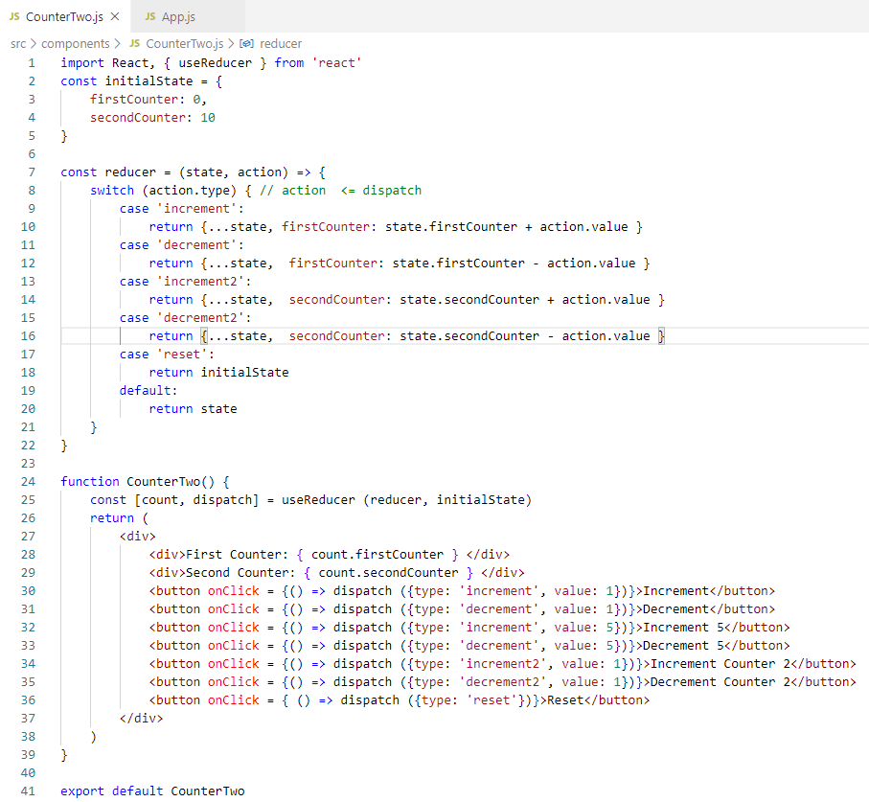
63.5 Multiple Counter by Object
https://www.youtube.com/watch?v=uX7lxFrWUbA&list=PLC3y8-rFHvwgg3vaYJgHGnModB54rxOk3&index=63
Multiple Counter by Object:
Code

Slide 20
63.6 Verify Multiple Counter

Slide 21
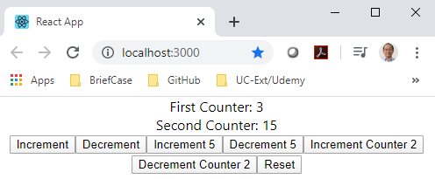
63.6 Multiple Counter by Object
https://www.youtube.com/watch?v=uX7lxFrWUbA&list=PLC3y8-rFHvwgg3vaYJgHGnModB54rxOk3&index=63
Multiple Counter by Object:
> npm start

Slide 22
63.7 Summary of Complex State Action

Slide 23
63.7 Summary of Complex State Action
https://www.youtube.com/watch?v=uX7lxFrWUbA&list=PLC3y8-rFHvwgg3vaYJgHGnModB54rxOk3&index=63
Summary of useReducer: Complex State Action
By using state as an object, we are able to keep rack of two different counters.
By using the action as the object, we can pass the additional data the reducer function.
By using state as the object, we are able to keep track of multiple state variables.
We maintain multiple variables in the single state object:
const intialState = {
firstCounter: 0.
secondCounter: 10
}
This is way that we dealing with the global state.
But right now, we are dealing with the local state.
We discuss more in the next discussion.

Slide 24
End of Chapter

