Slide 1

64 Multiple useReducer
Peter H. Chen

Slide 2
64 Multiple useReducer
https://www.youtube.com/watch?v=5DsCKNRA8s4&list=PLC3y8-rFHvwgg3vaYJgHGnModB54rxOk3&index=64
Multiple useReducer
In the last discussion, we maintained a state object to track two different counters.
To update the second counter, we created a additional switch cases in the reducer function. This is fine.
If we need two counters with the exact same state transition, there is a much simpler alternative and that is the use of multiple useReducer Hooks.

Slide 3
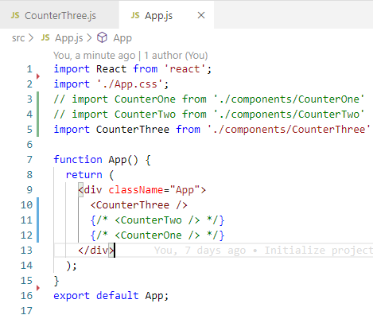
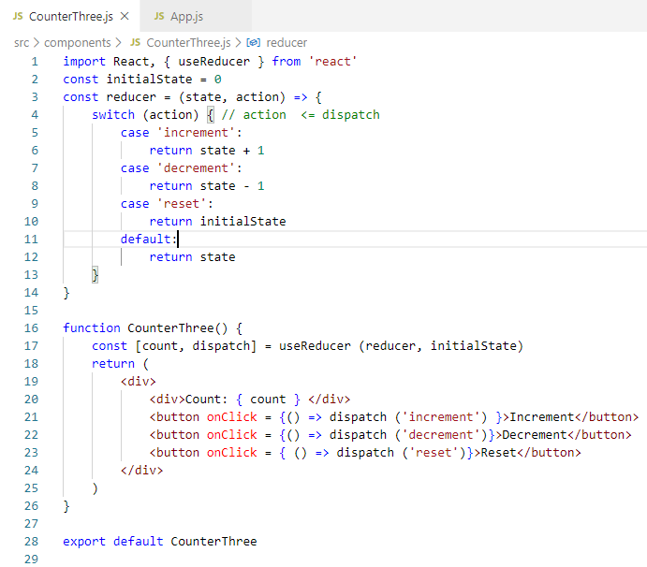
64 Multiple useReducer
https://www.youtube.com/watch?v=5DsCKNRA8s4&list=PLC3y8-rFHvwgg3vaYJgHGnModB54rxOk3&index=64
Multiple useReducer
Create CounterThree.js. Copy CounterOne.js code to CounterThree.js.
Add <CounterThree />

Slide 4
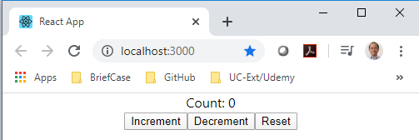
64 Multiple useReducer
https://www.youtube.com/watch?v=5DsCKNRA8s4&list=PLC3y8-rFHvwgg3vaYJgHGnModB54rxOk3&index=64
Multiple useReducer
> npm start

Slide 5
64.1 useReducer of Second Counter

Slide 6
64.1 useReducer of Second Counter
https://www.youtube.com/watch?v=5DsCKNRA8s4&list=PLC3y8-rFHvwgg3vaYJgHGnModB54rxOk3&index=64
CounterThree.js
Now, we implement the new requirement for multiple useRedcuer.
The second counter still have the same state transitions increment, decrement, or reset.
If this is the scenario, we can simply specifying multiple useReducer.
Right after the first useReducer(), we can call another useReduce().
const [count, dispatch] = useReducer (reducer, initialState)
const [countTwo, dispatchTwo] = useReducer (reducer, initialState)
In the JSX, we can duplicate the code:
<div>Count: { countTwo } </div>
<button onClick = {() => dispatchTwo ('increment') }>Increment</button>

Slide 7
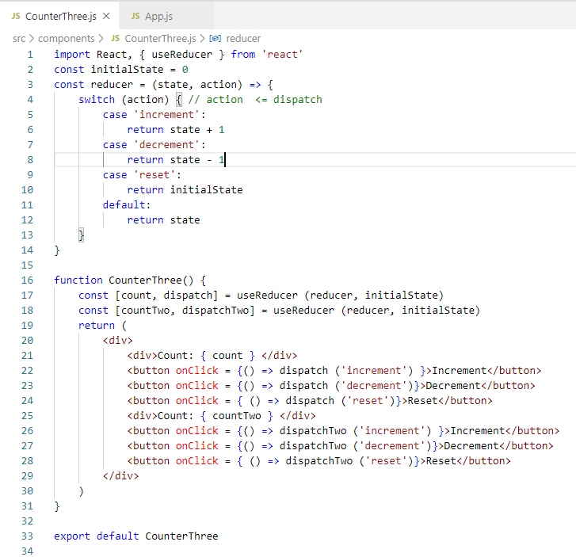
64.1 useReducer of Second Counter
https://www.youtube.com/watch?v=5DsCKNRA8s4&list=PLC3y8-rFHvwgg3vaYJgHGnModB54rxOk3&index=64
CounterThree.js

Slide 8
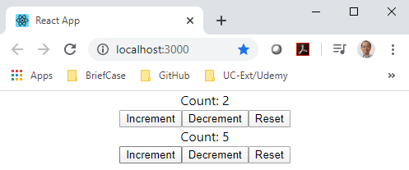
64.1 useReducer of Second Counter
https://www.youtube.com/watch?v=5DsCKNRA8s4&list=PLC3y8-rFHvwgg3vaYJgHGnModB54rxOk3&index=64
CounterThree.js
> npm start
We have two independent counters work independently even they use the same piece of codes.

Slide 9
64.2 Summary of Multiple useReducer

Slide 10
64.2 Summary of Multiple useReducer
https://www.youtube.com/watch?v=5DsCKNRA8s4&list=PLC3y8-rFHvwgg3vaYJgHGnModB54rxOk3&index=64
Summary of Multiple useReducer
It is a good idea to share the same pieces of code for multiple useReducer.
It avoid the complexity and merge the state if it were to be an object and also prevent us from duplicating the code in the reducer function.
In counterTwo.js, we have the duplicated code.
In counterThree.js, we fix the duplicated code problem.

Slide 11
End of Chapter

