Slide 1

65 useReducer with useContext
Peter H. Chen

Slide 2
65 useReducer with useContext
https://www.youtube.com/watch?v=BCD2irXaVoE&list=PLC3y8-rFHvwgg3vaYJgHGnModB54rxOk3&index=65
useReducer with useContext
We have discussed the useReducer for local state management.
useReducer: Local State management.
The state is at the component level. In some point, we need to share the state between the components.
Share state between components: Global state management.
We need to work with global state. How do we do that?
We can manage the state with useReducer along with useContext.
useReducer + useContext
In this discussion, we discuss the useReducer and useContext.

Slide 3
65 useReducer with useContext
https://www.youtube.com/watch?v=BCD2irXaVoE&list=PLC3y8-rFHvwgg3vaYJgHGnModB54rxOk3&index=65
useReducer with useContext
Consider the App.js with lots of components.
The root component is App. The root component nested components A, B, and C.
If each A, B, C component maintains their own counter.
We only see how to implement the counter by using useReducer Hook.
In each of the three components, we use of the useReducer Hook and implement a counter.
App.js
A
B
C
Counter
useReducer()
Counter
useReducer()
Counter
useReducer()

Slide 4
65 useReducer with useContext
https://www.youtube.com/watch?v=BCD2irXaVoE&list=PLC3y8-rFHvwgg3vaYJgHGnModB54rxOk3&index=65
useReducer with useContext
In the different application, we may have different requirements.
We have three components, A, B, and C, all have to implement a counter.
In this requirement, we need to share the value of counter.
Instead of three different counters, we need to implement one counter which is accessible by all these three components.
App.js
A
B
C
Counter
Counter
Counter

Slide 5
65 useReducer with useContext
https://www.youtube.com/watch?v=BCD2irXaVoE&list=PLC3y8-rFHvwgg3vaYJgHGnModB54rxOk3&index=65
useReducer with useContext
You may think it is obvious to do this.
You can implement a global counter in App.js and pass in methods as props to these three components. The components then have the handlers that call the props. Very straightforward.
Unfortunately, the real world application are not this simple.
App.js
Global counter
props
A
B
C
Counter
Counter
Counter

Slide 6
65 useReducer with useContext
https://www.youtube.com/watch?v=BCD2irXaVoE&list=PLC3y8-rFHvwgg3vaYJgHGnModB54rxOk3&index=65
useReducer with useContext
Your components will be nested deep within the components tree.
When there is a deep levels of nesting, passing props through every component is not the best solution.
App.js
Global counter
props
A
B
C
Counter
Counter
Counter

Slide 7
65 useReducer with useContext
https://www.youtube.com/watch?v=BCD2irXaVoE&list=PLC3y8-rFHvwgg3vaYJgHGnModB54rxOk3&index=65
useReducer with useContext
Consider the following example , we have App.js and within the App.js, we have different levels and different components.
In our requirements, we want to share the counter state between components A, D, and F.
We are going to maintain the counter state in App.js.
App.js
Counter = 0
A
B
C
Counter
D
E
Counter
F
Counter

Slide 8
65 useReducer with useContext
https://www.youtube.com/watch?v=BCD2irXaVoE&list=PLC3y8-rFHvwgg3vaYJgHGnModB54rxOk3&index=65
useReducer with useContext
We share the counter state and the method to change that state deep down in the component tree.
Passing props through so levels is definitely a bad idea.
What is a good solution? Use the Context API.
Since we have Hook, we can use useContext Hook to achieve this.
App.js
Counter = 0
A
B
C
Counter
D
E
Counter
F
Counter

Slide 9
65 useReducer with useContext
https://www.youtube.com/watch?v=BCD2irXaVoE&list=PLC3y8-rFHvwgg3vaYJgHGnModB54rxOk3&index=65
useReducer with useContext
We have discussed the useReducer and useContext.
We can use useReducer and useContext to achieve the goal: share global state management between the components.
App.js
Counter = 0
A
B
C
Counter
D
E
Counter
F
Counter

Slide 10
65.1 Component Tree

Slide 11
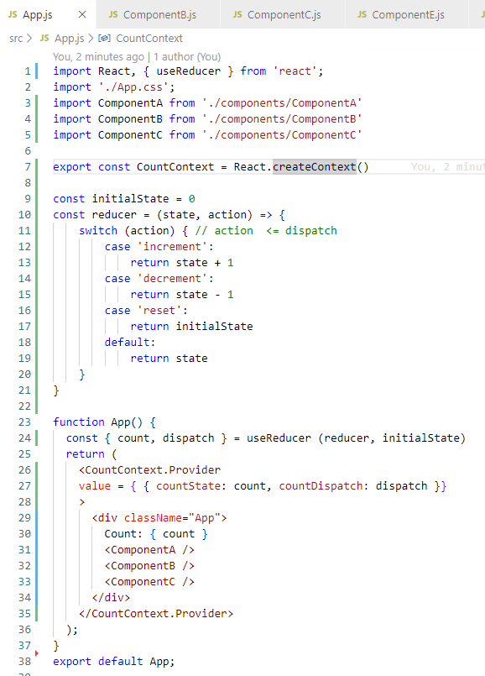
65.1 Component Tree
https://www.youtube.com/watch?v=BCD2irXaVoE&list=PLC3y8-rFHvwgg3vaYJgHGnModB54rxOk3&index=65
Component Tree
We import the components, A, B, and C in App.js
App.js
Counter = 0
A
B
C
Counter
D
E
Counter
F
Counter

Slide 12
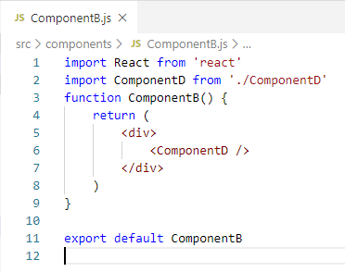
65.1 Component Tree
https://www.youtube.com/watch?v=BCD2irXaVoE&list=PLC3y8-rFHvwgg3vaYJgHGnModB54rxOk3&index=65
Component Tree
In CompnentB, we have nested with ComponentD.
App.js
Counter = 0
A
B
C
Counter
D
E
Counter
F
Counter

Slide 13
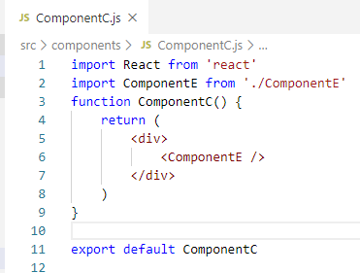
65.1 Component Tree
https://www.youtube.com/watch?v=BCD2irXaVoE&list=PLC3y8-rFHvwgg3vaYJgHGnModB54rxOk3&index=65
Component Tree
In ComponentC, we have nested with ComponentE.
App.js
Counter = 0
A
B
C
Counter
D
E
Counter
F
Counter

Slide 14
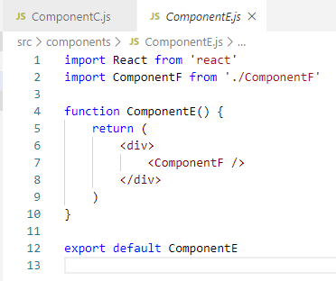
65.1 Component Tree
https://www.youtube.com/watch?v=BCD2irXaVoE&list=PLC3y8-rFHvwgg3vaYJgHGnModB54rxOk3&index=65
Component Tree
In ComponentE, we have nested with ComponentF.
App.js
Counter = 0
A
B
C
Counter
D
E
Counter
F
Counter

Slide 15
65.2 Count State in App, A, D, and F

Slide 16
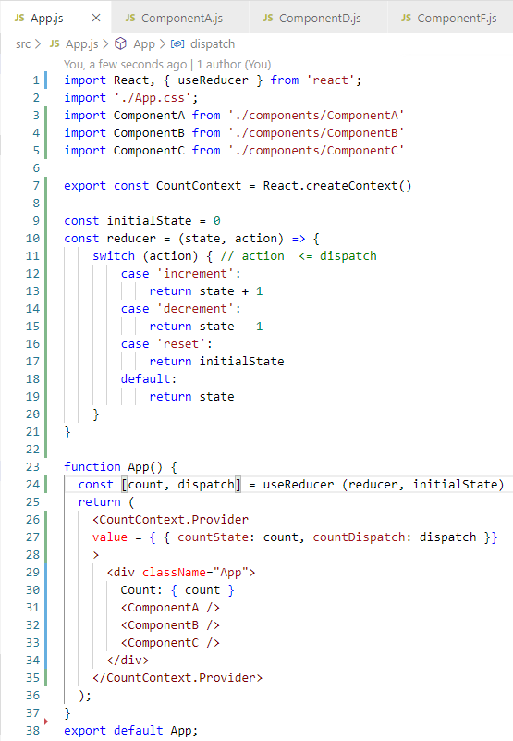
65.2 Count State in App, A, D, and F
https://www.youtube.com/watch?v=BCD2irXaVoE&list=PLC3y8-rFHvwgg3vaYJgHGnModB54rxOk3&index=65
Count State in Components App, A, D, and F
Our goal is to maintain the count state in App Component and modify the state from Component A, D, and F.
App.js
Counter = 0
A
B
C
Counter
D
E
Counter
F
Counter

Slide 17
65.2 Count State in App, A, D, and F
https://www.youtube.com/watch?v=BCD2irXaVoE&list=PLC3y8-rFHvwgg3vaYJgHGnModB54rxOk3&index=65
Count State in Components App, A, D, and F
We have two main steps. First step is to create a counter in App.js using the useReducer Hook. Second Step is to provide and consume the counter Context in the required components.
App.js
Counter = 0
A
B
C
Counter
D
E
Counter
F
Counter

Slide 18
65.3 Step 1

Slide 19
65.3 Step 1
https://www.youtube.com/watch?v=BCD2irXaVoE&list=PLC3y8-rFHvwgg3vaYJgHGnModB54rxOk3&index=65
Step 1
Implement a counter in a App.js using the useReducer.
First, define the initial state of the counter and reducer function.
Copy code (initial state and reducer function) from CounterOne.js

Slide 20
65.3 Step 1
https://www.youtube.com/watch?v=BCD2irXaVoE&list=PLC3y8-rFHvwgg3vaYJgHGnModB54rxOk3&index=65
Step 1
Second, add the import { useReducer } method from react.
In the App Component, we need to have
const [ count, dispatch ] = useReducer (reducer, intialState)
Note: the destructuring is in [], not {}
In the JSX, add the render of count value.
For the dispatch method, we do not want to dispatch any action in the App Component. We want to be able to dispatch actions from the nested component A, D, and F.

Slide 21
65.4 Step 2

Slide 22
65.4 Step 2
https://www.youtube.com/watch?v=BCD2irXaVoE&list=PLC3y8-rFHvwgg3vaYJgHGnModB54rxOk3&index=65
Step 2
For step 2, we need to make use of context to provide the count value and the dispatch method and consume the count value from the nested components.
First, we create the a context by using the context API.
Below the import statement, we add the
export const CountContext = React.createContext ()
Now, we have the context. We provide the context with a value.

Slide 23
65.4 Step 2
https://www.youtube.com/watch?v=BCD2irXaVoE&list=PLC3y8-rFHvwgg3vaYJgHGnModB54rxOk3&index=65
Step 2
In the App Component, we wrap everything with the context provider CountConext.provider.
On the CountContext.provider, we specify the value attribute and what the value we provide?
We provide the count value itself as well as the dispatch method.
The value will be an object including the attributes of countState and countDispatch.s

Slide 24
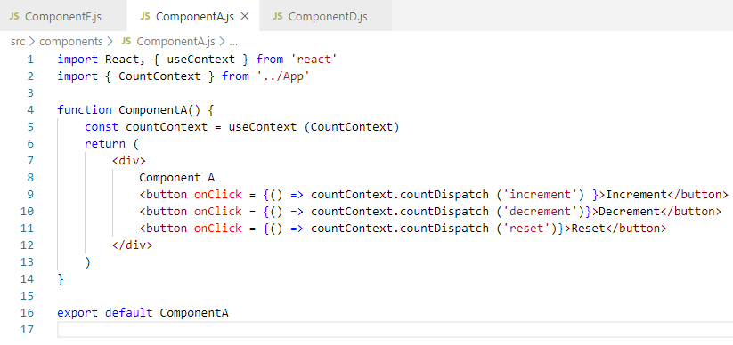
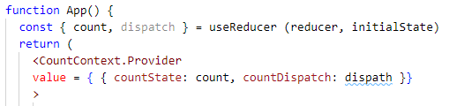
65.4 Step 2
https://www.youtube.com/watch?v=BCD2irXaVoE&list=PLC3y8-rFHvwgg3vaYJgHGnModB54rxOk3&index=65
Step 2
Finally, we can use the context Hook to consume the state and this dispatch method.
Let’s begin from Component A.
We already created the CountContext in App Component, we need use the created Context.
Import { useContext } …
Const countContext = useContext ( CountContext }
We copy the onClick and dispatch code from CounterOne.js.
The only difference is to replace the dispatch into countContext.countDispatch ().
This countDispatch value is provided by App Component.

Slide 25
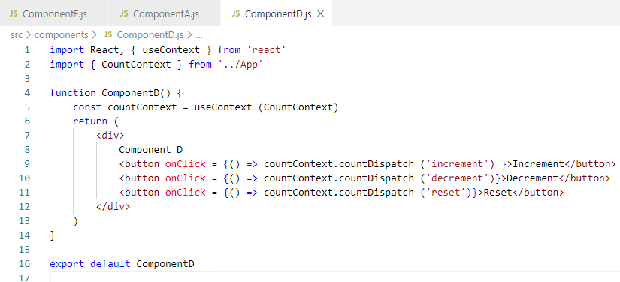
65.4 Step 2
https://www.youtube.com/watch?v=BCD2irXaVoE&list=PLC3y8-rFHvwgg3vaYJgHGnModB54rxOk3&index=65
Step 2
That is pretty much it.
Let’s repeat the code for Component D and Component F as well.
Copy all the codes from Component A to Component D.

Slide 26
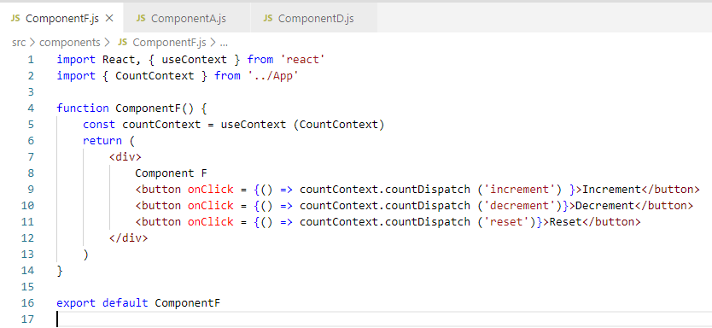
65.4 Step 2
https://www.youtube.com/watch?v=BCD2irXaVoE&list=PLC3y8-rFHvwgg3vaYJgHGnModB54rxOk3&index=65
Step 2
That is pretty much it.
Copy Component A to Component F as well.

Slide 27
65.5 Verify Display

Slide 28
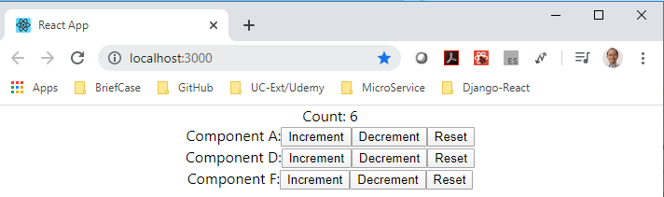
65.5 Verify Display
https://www.youtube.com/watch?v=BCD2irXaVoE&list=PLC3y8-rFHvwgg3vaYJgHGnModB54rxOk3&index=65
Verify Display
> npm start
Note:
All the buttons share the same variable “count”
From the component A, D, and F, we are able to manage this global count value.
Each increment, decrement, or reset will control the global variable count.

Slide 29
65.6 Render Global Value

Slide 30
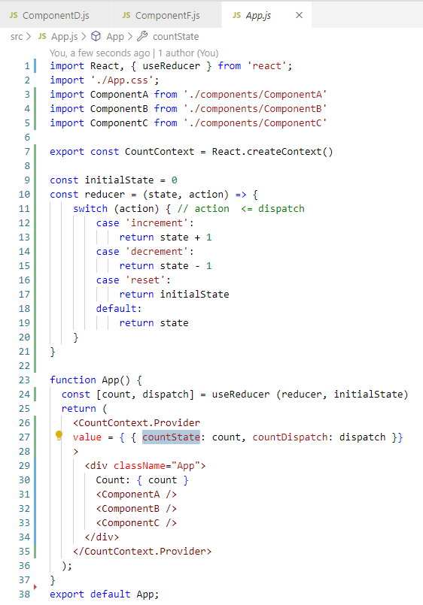
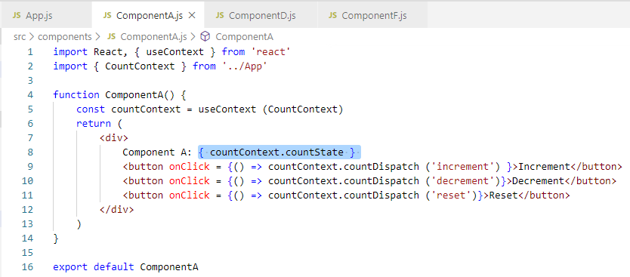
65.6 Render Global Value
https://www.youtube.com/watch?v=BCD2irXaVoE&list=PLC3y8-rFHvwgg3vaYJgHGnModB54rxOk3&index=65
Render Global Value
In the above example, we are not rendering the count value in the individual components.
Let’s render the global count value in the individual component now.
In component A, D, and F, we will add the count value.
In Component A; add “Component A: { countContext.countState }”

Slide 31
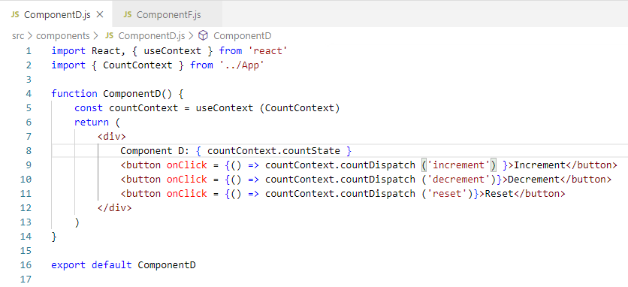
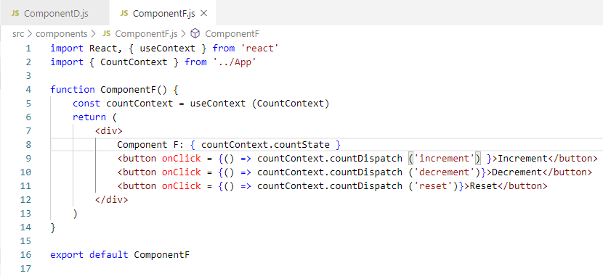
65.6 Render Global Value
https://www.youtube.com/watch?v=BCD2irXaVoE&list=PLC3y8-rFHvwgg3vaYJgHGnModB54rxOk3&index=65
Render Global Value
Similarly, in component B and F.

Slide 32
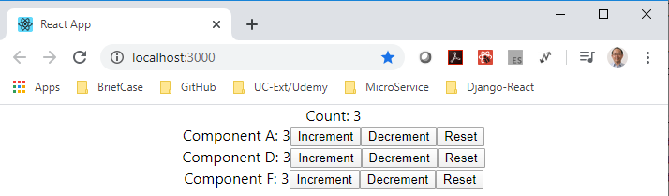
65.6 Render Global Value
https://www.youtube.com/watch?v=BCD2irXaVoE&list=PLC3y8-rFHvwgg3vaYJgHGnModB54rxOk3&index=65
Render Global Value
> npm start

Slide 33
65.7 Summary of Global Variable

Slide 34
65.7 Summary of Global Variable
https://www.youtube.com/watch?v=BCD2irXaVoE&list=PLC3y8-rFHvwgg3vaYJgHGnModB54rxOk3&index=65
Summary of Global Variable
From this example, we can see that we can share the global variable count on the top App Component.
We are able to see (display and control) the global variable count from each individual component A, D, and F.

Slide 35
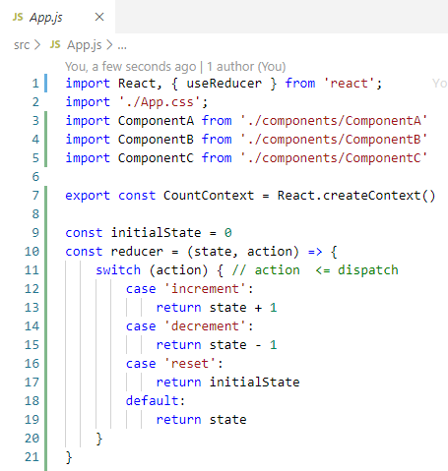
65.7 Summary of Global Variable
https://www.youtube.com/watch?v=BCD2irXaVoE&list=PLC3y8-rFHvwgg3vaYJgHGnModB54rxOk3&index=65
Summary of Global Variable
How to do that?
Initial Value and reducer funciton:
In App Component, we created our counter using reducer Hook. We declared the initial state and define the reducer function which modify that state.

Slide 36
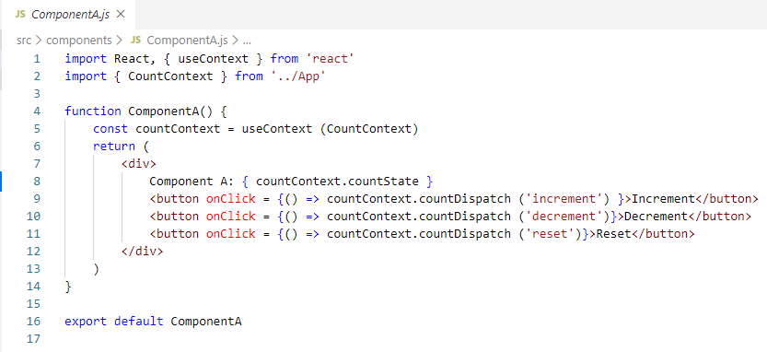
65.7 Summary of Global Variable
https://www.youtube.com/watch?v=BCD2irXaVoE&list=PLC3y8-rFHvwgg3vaYJgHGnModB54rxOk3&index=65
Summary of Global Variable
Finally, in the component A, D, and F:
We use Context to get hold of context values and access the appropriate values dispatch and count state.

Slide 37
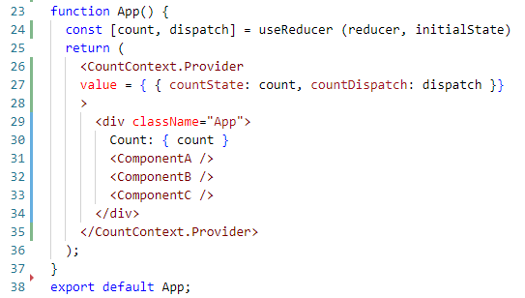
65.7 Summary of Global Variable
https://www.youtube.com/watch?v=BCD2irXaVoE&list=PLC3y8-rFHvwgg3vaYJgHGnModB54rxOk3&index=65
Summary of Global Variable
Pass in parameter from Provider to consumer:
In the useReducer, we pass in reducer and initial state as the parameter.
The reducer which returns the current value and dispatch method.
We use CountContext.Provider to provide two values as an object.
The object we provide contains two values, i.e., countState and countDispatch

Slide 38
End of Chapter

