Slide 1

65 useReducer with Fetch Data 01
Peter H. Chen

Slide 2
65 useReducer with Fetch Data 01
https://www.youtube.com/watch?v=snzS7-73SEQ&list=PLC3y8-rFHvwgg3vaYJgHGnModB54rxOk3&index=66
useReducer with Fetch Data: Part 1
We will be fetching data from a API endpoint using useReducer.
In the previous discussion, we already used the useEffect to collect data.
We use useEffect with useState Hook.
In this discussion, we will be using useEffect with useReducer Hook.
Remember, both useState and useReducer are used for state management.
We will compare in contrast them both for data fetching.
In this discussion, we will go over the data fetching by useEffect with useState Hook.
In the next discussion, we will go over the data fetching by useEffect with useReducer Hook.

Slide 3
65 useReducer with Fetch Data 01
https://www.youtube.com/watch?v=snzS7-73SEQ&list=PLC3y8-rFHvwgg3vaYJgHGnModB54rxOk3&index=66
useReducer with Fetch Data: Part 1
As soon as the component mount, we will make an API call to fetch data.
While the data is being fetched, we will show a loading indicator.
When the data is fetched successfully, we will hide the loading indicator and display the data.
If there was an error fetching data, we hide the loading indicator and display an error message.

Slide 4
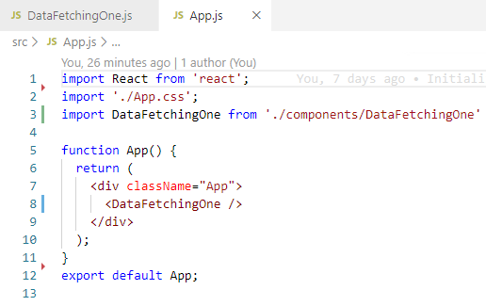
65 useReducer with Fetch Data 01
https://www.youtube.com/watch?v=snzS7-73SEQ&list=PLC3y8-rFHvwgg3vaYJgHGnModB54rxOk3&index=66
useReducer with Fetch Data: Part 1
App.js:

Slide 5
65.1 Install Axios Package

Slide 6
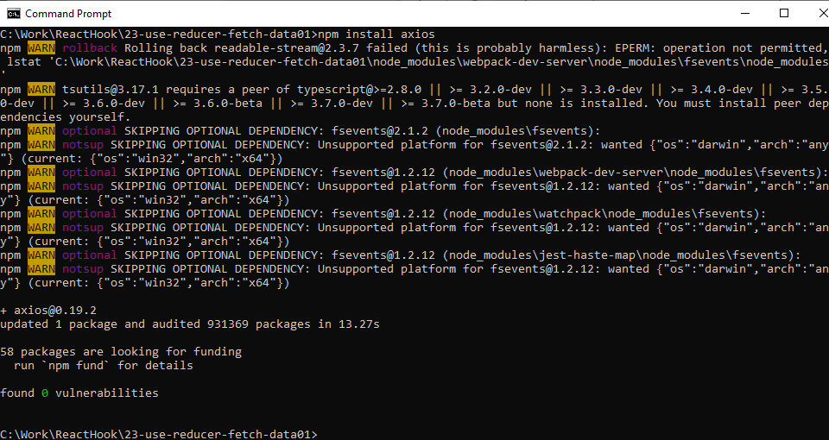
65.1 Install Axios Package
https://www.youtube.com/watch?v=snzS7-73SEQ&list=PLC3y8-rFHvwgg3vaYJgHGnModB54rxOk3&index=66
Install Axios Package
> npm install axios

Slide 7
65.2 Data Fetching

Slide 8
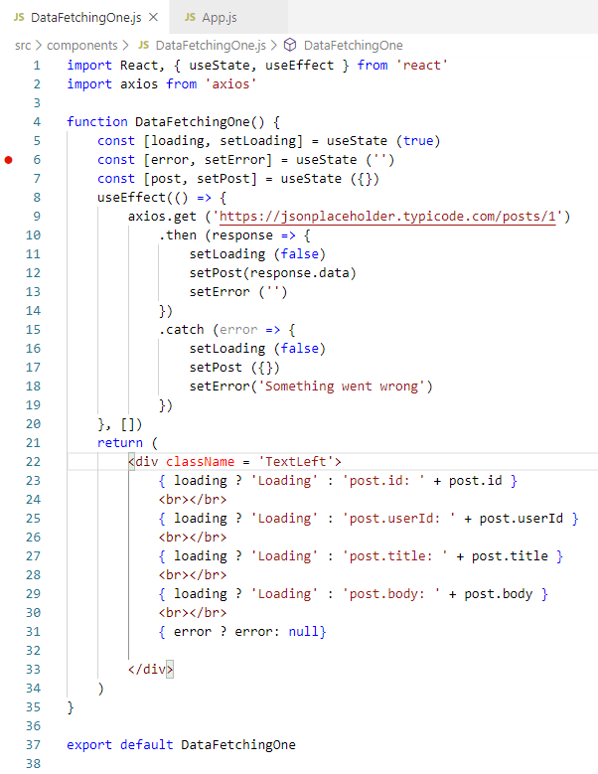
65.2 Data Fetching
https://www.youtube.com/watch?v=snzS7-73SEQ&list=PLC3y8-rFHvwgg3vaYJgHGnModB54rxOk3&index=66
Data Fetching:
Create ./components/DataFetchingOne.js
Import React, { useState, useEffect } from ‘react’
Import axios from ‘axios’

Slide 9
65.2 Data Fetching
https://www.youtube.com/watch?v=snzS7-73SEQ&list=PLC3y8-rFHvwgg3vaYJgHGnModB54rxOk3&index=66
Data Fetching:
We need three state variables, a loading flags to indicate the data fetching happening in the background.
So set loading and initial value will be true.
The next variable is an error message to display an error if something went wrong:
const [loading, setLoading] = useState (true)
Set error and the initial value will be an empty string:
const [error, setError] = useState (‘’)
Finally, a variable to hold the post which we will be fetching from an API endpoint.
Destructuring post and setPost with initial state is an empty object {}:
const [post, setPost] = useState ({})

Slide 10
65.2 Data Fetching
https://www.youtube.com/watch?v=snzS7-73SEQ&list=PLC3y8-rFHvwgg3vaYJgHGnModB54rxOk3&index=66
Data Fetching:
Now, we have the state variables. The next step is to make the API call and set the appropriate state side effect. We use useEffect.
It accepts an arrow function and the its first parameter and for the second parameter, we pass in an empty dependency array to ensure our API is only called once. We want componentDidMount behavior. Within the arrow function, we make our get request axios.get(‘’).

Slide 11
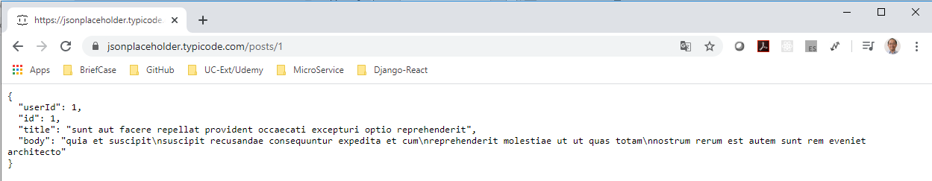
65.2 Data Fetching
https://www.youtube.com/watch?v=snzS7-73SEQ&list=PLC3y8-rFHvwgg3vaYJgHGnModB54rxOk3&index=66
Data Fetching:
For the endpoint, we use JSON placeholder for “posts/1”. URL is “https://jsonplaceholder.typicode.com/posts/1”
useEffect (() => {
axios.get (“https://jsonplaceholder.typicode.com/posts/1”)
}, [])

Slide 12
65.2 Data Fetching
https://www.youtube.com/watch?v=snzS7-73SEQ&list=PLC3y8-rFHvwgg3vaYJgHGnModB54rxOk3&index=66
Data Fetching:
If request is successful, we make three state transitions: setLoading(false), setPost (response.data), and setError (‘’).
If request is error in catch block, we set three state transition:

Slide 13
65.2 Data Fetching
https://www.youtube.com/watch?v=snzS7-73SEQ&list=PLC3y8-rFHvwgg3vaYJgHGnModB54rxOk3&index=66
Data Fetching:
useEffect (() => {
axiois.get (“https://jsonplaceholder.typicode.com/posts/1”)
.then (response => {
setLoading (false)
setPost (response.data)
setError (‘’)
})
.catch (error => {
set Loading (false)
setPost({})
setError (‘Something error’)
})
}, [])

Slide 14
65.2 Data Fetching
https://www.youtube.com/watch?v=snzS7-73SEQ&list=PLC3y8-rFHvwgg3vaYJgHGnModB54rxOk3&index=66
Install Axios Package
For the last part of code, we take JSX, if all the is busy loading:
We are going to display string loading, else we are going to display the post.title.
However, if there is an error, we also need to display that.
<div>
{ loading ? ‘Loading’: post.title }
{ error ? error: null }
</div>

Slide 15
65.3 Verify Display

Slide 16
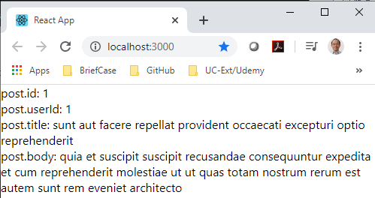
65.3 Verify Display
https://www.youtube.com/watch?v=snzS7-73SEQ&list=PLC3y8-rFHvwgg3vaYJgHGnModB54rxOk3&index=66
Install Axios Package
For the last part of code, we take JSX, if all the is busy loading:
We are going to display string loading, else we are going to display the post.title.
However, if there is an error, we also need to display that.
<div>
{ loading ? ‘Loading’: post.title }
{ error ? error: null }
</div>

Slide 17
End of Chapter

