Slide 1

67 Fetch Data by useEffect 02
Peter H. Chen

Slide 2
67 Fetch Data by useEffect 02
https://www.youtube.com/watch?v=imjfiXxvMD8&list=PLC3y8-rFHvwgg3vaYJgHGnModB54rxOk3&index=67
Fetch Data with useEffec: Part 2
In the previous discussion, we use useState and useEffect to fetch data.

Slide 3
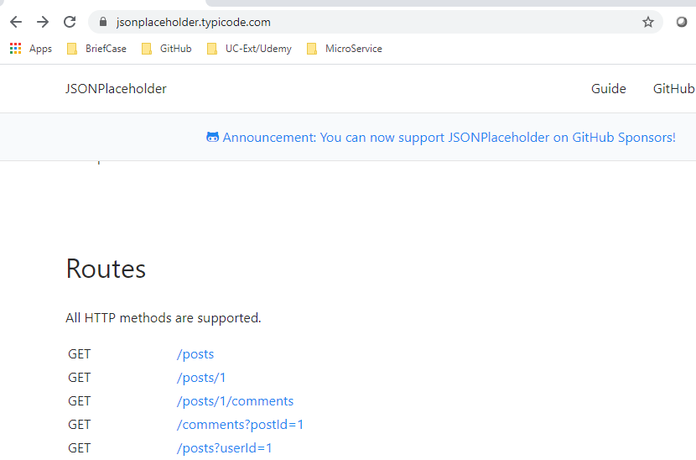
67 Fetch Data by useEffect 02
https://www.youtube.com/watch?v=imjfiXxvMD8&list=PLC3y8-rFHvwgg3vaYJgHGnModB54rxOk3&index=67
DataFecthing.js
We will fetch data from JSON placeholder:
https://jsonplaceholder.typicode.com/
Select ‘/posts/1’

Slide 4
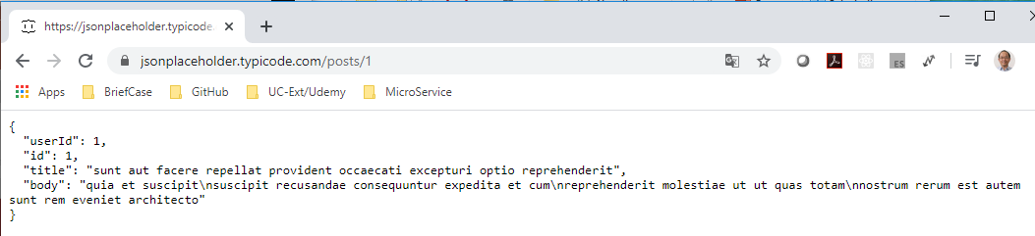
67 Fetch Data by useEffect 02
https://www.youtube.com/watch?v=imjfiXxvMD8&list=PLC3y8-rFHvwgg3vaYJgHGnModB54rxOk3&index=67
DataFecthing.js
Select: ‘Posts/1’
‘https://jsonplaceholder.typicode.com/posts/1’

Slide 5
67.1 First Step

Slide 6
67.1 First Step
https://www.youtube.com/watch?v=imjfiXxvMD8&list=PLC3y8-rFHvwgg3vaYJgHGnModB54rxOk3&index=67
Fetch Data with useEffec: Part 2
Type ‘rfce’ (React Functional Component ES7)
There are four steps to implement.
First Step:
Import React, { useReducer, useEffect } from ‘react’
Import axios from ‘axios’

Slide 7
67.1 First Step
https://www.youtube.com/watch?v=imjfiXxvMD8&list=PLC3y8-rFHvwgg3vaYJgHGnModB54rxOk3&index=67
Fetch Data with useEffec: Part 2
First Step:
Import React, { useReducer, useEffect } from ‘react’
Import axios from ‘axios’

Slide 8
67.2 Second Step

Slide 9
67.2 Second Step
https://www.youtube.com/watch?v=imjfiXxvMD8&list=PLC3y8-rFHvwgg3vaYJgHGnModB54rxOk3&index=67
Fetch Data with useEffec: Part 2
Second Step 2 (1):
Last time, we useState
//const { posts, setPosts } = useState ([])
This time, we use initialize
const initialState = {
loading: true,
error: ‘’,
post: {}
}

Slide 10
67.2 Second Step
https://www.youtube.com/watch?v=imjfiXxvMD8&list=PLC3y8-rFHvwgg3vaYJgHGnModB54rxOk3&index=67
Fetch Data with useEffec: Part 2
Second Step 2 (2):
The reducer function that accepts state and action as its argument and return the updated state. We have in get, then, and catch in useEffect().
const reducer = { state, action } => {
switch (action.type) {
case ‘FETCH_SUCCESS’:
return {
loading: false,
post: action.payload,
error: ‘’
}
case ‘FETCH_ERROR’:
return {
loading: false,
post: {},
error: ‘Something went wrong!’
}
default:
return state
}
}

Slide 11
67.3 Third Step

Slide 12
67.3 Third Step
https://www.youtube.com/watch?v=imjfiXxvMD8&list=PLC3y8-rFHvwgg3vaYJgHGnModB54rxOk3&index=67
Fetch Data with useEffec: Part 2
Third Step (1):
Fetch the data and set the state.
Within the DataFecthingTwo function component, we call use reducer passing function and initial state that we just defined. The reducer returns a pair of values which is current state and the dispatch method.
const [state, dispatch] = useReducer (reducer, insitalState)
useEffect (() =>{
axios
.get('https://jsonplaceholder.typicode.com/posts/1’)
.then (response => {
setLoading (false)
setPosts(response.data)
setError(‘’)
})
.catch (error => {
setLoading (false)
setPosts({})
setError('Something went wrong’)
})
})

Slide 13
67.3 Third Step
https://www.youtube.com/watch?v=imjfiXxvMD8&list=PLC3y8-rFHvwgg3vaYJgHGnModB54rxOk3&index=67
Fetch Data with useEffec: Part 2
Third Step (2):
If data fetching is successful, we dispatch an action type and data.
For data fetching error, we dispatch an action. We do not data.
.then (response => {
dispatch ({type: ‘FETCH_SUCCESS’, payload: response.data})
})
.catch (error => {
dispatch ({type: ‘FETCH_ERROR’})
})

Slide 14
67.4 Fourth Step

Slide 15
67.4 Fourth Step
https://www.youtube.com/watch?v=imjfiXxvMD8&list=PLC3y8-rFHvwgg3vaYJgHGnModB54rxOk3&index=67
Fetch Data with useEffec: Part 2
Fourth Step:
Render the UI:
<div>
{ state.loading ? ‘loading’: state.post.title }
{ state.error ? error : null }
</div>

Slide 16
67.5 Display of Data Reducer 02

Slide 17
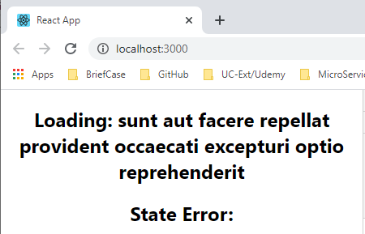
67.5 Display of Data Reducer 02
https://www.youtube.com/watch?v=imjfiXxvMD8&list=PLC3y8-rFHvwgg3vaYJgHGnModB54rxOk3&index=67
Display of Daat REducer: Part 2
> npm start

Slide 18
End of Chapter

