Slide 1

4 Component
Peter H. Chen

Slide 2
4 Component
https://www.youtube.com/watch?v=Y2hgEGPzTZY&list=PLC3y8-rFHvwgg3vaYJgHGnModB54rxOk3&index=4
Component-Based Architecture:
In React, a component represents a part of the User Interface.
Our application has five components: One for header, One for Side Nav, One for Main Content, one for Footer, and finally, one component to contain every other component.
The containing component is the root component and is usually named as App Component in our application.
Each of the four nested components describe a part of the user interface.
Header
Side Nav
Main Content
Root (App) Component
Footer

Slide 3
4 Component
https://www.youtube.com/watch?v=Y2hgEGPzTZY&list=PLC3y8-rFHvwgg3vaYJgHGnModB54rxOk3&index=4
Component-Based Architecture:
However, all the components come together to make up the entire application.
Components are also reusable. The same component can be used with different properties to display different information.
Header
Side Nav
Main Content
Root (App) Component
Footer

Slide 4
4 Component
https://www.youtube.com/watch?v=Y2hgEGPzTZY&list=PLC3y8-rFHvwgg3vaYJgHGnModB54rxOk3&index=4
Component-Based Architecture:
For example, the site map component can be the left side nav as well as the right side nav.
The components can also contain other components.
For example, App component contains the other components.
Header
Side Nav
Main Content
Side Nav
Root (App) Component
Footer

Slide 5
4 Component
https://www.youtube.com/watch?v=Y2hgEGPzTZY&list=PLC3y8-rFHvwgg3vaYJgHGnModB54rxOk3&index=4
Component-Based Architecture:
How the component translate the code in our application?
The component code is usually placed in a JavaScript file.
For example, App Component is placed in a App.js.
You can also have component files with .jsx extension.
In our discussion, we usually use .js instead of .jsx.
JavaScript File
App.js
Component Code
AppComponent

Slide 6
4 Component
https://www.youtube.com/watch?v=Y2hgEGPzTZY&list=PLC3y8-rFHvwgg3vaYJgHGnModB54rxOk3&index=4
Component Types:
The component code is basically the code inside a .js file.
What is the code look like? That depends the type of the component.
In React, we have two component types, a stateless functional component and a stateful class component.
Functional components are literally JavaScript functions. It returns HTML which describes the UI.
For example, a function called Welcome which return an <h1> tag that hello, name.
Stateless Functional Component
Stateful Class Component
JavaScript Functions
function Welcome (props) {
return <h1> Hello, {props.name} </h1>
}

Slide 7
4 Component
https://www.youtube.com/watch?v=Y2hgEGPzTZY&list=PLC3y8-rFHvwgg3vaYJgHGnModB54rxOk3&index=4
Component Types:
Class component, on the other hand, our regular ES6 classes that extend the component class from the react library.
They must contain a render method which returns HTML.
For example, class Welcome extends React.Component and the class contains a render method which returns an <h1> tag that says “Hello, name”.
Stateless Functional Component
Stateful Class Component
JavaScript Functions
Class extending Component class
Render method returning HTML
function Welcome (props) {
return <h1> Hello, {props.name} </h1>
}
function Welcome extends React.Component {
render () {
return <h1> Hello, {props.name} </h1>
}
}

Slide 8
4 Component
https://www.youtube.com/watch?v=Y2hgEGPzTZY&list=PLC3y8-rFHvwgg3vaYJgHGnModB54rxOk3&index=4
Component Types:
What are the differences? and when to use one over the other?
We will discuss in the next.
Remember the two components types, stateless functional component and stateful class component.
Stateless Functional Component
Stateful Class Component
JavaScript Functions
Class extending Component class
Render method returning HTML
function Welcome (props) {
return <h1> Hello, {props.name} </h1>
}
function Welcome extends React.Component {
render () {
return <h1> Hello, {props.name} </h1>
}
}

Slide 9
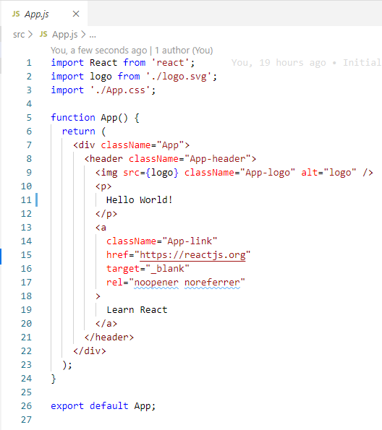
4 Component
https://www.youtube.com/watch?v=Y2hgEGPzTZY&list=PLC3y8-rFHvwgg3vaYJgHGnModB54rxOk3&index=4
Component Types:
Let’s look at the AppComponent in our Hello World Application.
Go back to the source code.

Slide 10
4 Component
https://www.youtube.com/watch?v=Y2hgEGPzTZY&list=PLC3y8-rFHvwgg3vaYJgHGnModB54rxOk3&index=4
Component Types:
The source code with file extension .js. It is a JavaScript file.
If you look at the code, it is a functional components.

Slide 11
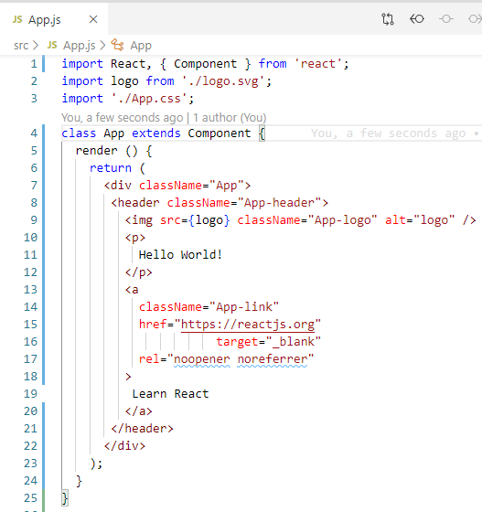
4 Component
https://www.youtube.com/watch?v=Y2hgEGPzTZY&list=PLC3y8-rFHvwgg3vaYJgHGnModB54rxOk3&index=4
Component Types:
Change into the class component as follows:
The class name is “App” and extends Component class from the React Library.
It contains the render () method which in turn returns some HTML.

Slide 12
4 Component
https://www.youtube.com/watch?v=Y2hgEGPzTZY&list=PLC3y8-rFHvwgg3vaYJgHGnModB54rxOk3&index=4
Component Types:
This is a simple “Hello World” application and just have one component <p> … </p>.
You can have 10, 100, 1000, or more components.
Facebook has more than 30,000 components.

Slide 13
4 Component
https://www.youtube.com/watch?v=Y2hgEGPzTZY&list=PLC3y8-rFHvwgg3vaYJgHGnModB54rxOk3&index=4
Components Summary
Components describes a port of the user interface.
Components are re-usable and can be nested inside other components.
There are two types of component:
Stateless Functional Components
Stateful Class Components
Components are the building blocks of any React Application.

Slide 14
4 Component
https://www.youtube.com/watch?v=Y2hgEGPzTZY&list=PLC3y8-rFHvwgg3vaYJgHGnModB54rxOk3&index=4
Component Types:
More complicate the application, more the number of components.

Slide 15
4.1 Quiz

Slide 16
4.1 Quiz
https://www.youtube.com/watch?v=Y2hgEGPzTZY&list=PLC3y8-rFHvwgg3vaYJgHGnModB54rxOk3&index=4
Quiz:
1. What is component?
Ans:
In React, a component represents a part of the User Interface.
Our application has five components: One for header, One for Side Nav, One for Main Content, one for Footer, and finally, one component to contain every other component.
Header
Side Nav
Main Content
Root (App) Component
Footer

Slide 17
4.1 Quiz
https://www.youtube.com/watch?v=Y2hgEGPzTZY&list=PLC3y8-rFHvwgg3vaYJgHGnModB54rxOk3&index=4
Quiz:
2. What are two types of component?
Ans: functional component and class component

Slide 18
4.1 Quiz
https://www.youtube.com/watch?v=Y2hgEGPzTZY&list=PLC3y8-rFHvwgg3vaYJgHGnModB54rxOk3&index=4
Quiz:
3. What are difference between the functional component and class component
Ans:
a) Functional component is stateless. Class component is stateful.
b) Functional components are JavaScript functions. It returns HTML which describes the UI.
Class components are ES6 classes that extend the component class from the react library. They must contain a render method which returns HTML.
Stateless Functional Component
Stateful Class Component
JavaScript Functions
Class extending Component class
Render method returning HTML
function Welcome (props) {
return <h1> Hello, {props.name} </h1>
}
function Welcome extends React.Component {
render () {
return <h1> Hello, {props.name} </h1>
}
}

Slide 19
End of Chapter

