Slide 1

33 Higher Order Components 1
Peter H. Chen

Slide 2
33 Higher Order Components 1
https://www.youtube.com/watch?v=B6aNv8nkUSw&list=PLC3y8-rFHvwgg3vaYJgHGnModB54rxOk3&index=33
Higher Order Components
Why there is a need for Higher Order Components?
What is Higher Order Component?
How to create Higher Order Component?
In the Click Counter, Hovered Counter, and Key Press Counter, we have three duplicated classes in the components folder.
How to make them into one?

Slide 3
33.1 Implement Click Counter

Slide 4
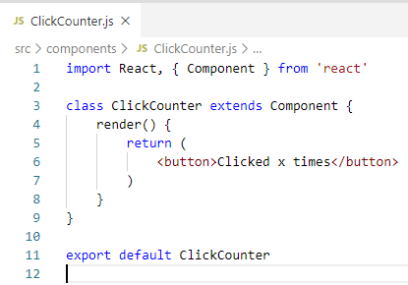
33.1 Implement Click Counter
https://www.youtube.com/watch?v=B6aNv8nkUSw&list=PLC3y8-rFHvwgg3vaYJgHGnModB54rxOk3&index=33
Higher Order Components
Create ClickCounter.js

Slide 5
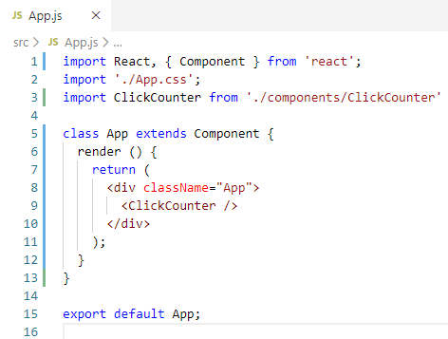
33.1 Implement Click Counter
https://www.youtube.com/watch?v=B6aNv8nkUSw&list=PLC3y8-rFHvwgg3vaYJgHGnModB54rxOk3&index=33
Higher Order Components
In App.js, import ClickCounter and <ClickCounter />

Slide 6
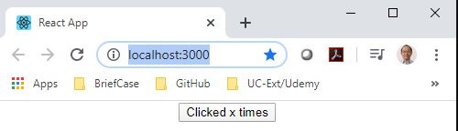
33.1 Implement Click Counter
https://www.youtube.com/watch?v=B6aNv8nkUSw&list=PLC3y8-rFHvwgg3vaYJgHGnModB54rxOk3&index=33
Higher Order Components
> npm start

Slide 7
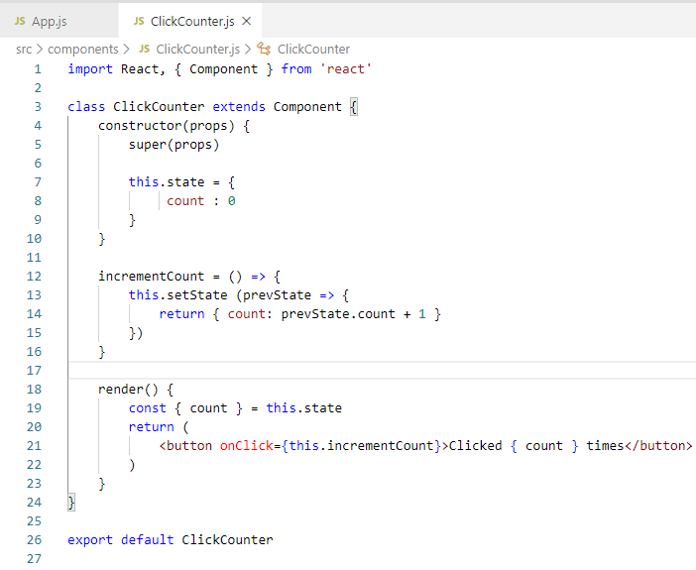
33.1 Implement Click Counter
https://www.youtube.com/watch?v=B6aNv8nkUSw&list=PLC3y8-rFHvwgg3vaYJgHGnModB54rxOk3&index=33
Higher Order Components
Now implement the actual counter.
Type “rconst” to add constructor.
Initialize the count to zero.
Add handler to the button.
Use prevState as parameter and return count as the new state.
In the render(), set the count to this.state and render return { count }

Slide 8
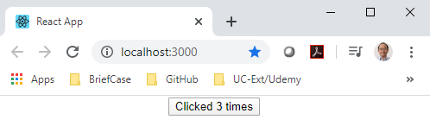
33.1 Implement Click Counter
https://www.youtube.com/watch?v=B6aNv8nkUSw&list=PLC3y8-rFHvwgg3vaYJgHGnModB54rxOk3&index=33
Higher Order Components
Now implement the actual counter.
Type “rconst” to add constructor.
Initialize the count to zero.
Add handler to the button.
Use prevState as parameter and return count as the new state.
In the render(), set the count to this.state and render return { count }

Slide 9
33.2 Implement Hover Counter

Slide 10
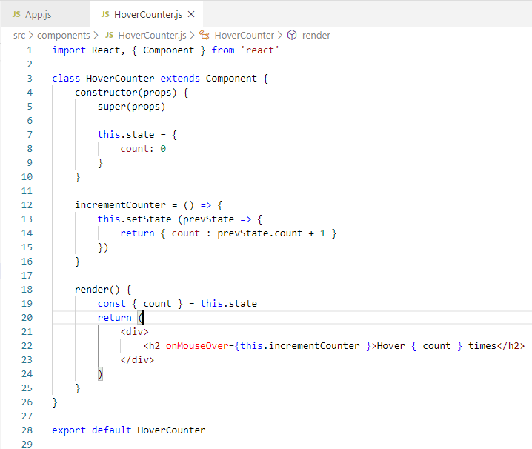
33.2 Implement Hover Counter
https://www.youtube.com/watch?v=B6aNv8nkUSw&list=PLC3y8-rFHvwgg3vaYJgHGnModB54rxOk3&index=33
Higher Order Components
After Click Counter, there is a new requirement for Mouse Hover Counter.
We add the Mouse Hover Counter below the Click Counter.
Type “rce” (react class component for ES7).
Add <h2 onMouseOver={this.incrementCount}>Hovered x times>/h2>
Now, we need the counter functionality that is already implemented in click counter.

Slide 11
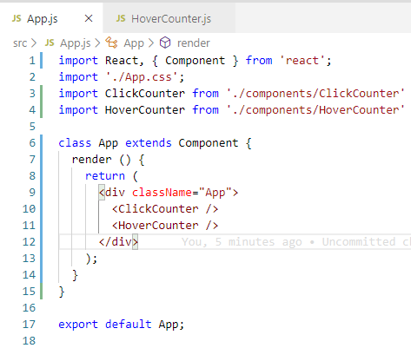
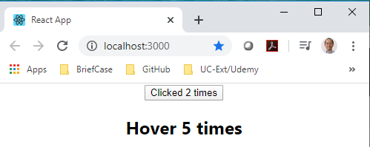
33.2 Implement Hover Counter
https://www.youtube.com/watch?v=B6aNv8nkUSw&list=PLC3y8-rFHvwgg3vaYJgHGnModB54rxOk3&index=33
Higher Order Components
> npm start

Slide 12
33.3 Implement Key Press Counter

Slide 13
33.3 Implement Key Press Counter
https://www.youtube.com/watch?v=B6aNv8nkUSw&list=PLC3y8-rFHvwgg3vaYJgHGnModB54rxOk3&index=33
Higher Order Components
Now, there is a new requirement for key press counter.
In the click counter and hover counter, there are functions can be re-used but they are duplicated.
So, if there is 10 components need a counter functionality. We will be writing the exact the same code over and over again.
The question is: Now, how can we re-use the code?

Slide 14
33.4 How Share Code?

Slide 15
33.4 How Share Code?
https://www.youtube.com/watch?v=B6aNv8nkUSw&list=PLC3y8-rFHvwgg3vaYJgHGnModB54rxOk3&index=33
How to reuse this code?
The immediate though is to lift this state to the parent component and pass down the handler as a prop.
Define a counter functionality in app component and provide the and the handler as props to ClickCounter and HoverCounter.
This will work for our scenario where we have counter components as children of the same parent.
Component Tree
Parent
Lift counter logic (state) to Parent and
pass down the handler as props
2
props
2
props
ClickCounter
HoverCounter
1
state

Slide 16
33.4 How Share Code?
https://www.youtube.com/watch?v=B6aNv8nkUSw&list=PLC3y8-rFHvwgg3vaYJgHGnModB54rxOk3&index=33
How to reuse this code?
If we have a scenario where the counter components are scattered in the react component tree, The props have to passed too many components within the tree. Lifting the state would definitely not be the correct solution.
There is a need to share common functionality between components without repeating code and that is the concept of high-order components.
Component Tree
Parent
ClickCounter
RandomComponentA
RandomComponentB
Lifting the state is not a great solution
HoverCounter

Slide 17
33.5 Summary

Slide 18
33.5 Summary
https://www.youtube.com/watch?v=B6aNv8nkUSw&list=PLC3y8-rFHvwgg3vaYJgHGnModB54rxOk3&index=33
Summary
For sharing the same functionality between the components:
Lifting the state would definitely not be the correct solution.
There is a need to share common functionality between components without repeating code and that is the concept of high-order components.
We will discuss next.
Component Tree
Parent
ClickCounter
RandomComponentA
RandomComponentB
Lifting the state is not a great solution
HoverCounter

Slide 19
33.6 Quiz

Slide 20
33.6 Quiz
https://www.youtube.com/watch?v=B6aNv8nkUSw&list=PLC3y8-rFHvwgg3vaYJgHGnModB54rxOk3&index=33
Quiz
1. What is HOC?
Ans: Share the same functionality between the components.

Slide 21
End of Chapter

