Slide 1

9 Props
Peter H. Chen

Slide 2
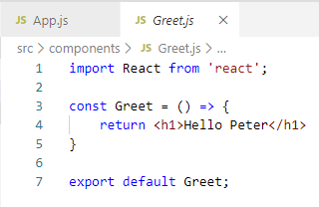
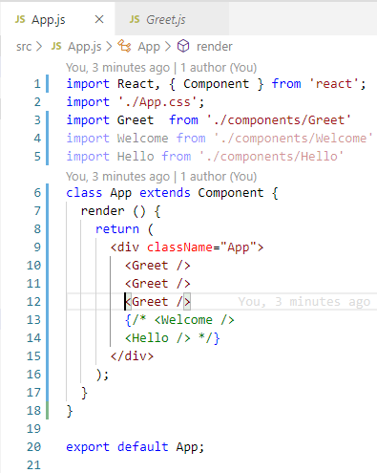
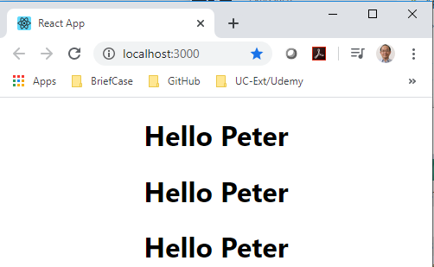
9 Props
https://www.youtube.com/watch?v=m7OWXtbiXX8&list=PLC3y8-rFHvwgg3vaYJgHGnModB54rxOk3&index=9
Props:
The component Greet can be re-used as many times as you want, for example, you can call Greet three times.

Slide 3
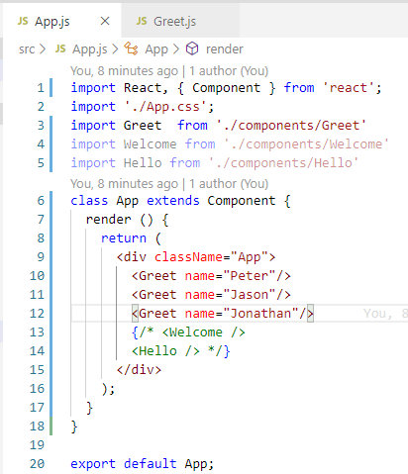
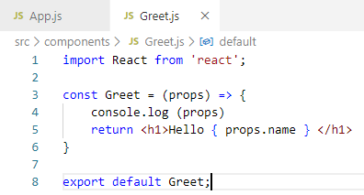
9 Props
https://www.youtube.com/watch?v=m7OWXtbiXX8&list=PLC3y8-rFHvwgg3vaYJgHGnModB54rxOk3&index=9
Props:
In Greet.js, we can have passing parameter ‘props’ as a convention, you can use other name but props is a convention for passing parameter.

Slide 4
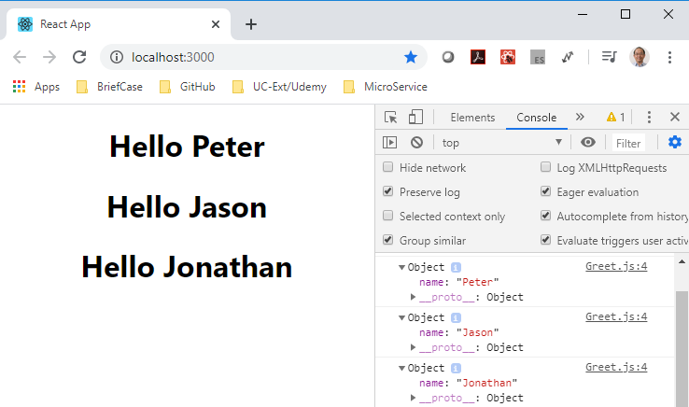
9 Props
https://www.youtube.com/watch?v=m7OWXtbiXX8&list=PLC3y8-rFHvwgg3vaYJgHGnModB54rxOk3&index=9
Props:
> npm start
> FN + F-12 to see console output

Slide 5
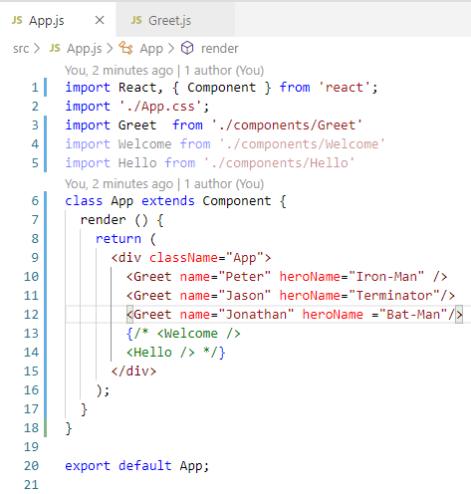
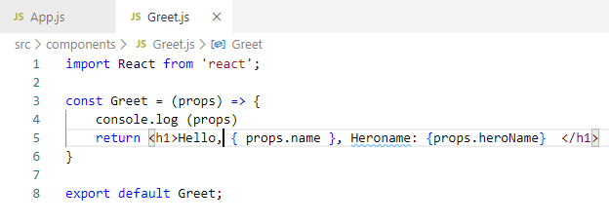
9 Props
https://www.youtube.com/watch?v=m7OWXtbiXX8&list=PLC3y8-rFHvwgg3vaYJgHGnModB54rxOk3&index=9
Props:
Let’s pass in the second argument.

Slide 6
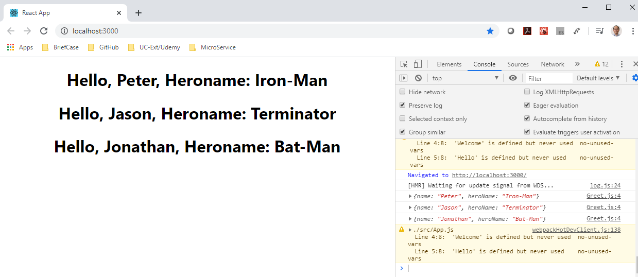
9 Props
https://www.youtube.com/watch?v=m7OWXtbiXX8&list=PLC3y8-rFHvwgg3vaYJgHGnModB54rxOk3&index=9
Props:
> npm start
> FN + F-12 to see console output

Slide 7
9.1 Props for Class Component

Slide 8
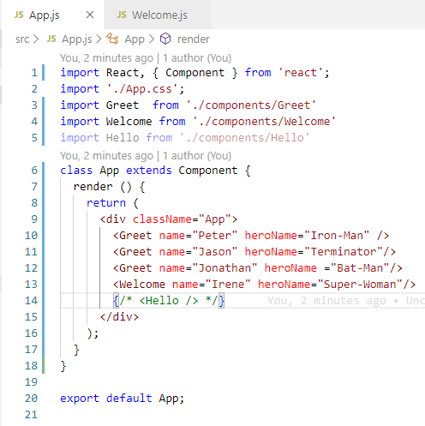
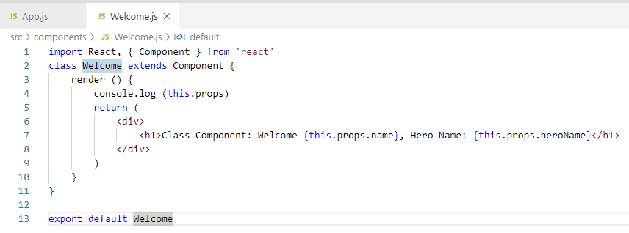
9.1 Props for Class Component
https://www.youtube.com/watch?v=m7OWXtbiXX8&list=PLC3y8-rFHvwgg3vaYJgHGnModB54rxOk3&index=9
Props:
Class component does not have passing props like function.
Just accessed by ‘this’ keyword. Use Console.log () inside the render() but outside the return (<element>)

Slide 9
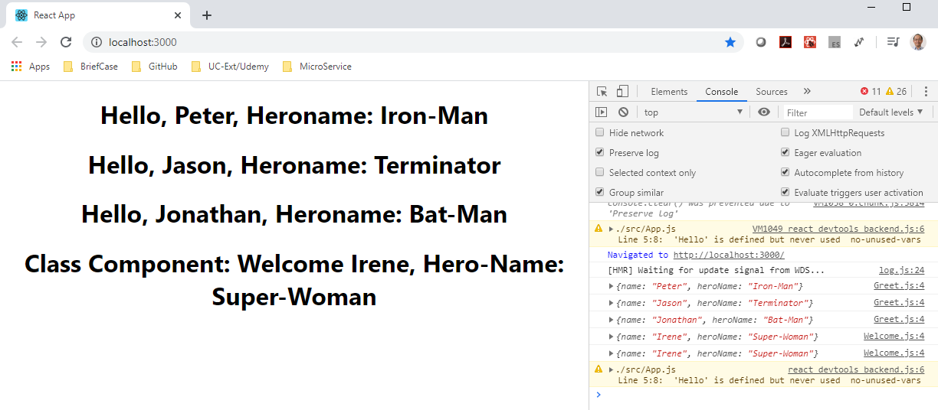
9.1 Props for Class Component
https://www.youtube.com/watch?v=m7OWXtbiXX8&list=PLC3y8-rFHvwgg3vaYJgHGnModB54rxOk3&index=9
Props:
> npm start
> FN + F-12 to see console output

Slide 10
9.1 Props for Class Component
https://www.youtube.com/watch?v=m7OWXtbiXX8&list=PLC3y8-rFHvwgg3vaYJgHGnModB54rxOk3&index=9
Summary:
Functional component: Use props as the passing parameter
Class Component: Use this.props to access the passing parameter.
Console.log output should be used outside the element.

Slide 11
9.2 Quiz

Slide 12
9.2 Quiz
https://www.youtube.com/watch?v=m7OWXtbiXX8&list=PLC3y8-rFHvwgg3vaYJgHGnModB54rxOk3&index=9
Quiz
1. What is props?
Ans: In React, the passing parameter is called ‘props’.
2. If we have component Greet, how to pass name=‘Peter’ and role=‘React Developer’ props to the functional components?
Ans:
a) Caller:
<div className=‘App’>
<Greet name=‘peter’ role=‘React Developer’ />
</div>
b) Functional component with arrow function:
const Greet = (props) => {
console.log (‘name : { props.name} role: { props.role } ‘)
return <h1>name: {props.name} role: { props.role } </h1>
}

Slide 13
9.2 Quiz
https://www.youtube.com/watch?v=m7OWXtbiXX8&list=PLC3y8-rFHvwgg3vaYJgHGnModB54rxOk3&index=9
Quiz
3. If we have component Greet1, how to pass name=‘Peter’ and role=‘React Developer’ props to the class components?
Ans:
a) Caller:
<div className=‘App’>
<Greet1 name=‘peter’ role=‘React Developer’ />
</div>

Slide 14
9.2 Quiz
https://www.youtube.com/watch?v=m7OWXtbiXX8&list=PLC3y8-rFHvwgg3vaYJgHGnModB54rxOk3&index=9
Quiz
3-b) Functional component with arrow function:
class Greet1 extends Component {
render () {
console.log (‘name : { props.name} role: { props.role } ‘)
return (
<div>
<h1>name: {props.name} role: { props.role } </h1>
</div>
)
}
}

Slide 15
End of Chapter

