Slide 1

12 Destructure
Peter H. Chen

Slide 2
12 Destructure
https://www.youtube.com/watch?v=5_PdMS9CLLI&list=PLC3y8-rFHvwgg3vaYJgHGnModB54rxOk3&index=12
Destructuring props and state in React:
Destructuring is an ES6 feature that make possible to unpack values from arrays or properties from objects into distinct variables.
In React, destructuring props and state improves code readability.
We are more likely going to find the destructuring syntax in most of the online material and that is the reason we discuss this topic.
Let’s start with functional components. We have created a functional component Greet.

Slide 3
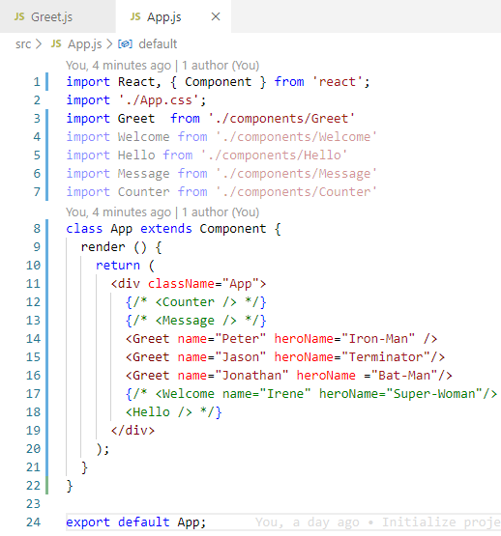
12 Destructure
https://www.youtube.com/watch?v=5_PdMS9CLLI&list=PLC3y8-rFHvwgg3vaYJgHGnModB54rxOk3&index=12
Destructuring props and state in React:
In App.js, we pass in name and heroName as props and in Greet component, we access them using props.name and props.heroName.

Slide 4
12.1 Functional Component

Slide 5
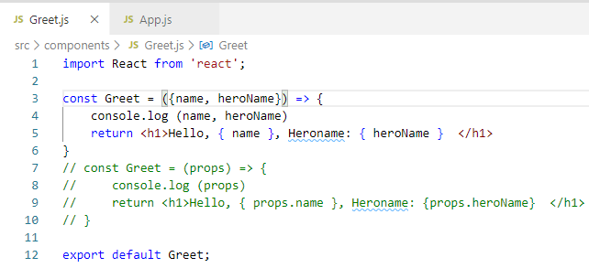
12.1 Functional Component
https://www.youtube.com/watch?v=5_PdMS9CLLI&list=PLC3y8-rFHvwgg3vaYJgHGnModB54rxOk3&index=12
Destructuring props and state in Functional Component:
There are two ways to destructure props in a functional component.
The first way is to destructure it in the function parameter itself.
So instead of just props, we are going to have parenthesis and within the parentheses, we have the destructuring using { name, heroName }. We are basically extracting name and heroName from the props object in the JSX.
We can now simply use name and heroName instead of props.name and props.heroName.

Slide 6
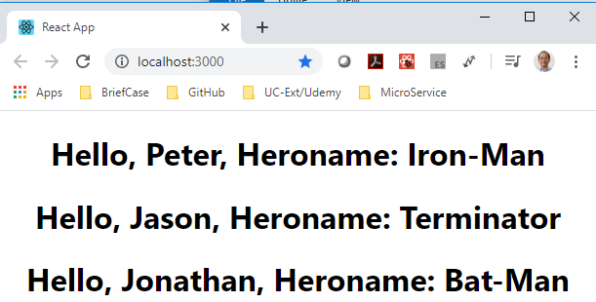
12.1 Functional Component
https://www.youtube.com/watch?v=5_PdMS9CLLI&list=PLC3y8-rFHvwgg3vaYJgHGnModB54rxOk3&index=12
Destructuring props and state in Functional Component:
> npm start

Slide 7
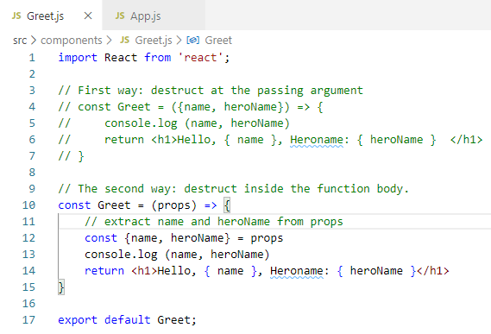
12.1 Functional Component
https://www.youtube.com/watch?v=5_PdMS9CLLI&list=PLC3y8-rFHvwgg3vaYJgHGnModB54rxOk3&index=12
Destructuring props and state in Functional Component:
The second way is the destructure it in the function body.
Const { name, heroName } = props

Slide 8
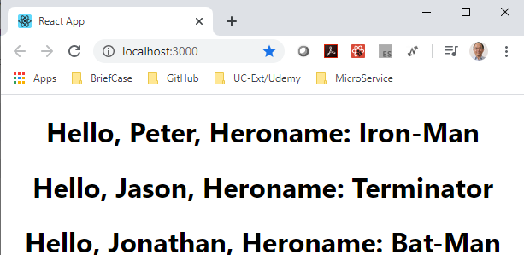
12.1 Functional Component
https://www.youtube.com/watch?v=5_PdMS9CLLI&list=PLC3y8-rFHvwgg3vaYJgHGnModB54rxOk3&index=12
Destructuring props and state in Functional Component:
> npm start

Slide 9
12.2 Class Component

Slide 10
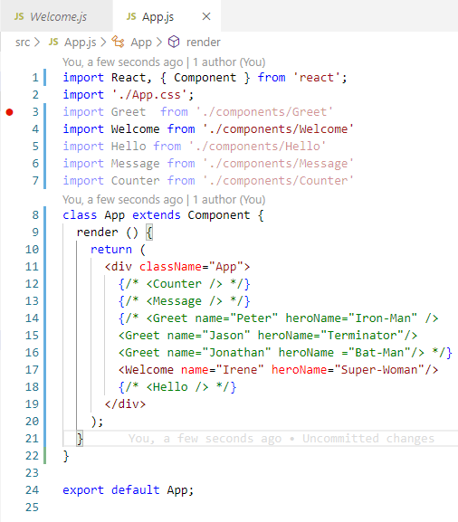
12.2 Class Component
https://www.youtube.com/watch?v=5_PdMS9CLLI&list=PLC3y8-rFHvwgg3vaYJgHGnModB54rxOk3&index=12
Destructuring props and state in Class Component:
Check the Welcome component.

Slide 11
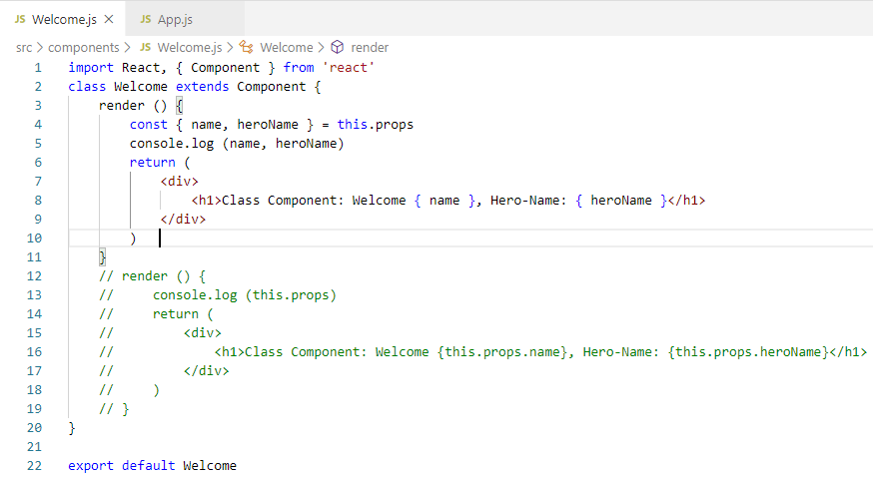
12.2 Class Component
https://www.youtube.com/watch?v=5_PdMS9CLLI&list=PLC3y8-rFHvwgg3vaYJgHGnModB54rxOk3&index=12
Destructuring props and state in Class Component:
Check the Welcome component.
Extract this.pros into const { name, heroName }

Slide 12
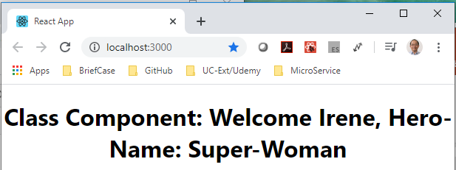
12.2 Class Component
https://www.youtube.com/watch?v=5_PdMS9CLLI&list=PLC3y8-rFHvwgg3vaYJgHGnModB54rxOk3&index=12
Destructuring props and state in Class Component:
Check the Welcome component.
> npm start

Slide 13
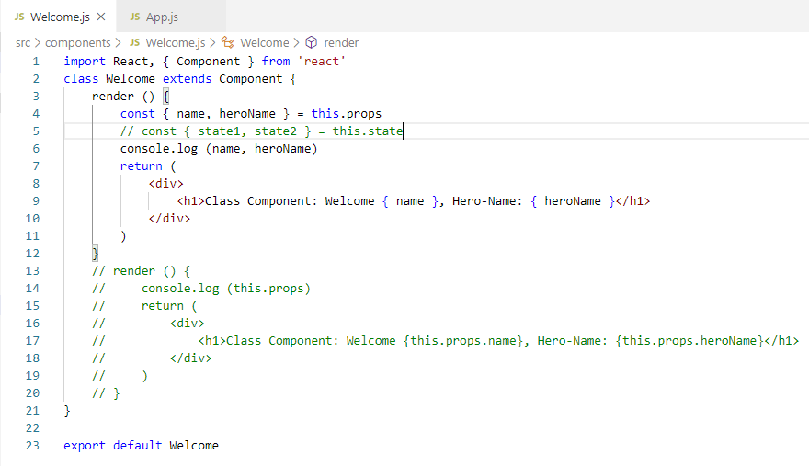
12.2 Class Component
https://www.youtube.com/watch?v=5_PdMS9CLLI&list=PLC3y8-rFHvwgg3vaYJgHGnModB54rxOk3&index=12
Destructuring props and state in Class Component:
You can extract the state for class component as well.
const { state1, state2 } = this.state

Slide 14
12.3 Quiz

Slide 15
12.3 Quiz
https://www.youtube.com/watch?v=5_PdMS9CLLI&list=PLC3y8-rFHvwgg3vaYJgHGnModB54rxOk3&index=12
Quiz
1. How may way to access the props data, for example, passed in name=‘Peter’ and job = ‘Software Developer’?
Ans: Two ways
a) <p> { props.name} {props.job} </p>
b)
> render () {
> const { name, job } = this.props
> return (<p> {name} {job} </p>)
>}

Slide 16
End of Chapter

