Slide 1

10 State
Peter H. Chen

Slide 2
10 State
https://www.youtube.com/watch?v=4ORZ1GmjaMc&list=PLC3y8-rFHvwgg3vaYJgHGnModB54rxOk3&index=10
Props vs. State:
Props get passed to the component and state is managed within the component.
Analogy for this would be function parameters against variables declared within the function body.
Because a parent usually passes down the props to the child component, props are immutable. The parent owns the props and cannot be changed by the children. State, on the other hand, is managed within the component and hence, the component has fully controlled to change to change the state.
Props
State
Props get passed to the component
Function parameters
Props are immutable
props – Functional Components
this.props – Class Components
State is managed within the component
Variables declared in the function body
State can be changed
useState Hook – Functional Component
this.state – Class Component.

Slide 3
10 State
https://www.youtube.com/watch?v=4ORZ1GmjaMc&list=PLC3y8-rFHvwgg3vaYJgHGnModB54rxOk3&index=10
Props vs. State:
In the functional components, props can be accessed using the props parameter.
In class components, props can be accessed using this.props.
State, on the other hand, can be accessed using useState Hook in functional component and this.state in Class Component.
Hook are a new feature in React.
When you start on existing projects at your work, you are more likely to encounter class components and the state object rather than the useState Hook.
Essentially, you have good understanding of the state in class components.
Props
State
Props get passed to the component
Function parameters
Props are immutable
props – Functional Components
this.props – Class Components
State is managed within the component
Variables declared in the function body
State can be changed
useState Hook – Functional Component
this.state – Class Component.

Slide 4
10 State
https://www.youtube.com/watch?v=4ORZ1GmjaMc&list=PLC3y8-rFHvwgg3vaYJgHGnModB54rxOk3&index=10
Props vs. State:
Well, that is the comparison between props and state in React Comoponents.
Ultimately, both props and state hold information that influences the UI in the browser.
With this understanding, let’s look at an example on how state can be used in class components.
Props
State
Props get passed to the component
Function parameters
Props are immutable
props – Functional Components
this.props – Class Components
State is managed within the component
Variables declared in the function body
State can be changed
useState Hook – Functional Component
this.state – Class Component.

Slide 5
10 State
https://www.youtube.com/watch?v=4ORZ1GmjaMc&list=PLC3y8-rFHvwgg3vaYJgHGnModB54rxOk3&index=10
Message.js:
Add a button below the “Welcome visitor: Peter”, when you click button, the message change into “Thanks you for the Subscribing.”
The parameter from parent passed to child need to be changed. The props will not work. We need the state.

Slide 6
10 State
https://www.youtube.com/watch?v=4ORZ1GmjaMc&list=PLC3y8-rFHvwgg3vaYJgHGnModB54rxOk3&index=10
Message.js:
The first step is initializer. We can use constructor in the class Message.
In the constructor(), we call the super() method. This is required because we extend React Component class and a super() call have to be made to inherit all the data and methods from the base class.
Then, we create our state object
this.state = {
Message: “Welcome visitor”
}

Slide 7
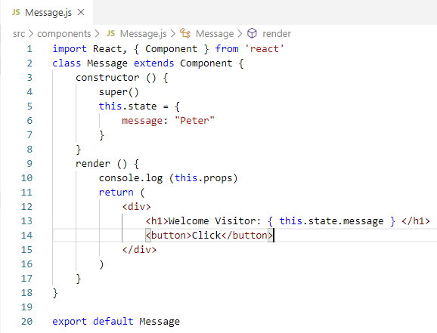
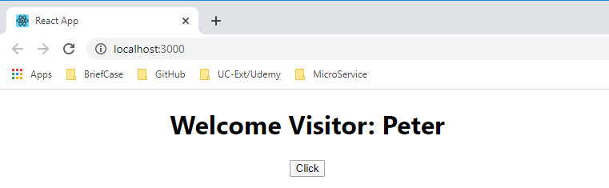
10 State
https://www.youtube.com/watch?v=4ORZ1GmjaMc&list=PLC3y8-rFHvwgg3vaYJgHGnModB54rxOk3&index=10
Message.js:
The second step is to bind this.state value in the render function and we do this very similar to props.
Instead of this.props, we simply use this.state.
In the return statement within curly braces. { this.state.message }
> npm start

Slide 8
10 State
https://www.youtube.com/watch?v=4ORZ1GmjaMc&list=PLC3y8-rFHvwgg3vaYJgHGnModB54rxOk3&index=10
Message.js:
Because we use the state to render the message, we now have the ability to change this.message.
Create a button and onClick of that button to change the message.

Slide 9
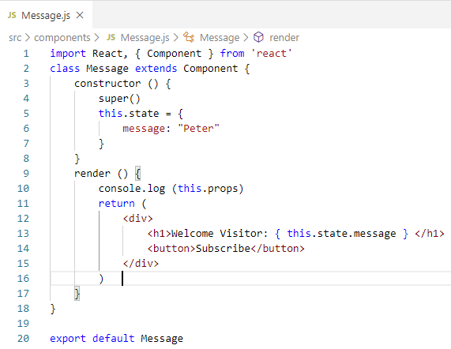
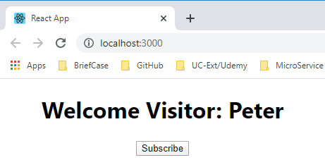
10 State
https://www.youtube.com/watch?v=4ORZ1GmjaMc&list=PLC3y8-rFHvwgg3vaYJgHGnModB54rxOk3&index=10
Message.js:
Step 3: Add HTML for a button element.
We need <div> </div> for multiple HTML statements. Because React want only one HTML element return.
> npm start

Slide 10
10 State
https://www.youtube.com/watch?v=4ORZ1GmjaMc&list=PLC3y8-rFHvwgg3vaYJgHGnModB54rxOk3&index=10
Message.js:
Step 4 and final step: add the listen to the click event on this button and change the message. We will take a look at event handling in React in the next discussion.
We add onClick attribute for event handling.
<button onClick = {} >Subscribe</button>
The event handler is in the curly brace. Event handler is an arrow function.
<button onClick = { () => this.changeMessage() } > Subscribe</button>
We need to define this.ChangeMessage.
changeMessage () {
this.setState ({
Message: “Thanks for Subscribing.”
)};
}

Slide 11
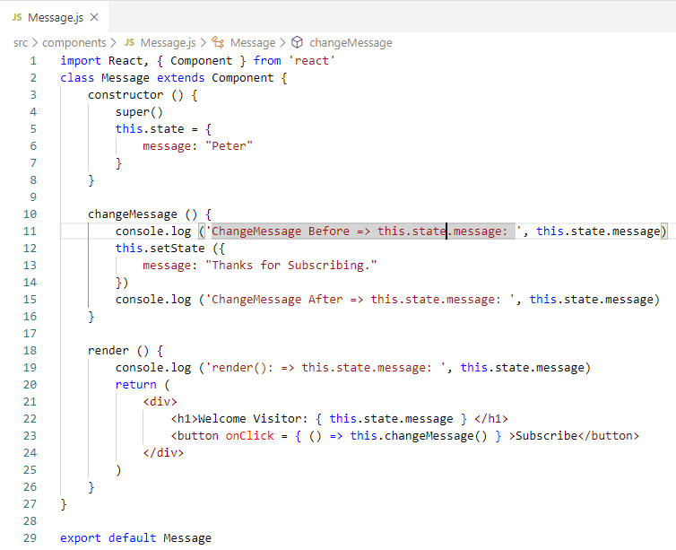
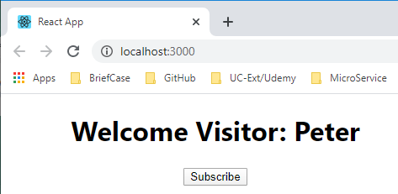
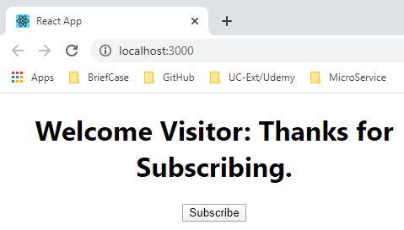
10 State
https://www.youtube.com/watch?v=4ORZ1GmjaMc&list=PLC3y8-rFHvwgg3vaYJgHGnModB54rxOk3&index=10
Message.js:
> npm start

Slide 12
10.1 Quiz

Slide 13
10.1 Quiz
https://www.youtube.com/watch?v=4ORZ1GmjaMc&list=PLC3y8-rFHvwgg3vaYJgHGnModB54rxOk3&index=10
Quiz
1. What is state?
Ans: State is managed within the component
2. What is difference of State and props?
Ans:
a) props is parameter passing and immutable
b) state is variable defined in class and mutable.
3. How to access props in functional and class components?
a) functional component: props
b) class component: this.props

Slide 14
10.1 Quiz
https://www.youtube.com/watch?v=4ORZ1GmjaMc&list=PLC3y8-rFHvwgg3vaYJgHGnModB54rxOk3&index=10
Quiz
3. How to access state in functional and class components?
a) functional component: useState Hook
b) class component: this.state
4. How to initialized state variable message to “Peter” in class Message?
Ans:
class Message extends Component {
constructor () {
super()
this.state = {
message: “Peter”
}
}
}

Slide 15
10.1 Quiz
https://www.youtube.com/watch?v=4ORZ1GmjaMc&list=PLC3y8-rFHvwgg3vaYJgHGnModB54rxOk3&index=10
Quiz
5. How to render state variable message in <h1> element?
class Message extends Component {
render () {
console.log (this.state.message)
return (
<div>
<h1> {this.state.message} </h1>
</div>
)
}
}

Slide 16
End of Chapter

