Slide 1

16 Conditional Rendering
Peter H. Chen

Slide 2
16 Conditional Rendering
https://www.youtube.com/watch?v=7o5FPaVA9m0&list=PLC3y8-rFHvwgg3vaYJgHGnModB54rxOk3&index=16
Conditional Rendering:
When you building the application, you may need to show or hide some HTML element based on a certain JavaScript condition:
1. if / else
2. Element variables
3. Ternary conditional operator.
4. Short circuit operator.

Slide 3
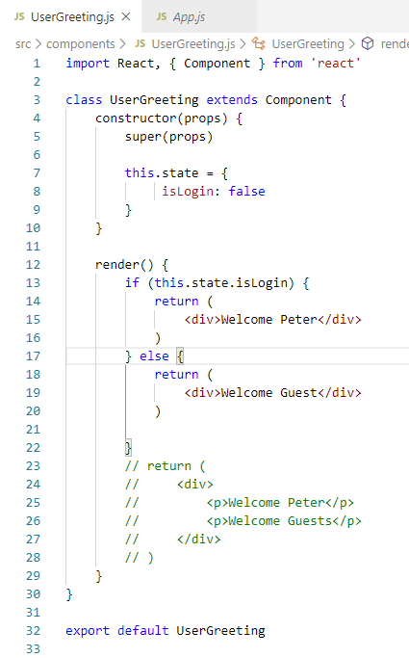
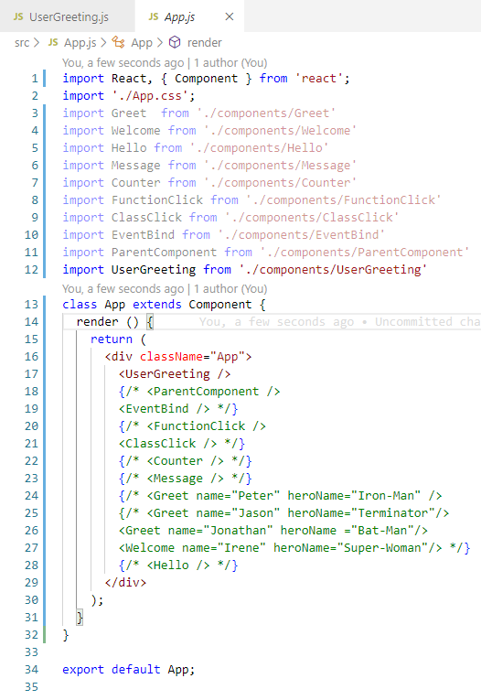
16 Conditional Rendering
https://www.youtube.com/watch?v=7o5FPaVA9m0&list=PLC3y8-rFHvwgg3vaYJgHGnModB54rxOk3&index=16
Conditional Rendering:
Create components/UserGreeting.js.
Type ‘rce’ (React Class Component with ES7)
Type ‘rconst’ (React Constructor)

Slide 4
16.1 if/else

Slide 5
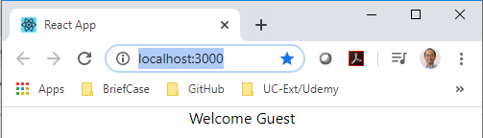
16.1 if/else
https://www.youtube.com/watch?v=7o5FPaVA9m0&list=PLC3y8-rFHvwgg3vaYJgHGnModB54rxOk3&index=16
Conditional Rendering:
> npm start
isLogin : false => display “Welcome Guest”

Slide 6
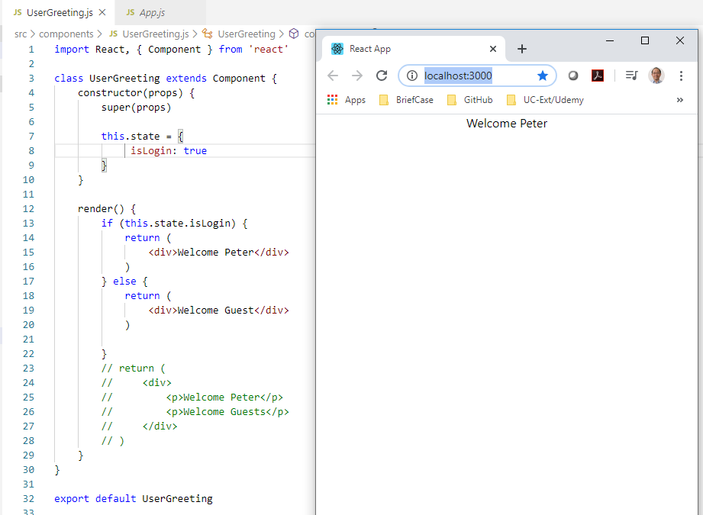
16.1 if/else
https://www.youtube.com/watch?v=7o5FPaVA9m0&list=PLC3y8-rFHvwgg3vaYJgHGnModB54rxOk3&index=16
Conditional Rendering:
> npm start
isLogin : true => display “Welcome Peter”

Slide 7
16.2 Element Variable

Slide 8
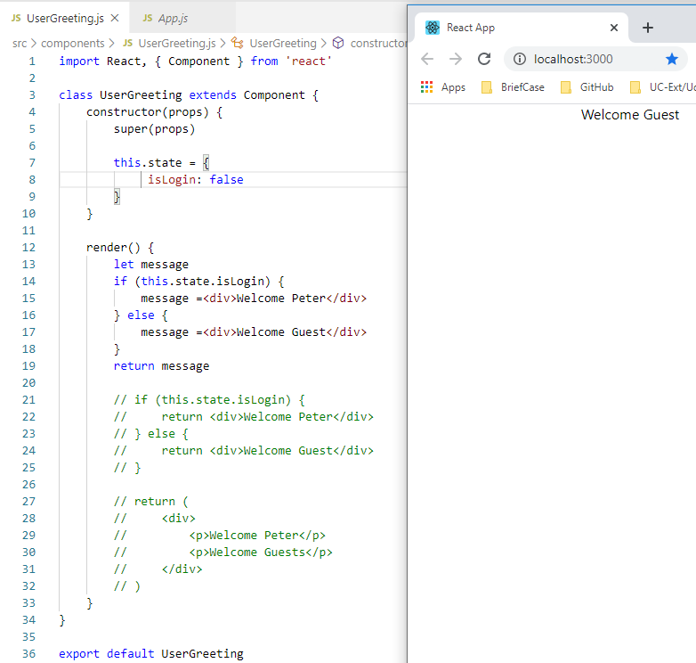
16.2 Element Variable
https://www.youtube.com/watch?v=7o5FPaVA9m0&list=PLC3y8-rFHvwgg3vaYJgHGnModB54rxOk3&index=16
Conditional Rendering:
Assign message

Slide 9
16.3 Ternary Operator

Slide 10
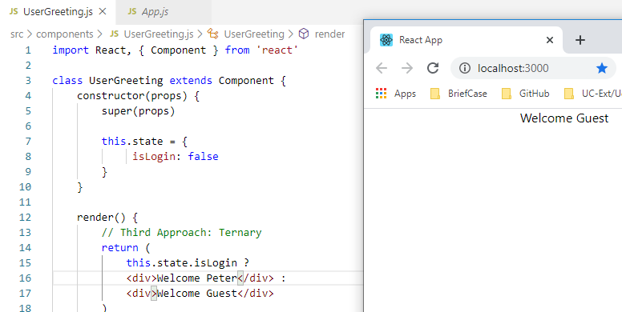
16.3 Ternary Operator
https://www.youtube.com/watch?v=7o5FPaVA9m0&list=PLC3y8-rFHvwgg3vaYJgHGnModB54rxOk3&index=16
Conditional Rendering:
Ternary Operator (? : )

Slide 11
16.4 Short Circuit Operator

Slide 12
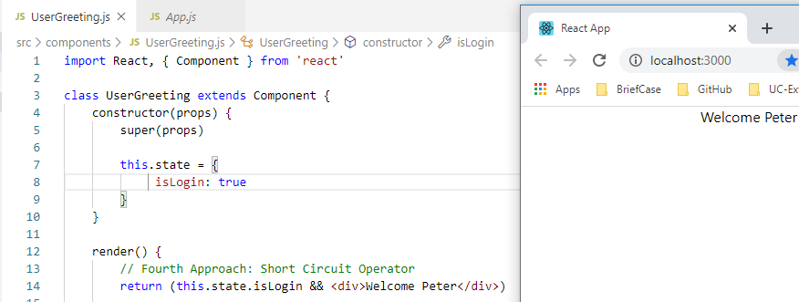
16.4 Short Circuit Operator
https://www.youtube.com/watch?v=7o5FPaVA9m0&list=PLC3y8-rFHvwgg3vaYJgHGnModB54rxOk3&index=16
Conditional Rendering:
Short Circuit Operator

Slide 13
16.5 Summary of Conditional Rendering

Slide 14
16.5 Summary of Conditional Rendering
https://www.youtube.com/watch?v=7o5FPaVA9m0&list=PLC3y8-rFHvwgg3vaYJgHGnModB54rxOk3&index=16
Conditional Rendering:
1. if / else
2. Element variables
3. Ternary conditional operator.
4. Short circuit operator.

Slide 15
16.6 Quiz

Slide 16
16.6 Quiz
https://www.youtube.com/watch?v=7o5FPaVA9m0&list=PLC3y8-rFHvwgg3vaYJgHGnModB54rxOk3&index=16
Quiz
1.
Ans:
> constructor (props) {
> this.state = {
> isLogin: false
> }
> }
> render () {
> if (this.state.isLogin) {
> msg = <div> abc </div>
> } else {
> msg = <div> def </div>
> }
> return msg
> }

Slide 17
End of Chapter

