Slide 1

30 Forward Refs
Peter H. Chen

Slide 2
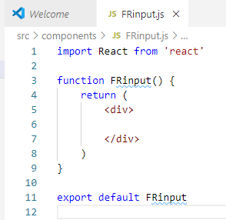
30 Forward Refs
https://www.youtube.com/watch?v=RLWniwmfdq4&list=PLC3y8-rFHvwgg3vaYJgHGnModB54rxOk3&index=30
In this section, we will discuss forwarding refs.
Forwarding refs is a technique automatically passing a ref through a component to one of it children.
We will discuss an example of forwarding refs.
Create a new file FRinput.js
Type ‘rfce’ (React Functional Component for ES7).

Slide 3
30.1 Input Text Field

Slide 4
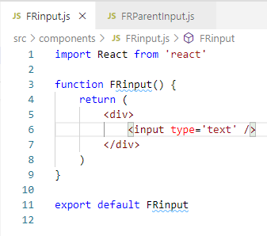
30.1 Input Text Field
https://www.youtube.com/watch?v=RLWniwmfdq4&list=PLC3y8-rFHvwgg3vaYJgHGnModB54rxOk3&index=30
Add input Text:
> <input type=“text” />

Slide 5
30.2 Create Parent Input

Slide 6
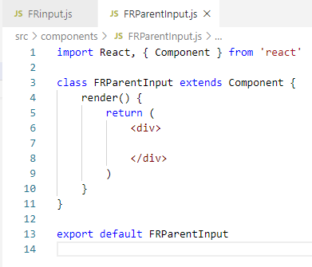
30.2 Create Parent Input
https://www.youtube.com/watch?v=RLWniwmfdq4&list=PLC3y8-rFHvwgg3vaYJgHGnModB54rxOk3&index=30
Create another Parent file: FRParentInput.js
Type ‘rce’ (React Class Component for ES7).

Slide 7
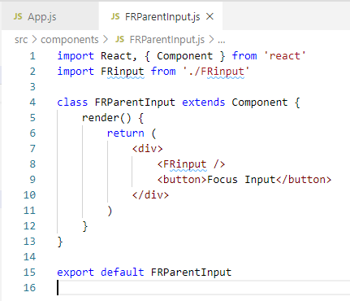
30.1 Input Text Field
https://www.youtube.com/watch?v=RLWniwmfdq4&list=PLC3y8-rFHvwgg3vaYJgHGnModB54rxOk3&index=30
In the JSX, we add
> <FRinput />
<button>Focus Inout </button>

Slide 8
30.3 Add Parent Component

Slide 9
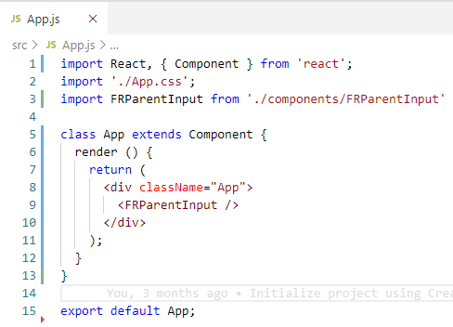
30.3 Add Parent Component
https://www.youtube.com/watch?v=RLWniwmfdq4&list=PLC3y8-rFHvwgg3vaYJgHGnModB54rxOk3&index=30
In the App.js, we add the parent component
> <FRParentInput />.

Slide 10
30.4 Test Browser

Slide 11
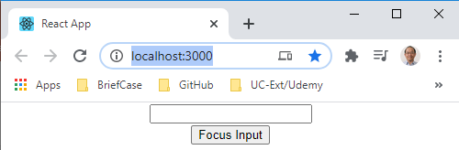
30.4 Test Browser
https://www.youtube.com/watch?v=RLWniwmfdq4&list=PLC3y8-rFHvwgg3vaYJgHGnModB54rxOk3&index=30
Open Browser
> npm start
Similar to the last section, we want to click the button on the parent component.
The input in the child component should receive focus.
However, unlike the last section, the ref was pointing to the child component.
In this section, we use forwarding technique to allow the parent component directly reference to the native input element.
We have four steps:

Slide 12
30.5 Step 1: Create a Ref

Slide 13
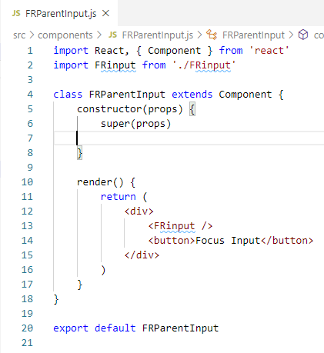
30.5 Step 1: Create a Ref
https://www.youtube.com/watch?v=RLWniwmfdq4&list=PLC3y8-rFHvwgg3vaYJgHGnModB54rxOk3&index=30
Step 1: Create a Ref
Create a ref in the parent component
In FRParentInput.js, type ‘rconst’ (React Constructor)

Slide 14
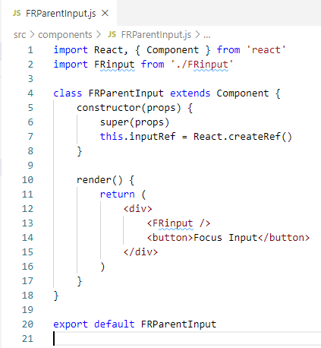
30.5 Step 1: Create a Ref
https://www.youtube.com/watch?v=RLWniwmfdq4&list=PLC3y8-rFHvwgg3vaYJgHGnModB54rxOk3&index=30
Step 1: Create a Ref
Create a ref in the parent component
> this.inputRef = React.createRef()

Slide 15
30.6 Step 2: Attach Ref

Slide 16
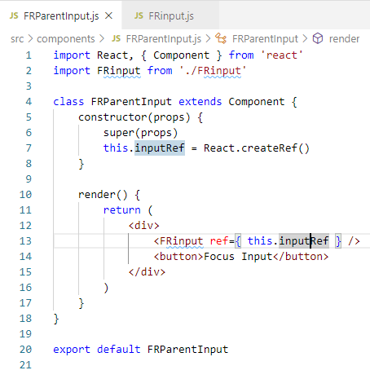
30.6 Step 2: Attach Ref
https://www.youtube.com/watch?v=RLWniwmfdq4&list=PLC3y8-rFHvwgg3vaYJgHGnModB54rxOk3&index=30
Step 2: Attach Ref
Attach the ref to the child component using the ref attribute.
In FRParentInput.js, pass the ref to child compaonent.
> <FRinput ref = { this.inputRef } />

Slide 17
30.7 Step 3: Forward Ref

Slide 18
30.7 Step 3: Forward Ref
https://www.youtube.com/watch?v=RLWniwmfdq4&list=PLC3y8-rFHvwgg3vaYJgHGnModB54rxOk3&index=30
Step 3: Forward Ref
We need to forward this ref to the input element in the child component and ref forwarding can be achieved using the forwardRef () method from the React Library.
The FRinput.js which is out child component. We are going to modify how we create the functional component.
We comment our the exiting code and use the new way to define it.

Slide 19
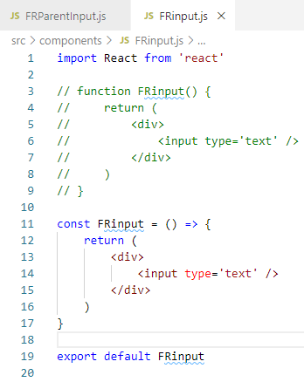
30.7 Step 3: Forward Ref
https://www.youtube.com/watch?v=RLWniwmfdq4&list=PLC3y8-rFHvwgg3vaYJgHGnModB54rxOk3&index=30
Step 3: Forward Ref
First, we use the arrow function.
Type ‘rafce’ (React Arrow Function Component For ES7)
We did not change anything, just change the function to arrow function.

Slide 20
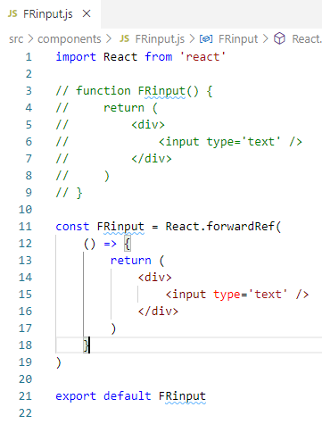
30.7 Step 3: Forward Ref
https://www.youtube.com/watch?v=RLWniwmfdq4&list=PLC3y8-rFHvwgg3vaYJgHGnModB54rxOk3&index=30
Step 3: Forward Ref
To forward the ref, we use React.forwardRef () method.
The method is going to be assigned to the constant.
> const Frinput = React.forwardRef ()
The React.forwardRef() method takes in a component as its parameter.
Since we already have the functional component, we will cut down the entire arrow function and paste it inside the parentheses.
The arrow function is passed as the parameter of the forwardRef() Method.

Slide 21
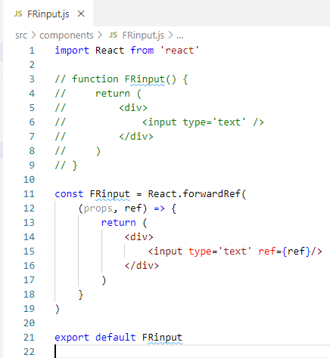
30.7 Step 3: Forward Ref
https://www.youtube.com/watch?v=RLWniwmfdq4&list=PLC3y8-rFHvwgg3vaYJgHGnModB54rxOk3&index=30
Step 3: Forward Ref
We know every functional component receive props as its parameter. Now we pass the component is passed as a parameter to the createRef() method.
It receives the ref attribute as its second parameter.
> forwardRef ((prop, ref ) => {}
We can use this ref parameter and pass it as a value to the ref attribute on the native input element.
So on the input element, ref attribute and assign the value of the ref parameter.
> <input type = “text” ref={ref} />
This ref parameter will point to the value of the ref attribute from the parent component.

Slide 22
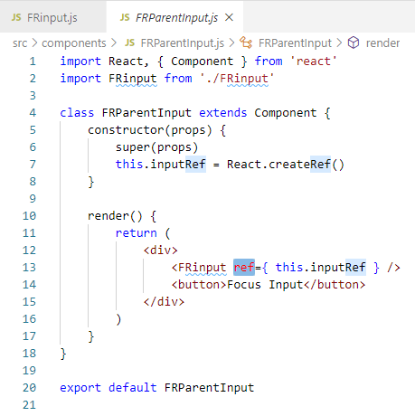
30.7 Step 3: Forward Ref
https://www.youtube.com/watch?v=RLWniwmfdq4&list=PLC3y8-rFHvwgg3vaYJgHGnModB54rxOk3&index=30
Step 3: Forward Ref
> <input type = “text” ref={ref} />
This ref parameter will point to the value of the ref attribute from the parent component.
Or, in other word, the ref is being forward from the parent component to the native input element.

Slide 23
30.8 Step 4: Click Handler

Slide 24
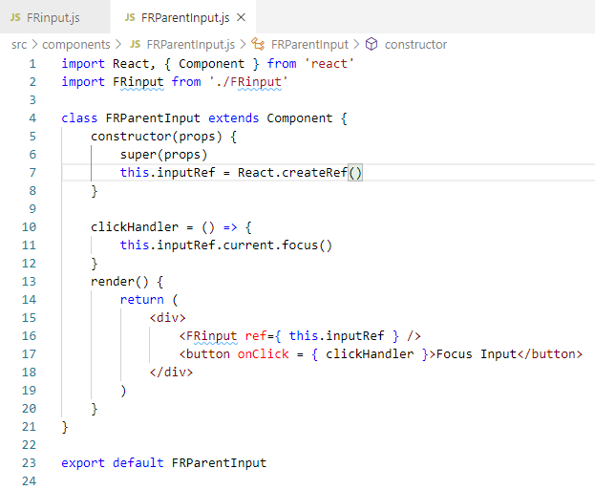
30.8 Step 4: Click Handler
https://www.youtube.com/watch?v=RLWniwmfdq4&list=PLC3y8-rFHvwgg3vaYJgHGnModB54rxOk3&index=30
Step 4: Click Handler
In FRParentInput.js, we define the clickHandler
clickHandler = () => {
this.inputRef.current.focus()
}
<button onClick= { this.clickHandler } > Focus Input</button>

Slide 25
30.9 Verify

Slide 26
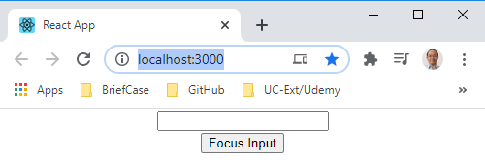
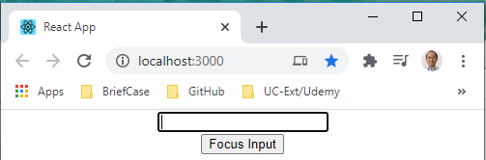
30.9 Verify
https://www.youtube.com/watch?v=RLWniwmfdq4&list=PLC3y8-rFHvwgg3vaYJgHGnModB54rxOk3&index=30
Verify
Open Browser
> npm start
Click the “Focus Input” button.
We get the focus for Input Text field.

Slide 27
30.10 Overview

Slide 28
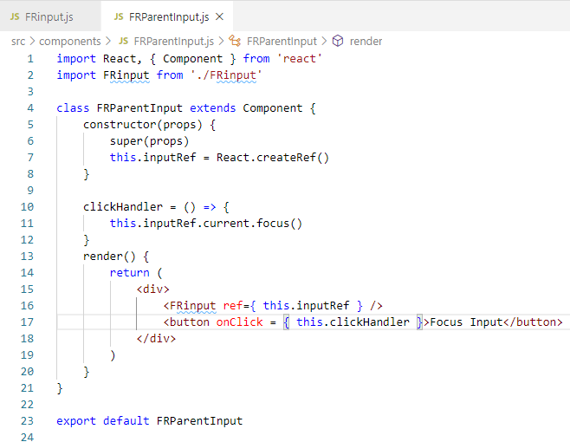
30.10 Overview
https://www.youtube.com/watch?v=RLWniwmfdq4&list=PLC3y8-rFHvwgg3vaYJgHGnModB54rxOk3&index=30
In the FRParentInput.js, we
Create the Ref.
Attach the ref to the child. The child component see the ref and tell the parent. Hey, I am not the guy that you are looking for. You want the native element. Right? Let me directly introduce you.
1
2

Slide 29
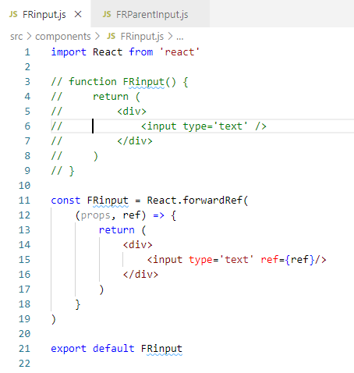
30.10 Overview
https://www.youtube.com/watch?v=RLWniwmfdq4&list=PLC3y8-rFHvwgg3vaYJgHGnModB54rxOk3&index=30
In the FRinput.js:
So the child component receives the ref from the parent component.
Attach the ref to the native input element.
1
2

Slide 30
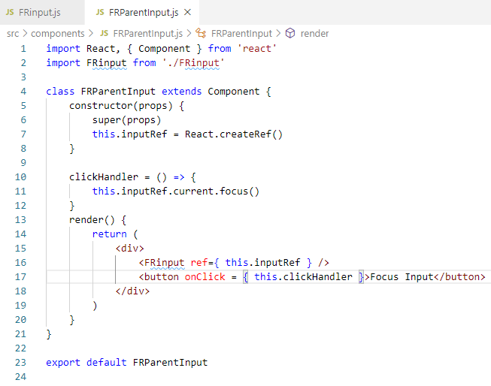
30.10 Overview
https://www.youtube.com/watch?v=RLWniwmfdq4&list=PLC3y8-rFHvwgg3vaYJgHGnModB54rxOk3&index=30
In the FRParentInput.js:
Now, the parent component has directly access this input element using this.inputRef variable: this.inputRef.current.focus().

Slide 31
30.10 Overview
https://www.youtube.com/watch?v=RLWniwmfdq4&list=PLC3y8-rFHvwgg3vaYJgHGnModB54rxOk3&index=30
In the FRInput.js:
The child element is basically forwarding this reference.
Now, ref forward is something you are rarely used in our application.
The ref forwarding will use library or higher-order component.
It is nice to get concept of the ref forwarding.

Slide 32
30.11 Quiz

Slide 33
30.11 Quiz
https://www.youtube.com/watch?v=RLWniwmfdq4&list=PLC3y8-rFHvwgg3vaYJgHGnModB54rxOk3&index=30
Quiz
1. Give an example of parent pass the ref forwarding to child.
Ans:
Create the Ref.
Attach the ref to the child. The child component see the ref and tell the parent. Hey, I am not the guy that you are looking for. You want the native element. Right? Let me directly introduce you.
1
2

Slide 34
30.11 Quiz
https://www.youtube.com/watch?v=RLWniwmfdq4&list=PLC3y8-rFHvwgg3vaYJgHGnModB54rxOk3&index=30
Quiz
2. Give an example of child response to ref forwarding with arrow function passing parameter.
Ans:
So the child component receives the ref from the parent component.
Attach the ref to the native input element.
1
2

Slide 35
30.11 Quiz
https://www.youtube.com/watch?v=RLWniwmfdq4&list=PLC3y8-rFHvwgg3vaYJgHGnModB54rxOk3&index=30
Quiz
3. Give an example of how parent component access through the this.inputRef variable
Ans:
The parent component has directly access this input element using this.inputRef variable: this.inputRef.current.focus().

Slide 36
End of Chapter

