Slide 1

3 Folder Structure
Peter H. Chen

Slide 2
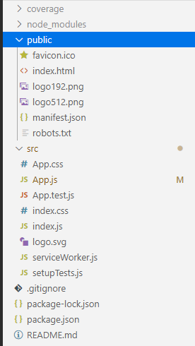
3 Folder Structure
https://www.youtube.com/watch?v=9VIiLJL0H4Y&list=PLC3y8-rFHvwgg3vaYJgHGnModB54rxOk3&index=3
React Folder Structure

Slide 3
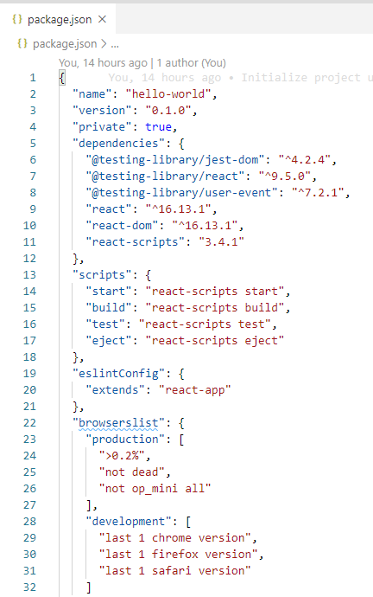
3 Folder Structure
https://www.youtube.com/watch?v=9VIiLJL0H4Y&list=PLC3y8-rFHvwgg3vaYJgHGnModB54rxOk3&index=3
Start with package.json:
This file contains the dependencies and script required for the project.
You can see the react version 16.13 and that is listed as the dependencies.
We also have scripts that run the application, build application, or even run tests.

Slide 4
3 Folder Structure
https://www.youtube.com/watch?v=9VIiLJL0H4Y&list=PLC3y8-rFHvwgg3vaYJgHGnModB54rxOk3&index=3
React Folder Structure:
Now based on whether you have just npm or yarn as a package manager, you are going to see yarn-lock.json or package-lock.json file. These simply ensure consistent installation of your dependencies and you do not really have to worry about them.
We also have .gitignore and a README.md file.
package-lock.json:
https://docs.npmjs.com/configuring-npm/package-lock-json.html
package-lock.json is automatically generated for any operations where npm modifies either the node_modules tree, or package.json.

Slide 5
3 Folder Structure
https://www.youtube.com/watch?v=9VIiLJL0H4Y&list=PLC3y8-rFHvwgg3vaYJgHGnModB54rxOk3&index=3
React Folder Structure:
node_modules: This is the folder which all the dependencies are installed. It is generated when you run create-react-app command or when you run npm install.

Slide 6
3 Folder Structure
https://www.youtube.com/watch?v=9VIiLJL0H4Y&list=PLC3y8-rFHvwgg3vaYJgHGnModB54rxOk3&index=3
React Folder Structure:
public:
The folder contains three files. manifest.json is concerned with progressive web apps which is out of scope of our discussion.
The favicon.ico is the react icon.

Slide 7
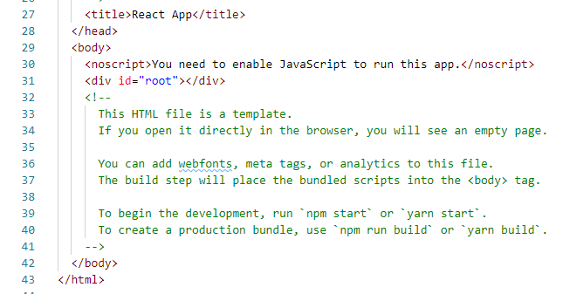
3 Folder Structure
https://www.youtube.com/watch?v=9VIiLJL0H4Y&list=PLC3y8-rFHvwgg3vaYJgHGnModB54rxOk3&index=3
React Folder Structure:
public:
We only have to concentrate on index.html.
The index.html file is the only html file in your application.
We are building the single page application and this is the view might dynamically change in the browser but it is the this HTML file that get served up.
Typically, you are not going to add any code in this file.

Slide 8
3 Folder Structure
https://www.youtube.com/watch?v=9VIiLJL0H4Y&list=PLC3y8-rFHvwgg3vaYJgHGnModB54rxOk3&index=3
React Folder Structure:
public:
Maybe some change in the head tag but definitely not in the body tag.
You want react to control the UI and for that purpose, we have one div tag with ID is equal to root.
At run time, the react application takes over this div tag and is ultimately responsible for the UI. We will focus this div tag in React UI development.
Note:
https://create-react-app.dev/docs/using-the-public-folder/
The public folder contains the HTML file, for example, to set the page title and meta tags.
The <script> tag with the compiled code will be added to it automatically during the build process.

Slide 9
3 Folder Structure
https://www.youtube.com/watch?v=9VIiLJL0H4Y&list=PLC3y8-rFHvwgg3vaYJgHGnModB54rxOk3&index=3
React Folder Structure:
src:
This is the source folder you will be working with the most during development.
The starting point of react application is index.js.

Slide 10
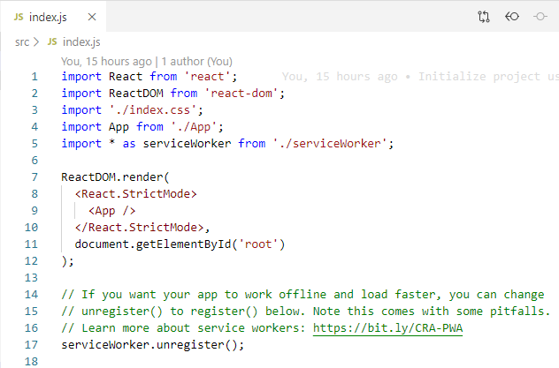
3 Folder Structure
https://www.youtube.com/watch?v=9VIiLJL0H4Y&list=PLC3y8-rFHvwgg3vaYJgHGnModB54rxOk3&index=3
React Folder Structure:
src/index.js:
In idex.js, we specify the root component which is App Component and DOM element which will be controlled by React.
The DOM element in our example is an element with an ID of root.
This root is the element in our index.html.
We call this div element as root DOM node because everything inside root will be controlled by React.

Slide 11
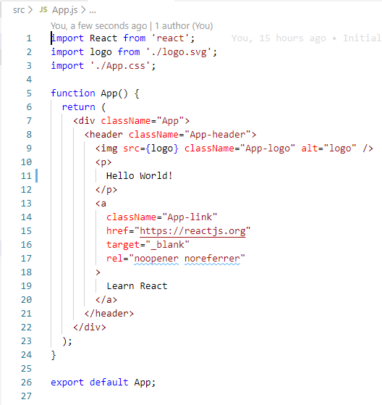
3 Folder Structure
https://www.youtube.com/watch?v=9VIiLJL0H4Y&list=PLC3y8-rFHvwgg3vaYJgHGnModB54rxOk3&index=3
React Folder Structure:
App.js:
For the hello world application, the App Component is rendered inside the root DOM node that bring us the App component which is present in App.js.
This is the file we edited in the previous discussion and is responsible for HTML displayed in the browser.
In other words, the App Component represents the view which we see in the browser.
In addition to App.js, create-react-app also generate CSS file for styling and App.test.js for unit test.

Slide 12
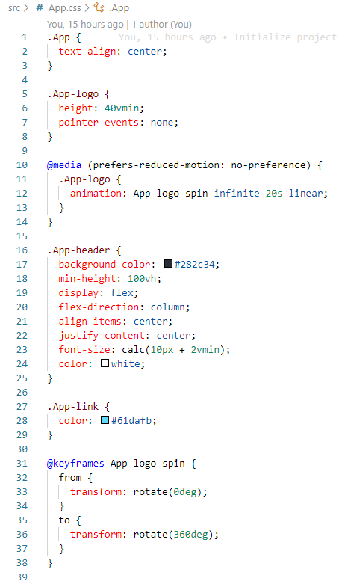
3 Folder Structure
https://www.youtube.com/watch?v=9VIiLJL0H4Y&list=PLC3y8-rFHvwgg3vaYJgHGnModB54rxOk3&index=3
React Folder Structure:
App.css:
The CSS file contains the classes which are applied in the App Component.

Slide 13
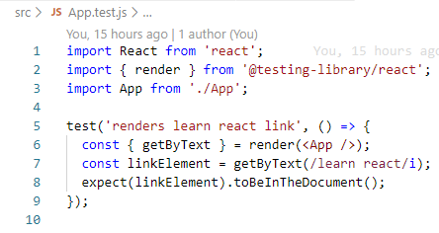
3 Folder Structure
https://www.youtube.com/watch?v=9VIiLJL0H4Y&list=PLC3y8-rFHvwgg3vaYJgHGnModB54rxOk3&index=3
React Folder Structure:
App.test.js:
App.test.js contains simple test case.

Slide 14
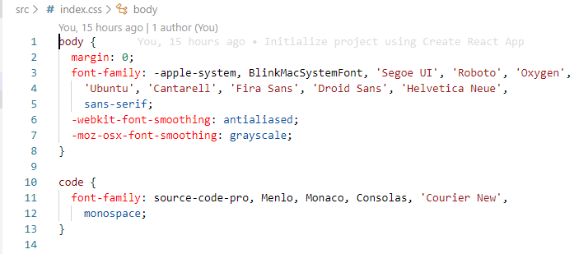
3 Folder Structure
https://www.youtube.com/watch?v=9VIiLJL0H4Y&list=PLC3y8-rFHvwgg3vaYJgHGnModB54rxOk3&index=3
React Folder Structure:
Index.css:
We also have index.css file to apply style of body tag.

Slide 15
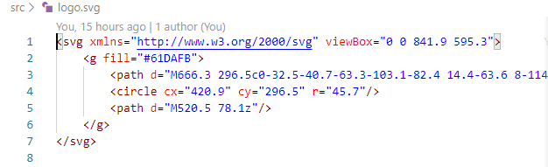
3 Folder Structure
https://www.youtube.com/watch?v=9VIiLJL0H4Y&list=PLC3y8-rFHvwgg3vaYJgHGnModB54rxOk3&index=3
React Folder Structure:
Logo.svg:
The logo.svg which is referenced in the App component.

Slide 16
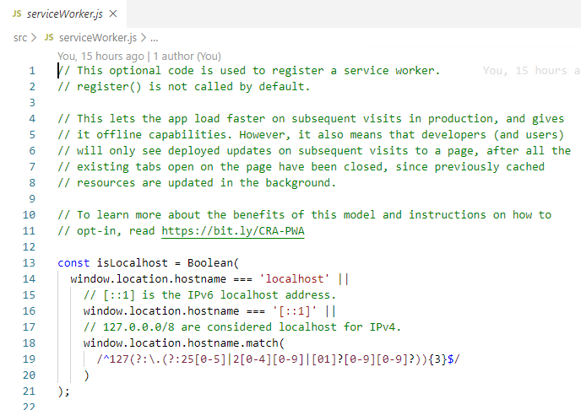
3 Folder Structure
https://www.youtube.com/watch?v=9VIiLJL0H4Y&list=PLC3y8-rFHvwgg3vaYJgHGnModB54rxOk3&index=3
React Folder Structure:
serviceWorker.js:
serviceWorker concerns with progressive web app and can be ignored.

Slide 17
3 Folder Structure
https://www.youtube.com/watch?v=9VIiLJL0H4Y&list=PLC3y8-rFHvwgg3vaYJgHGnModB54rxOk3&index=3
React Folder Structure:
The above is the folder structure of a React application created by create-react-app.
When you run the command “npm start”, the index.html is served in the browser.
The index.html contains the root DOM node.
Next, the control enter the index.js React DOM.
When there is the App component on the root DOM node, the App component contains the HTML which is ultimately displayed in the browser.
Now, we will focus on ‘Component’ for React.

Slide 18
3.1 Quiz

Slide 19
3.1 Quiz
https://www.youtube.com/watch?v=9VIiLJL0H4Y&list=PLC3y8-rFHvwgg3vaYJgHGnModB54rxOk3&index=3
1. What is React Folder Structure?
Ans:
Folder:
a) node_modules: All the dependencies are installed; It is generated when you run create-react-app command or when you run npm install.
b) public: The public folder contains the HTML file, for example, to set the page title and meta tags.
c) src: source file: App.css, App.js, index.css, index.js, App.test.js
Files:
a) package.json: tendencies and script
b) package-lock.json is automatically generated for any operations where npm modifies either the node_modules tree, or package.json.

Slide 20
End of Chapter

