Slide 1

27 Memo
Peter H. Chen

Slide 2
27 Memo
https://www.youtube.com/watch?v=7TaBhrnPH78&list=PLC3y8-rFHvwgg3vaYJgHGnModB54rxOk3&index=27
Memo
We discuss pure component in the last discussion.
The pure component only re-render the class component when there is a difference in the shallow comparison of props and state.
The pure component using the shallow component comparison of props and state and results in a performance improvement.
Pure component only works with class based components.
It would be nice if we can achieve the same in functional components as well.
That is where React.memo comes into the picture.
What is memo component?
The pure component is for class based component and the memo component is for functional component.

Slide 3
27.1 Add Functional Component MemoComp

Slide 4
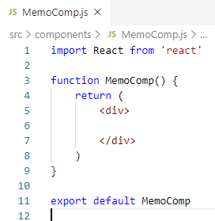
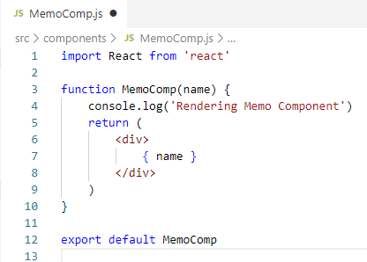
27.1 Add Functional Component MemoComp
https://www.youtube.com/watch?v=7TaBhrnPH78&list=PLC3y8-rFHvwgg3vaYJgHGnModB54rxOk3&index=27
Memo
Let’s look at the example.
Create MemoComp.js, type ‘rfce’ (React Functional Component for ES7) to create functional component.
Within the function parentheses, we pass the name prop, render { name }, and console.log (‘message’)

Slide 5
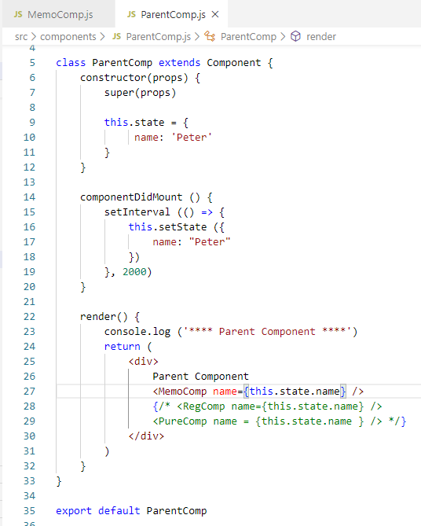
27.1 Add Functional Component MemoComp
https://www.youtube.com/watch?v=7TaBhrnPH78&list=PLC3y8-rFHvwgg3vaYJgHGnModB54rxOk3&index=27
Memo
In the parentComponeny.js, add the MemoComp Component.
The componentDidMount () { setInteval (() => { setState () }, 2000) }, setup the interval 2 seconds to setState. This make the state change every 2 seconds.
We will get the performance improvement after 2 seconds by not calling the <MemoComp name={ this.state.name } />.

Slide 6
27.2 Add HOC React.memo()

Slide 7
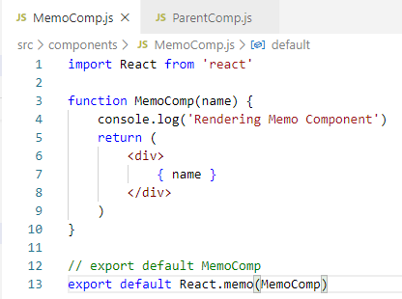
27.2 Add HOC React.memo()
https://www.youtube.com/watch?v=7TaBhrnPH78&list=PLC3y8-rFHvwgg3vaYJgHGnModB54rxOk3&index=27
Memo
We need to prevent the name is re-render every 2 seconds
How do we prevent Memo Component in every 2 seconds?
Change “export default MemoComp” to “export default React.memo(MemoComp)”.

Slide 8
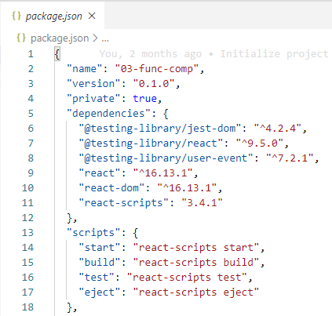
27.2 Add HOC React.memo()
https://www.youtube.com/watch?v=7TaBhrnPH78&list=PLC3y8-rFHvwgg3vaYJgHGnModB54rxOk3&index=27
Memo
The React.memo was introduced in 16.6. So the package installed, make sure your package.json react version is > 16.3.

Slide 9
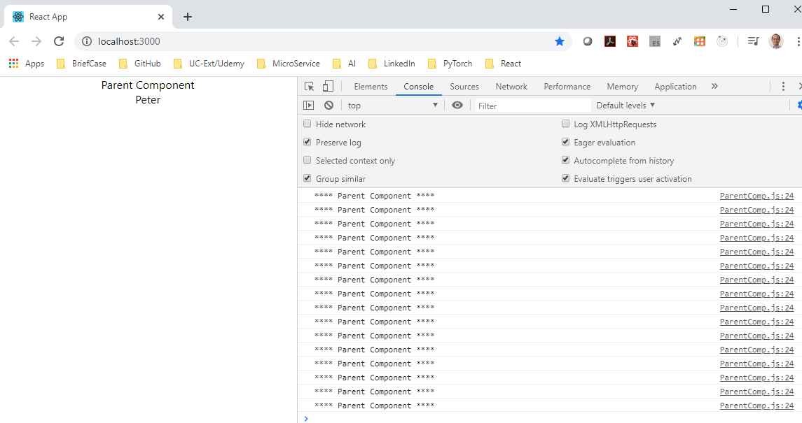
27 Memo
https://www.youtube.com/watch?v=7TaBhrnPH78&list=PLC3y8-rFHvwgg3vaYJgHGnModB54rxOk3&index=27
Memo
Go back the browser.
We can see only the parent is re-rendered.
The MemoComp is not called Since the props (name) is not changing every two seconds.

Slide 10
27.2 Add HOC React.memo()
https://www.youtube.com/watch?v=7TaBhrnPH78&list=PLC3y8-rFHvwgg3vaYJgHGnModB54rxOk3&index=27
Memo
We can see “React.memo (MemoComp)” is a HOC (Higher-Order Component).
React.memo () accepts a component, add somethings (console.log and name) to that component and return a new enhanced component.
In our case, a component capable of avoiding re-render when there is no changed in props.

Slide 11
27.3 Quiz

Slide 12
27.3 Quiz
https://www.youtube.com/watch?v=7TaBhrnPH78&list=PLC3y8-rFHvwgg3vaYJgHGnModB54rxOk3&index=27
Quiz
1. What is memo component?
Ans:
a) Memo component is used for performance optimization for functional component (Similar to the pure component in class component).
b) Memo component uses Higher Order component to wrap the render function to prevent UI update if props and state are not changed.
c) React.memo (function-name) as below.

Slide 13
End of Chapter

