Slide 1

46 useState PrevState
Peter H. Chen

Slide 2
46 useState PrevState
https://www.youtube.com/watch?v=d0plTCQgsXs&list=PLC3y8-rFHvwgg3vaYJgHGnModB54rxOk3&index=46
useState prevState:
In the last discussion, we have basic useState in Hooks.
In this discussion, we use set State based on pervious State.

Slide 3
46.1 Rest, Increment, and Decrement

Slide 4
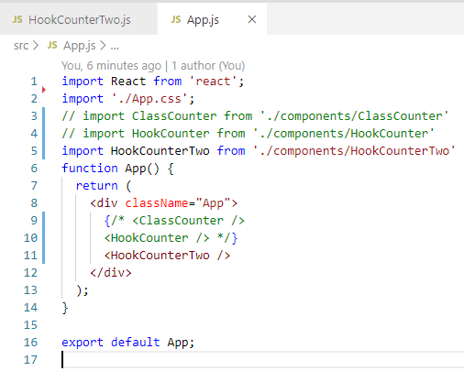
46.1 Rest, Increment, and Decrement
https://www.youtube.com/watch?v=d0plTCQgsXs&list=PLC3y8-rFHvwgg3vaYJgHGnModB54rxOk3&index=46
Set State with Previous State:
Import Functional Counter “HookCounterTwo”

Slide 5
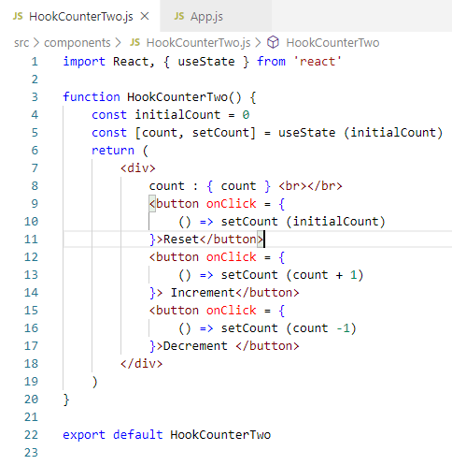
46.1 Rest, Increment, and Decrement
https://www.youtube.com/watch?v=d0plTCQgsXs&list=PLC3y8-rFHvwgg3vaYJgHGnModB54rxOk3&index=46
Set State with Previous State:
Create rfce (React Functional Counter ES7) “HookCounterTwo”

Slide 6
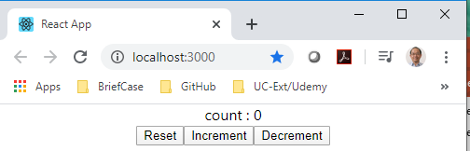
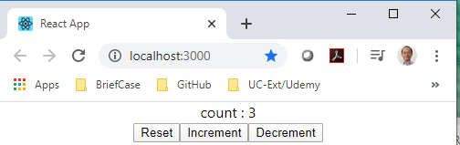
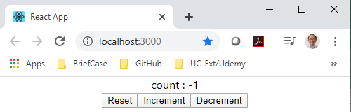
46.1 Rest, Increment, and Decrement
https://www.youtube.com/watch?v=d0plTCQgsXs&list=PLC3y8-rFHvwgg3vaYJgHGnModB54rxOk3&index=46
Set State with Previous State:
> npm start

Slide 7
46.1 Rest, Increment, and Decrement
https://www.youtube.com/watch?v=d0plTCQgsXs&list=PLC3y8-rFHvwgg3vaYJgHGnModB54rxOk3&index=46
Code Explain:
https://hackernoon.com/react-hooks-usestate-using-the-state-hook-89ec55b84f8c
https://stackoverflow.com/questions/53165945/what-is-usestate-in-react
useState: returns a stateful varaible and a function to update it.
useEffect: Let you perform side effect in function component.
useCOntext: Accept a context object (value return from React.createCOntext) and returns s the current context value.

Slide 8
46.2 Increment 5

Slide 9
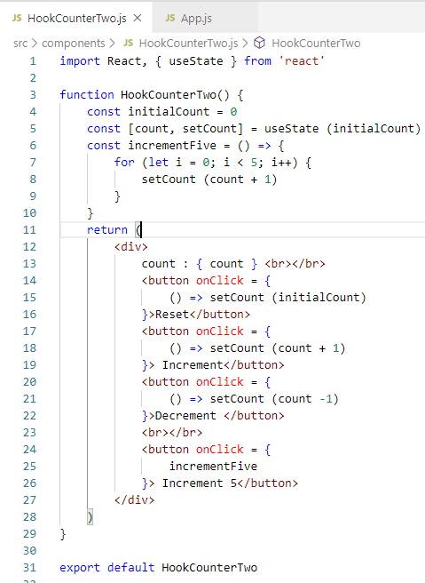
46.2 Increment 5
https://www.youtube.com/watch?v=d0plTCQgsXs&list=PLC3y8-rFHvwgg3vaYJgHGnModB54rxOk3&index=46
Increment 5
We will create increment 5.
Loop 5 times: setCount (count + 1)

Slide 10
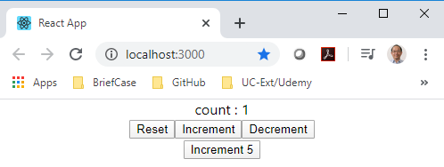
46.2 Increment 5
https://www.youtube.com/watch?v=d0plTCQgsXs&list=PLC3y8-rFHvwgg3vaYJgHGnModB54rxOk3&index=46
Increment 5
> npm start
Click “Increment 5” button only increase by 1.

Slide 11
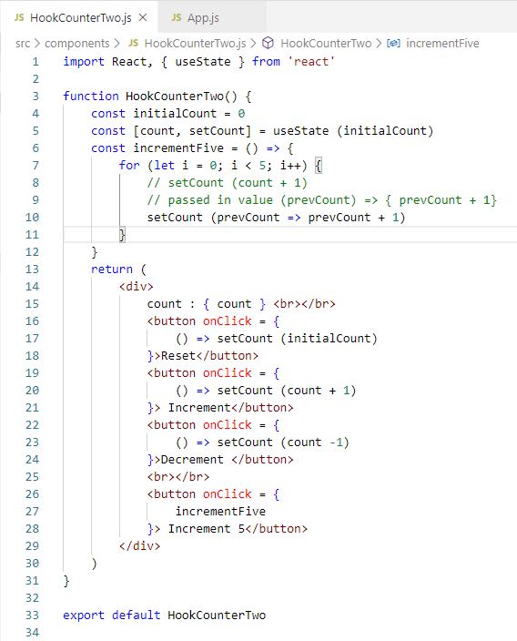
46.2 Increment 5
https://www.youtube.com/watch?v=d0plTCQgsXs&list=PLC3y8-rFHvwgg3vaYJgHGnModB54rxOk3&index=46
Increment 5
setCount (count): count access the old value.
So prevCount is going to be the argument and the function body prevCount + 1.
In Class Component, we do not need to worry about this.

Slide 12
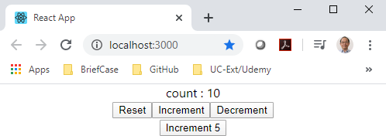
46.2 Increment 5
https://www.youtube.com/watch?v=d0plTCQgsXs&list=PLC3y8-rFHvwgg3vaYJgHGnModB54rxOk3&index=46
Increment 5
> npm start

Slide 13
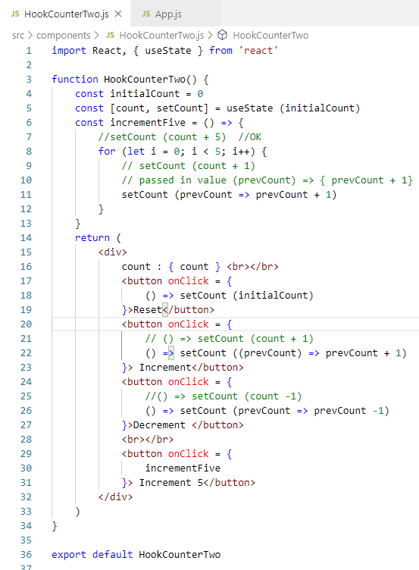
46.2 Increment 5
https://www.youtube.com/watch?v=d0plTCQgsXs&list=PLC3y8-rFHvwgg3vaYJgHGnModB54rxOk3&index=46
Increment 5
Change other increment 1 with prevCount.

Slide 14
46.3 Quiz

Slide 15
46.3 Quiz
https://www.youtube.com/watch?v=d0plTCQgsXs&list=PLC3y8-rFHvwgg3vaYJgHGnModB54rxOk3&index=46
Quiz
1. How to set state with previous state?
Ans:
const [count, setCount] = useState (0)
setCount (count)
Note:
https://reactjs.org/docs/hooks-state.html
// Declare a new state variable, which we'll call "count"
const [count, setCount] = useState(0);
We declare a state variable called count, and set it to 0.
React will remember its current value between re-renders, and provide the most recent one to our function. If we want to update the current count, we can call setCount.
Because the const [count, setCount], we cannot change variable count. We can only use setCount()

Slide 16
End of Chapter

