Slide 1

2 Hello World
Peter H. Chen

Slide 2
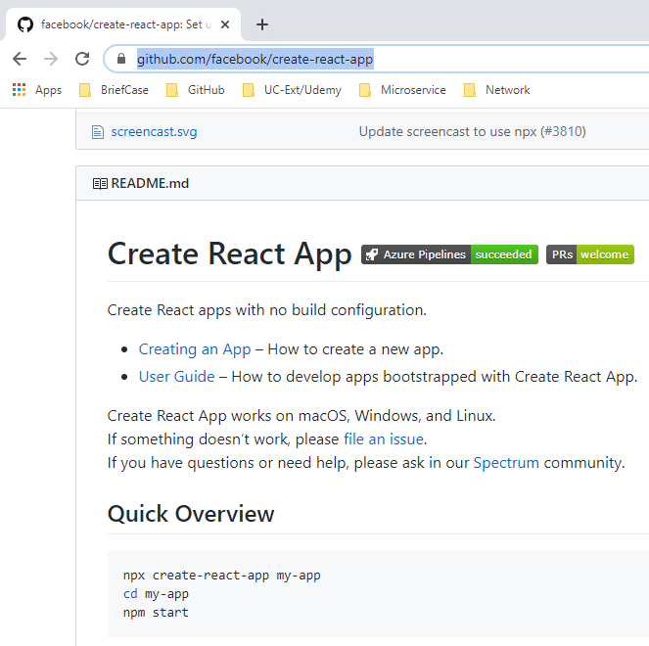
2 Hello World
https://www.youtube.com/watch?v=9hb_0TZ_MVI&list=PLC3y8-rFHvwgg3vaYJgHGnModB54rxOk3&index=2
Create React App
https://github.com/facebook/create-react-app
> npx create-react-app my-app
> cd my-app
> npm start

Slide 3
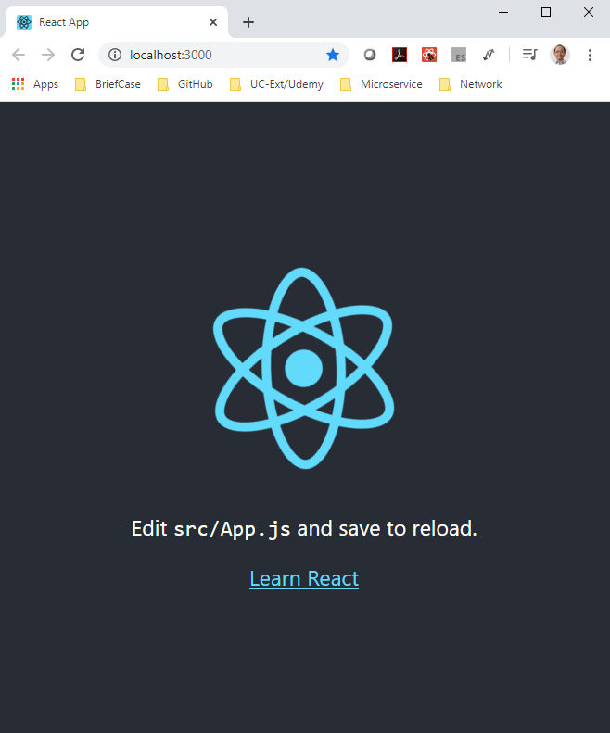
2 Hello World
https://www.youtube.com/watch?v=9hb_0TZ_MVI&list=PLC3y8-rFHvwgg3vaYJgHGnModB54rxOk3&index=2
Create React App
> npm start

Slide 4
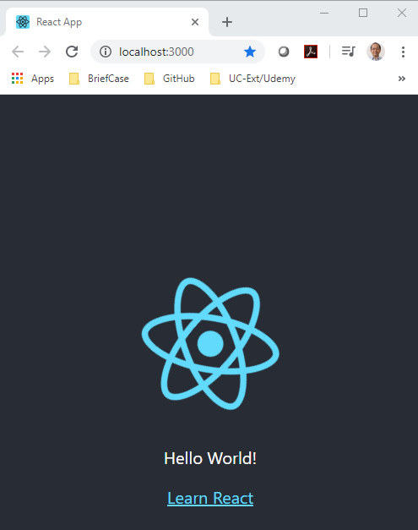
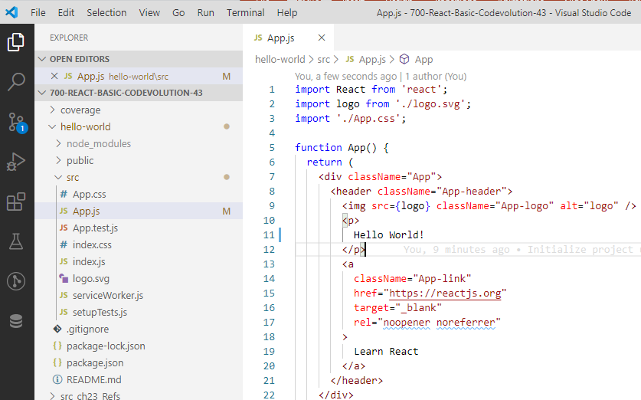
2 Hello World
https://www.youtube.com/watch?v=9hb_0TZ_MVI&list=PLC3y8-rFHvwgg3vaYJgHGnModB54rxOk3&index=2
Create React App
Change text to “Hello World”
> npm start

Slide 5
2 Hello World
https://www.youtube.com/watch?v=9hb_0TZ_MVI&list=PLC3y8-rFHvwgg3vaYJgHGnModB54rxOk3&index=2
Create-react-app: we have two approaches to create the project_name.
npx: npm package runner
> npx create-react-app <project_name>
The npx is installed when you install node and how you able to run create-react-app without having to install it.
npm: node package manager
> npm install create-react-app –g
> create-react-app <project_name>
install the create-react-app command first and then use “create-react-app” command to create the project_name.
We use “npx create-react-app <project_name>” because we do not need to install package create-react-app globally and we do not have to worry about constantly update the package create-react-app.

Slide 6
2.1 Bootstrap to React

Slide 7
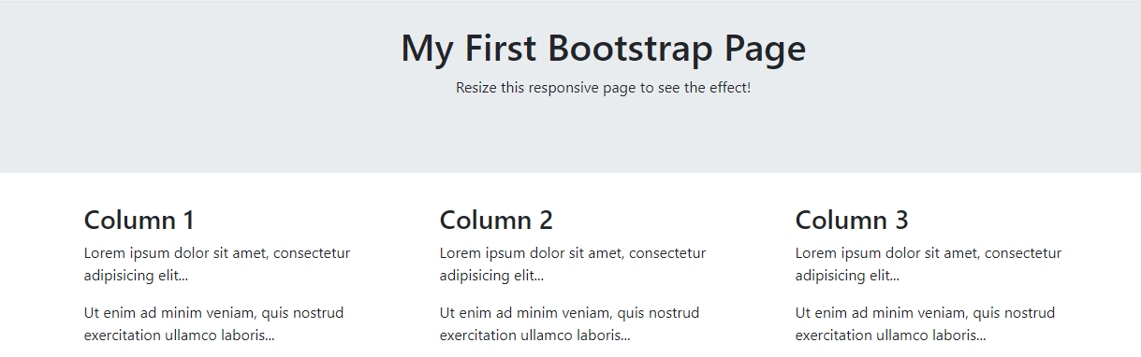
2.1 Bootstrap to React
https://www.w3schools.com/bootstrap4/tryit.asp?filename=trybs_default&stacked=h
In the W3School, there are exiting layout.
How to convert these layout into create-react-app?
Bootstrap 4: https://www.w3schools.com/bootstrap4/tryit.asp?filename=trybs_default&stacked=h

Slide 8
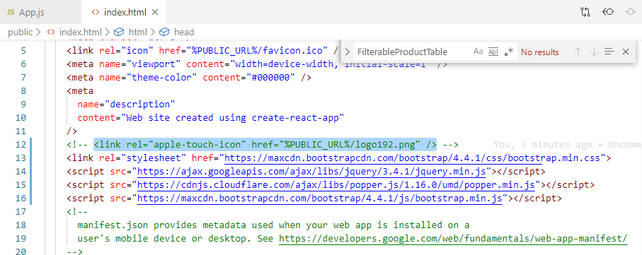
2.1 Bootstrap to React
https://www.w3schools.com/bootstrap4/tryit.asp?filename=trybs_default&stacked=h
Copy the following CDN into index.html

Slide 9
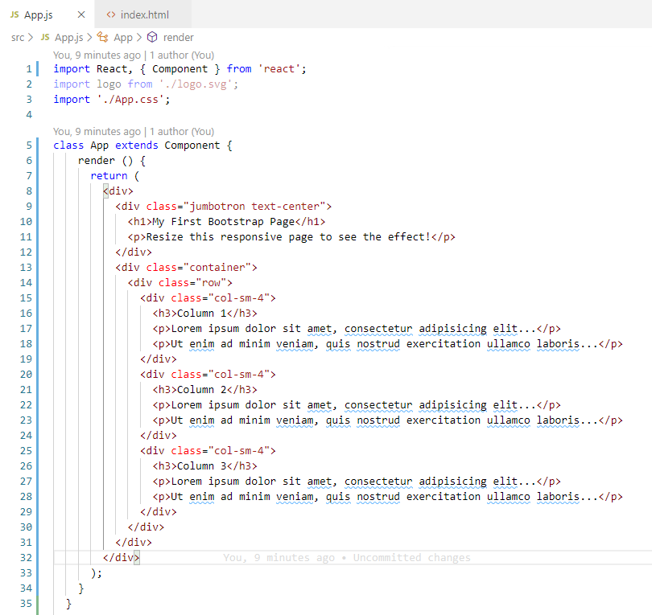
2.1 Bootstrap to React
https://www.w3schools.com/bootstrap4/tryit.asp?filename=trybs_default&stacked=h
Copy the layout in <div> … </div>

Slide 10
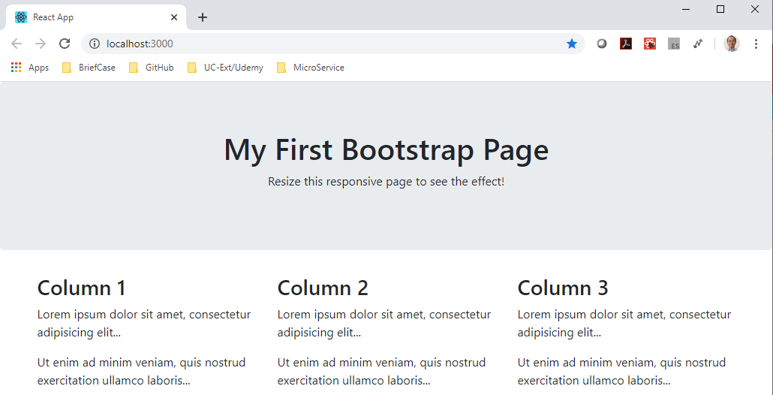
2.1 Bootstrap to React
https://www.w3schools.com/bootstrap4/tryit.asp?filename=trybs_default&stacked=h
> npm start

Slide 11
2.2 Quiz

Slide 12
2.2 Quiz
https://www.w3schools.com/bootstrap4/tryit.asp?filename=trybs_default&stacked=h
Quiz
1. What is the commands to create the react application?
Ans: Two ways to create application:
a) npx: npm package runner
> npx create-react-app <project_name>
The npx is installed when you install node and how you able to run create-react-app without having to install it.
b) npm: node package manager
> npm install create-react-app –g
> create-react-app <project_name>
install the create-react-app command first and then use “create-react-app” command to create the project_name.

Slide 13
End of Chapter

