Slide 1

5 Functional Component
Peter H. Chen

Slide 2
5 Functional Component
https://www.youtube.com/watch?v=Cla1WwguArA&list=PLC3y8-rFHvwgg3vaYJgHGnModB54rxOk3&index=5
Functional Component:
Functional Components are just JavaScript Function.
Functional Components can receive an object of properties which is referred to as props and return HTML which describes the UI.
Now, the HTML is actually something known as JSX.
For the sake of understanding point of view, we just call it HTML.
A functional component is a JavaScript function that accepts an input of properties and return HTML that describes the UI.
We go back the VS code and create a very first functional component.
Properties
(props)
JavaScript Function
HTML (JSX)

Slide 3
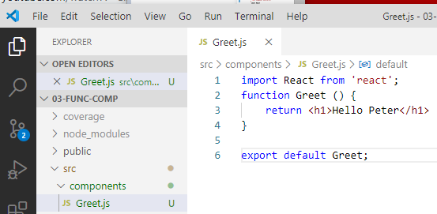
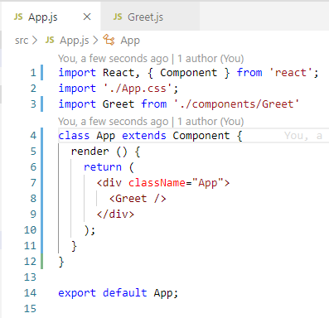
5 Functional Component
https://www.youtube.com/watch?v=Cla1WwguArA&list=PLC3y8-rFHvwgg3vaYJgHGnModB54rxOk3&index=5
Create components/Greet.js
In App.js, add <Greet />

Slide 4
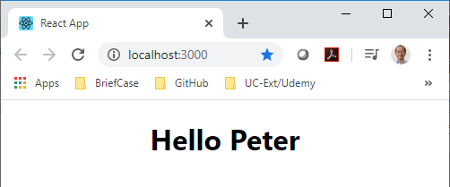
5 Functional Component
https://www.youtube.com/watch?v=Cla1WwguArA&list=PLC3y8-rFHvwgg3vaYJgHGnModB54rxOk3&index=5
> npm start

Slide 5
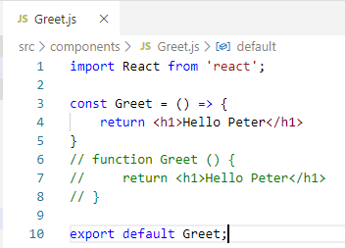
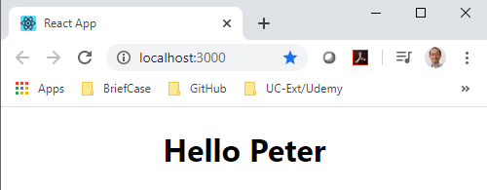
5 Functional Component
https://www.youtube.com/watch?v=Cla1WwguArA&list=PLC3y8-rFHvwgg3vaYJgHGnModB54rxOk3&index=5
Although it work perfectly, the convention functional component is to use arrow function to replace the function.

Slide 6
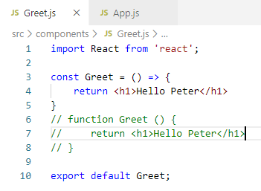
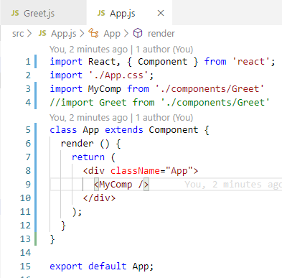
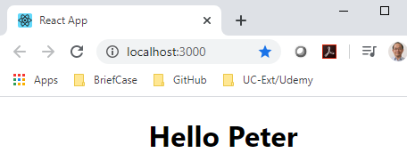
5 Functional Component
https://www.youtube.com/watch?v=Cla1WwguArA&list=PLC3y8-rFHvwgg3vaYJgHGnModB54rxOk3&index=5
Summary of Functional Component:
Import Greet Component:
import Greet from ‘./components/Greet’.
you can change to import MyComp ‘./components/Greet’.
and use <MyComp />

Slide 7
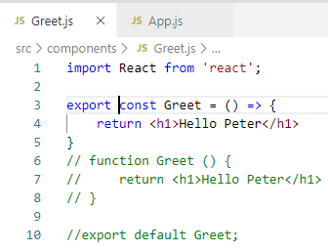
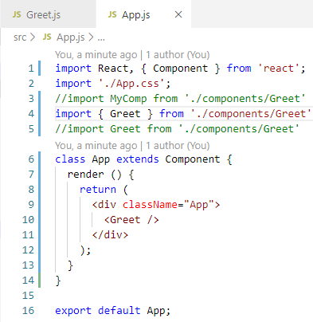
5 Functional Component
https://www.youtube.com/watch?v=Cla1WwguArA&list=PLC3y8-rFHvwgg3vaYJgHGnModB54rxOk3&index=5
Summary of Functional Component:
If you comment out
// export default Greet
export const Greet = () { … }
You have to use the same name { Greet }
import { Greet } from ‘./components/Greet’

Slide 8
5 Functional Component
https://www.youtube.com/watch?v=Cla1WwguArA&list=PLC3y8-rFHvwgg3vaYJgHGnModB54rxOk3&index=5
Summary of Functional Component:
For most of the cases, we will be using “export default Greet”.

Slide 9
5.1 Quiz

Slide 10
5.1 Quiz
https://www.youtube.com/watch?v=Cla1WwguArA&list=PLC3y8-rFHvwgg3vaYJgHGnModB54rxOk3&index=5
Quiz:
1. What is functional component?
Ans:
Functional Components are just JavaScript Function.
Functional component is stateless before Hook (2019). Class component is stateful.
Functional Components can receive an object of properties which is referred to as props and return HTML which describes the UI.
Now, the HTML in React is actually something known as JSX.
JSX is a little bit different form HTML. For the sake of understanding point of view, we just call it HTML.
A functional component is a JavaScript function that accepts an input of properties and return HTML that describes the UI.

Slide 11
End of Chapter

