Slide 1

23 Routing and Navigation
Peter H. Chen

Slide 2
23 Routing and Navigation
https://www.youtube.com/watch?v=N8FBmB2jme8&index=6&list=PLC3y8-rFHvwhBRAgFinJR8KHIrCdTkZcZ
In this section, we discuss Routing and Navigation in Angular.
Any Angular application you build have multiple components.
Each component has its own view.
We need a way to navigate between these views as user performs some actions.
For this purpose, we make Angular router.
Even we learn about services, we will not use service while explain the different concepts of routing. We want to focus on routing alone.
We will use hard code data as the example.
There are a lot of concepts in Angular router, let’s learn one concept at a time.
We will learn how to navigate two different views with button clicks.

Slide 3
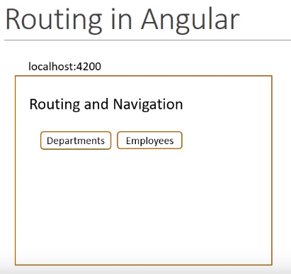
23 Routing and Navigation
https://www.youtube.com/watch?v=N8FBmB2jme8&index=6&list=PLC3y8-rFHvwhBRAgFinJR8KHIrCdTkZcZ
When the user navigate to the localhost:4200, we display a title that says “Routing and Navigation”.
Below the title, we have two buttons, “Department” and “Employees”.

Slide 4
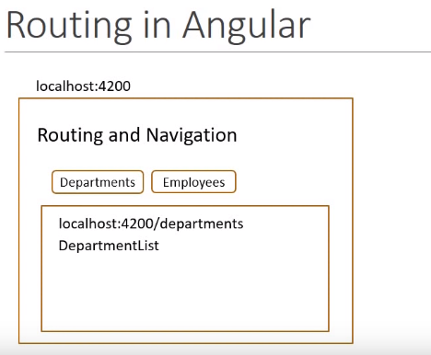
23 Routing and Navigation
https://www.youtube.com/watch?v=N8FBmB2jme8&index=6&list=PLC3y8-rFHvwhBRAgFinJR8KHIrCdTkZcZ
If we navigate to the URL localhost:4200/departments or click department button, we display a “DepartmentList”.

Slide 5
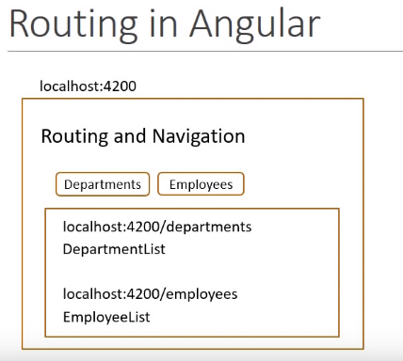
23 Routing and Navigation
https://www.youtube.com/watch?v=N8FBmB2jme8&index=6&list=PLC3y8-rFHvwhBRAgFinJR8KHIrCdTkZcZ
If we navigate to the URL localhost:4200/emplyees or click Employees button, we display a “EmployeeList”.

Slide 6
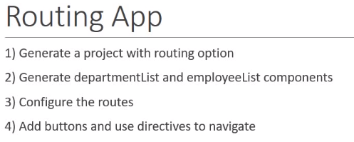
23 Routing and Navigation
https://www.youtube.com/watch?v=N8FBmB2jme8&index=6&list=PLC3y8-rFHvwhBRAgFinJR8KHIrCdTkZcZ
Based on URL or which button the user click, we navigate to the appropriate view.
To implement the requirement, here are the steps.
First step, we create a project with Angular CLI with the routing option.
Second step, we generate the department list component and employee list component. These are the components we want to display in the view.
Third step, we configure the routes for our application. This will allow us to navigate the routes from the URL.
Fourth step, we add the buttons and use directives to navigate the configured routes.

Slide 7
23 Routing and Navigation
https://www.youtube.com/watch?v=N8FBmB2jme8&index=6&list=PLC3y8-rFHvwhBRAgFinJR8KHIrCdTkZcZ
So, let’s begin with step one, generating a new application with routing option (--routing) as below.
In ANGULAR folder, we type:
> ng new a2301-routing-demo --routing

Slide 8
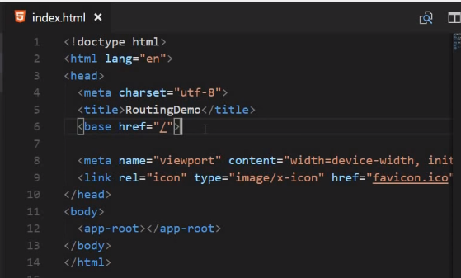
23 Routing and Navigation
https://www.youtube.com/watch?v=N8FBmB2jme8&index=6&list=PLC3y8-rFHvwhBRAgFinJR8KHIrCdTkZcZ
Now, we may not always generate a new application with the routing option.
We might want to add routing to our existing application as well.
Let’s go over what the routing option does and you can replicate the exact same code im your existing application as well.
Now, the first thing you need to include is the base tag in your index.html.
Open src/index.html file, as a child to the head tag, add a base tag and set the value of href attribute to the forward slash. This is required so that the application knows how to construct the URL while navigating.

Slide 9
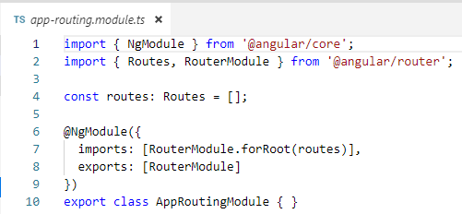
23 Routing and Navigation
https://www.youtube.com/watch?v=N8FBmB2jme8&index=6&list=PLC3y8-rFHvwhBRAgFinJR8KHIrCdTkZcZ
Next, in the app folder, open a file, app-routing.module.ts.
This file contains the routing module for our application.
This is where we configure for different route. We will come back later.

Slide 10
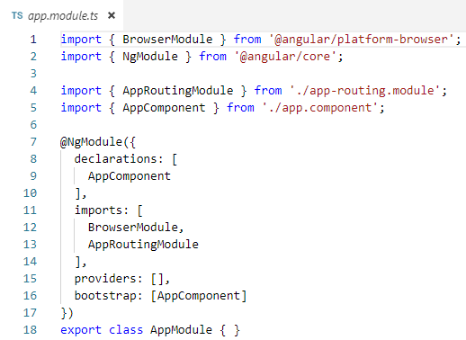
23 Routing and Navigation
https://www.youtube.com/watch?v=N8FBmB2jme8&index=6&list=PLC3y8-rFHvwhBRAgFinJR8KHIrCdTkZcZ
Finally, we import { AppRoutingModule } in the app.modules.ts and add to imports array.
That is the parts of routing demo application.

Slide 11
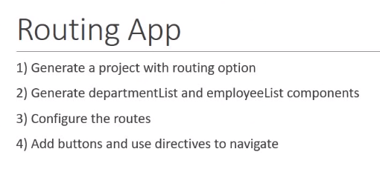
23 Routing and Navigation
https://www.youtube.com/watch?v=N8FBmB2jme8&index=6&list=PLC3y8-rFHvwhBRAgFinJR8KHIrCdTkZcZ
That is the first step. Generate a new project with routing option.

Slide 12
23 Routing and Navigation
https://www.youtube.com/watch?v=N8FBmB2jme8&index=6&list=PLC3y8-rFHvwhBRAgFinJR8KHIrCdTkZcZ
The second step is to generate the department list and employee list components we will be navigating to.

Slide 13
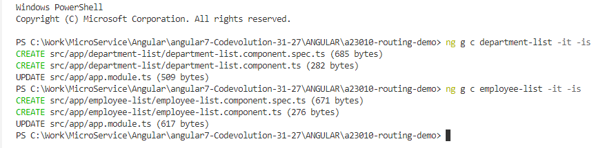
23 Routing and Navigation
https://www.youtube.com/watch?v=N8FBmB2jme8&index=6&list=PLC3y8-rFHvwhBRAgFinJR8KHIrCdTkZcZ
In the project folder,
> ng g c department-list -it –is
> ng g c employee-list -it -is
g: generate, c: component, it: inline template, -is: inline style
So, that is our second steps, generate two components.

Slide 14
23 Routing and Navigation
https://www.youtube.com/watch?v=N8FBmB2jme8&index=6&list=PLC3y8-rFHvwhBRAgFinJR8KHIrCdTkZcZ
The third step is to configure the route for the application.
We do that in the app-routing.module.

Slide 15
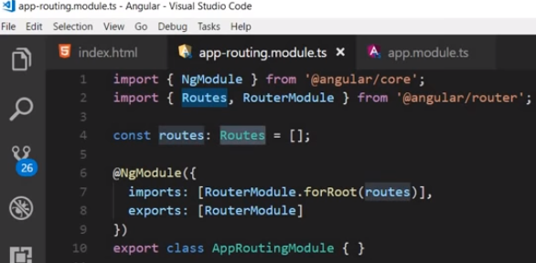
23 Routing and Navigation
https://www.youtube.com/watch?v=N8FBmB2jme8&index=6&list=PLC3y8-rFHvwhBRAgFinJR8KHIrCdTkZcZ
We have the constant routes which is strongly typed to routes from the router package.
Here, we define all possible routes for our application.
Each route is nothing but an object.

Slide 16
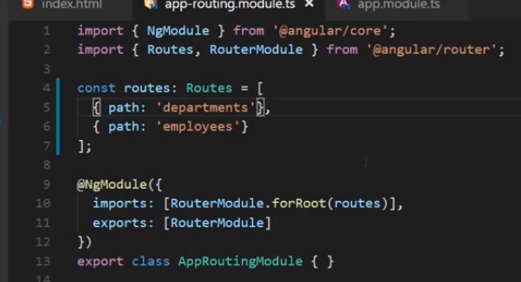
23 Routing and Navigation
https://www.youtube.com/watch?v=N8FBmB2jme8&index=6&list=PLC3y8-rFHvwhBRAgFinJR8KHIrCdTkZcZ
The object contains a path which is reflected in the URL and the component to be rendered when we navigate to that corresponding path. We need to configure two route for our application.
The first one is department and the second one is employee.
The first one { path: ‘departments’ }, { path: employees’ }

Slide 17
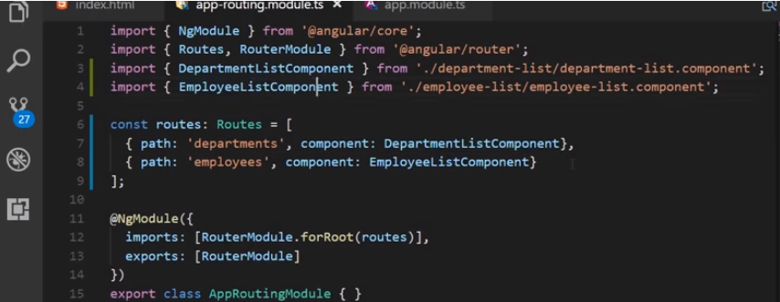
23 Routing and Navigation
https://www.youtube.com/watch?v=N8FBmB2jme8&index=6&list=PLC3y8-rFHvwhBRAgFinJR8KHIrCdTkZcZ
If we navigate the departments, we need to display the department list specify property.
Similarly, If we navigate the employees, we need to display employee list specify property.
Make sure to import two components appropriately.

Slide 18
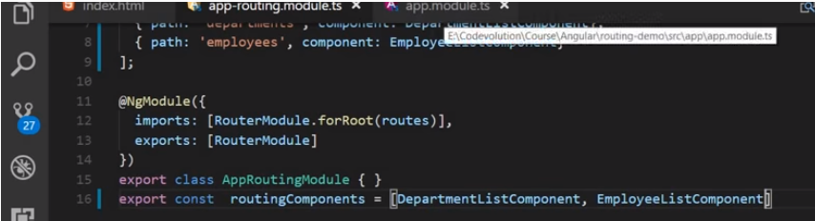
23 Routing and Navigation
https://www.youtube.com/watch?v=N8FBmB2jme8&index=6&list=PLC3y8-rFHvwhBRAgFinJR8KHIrCdTkZcZ
The above routing components can be expressed as an array
routingComponents = [DepartmentListCoompoent, EmployeeListComponent].

Slide 19
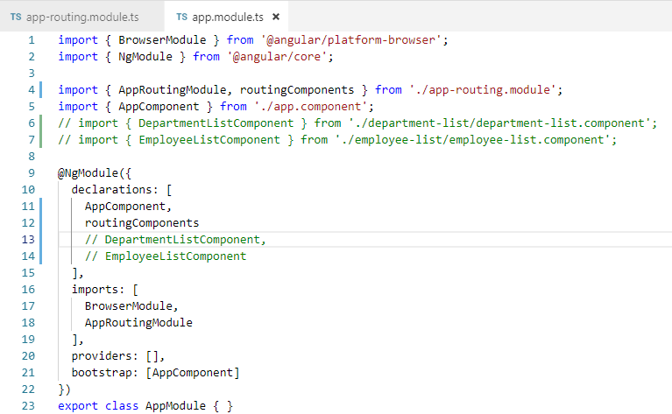
23 Routing and Navigation
https://www.youtube.com/watch?v=N8FBmB2jme8&index=6&list=PLC3y8-rFHvwhBRAgFinJR8KHIrCdTkZcZ
We than import routingComponents array into app.modules.
This is a good practice to use one component array instead of two individual components.

Slide 20
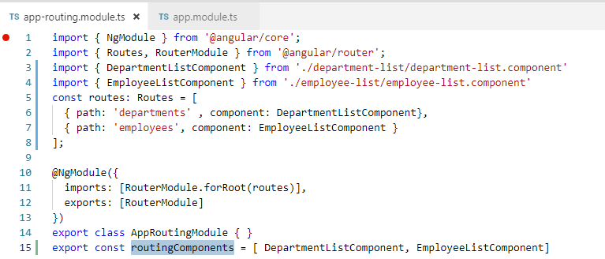
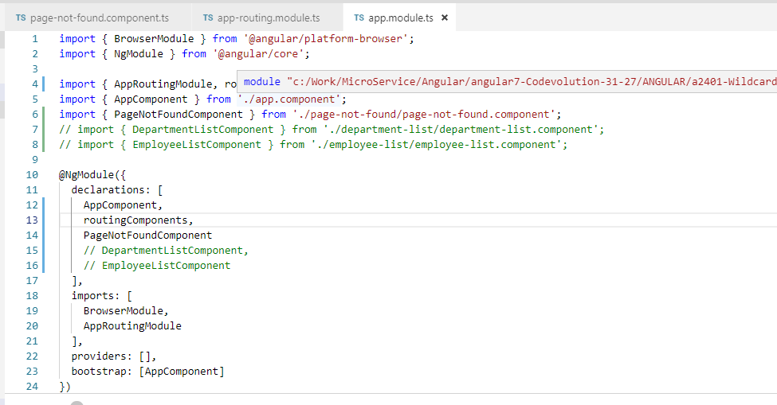
23 Routing and Navigation
https://www.youtube.com/watch?v=N8FBmB2jme8&index=6&list=PLC3y8-rFHvwhBRAgFinJR8KHIrCdTkZcZ
All right, the routes have been configured.
If we navigate “localhost:4200/departments”, we display the DepartmentListCompnent.
If we navigate “localhost:4200/employees”, we display the EmployeeListCompnent.

Slide 21
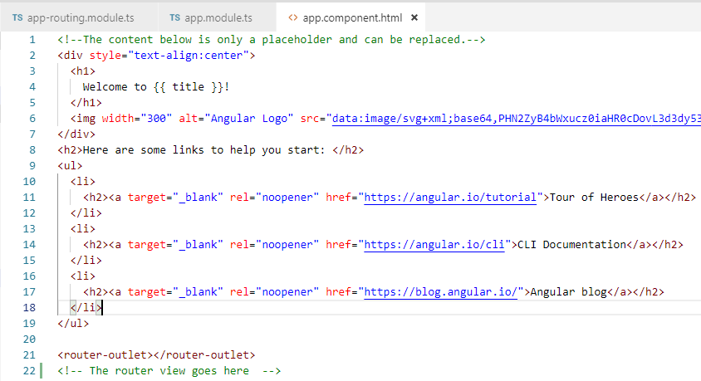
23 Routing and Navigation
https://www.youtube.com/watch?v=N8FBmB2jme8&index=6&list=PLC3y8-rFHvwhBRAgFinJR8KHIrCdTkZcZ
Hang on, where is the place specifying these components have to be displayed.
The answer is the router outlet directive.
Look at app.component,html, at very bottom have the <router-outlet>
The directive is available from the router package and it marks where is the router display the view.
So you say that the router views go here.

Slide 22
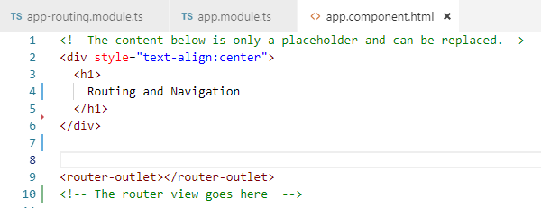
23 Routing and Navigation
https://www.youtube.com/watch?v=N8FBmB2jme8&index=6&list=PLC3y8-rFHvwhBRAgFinJR8KHIrCdTkZcZ
Let us also simplify the app.component.html.
We remove all the unnecessary HTML markup.
Save it and test.
> npm start

Slide 23
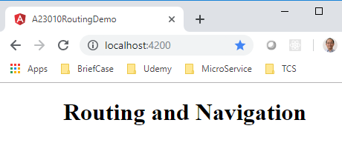
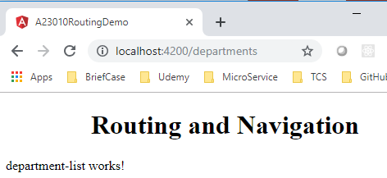
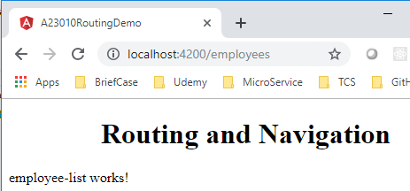
23 Routing and Navigation
https://www.youtube.com/watch?v=N8FBmB2jme8&index=6&list=PLC3y8-rFHvwhBRAgFinJR8KHIrCdTkZcZ
Open chrome and enter “localhost:4200”
Enter “localhost:4200/departments”
Enter “localhost:4200/employees”

Slide 24
23 Routing and Navigation
https://www.youtube.com/watch?v=N8FBmB2jme8&index=6&list=PLC3y8-rFHvwhBRAgFinJR8KHIrCdTkZcZ
So the routing is work now. But we cannot expect user typing the URL.
So, let us add some buttons to navigate these views.
Let’s go back to app.component.html ,
Under the </div>, add two anchor tags <a> for Departments and Employees.
Within two anchor tags <a>, we add the two special directives from the router package, the first one is the router directive which specify the path we want to navigate to. So when we click the on the department button, we want to navigate to the departments path.
Similarly, when we click on the employees button, we navigate to the employees path.

Slide 25
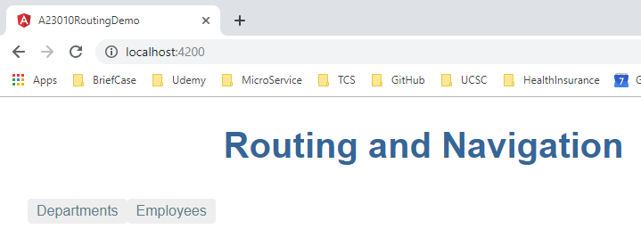
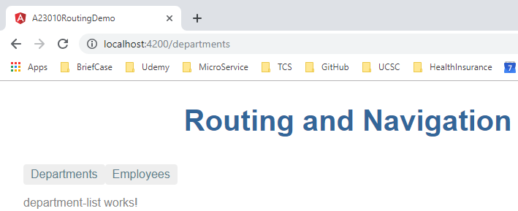
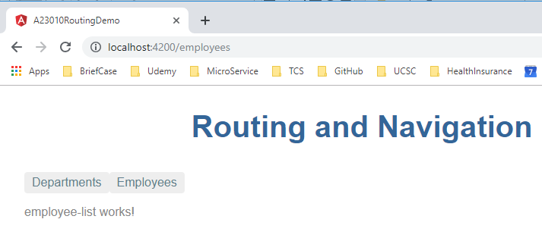
23 Routing and Navigation
https://www.youtube.com/watch?v=N8FBmB2jme8&index=6&list=PLC3y8-rFHvwhBRAgFinJR8KHIrCdTkZcZ
> ng Server
Click button to see the routing information.

Slide 26
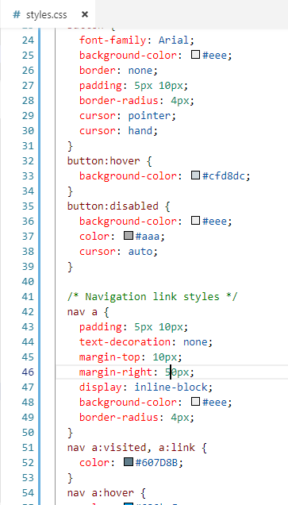
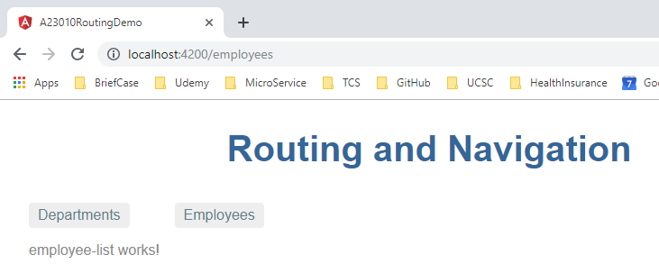
23 Routing and Navigation
https://www.youtube.com/watch?v=N8FBmB2jme8&index=6&list=PLC3y8-rFHvwhBRAgFinJR8KHIrCdTkZcZ
Set margin-right for anchor tag <a>.

Slide 27
End of Chapter

